Slide 1



Setup:
Prepare your scantron:
Use
a pencil,
not a pen!
Fill in your name and fill the bubbles under
your name.
LAST NAME FIRST, First name second
Put your 4-digit code instead of “IDENTIFICATION NUMBER”.
--- (The last 4 digits of your OleMiss ID.)
Question # 1: answer A
Question # 2: answer B
Question # 3: answer C
Reading assignment
Chapter 5, Light and matter, pp. 137 – 164
Please take a moment to mute your cell phone!

Slide 2
Phases
The phases of matter
• Solid
• Liquid (only under pressure – rarely in astronomy)
• Gas
Hot matter:
T > 1,000 - 2,000 K molecules fall apart into atoms (gas)
T > 2,000 - 3,000 K atoms are ionized (plasma)
More accurately:
hydrogen
H⁺ at 10,000 K
He⁺ at 20,000K ; He⁺⁺ at 40,000K
C⁺ , N⁺ , O⁺ , ... at ~2,000K
…
C ⁺⁺⁺⁺⁺⁺ , N ⁺⁺⁺⁺⁺⁺⁺ , O ⁺⁺⁺⁺⁺⁺⁺, … at >50,000K
→
helium
→
once ionized
called metals
→
fully ionized

Slide 3
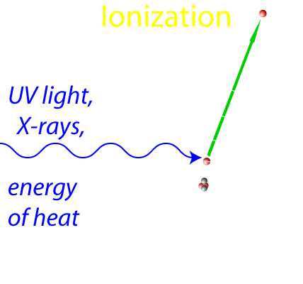
What is plasma?
• Matter with a lot of ionized atoms.
⇒ Feels magnetic field
Examples: Flame
Lightening bolt
Substance of the stars
The Solar wind
Hot interstellar matter
_______________________________________________________
What is interstellar matter made of?
• when gas: H₂, H, H+, and other atoms, ions, and molecules
• when solid grains (“dust”): ice, carbon (‘soot’), silicates (“rock”)

Slide 4
Questions coming …

Slide 5
Question 4
sec
30
29
28
27
26
25
24
23
22
21
20
18
17
16
15
14
13
12
11
10
9
8
7
6
5
4
3
2
1
0
19
What is plasma?
A Substance under tremendous pressure.
B Liquid or gas containing chemical compounds.
C Gas containing (at least a portion of) ionized atoms.
D Fully ionized gas.
E A gas of purely neutral hydrogen atoms.
Next question coming …

Slide 6
Question 5
sec
30
29
28
27
26
25
24
23
22
21
20
18
17
16
15
14
13
12
11
10
9
8
7
6
5
4
3
2
1
0
19
What is ionization?
A Molecules fall apart into atoms due to heat.
Glowing gas is formed.
B Nuclear processes in stars produce dangerous radiation.
C Atomic nuclei fall apart into neutrons and protons.
A neutron star results.
D Atoms lose (some of) their electrons due to heat or UV
radiation. The substance becomes plasma.

Slide 7
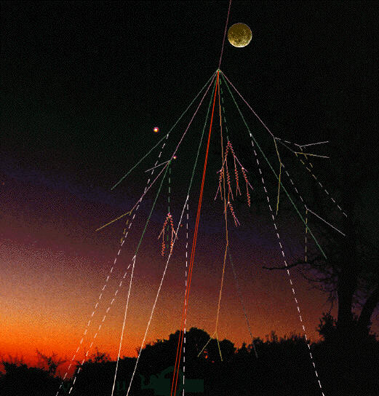
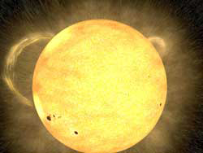
Cosmic rays
From Deep Space (??)
The Solar Wind
protons, electrons
Earth’s
atmosphere and magnetic field
absorb them
(dangerous for astronauts)
very energetic protons & nuclei
Break up into showers
of many less energetic particles
in the atmosphere.
(always present: causes mutations)

Slide 8
Question coming …

Slide 9
Question 6
sec
45
40
35
30
25
19
18
17
16
15
14
13
12
11
10
9
8
7
6
4
3
2
1
0
20
(45)
5
Which of the following causes a noticeable amount of radiation, present on Earth?
The Solar Wind.
“Deep Space” cosmic rays.
Radiation from nuclear reactors.
Radiation from naturally occurring decays.
A I and III.
B II and IV.
C I, II and III.
D None of the above.
E All of the above.

Slide 10
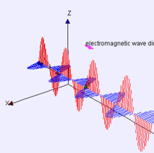
The physics of light
Light … is an electromagnetic wave:
• … is a wave pattern
of electric and magnetic fields
• … propagates in vacuum
• … has wavelength (blue: 400 nm, red: 700 nm)
Learn
units of distance!
1 mm = millimeter
1000 μm = 1 mm
1000 nm = 1 μm
Millimeter
(size of ant)
0.4 μm
0.7 μm
Micrometer
(size of a germ)
Nanometer
(size of ten atoms)

