Slide 1
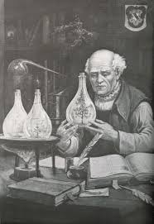
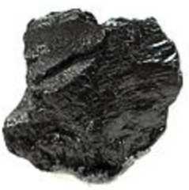

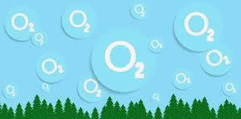
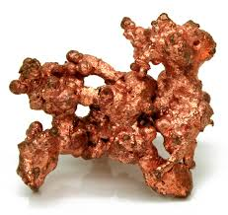
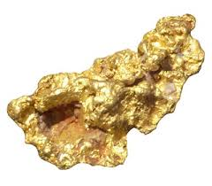
What is in an atom?
WRONG:
Wrong answer:
protons, electrons, neutrons
Why important?
makes you confuse nuclear with chemical
Why different?
energy: ~1 eV (chemical) vs. ~1 MeV (nuclear)
(1 electronvolt) (1 million eV)
Consequence:
- nuclei change only in very extreme situations
(reactors, atomic bombs, centers of stars
+ tiny amounts in radioactive decays)
e⁻
n⁰
e⁻
p⁺
e⁻
p⁺
e⁻
n⁰
e⁻
Proven wrong:
Rutherford
1909
Paracelsus
(alchemist, ~ 1500)
Carbon
Won’t happen
Oxygen
Copper
Gold
Didn’t work

Slide 2

What is in an atom?
Correct
but not to scale:
nucleus shown too large
Correct answer:
One nucleus + electrons
Correct sizes:
nucleus = 1 unit size
atom = 50,000 units size
(size of atom = electrons’ orbits)
The nucleus is an extremely tiny thing
in the center of an atom, like a point!
(even though most of the mass
of the atom is in the nucleus)
e⁻
electron (-)
nucleus (++++++)
Nuclei are preserved:
C
(case of carbon in drawing)
The electric charge of
the nucleus tells
which
chemical element
it is.
Carbon dioxide
Carbon + oxygen
CO₂ C + O₂

Slide 3
Questions coming …

Slide 4
Question 6
sec
30
29
28
27
26
25
24
23
22
21
20
18
17
16
15
14
13
12
11
10
9
8
7
6
5
4
3
2
1
0
19
The constituents of atoms are:
A Protons, electrons and neutrons.
B Chemical compounds.
C Molecules of various sorts.
D Electrons and protons.
E One nucleus and electrons.
Next question coming …

Slide 5
Question 7
sec
30
29
28
27
26
25
24
23
22
21
20
18
17
16
15
14
13
12
11
10
9
8
7
6
5
4
3
2
1
0
19
Can a chemical process turn hydrogen into helium?
A Yes, but only at very hot temperature.
B Yes, and that is the process that keeps the Sun hot.
C No, because too much energy is needed to change one nucleus into another.
D No, because a chemical process can turn hydrogen only into oxygen.

Slide 6
Phases
The phases of matter
• Solid
• Liquid (only under pressure – rarely in astronomy)
• Gas
Hot matter:
T > 1,000 - 2,000 K molecules fall apart into atoms (gas)
T > 2,000 - 3,000 K atoms are ionized (plasma)
More accurately:
hydrogen
H⁺ at 10,000 K
He⁺ at 20,000K ; He⁺⁺ at 40,000K
C⁺ , N⁺ , O⁺ , ... at ~2,000K
…
C ⁺⁺⁺⁺⁺⁺ , N ⁺⁺⁺⁺⁺⁺⁺ , O ⁺⁺⁺⁺⁺⁺⁺, … at >50,000K
→
helium
→
once ionized
called metals
→
fully ionized

