Slide 1



Setup:
Prepare your scantron:
Use
a pencil,
not a pen!
Fill in your name and fill the bubbles under
your name.
LAST NAME FIRST, First name second
Put your 4-digit code instead of “IDENTIFICATION NUMBER”.
--- (The last 4 digits of your OleMiss ID.)
Question # 1: answer A
Question # 2: answer B
Question # 3: answer A
Reading assignment
Angular size; a (pp. 27-28)
Please take a moment to mute your cell phone!

Slide 2
Review questions coming …

Slide 3
Question 4
sec
30
29
28
27
26
25
24
23
22
21
20
18
17
16
15
14
13
12
11
10
9
8
7
6
5
4
3
2
1
0
This question
counts double!
19
How large does the Moon appear in the sky?
A A few inches.
B A few thousand miles.
C A few arc seconds.
D A light year.
E A half a degree.
Next question coming …

Slide 4
Question 5
sec
30
29
28
27
26
25
24
23
22
21
20
18
17
16
15
14
13
12
11
10
9
8
7
6
5
4
3
2
1
0
This question
counts double!
19
What is absolute magnitude of a star?
A It is how bright the star looks from the center of the Galaxy.
B It is how bright the star would look from a distance of 10 parsecs.
C It is how bright the star was when it was born.
D It is how bright the star looks in very good weather.
E It is how bright the star looks from space.
Next question coming …

Slide 5
Question 6
sec
30
29
28
27
26
25
24
23
22
21
20
18
17
16
15
14
13
12
11
10
9
8
7
6
5
4
3
2
1
0
This question
counts double!
19
How bright would the Sun look in the sky
from a distance of 10 parsecs?
A -12^{mg} (as bright as the full Moon).
B 1^{mg} (as bright as the brightest stars in the sky).
C 5^{mg} (barely visible to the naked eye).
D 15^{mg} (very faint).
E Invisible: we cannot see that far.
Next question coming …

Slide 6
Question 7
sec
30
29
28
27
26
25
24
23
22
21
20
18
17
16
15
14
13
12
11
10
9
8
7
6
5
4
3
2
1
0
This question
counts double!
19
Zeta Cancri is a double star, the two stars are separated by 0.7 arc seconds in the sky.
What type of telescope do you need to see them as separated?
A only your eyes
B a pair of binoculars
C an amateur telescope will suffice
D at least a 5-meter telescope
E no telescope can separate them

Slide 7
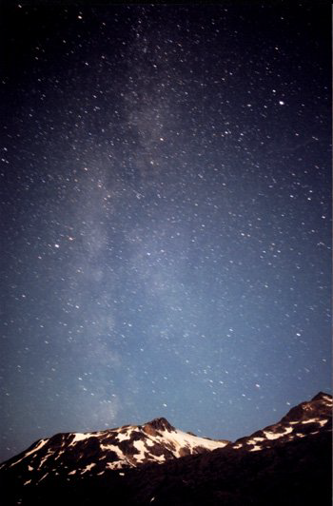
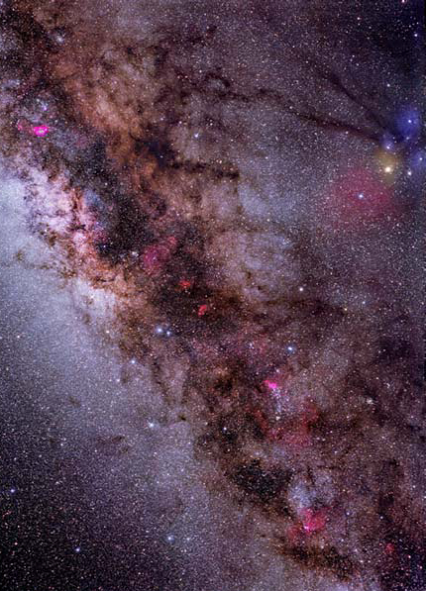
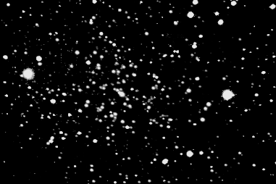
An observational perspective on real astronomy.
Stars are always dots in the telescope:
(5000 with the naked eye)
Star with naked eye:
Star in a telescope:
Must analyze spectrum (color) of stars to learn about them - a hard job!
All else in the sky is faint: “deep sky” objects
Must collect light for a long time with large telescopes - a hard job!
Photography
(30 minutes)
With the
naked eye
The
Milky
Way
Look in a telescope

Slide 8
Questions coming …

Slide 9
Question 8
sec
30
29
28
27
26
25
24
23
22
21
20
18
17
16
15
14
13
12
11
10
9
8
7
6
5
4
3
2
1
0
19
How does a star look in a good telescope?
A A large disk with swirls of hot gas visible on it.
B A large disk with mountains and rivers visible on it.
C A large disk with clouds visible on it.
D A small disk with a few starspots.
E A bright dot.
Next question coming …

Slide 10
Question 9
sec
30
29
28
27
26
25
24
23
22
21
20
18
17
16
15
14
13
12
11
10
9
8
7
6
5
4
3
2
1
0
19
How many stars are visible with the naked eye
(total, in the whole sky)?
A 300
B 5000
C 3 million
D 14 billion
E It has not been counted yet: more than trillions.
Next question coming …

Slide 11
Question 10
sec
30
29
28
27
26
25
24
23
22
21
20
18
17
16
15
14
13
12
11
10
9
8
7
6
5
4
3
2
1
0
19
Is the Milky Way visible to the naked eye
in a dark location?
A No. We need large telescopes to see the
Milky Way at all.
B No, but a pair of binoculars is sufficient to see it.
C Barely.
D As a faint and tiny patch of glow.
E As a band of light all the way around the sky.

Slide 12
Question 11
sec
30
29
28
27
26
25
24
23
22
21
20
18
17
16
15
14
13
12
11
10
9
8
7
6
5
4
3
2
1
0
19
What is the light of the Milky Way in actual fact?
A The light of a few billion stars washed together.
B A reflection of sunlight in Earth’s atmosphere.
C A reflection of sunlight on dust particles in the
Solar System.
D The glow of the upper atmosphere due to cosmic radiation.
E The glow of gas left behind when the Universe was born.

Slide 13
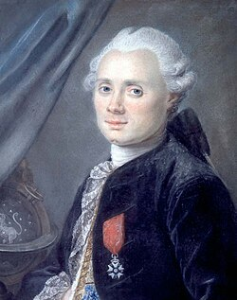
What is in the sky?
All outside the Solar System,
remember?
- Stars (in constellations)
- Everything you see is part of the Galaxy
• The glow of the Milky Way
• Stars
• Star clusters
open clusters (young, unstable)
globular clusters (old, rich)
• Planetary nebulae (dying stars’ last breath)
• Supernova remnants (star blew up)
• Diffuse nebulae (glowing interstellar gas / star formation region)
- Except: other galaxies.
Only 3 other galaxies to the naked eye:
• The Andromeda Galaxy
• The Small Magellanic Cloud (southern)
• The Large Magellanic Cloud (southern)
The
Messier
Catalog
M1 through M110
Size:
(Charles Messier 1774)
~ 10 ly
~ 100 ly
~ 1 ly
~ 10 ly
~ 100 ly

Slide 14
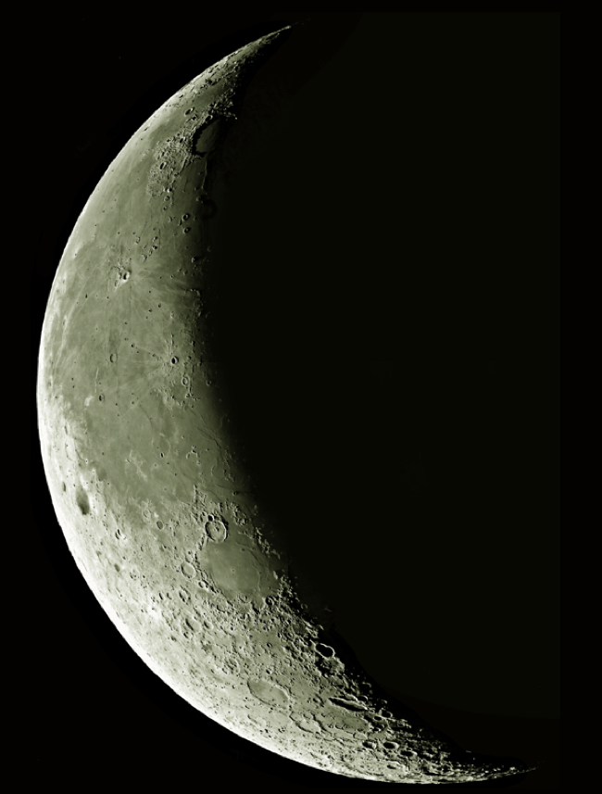
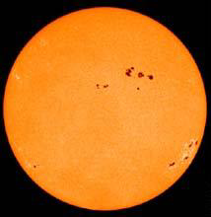
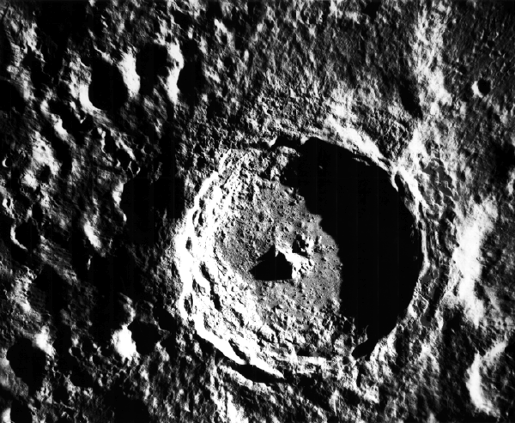
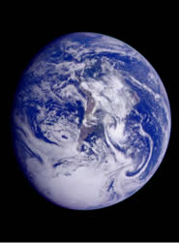
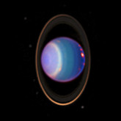
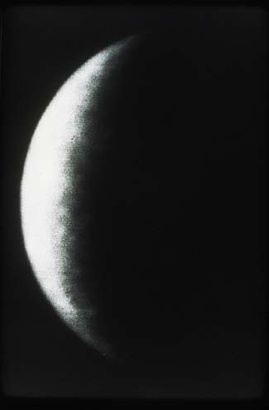
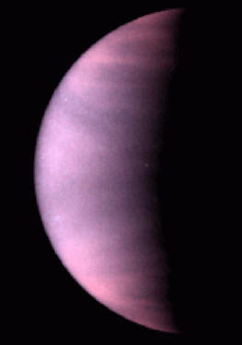
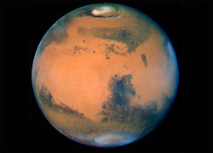
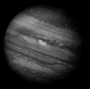
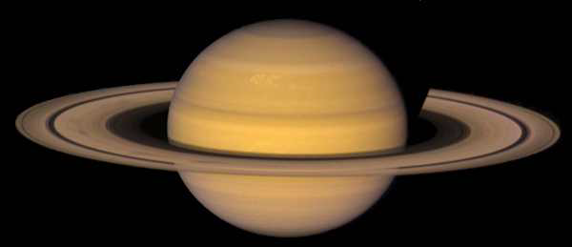
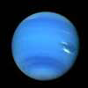
Solar System
… and there is the Solar System of course.
This is what you would see in a very good telescope.
Sun
Moon
Mercury Venus Earth Mars Jupiter Saturn Uranus Neptune

Slide 15
Question 12
sec
30
29
28
27
26
25
24
23
22
21
20
18
17
16
15
14
13
12
11
10
9
8
7
6
5
4
3
2
1
0
19
Which of the following is not a deep-sky object?
A A galaxy.
B A star cluster.
C A very dim star.
D A planetary nebula.
E A supernova remnant.
Next question coming …

Slide 16
Question 13
sec
30
29
28
27
26
25
24
23
22
21
20
18
17
16
15
14
13
12
11
10
9
8
7
6
5
4
3
2
1
0
19
The Messier catalog is a list of what?
A Stars.
B Deep sky objects.
C Comets.
D Nebulae.
E Star clusters.

Slide 17
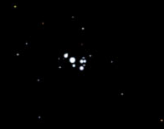
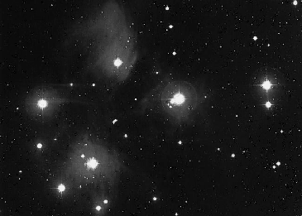
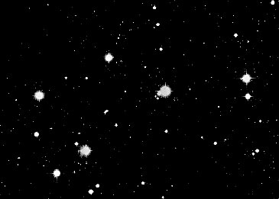
M45 the Pleiades – the Seven Sisters
Open star cluster
(notice the unusual reflection from dust)
With the naked eye
(young, disintegrating cluster))
Photography (5 hours)
Look in a telescope

Slide 18
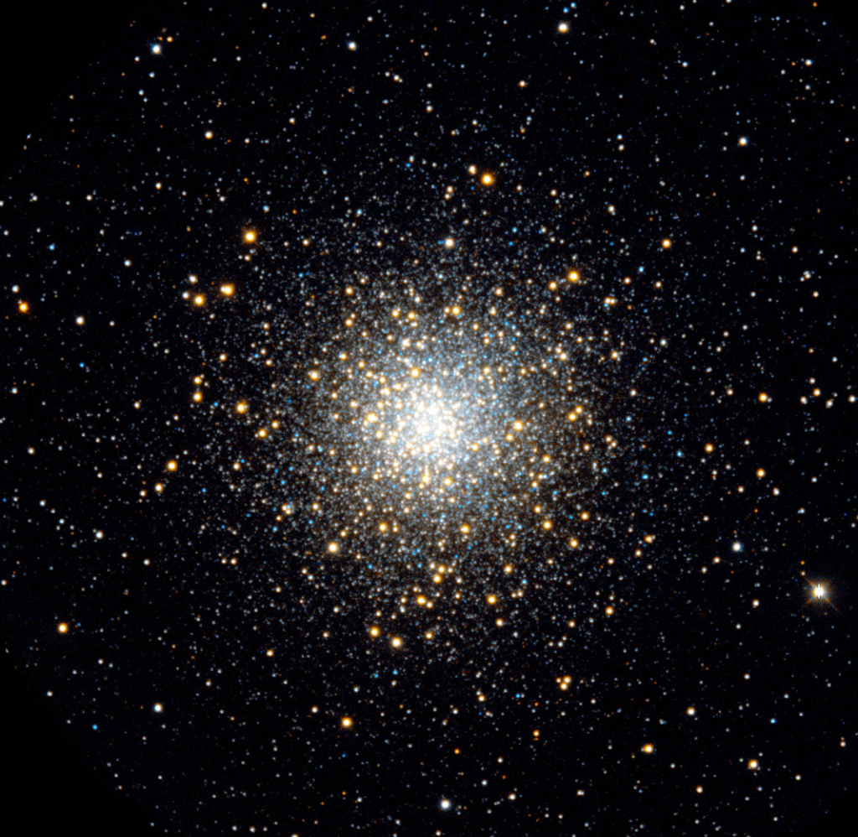
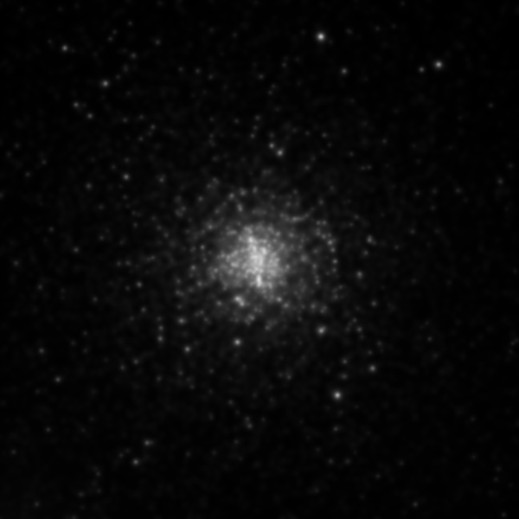
M13 – the Hercules cluster
Globular star cluster
(old, stable, rich cluster))
With the naked eye
Photography (5 hours)
Look in a telescope

Slide 19
Question 14
sec
30
29
28
27
26
25
24
23
22
21
20
18
17
16
15
14
13
12
11
10
9
8
7
6
5
4
3
2
1
0
19
Which one is larger –
an open cluster or a globular cluster?
A Both types are the same size, about a million light years.
B Both types are the same size, about a thousand light years.
C A globular is ~ 100 ly, an open cluster is ~ 10 ly.
D A globular is ~ 10 ly, an open cluster is ~ 100 ly.
E A globular is ~ 10000 ly, an open cluster is ~ 10 ly.
Next question coming …

Slide 20
Question 15
sec
30
29
28
27
26
25
24
23
22
21
20
18
17
16
15
14
13
12
11
10
9
8
7
6
5
4
3
2
1
0
19
Which one is young, which one is old?
A Globular cluster – old, open cluster - young.
B Globular cluster – young, open cluster - old.
C Both types may be old or young.
D Both types are young as stars go.
E Both types are old as stars go.

Slide 21
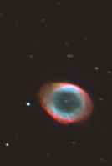
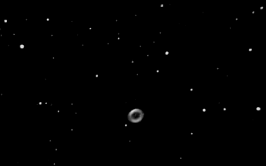
M 57 – the Ring Nebula
A planetary nebula
(the last breath of a dying star)
With the naked eye
Photography
(90 minutes)
Look in a telescope
(Picture taken in
Kennon
by two students)

Slide 22
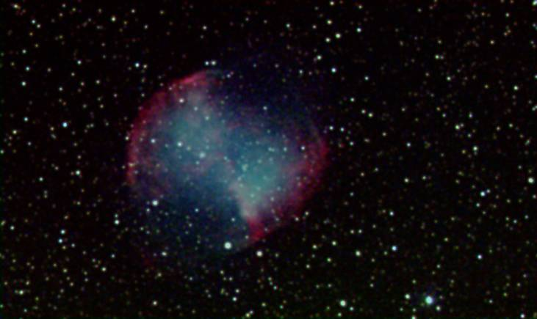
M 27 - ours
The Dumbell – another planetary nebula
(M 27)

Slide 23
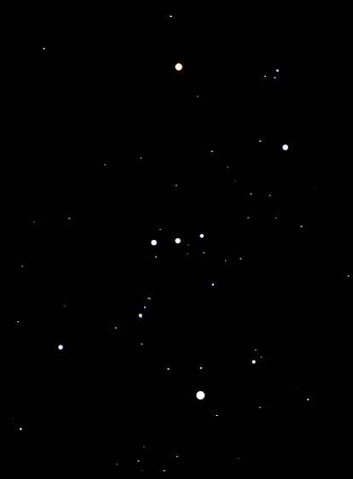
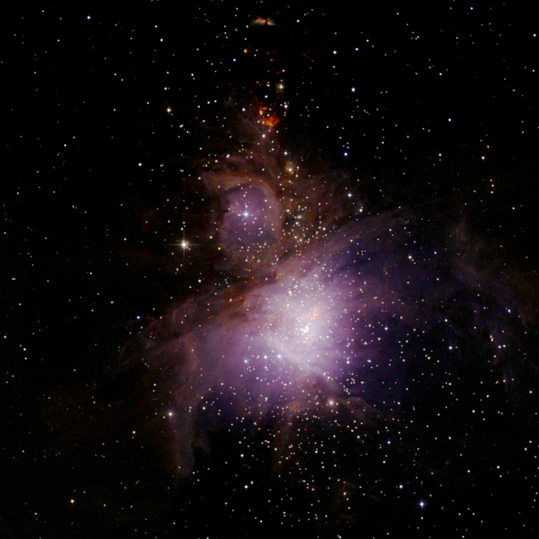
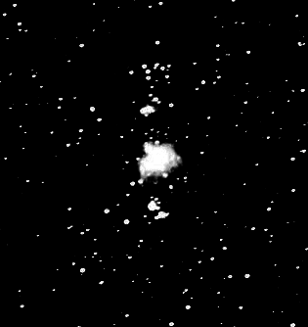
M42 – the Orion Nebula
With the naked eye
Diffuse nebula
Gas and dust cloud, illuminated by hot stars
(star formation region)
Photography (1 hour)
Look in a telescope

Slide 24
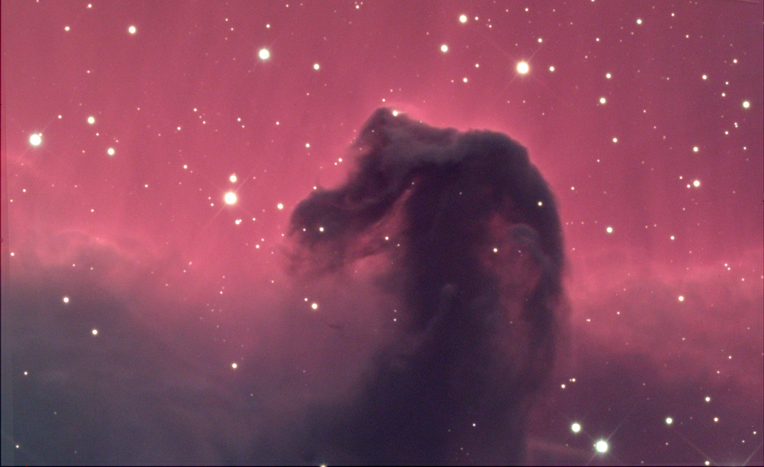
The Horsehead
With the naked eye:
A diffuse nebula
Look in a telescope:
Photo-
graphy
(10 hours)

Slide 25
Questions coming …

Slide 26
Question 16
sec
30
29
28
27
26
25
24
23
22
21
20
18
17
16
15
14
13
12
11
10
9
8
7
6
5
4
3
2
1
0
19
New stars are formed in …
A planetary nebulae
B diffuse nebulae
C open clusters
D globular clusters
E diffuse and planetary nebulae
Next question coming …

Slide 27
Question 17
sec
30
29
28
27
26
25
24
23
22
21
20
18
17
16
15
14
13
12
11
10
9
8
7
6
5
4
3
2
1
0
19
A planetary nebula is …
A an object that orbits a star
B as large as 100 light years
C young as stars go
D old as stars go
E the result of a star blowing up

