Slide 1



Setup:
Prepare your scantron:
Use
a pencil,
not a pen!
Fill in your name and fill the bubbles under
your name.
LAST NAME FIRST, First name second
Put your 4-digit code instead of “IDENTIFICATION NUMBER”.
--- (The last 4 digits of your OleMiss ID.)
Question # 1: answer A
Question # 2: answer A
Question # 3: answer D
TEST 1 on Friday 2:00 pm
Take it seriously – no makeups!
Only 20 questions
Learn all that is on the slides
(including all the small details!)
Please take a moment to mute your cell phone!

Slide 2
Question 4
sec
45
40
35
30
25
19
18
17
16
15
14
13
12
11
10
9
8
7
6
4
3
2
1
0
20
This question
counts double!
5
45
Why do astronomers no longer look into
their telescopes?
A Because the observer’s body would obstruct the
light in research-grade telescopes.
B Because visual observations are unreliable.
C Because there is dangerous radiation in a research observatory.
D Because large telescopes collect so much light that their eyes
would be damaged.
E Because there is nothing left to discover in optical light;
infrared and X-ray radiation must be observed to make new
discoveries.
Next question coming …

Slide 3
Question 5
sec
30
29
28
27
26
25
24
23
22
21
20
18
17
16
15
14
13
12
11
10
9
8
7
6
5
4
3
2
1
0
This question
counts double!
19
The “largest” telescope in the world is/has …
A 5,000 times magnification
B 2 m in diameter
C 10 m in diameter
D in space
E 50 m long
Next question coming …

Slide 4
Question 6
sec
45
40
35
30
25
19
18
17
16
15
14
13
12
11
10
9
8
7
6
4
3
2
1
0
20
This question
counts double!
5
45
Is the Hubble space telescope the largest
telescope in the world?
A Yes.
B No, but many others are almost as large (2 meters).
C No, it is much smaller than many other research telescopes,
but its optics (lens/mirror) is exceptionally good optical quality.
D No, it is much smaller than many other research telescopes,
but its location (i.e. space) makes it superior to all others.
E No, it counts a small research telescope, and other telescopes
are used now for most scientific work.

Slide 5
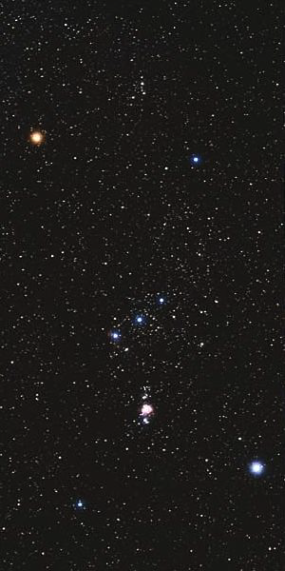
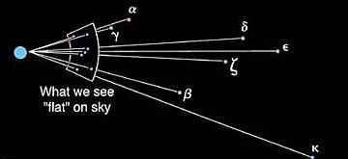
Constellations and designations of stars
Constellation = random collection
of stars (figure)
α
γ
Stars’ names:
Greek letter + constellation name
Orionis (= Betelgeuse)
γ Orionis (⇒ No special name)
α Canis Majoris (= Sirius)
ζ
β
κ

Slide 6
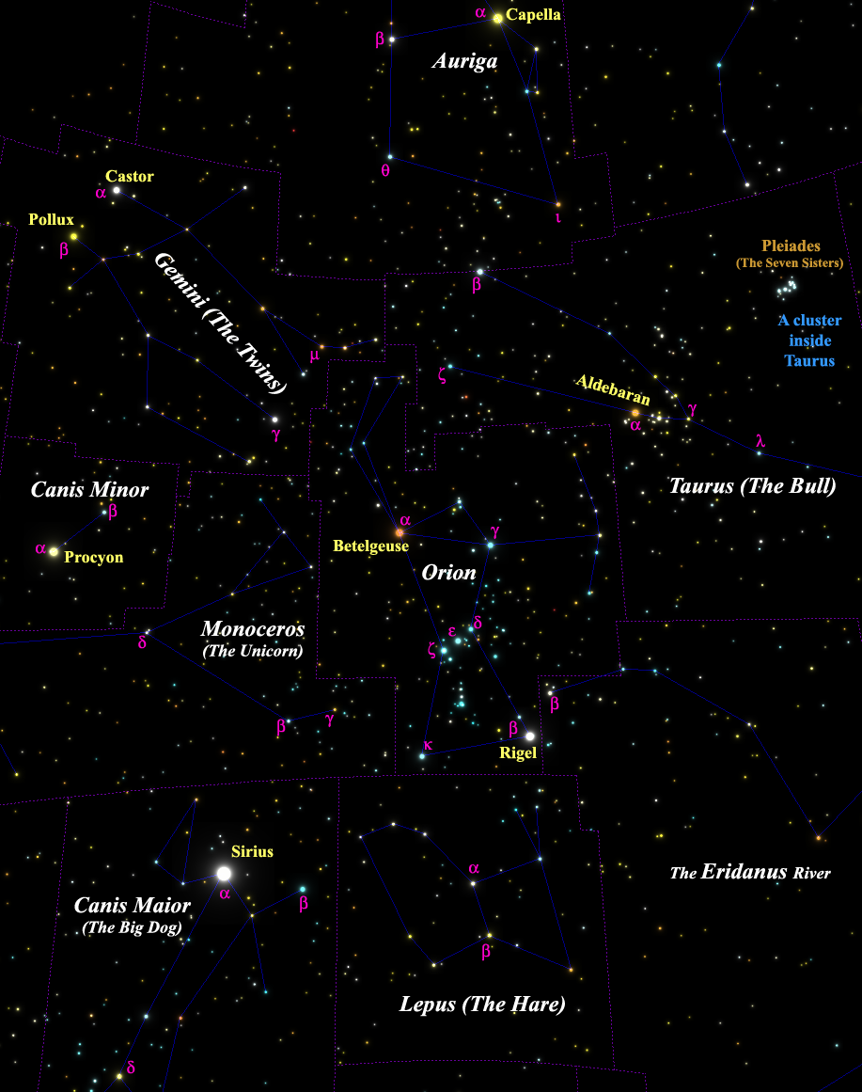
More star names - examples
Find:
Leporis
Geminorum
Tauri
A few distances:
Canis Maioris - 9 ly
β Canis Maioris - 500 ly
δ Canis Maioris - 1,800 ly
Canis Maioris - 430 ly
95% of the 5,000 naked-eye stars are at 50 to 500 ly:
in the solar neighborhood.

Slide 7
Questions coming …

Slide 8
Question 7
sec
30
29
28
27
26
25
24
23
22
21
20
18
17
16
15
14
13
12
11
10
9
8
7
6
5
4
3
2
1
0
19
What is β Canis Maioris?
A The name of a bright star.
B The name of a planet.
C The name of a constellation.
D A galaxy.
E The name of a moon revolving
around the planet α Canis Maioris.
Next question coming …

Slide 9
Question 8
sec
30
29
28
27
26
25
24
23
22
21
20
18
17
16
15
14
13
12
11
10
9
8
7
6
5
4
3
2
1
0
19
The Pleiades (the “Seven Sisters”) is …
A A constellation.
B A star.
C Not a constellation, but it is a star cluster inside
the constellation of Taurus.
D A constellation, which is the same thing as a star cluster.
E A collection of seven random stars, unrelated to each other.

Slide 10
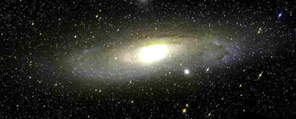
(Hipparchos ~ 170 BC)
Understand brightness of stars: the magnitude scale
An m = 10^{mg,} star,
need
an amateur telescope
to see it
The Andromeda Galaxy
m = 3^{mg} in total
An m = 17^{mg,} star,
need
a professional telescope
to see it
Magnitudes mean brightness:
• The larger the number, the fainter the object
• One magnitude difference means a lot dimmer (2.5 times)
A fifth magnitude star: m = 5^{mg,},
just visible to the naked eye
A third magnitude star: m = 3^{mg}
A second magnitude star: m = 2^{mg}
__
I
A first magnitude star: m = 1^{mg}
m = -2.5 × lg
I
Vega

Slide 11
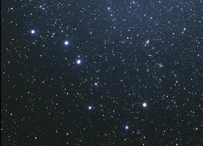
Example: stars in the Big Dipper
4.0 mg
1.9 mg
2.2 mg
3.3 mg
5.6 mg

Slide 12
Questions coming …

Slide 13
Question 9
sec
30
29
28
27
26
25
24
23
22
21
20
18
17
16
15
14
13
12
11
10
9
8
7
6
5
4
3
2
1
0
19
Which one is brighter, a 2^{mg} star or a 5^{mg} star?
A The 2^{mg} star is brighter.
B The 5^{mg} star is brighter.
C They are equally bright.
D Cannot tell from these numbers.
Next question coming …

Slide 14
Question 10
sec
30
29
28
27
26
25
24
23
22
21
20
18
17
16
15
14
13
12
11
10
9
8
7
6
5
4
3
2
1
0
19
How much brighter is a 1^{mg} star than a 6^{mg} star?
A Only a little (by 5%).
B Twice as bright.
C Five times as bright.
D A hundred times as bright.
E A billion times as bright.

Slide 15
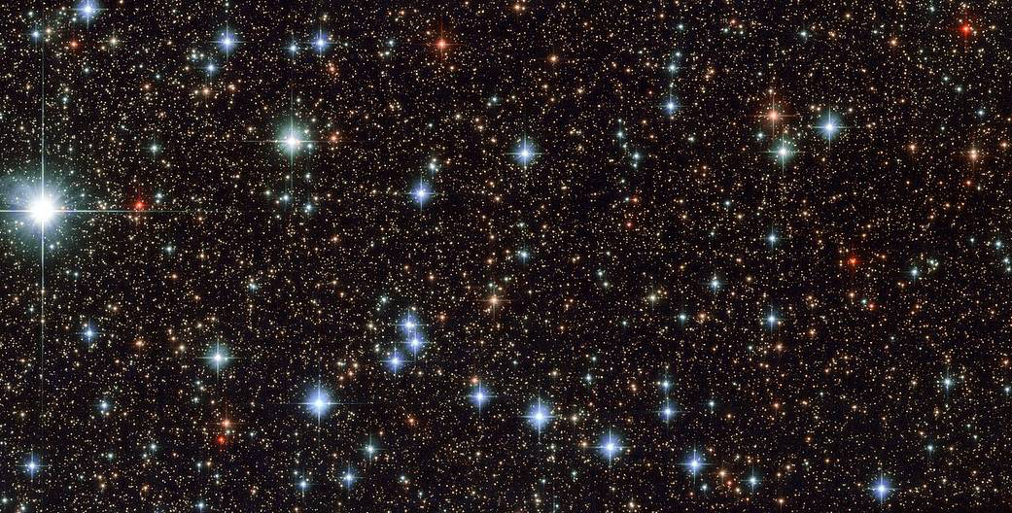
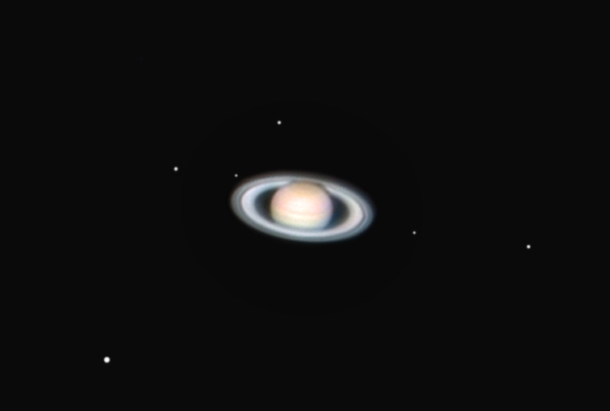
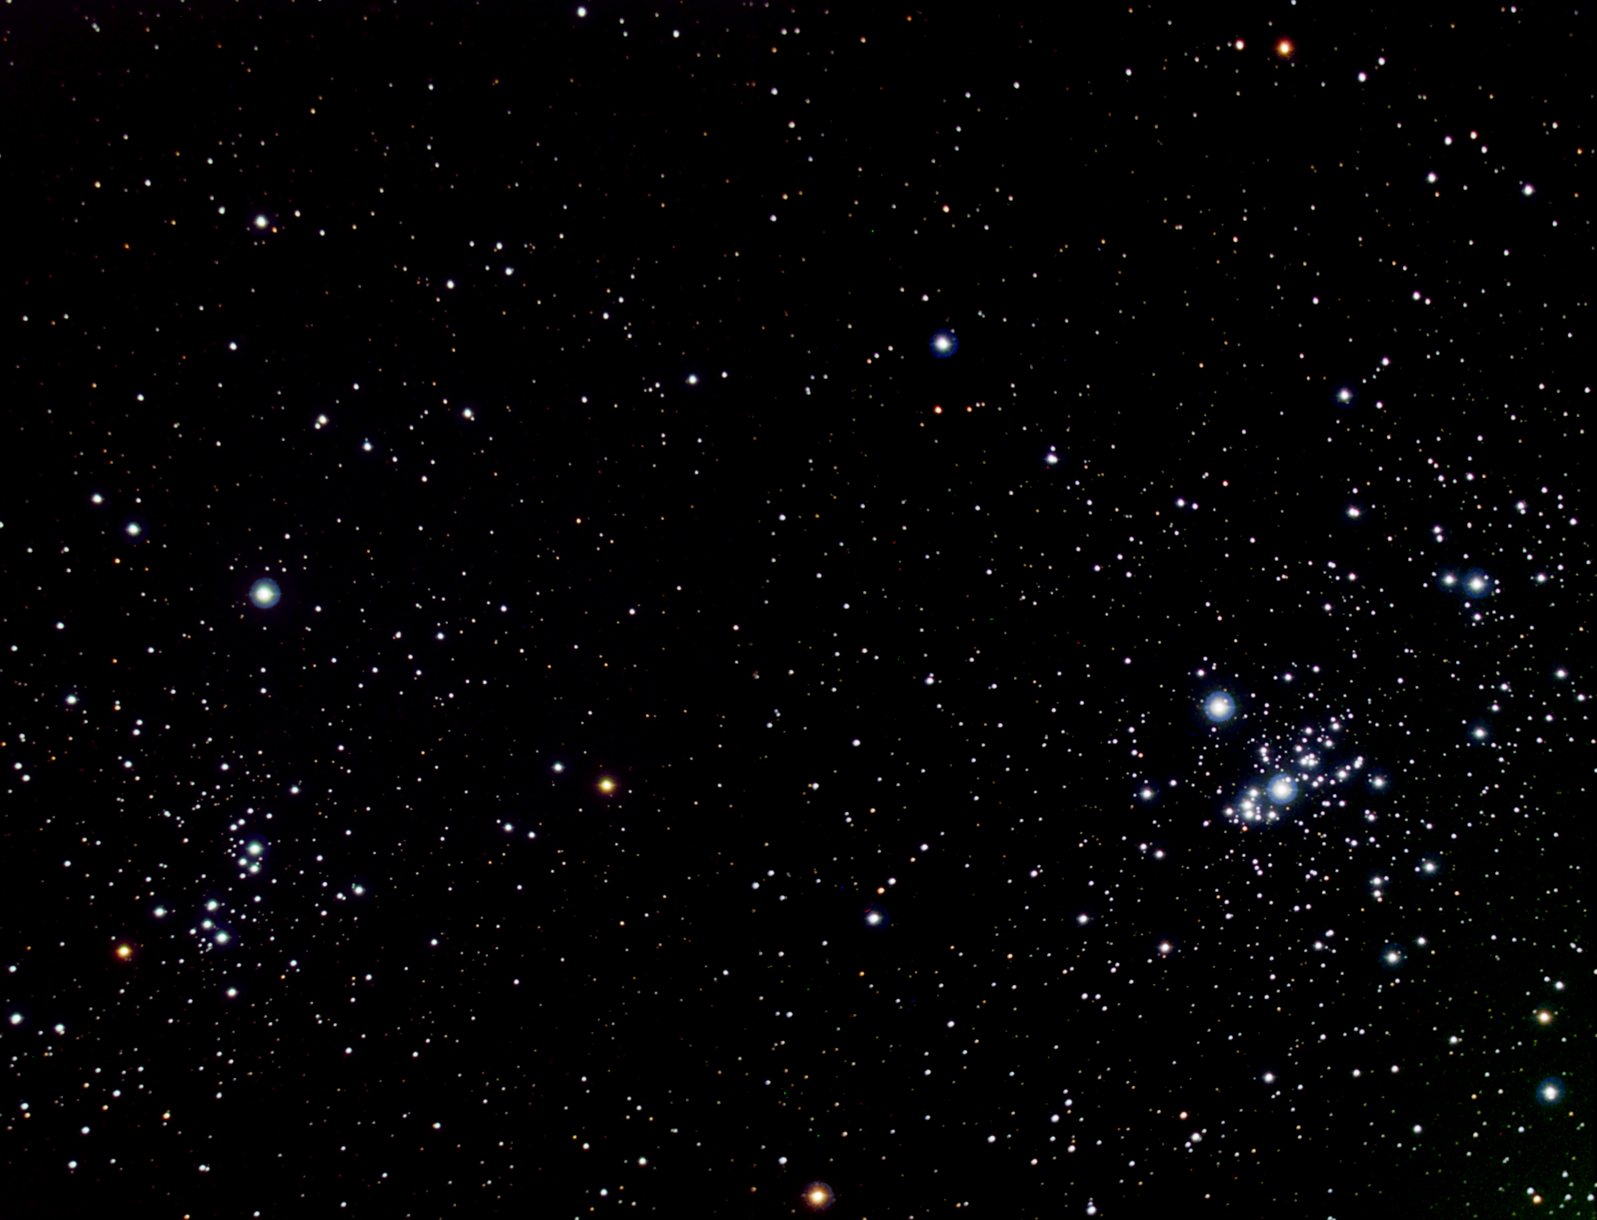
The Milky Way in Sagittarius (long exposure)
9.8 mg
16.2 mg
12.2 mg
An open cluster in Perseus
Dione
10.5^{mg}
Iapetus
11.2^{mg}
13.2^{mg}
Magnitude
limit in
professional
astronomy:
22^{mg}-24^{mg}
Titan
8.4^{mg}
9.0^{mg}
5.6 mg
Saturn and its moons
7.1^{mg}

Slide 16
Questions coming …

Slide 17
Question 11
sec
30
29
28
27
26
25
24
23
22
21
20
18
17
16
15
14
13
12
11
10
9
8
7
6
5
4
3
2
1
0
19
What is the brightness of the dimmest star
that is barely showing up in long exposure
professional images?
A 7.0^{mg}
B 17.0^{mg}
C 23.0^{mg}
D 43^{mg}
E 150^{mg}
Next question coming …

Slide 18
Question 12
sec
30
29
28
27
26
25
24
23
22
21
20
18
17
16
15
14
13
12
11
10
9
8
7
6
5
4
3
2
1
0
19
Do you need a telescope to see Pluto whose
brightness is a 15^{mg}?
A No, it can be seen by the naked eye.
B Yes, but even binoculars will suffice.
C Yes, a small amateur telescope is needed.
D A fairly large amateur telescope or a small
professional telescope is needed.
E Pluto is only observable in the largest professional
telescopes in the world.

Slide 19
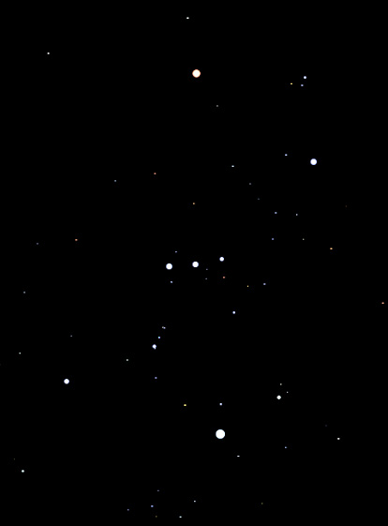
Exercises on magnitudes 1
This is how Orion looks to a naked-eye
observer in complete darkness.
α
α Orionis: 0.5 mg
α Orionis is one of the brightest stars in the sky.
How bright do you think it is?
How bright do you think κ Orionis is?
κ Orionis : 2.0 mg
θ
θ Orionis : 4.3 mg
How bright do you think θ Orionis is?
κ

Slide 20
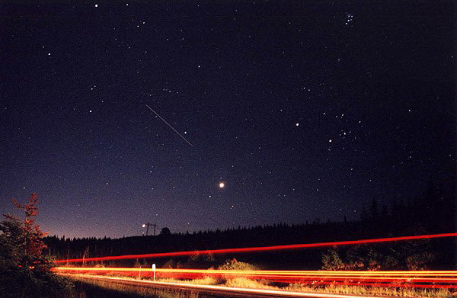
Exercises on magnitudes 2
Capella is 0 mg.
How bright do you think the following are?
Pleiades
2 mg
1 mg
International
Space Station
Aldebaran
1 mg
- 4 mg
Venus
- 2 mg
Jupiter

Slide 21
Questions coming …

Slide 22
Question 13
sec
30
29
28
27
26
25
24
23
22
21
20
18
17
16
15
14
13
12
11
10
9
8
7
6
5
4
3
2
1
0
19
The magnitude of a star tells us …
A How far the star us from us.
B How bright the star appears in the sky.
C How bright the star is in reality.
D How large the star appears in the sky.
E How large the star is in reality.
Next question coming …

Slide 23
Question 14
sec
30
29
28
27
26
25
24
23
22
21
20
18
17
16
15
14
13
12
11
10
9
8
7
6
5
4
3
2
1
0
19
Which one is brighter, a 1^{mg} star or a 5^{mg} star,
and how much?
A The magnitude of a star does not refer to
brightness at all, it refers to size.
B The 1^{mg} star is much brighter.
C The 1^{mg} star is a little brighter.
D The 1^{mg} star is much fainter.
E The 1^{mg} star is a little fainter.

