Slide 1


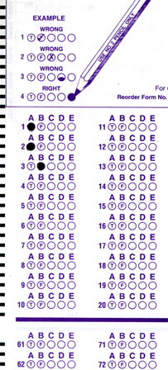
Setup:
Prepare your scantron:
Use
a pencil,
not a pen!
Fill in your name and fill the bubbles under
your name.
LAST NAME FIRST, First name second
Put your 4-digit code instead of “IDENTIFICATION NUMBER”.
--- (The last 4 digits of your OleMiss ID.)
Recall reading assignment
Chapter 6, Telescopes, pp. 165 – 189
(skip the math)
Question # 1: answer A
Question # 2: answer A
Question # 3: answer C
TEST 1 on Friday 2:00 pm
Take it seriously – no makeups!
Only 20 questions
Learn all that is on the slides
(including all the small details!)
Please take a moment to mute your cell phone!

Slide 2
Review questions coming …

Slide 3
Question 4
sec
30
29
28
27
26
25
24
23
22
21
20
18
17
16
15
14
13
12
11
10
9
8
7
6
5
4
3
2
1
0
This question
counts double!
19
What is seeing?
A The amount of air starlight passes through to reach our eyes.
B The diameter of the blur caused by the atmosphere.
C The amount of light passing through the atmosphere.
D The brightness of a star as it appears to us in the sky.
Next question coming …

Slide 4
Question 5
sec
30
29
28
27
26
25
24
23
22
21
20
18
17
16
15
14
13
12
11
10
9
8
7
6
5
4
3
2
1
0
This question
counts double!
19
Which of the following is the most important
measure of a telescope?
A The magnification.
B The length of the telescope.
C The focal length of its mirror (or lens).
D The diameter of its mirror (or lens).
E The distance of the farthest object it can see.
Next question coming …

Slide 5
Question 6
sec
30
29
28
27
26
25
24
23
22
21
20
18
17
16
15
14
13
12
11
10
9
8
7
6
5
4
3
2
1
0
This question
counts double!
19
A telescope with a magnification 10,000 times is …
A useless because of seeing
B useless because the mount shakes
C useful only when the sky is absolutely cloudless
D usually good
E has not enough magnification

Slide 6
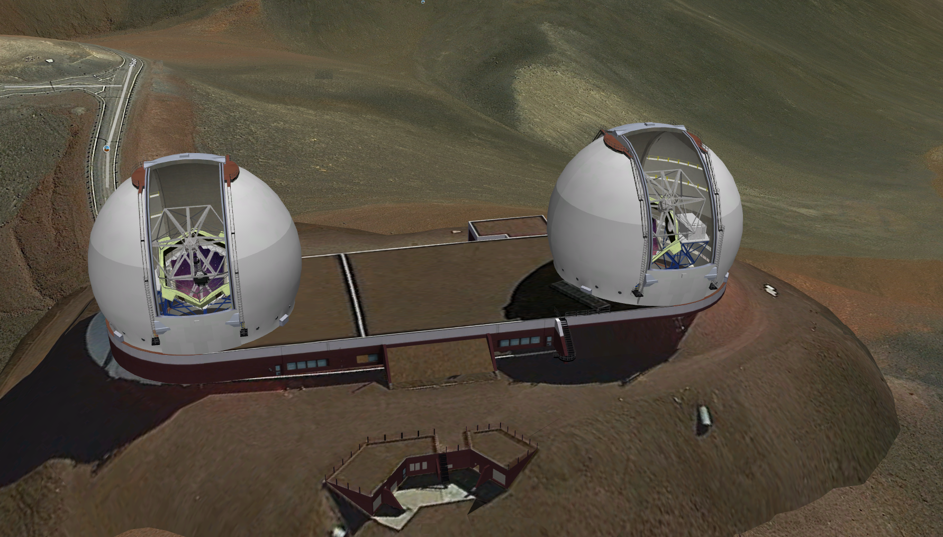
The 10-m Keck telescopes on Mauna Kea, Hawaii
$192 million; first light: 1993

Slide 7
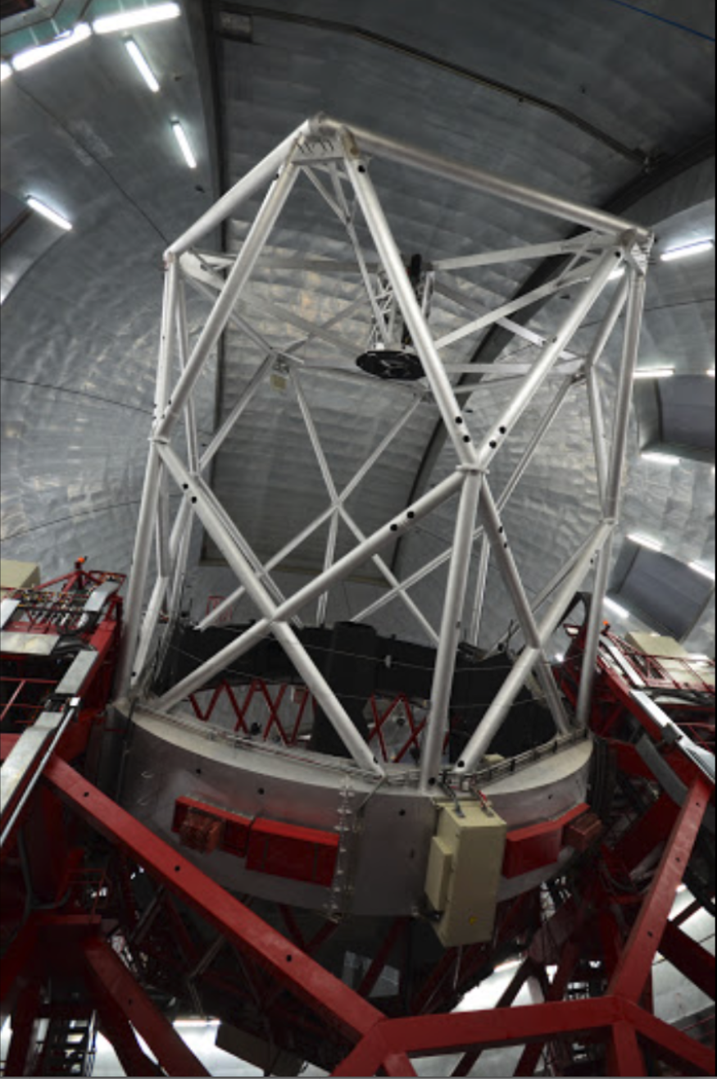
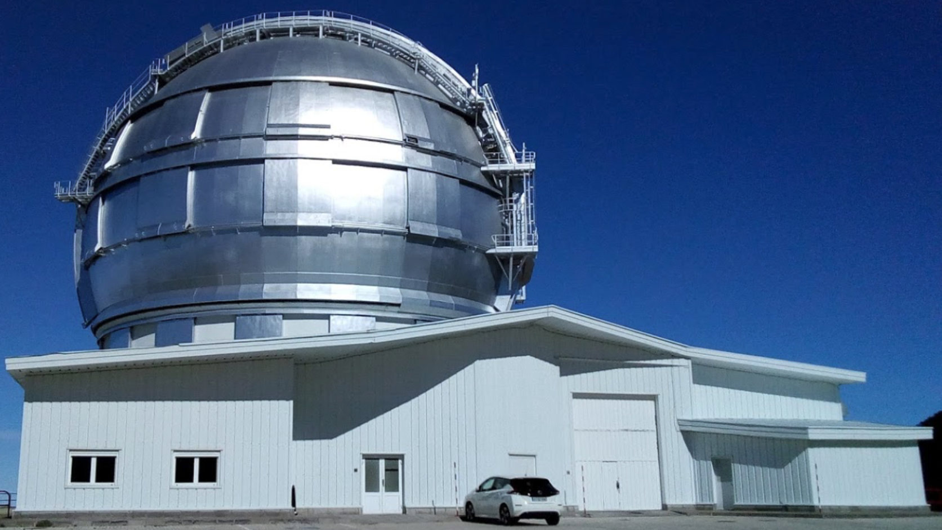
The largest telescope
in the world:
Gran Telescopo Canarias
La Palma Island (Spain)
Diameter: 10.4 m
Worth: $180 million
First light: 2007

Slide 8
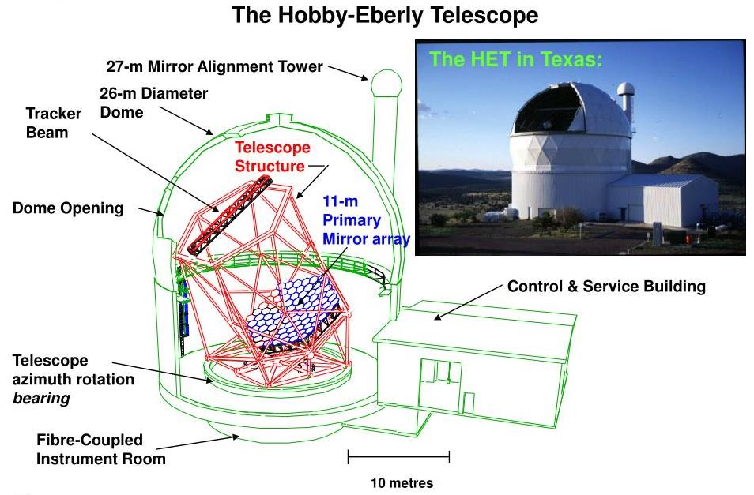
A large telescope with limited motion (58º up) in the Texas desert:
Equivalent diameter: 10 m. Worth: $1 million in 1939 dollars

Slide 9
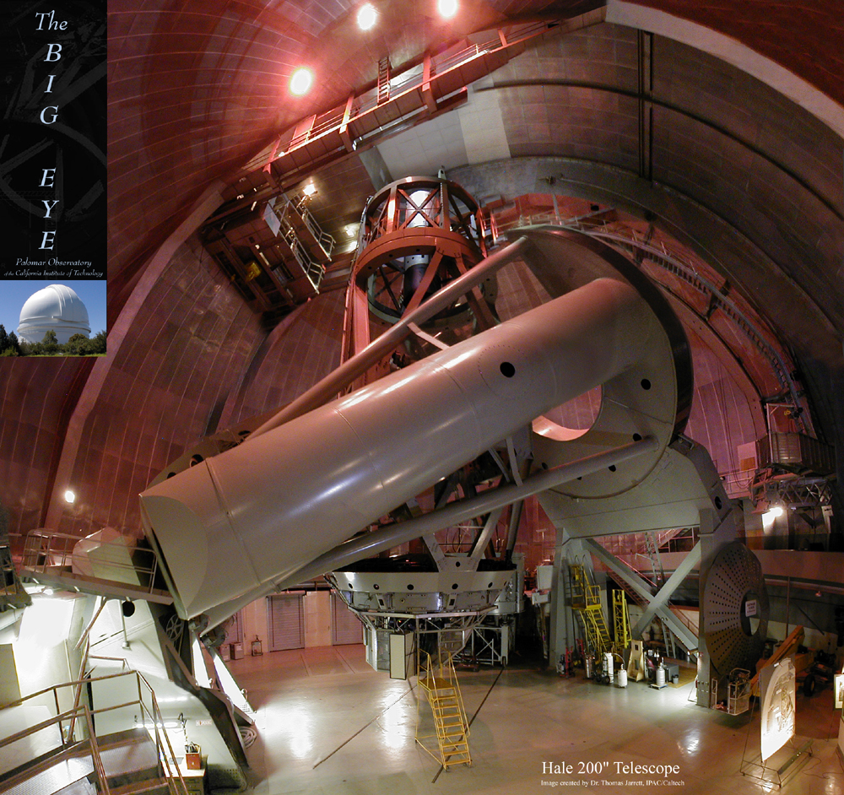
Mt. Palomar
Flagship for a half a century:
(1948-92)
Mt. Palomar Observatory
Observer in cage
California
SW of LA
Diameter:
5 m
Length of tube:
16 m
Main mirror

Slide 10
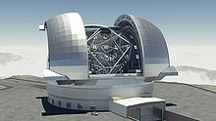
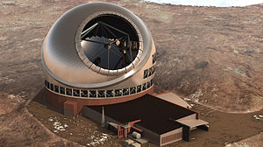
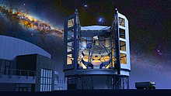
Under construction …
Extremely Large Telescope
Cerro Armazones, Chile
2025 ?
€1.3 billion
Effective diameter: 39.2 m
Thirty Meter Telescope
Mauna Kea, Hawaii
2027 ?
$1.4 billion
Effective diameter: 30 m
Giant Magellan Telescope
Las Campanas, Chile
2025 ?
$ 1 billion
Effective diameter: 24.5 m

Slide 11
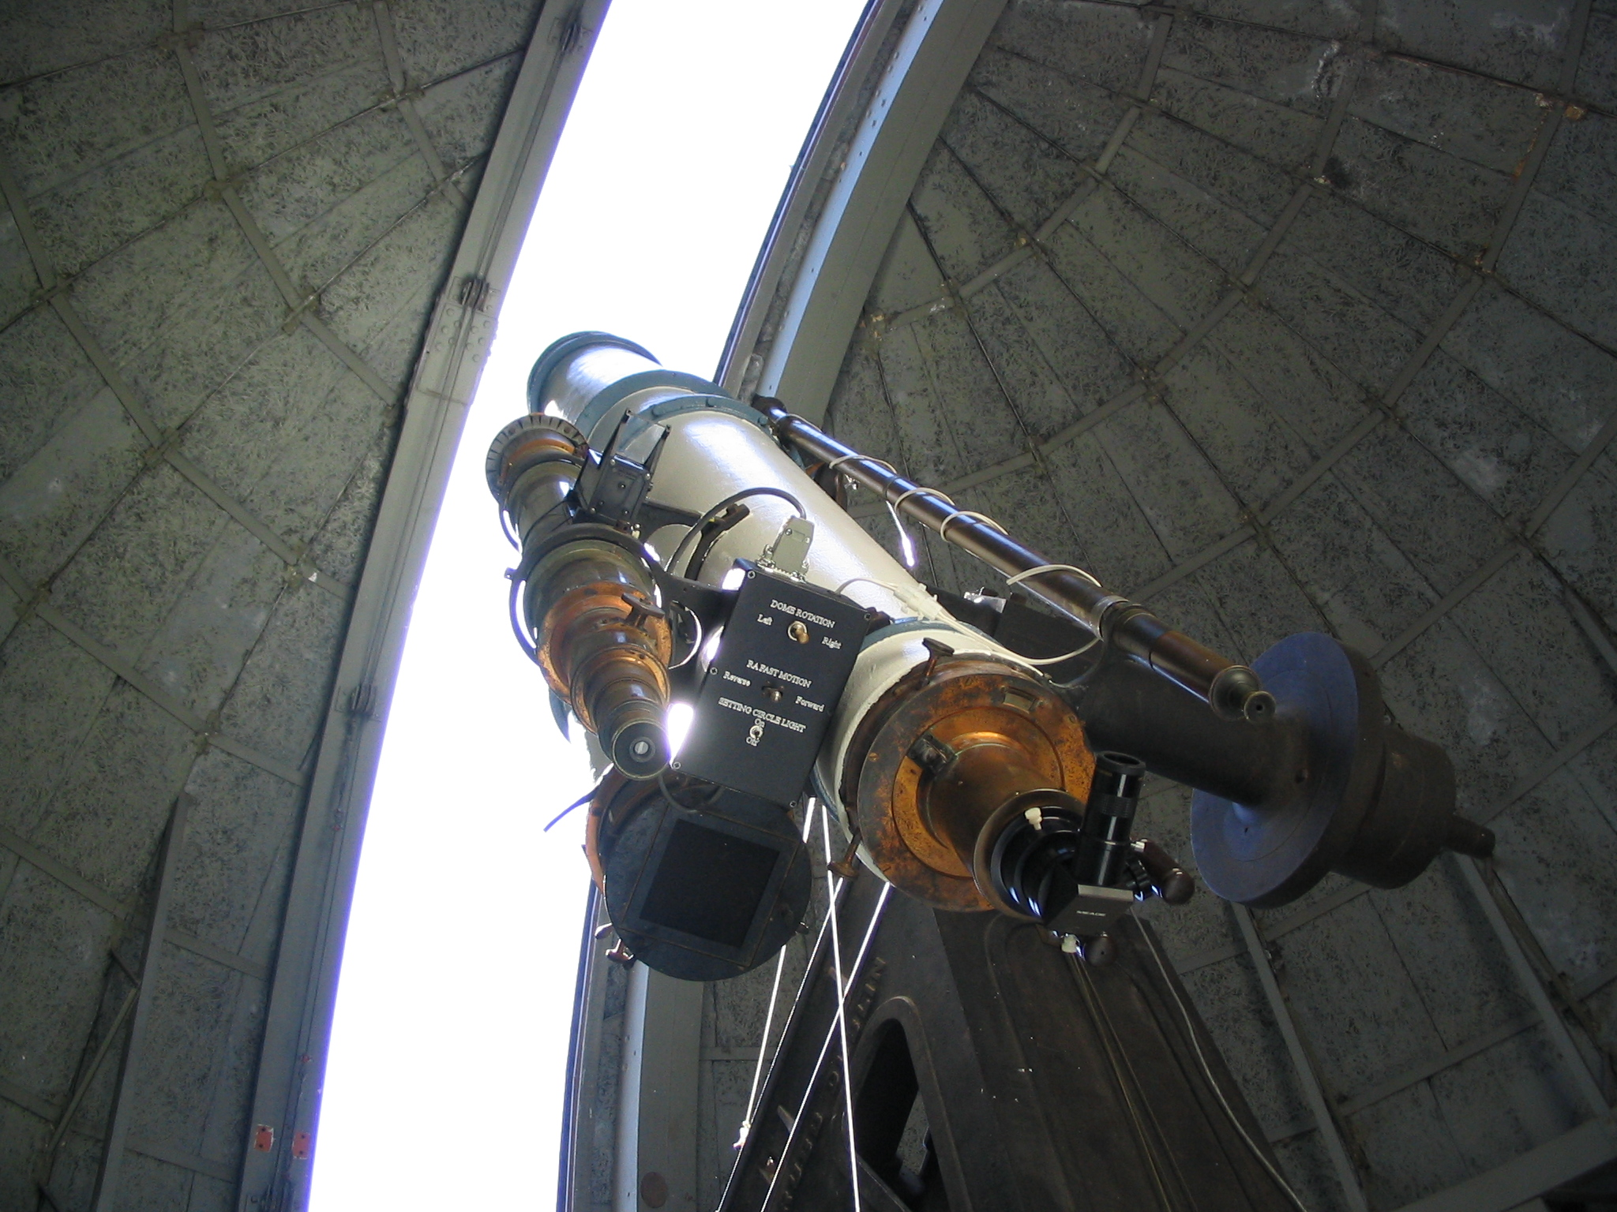
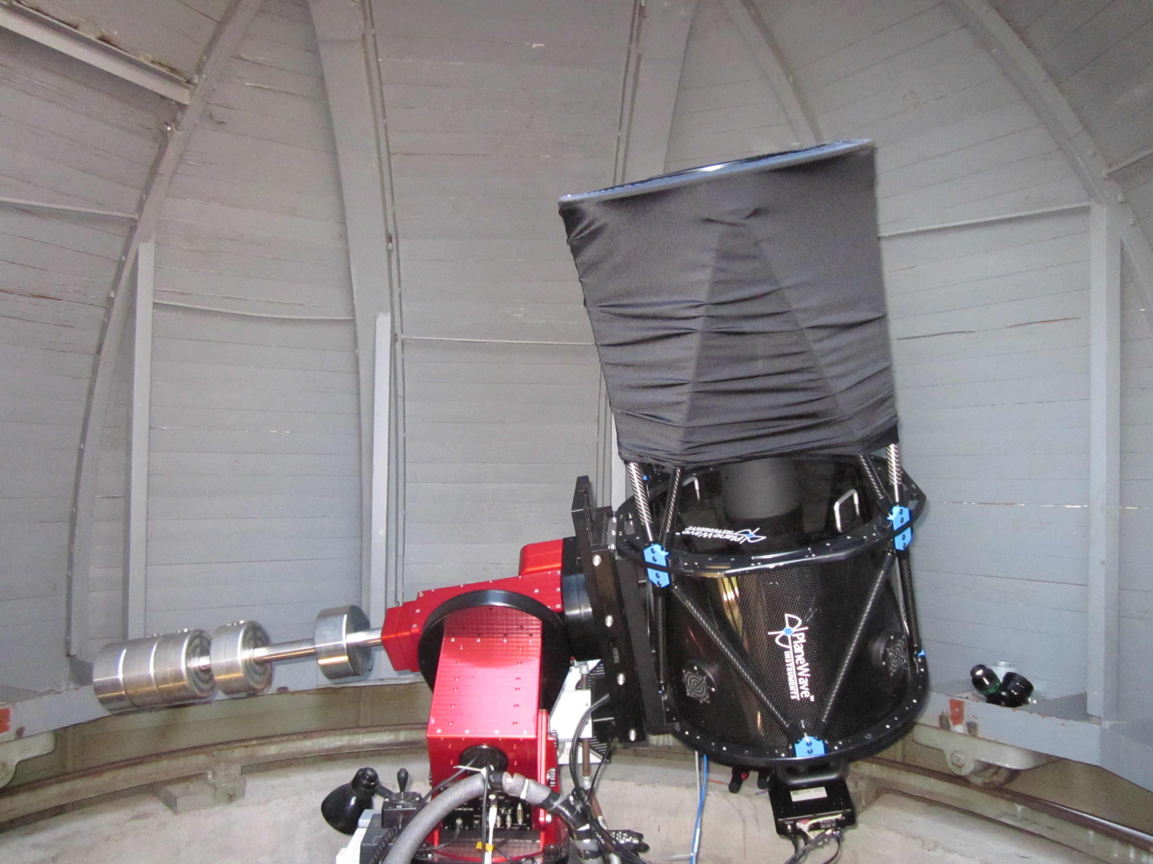
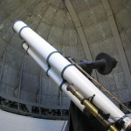
The 17” CDK telescope
(little but modern)
in the little dome
Fully photographic use:
CCD camera installed
The Grubb Refractor
in the
large dome
(1892)
Diameter
15”

Slide 12
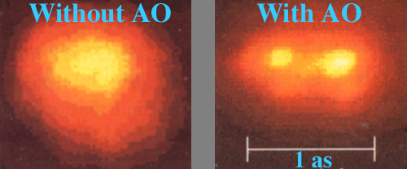
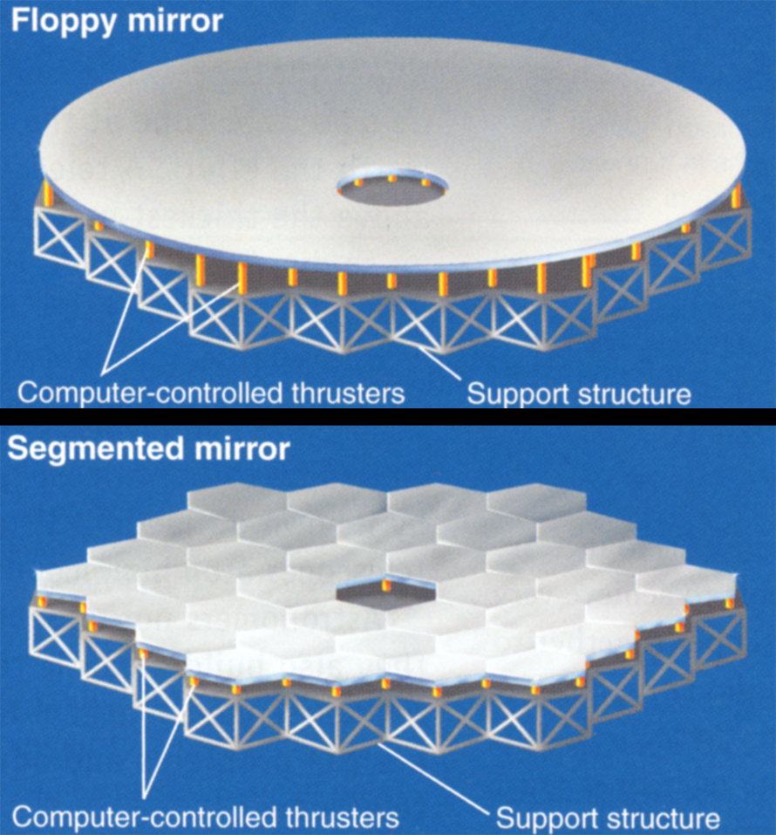
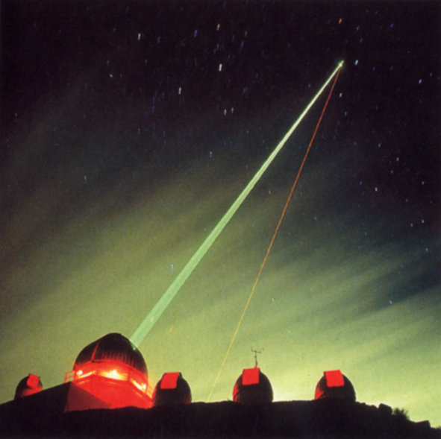
Adaptive optics
How do you fight seeing?
(1) Put your observatory on a mountaintop: seeing at best: ~ 0.4 as
(2) Use adaptive optics: seeing at best: ~ 0.05 as
• Deform your mirror to compensate for seeing
• Observe a “guide” star and have a computer tell how to deform mirror
• Do this ~ 100 times each second
No guide star?
Make one!

Slide 13
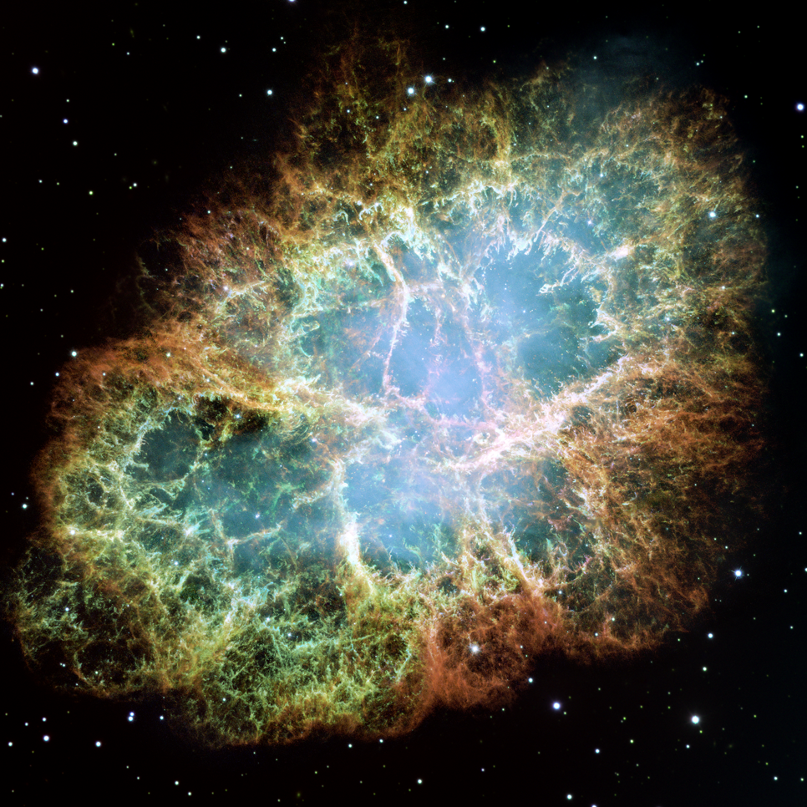
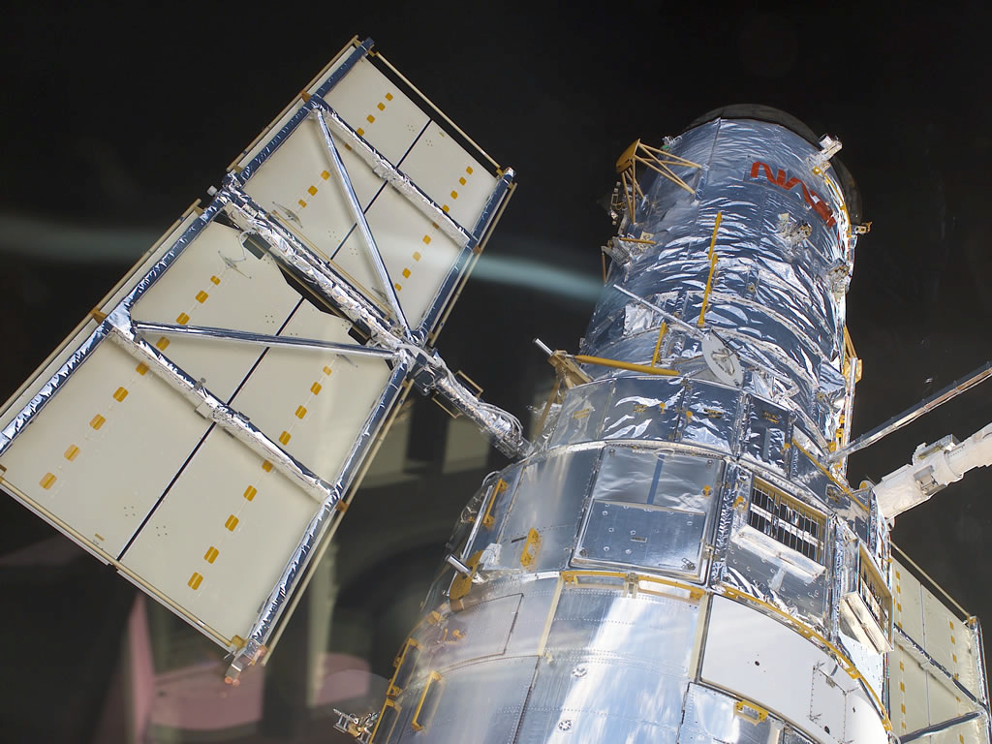
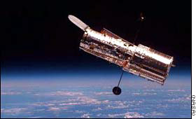
The Hubble
How do you fight seeing?
(3) Put your telescope on a spaceship:
seeing: 0 as
Hubble Space Telescope is a “small” telescope
Diameter: 2 m; resolution: 0.06 as
More discoveries than all other
telescopes combined.

Slide 14
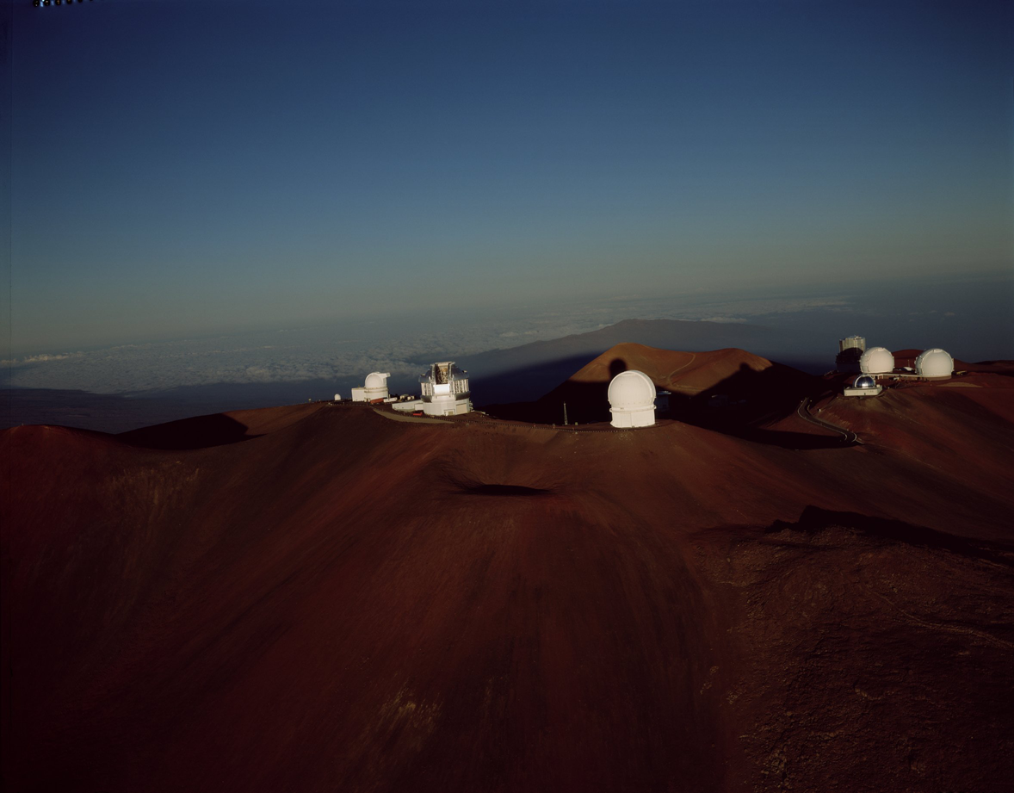
Mauna Kea
M
A
U
N
A
K
E
A

Slide 15
Questions coming …

Slide 16
Question 7
sec
45
40
35
30
25
19
18
17
16
15
14
13
12
11
10
9
8
7
6
4
3
2
1
0
20
5
45
Why does the Hubble Telescope make very
detailed images?
A Because it has the largest diameter of all telescopes.
B Because it is of exceptionally good quality.
C Because it is in space where the atmosphere does
not blur the image.
D Because it can use infrared radiation that other
telescopes cannot.
E Because it is in space, closer to the stars than other telescopes.
Next question coming …

Slide 17
Question 8
sec
45
40
35
30
25
19
18
17
16
15
14
13
12
11
10
9
8
7
6
4
3
2
1
0
20
5
45
What is adaptive optics?
A When the telescope follows the stars as they
move in the sky.
B When some of the telescope’s lens or mirror is covered according to changes in the atmosphere.
C When the shape of the optics is changed according to the changes in the atmosphere.
D When appropriate color filters are used as the atmosphere absorbs more or less red or blue light.
E When the magnification of the telescope is chosen according to how turbulent the atmosphere is on the day of the observation.

Slide 18
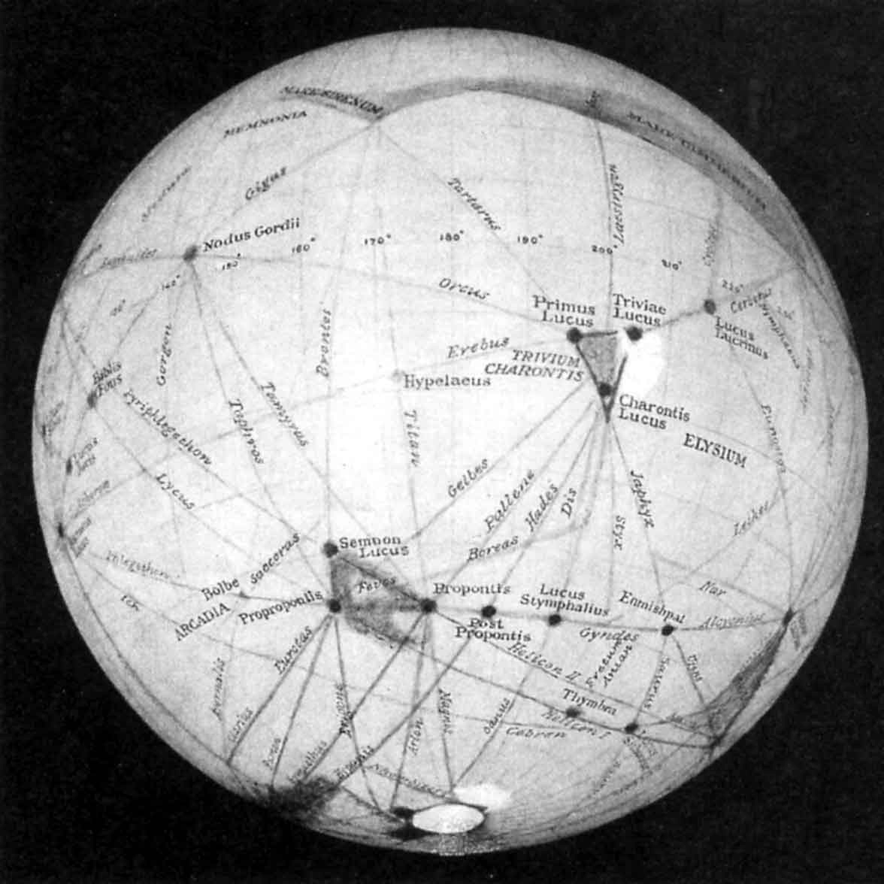
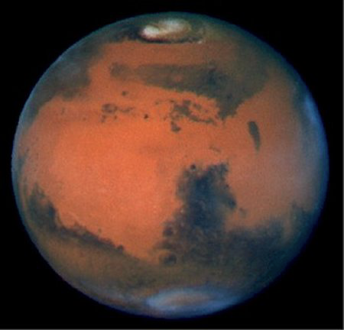
Visual vs. CCD
The professional way of doing astronomy: picture taking and imaging
(1) Visual observation: always unreliable
Recall the canals on Mars - G. Schiaparelli &P. Lowell

Slide 19
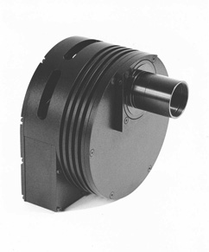
CCD
The professional way of doing astronomy: picture taking and imaging
(2) Photography: • reliable • can collect light for a long time
(3) The modern way: CCD imaging
• in CCD chip light moves electrons into pixel
• computer counts electrons in each pixel
and turns numbers into image on screen
Similar to a digital camera but:
• chip is cooled to reduce noise
• computer controlled - image can be much
improved with computerized processing techniques
• many images can be added to improve quality
The CCD revolution after 1995: one can take pictures
even of galaxies with amateur equipment from light-polluted sites.

Slide 20
Questions coming …

Slide 21
Question 9
sec
45
40
35
30
25
19
18
17
16
15
14
13
12
11
10
9
8
7
6
4
3
2
1
0
20
5
45
Why do astronomers no longer look into
their telescopes?
A Because the observer’s body would obstruct the
light in research-grade telescopes.
B Because visual observations are unreliable.
C Because there is dangerous radiation in a research observatory.
D Because large telescopes collect so much light that their eyes
would be damaged.
E Because there is nothing left to discover in optical light;
infrared and X-ray radiation must be observed to make new
discoveries.
Next question coming …

Slide 22
Question 10
sec
45
40
35
30
25
19
18
17
16
15
14
13
12
11
10
9
8
7
6
4
3
2
1
0
20
5
45
What is a CCD?
A A new type of telescope that replaces reflectors.
B A new type of optical device that replaces the lens or mirror
of a telescope.
C A new type of a telescope mount.
D A new type of a detector that replaces photography.
E A new type of an instrument that separates colors in starlight.
Next question coming …

Slide 23
Question 11
sec
45
40
35
30
25
19
18
17
16
15
14
13
12
11
10
9
8
7
6
4
3
2
1
0
20
5
45
Which of the following is an advantage of
imaging over visual observations in astronomy?
A One can get better resolution.
B The human eye cannot see X-rays, but cameras can.
C One can collect light for a long time.
D Cameras can be handled automatically in observatories in
remote high mountains.
E Seeing does not affect camera images.

