Slide 1
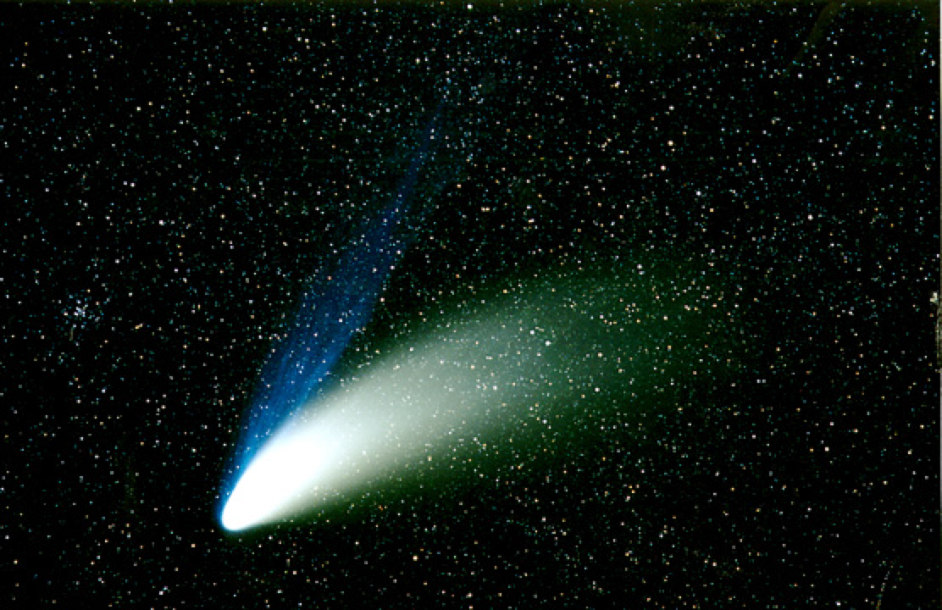
Welcome to Astronomy 104!
What we’ll do today:
• Introductions
• Review syllabus
• Review home page
• A little astronomy:
What’s up in the sky?
First lab: Next week
Location: Kennon Observatory.

Slide 2

Setup
Not today!
Prepare your scantron:
Fill in your name and fill the bubbles under your name.
Put your 4-digit code in place of “identification number”
LAST NAME FIRST, First name second
Please note that the scantrons must be turned in by each student in person,
not by a classmate!
Question # 1: answer A
Question # 2: answer A
Question # 3: answer A
Use a pencil, not a pen!
(Scantron number 16485)
Please take a moment to mute or switch off your cell phones!

Slide 3
What is astronomy?
Today’s first thing to learn and remember:
The science of the stars.
What is astrology?
The con art of predicting the future.
Oh yes,
A thousand years ago most people were not bright enough to know this.
Are we?

Slide 4
Here is how the quizzes will work
There will be 2 to 4 sets of questions each class
and
you’ll turn in your scantron at the end of the class
before you leave.
Be sure to bring a scantron to the next class!

Slide 5
Question 1
sec
30
29
28
27
26
25
24
23
22
21
20
18
17
16
15
14
13
12
11
10
9
8
7
6
5
4
3
2
1
0
19
Who stole the Moon?
A Mr. Scrooge.
B Mr. Grinch.
C Mr. Finch.
D Mr. Lynch.
E Ms. Cow.
Next question coming …

Slide 6
Question 2
sec
30
29
28
27
26
25
24
23
22
21
20
18
17
16
15
14
13
12
11
10
9
8
7
6
5
4
3
2
1
0
19
What is astrology?
A A sort of religion.
B Waste of money.
C The branch of science that studies stars.
D The branch of science that predicts the future
based on the motion of the planets.
E Con art.
Next question coming …

Slide 7
Question 3
sec
30
29
28
27
26
25
24
23
22
21
20
18
17
16
15
14
13
12
11
10
9
8
7
6
5
4
3
2
1
0
19
What class is this?
A Astro 101.
B Astronomy 103.
C Astronomy 104.
D Astrology 103.
E Astrology 104.
Next time it will be for real!

Slide 8
Enjoy the pictures …
And now
enjoy the pictures …

Slide 9
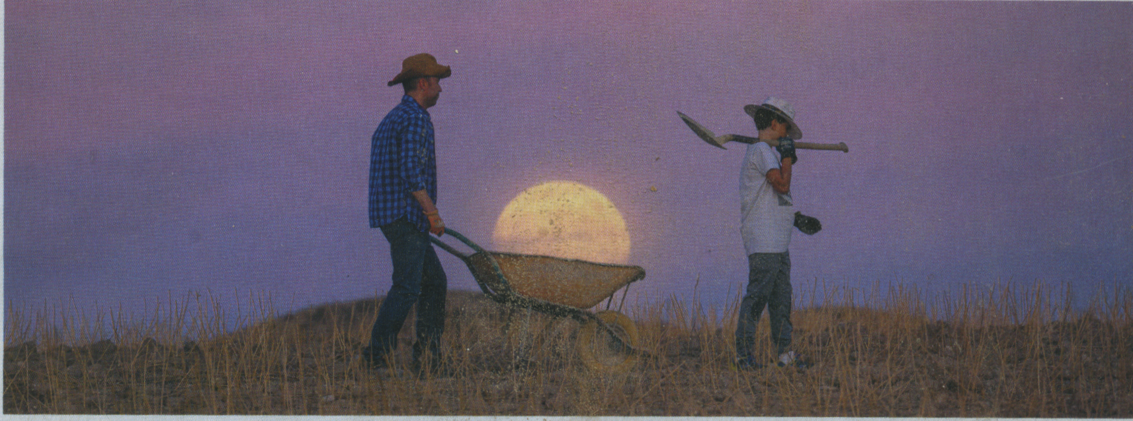
Does the Moon fit?

Slide 10
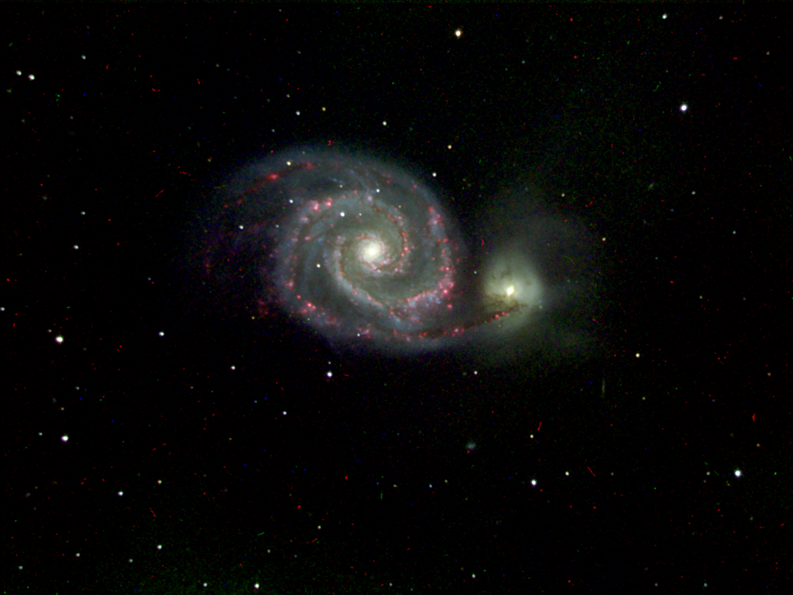
Our M51
Yes, there are pretty things up there … but it takes a lot to get to them
The Whirlpool Galaxy (M51)
Picture by:
K. Ford, C. A. Jackson
Students in Astro 104

Slide 11
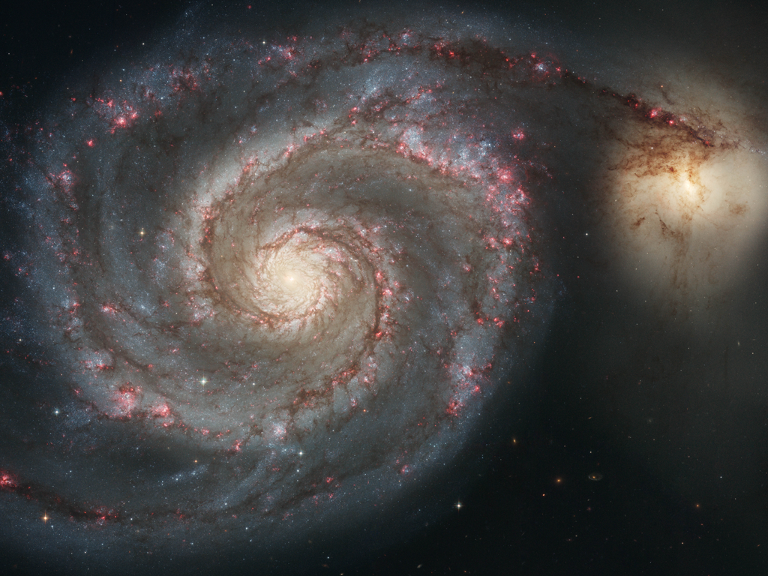
M 51 (HST)

Slide 12
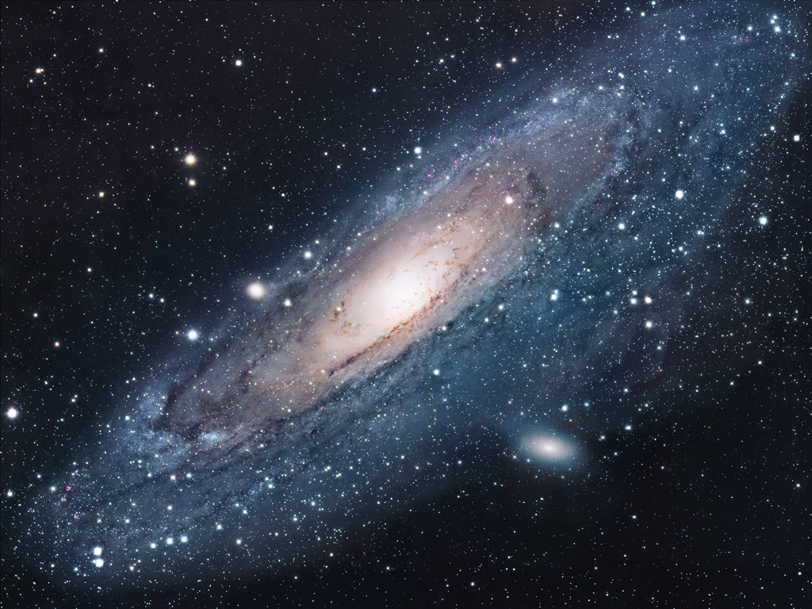
M31
M 31
(The Andromeda Galaxy)

Slide 13
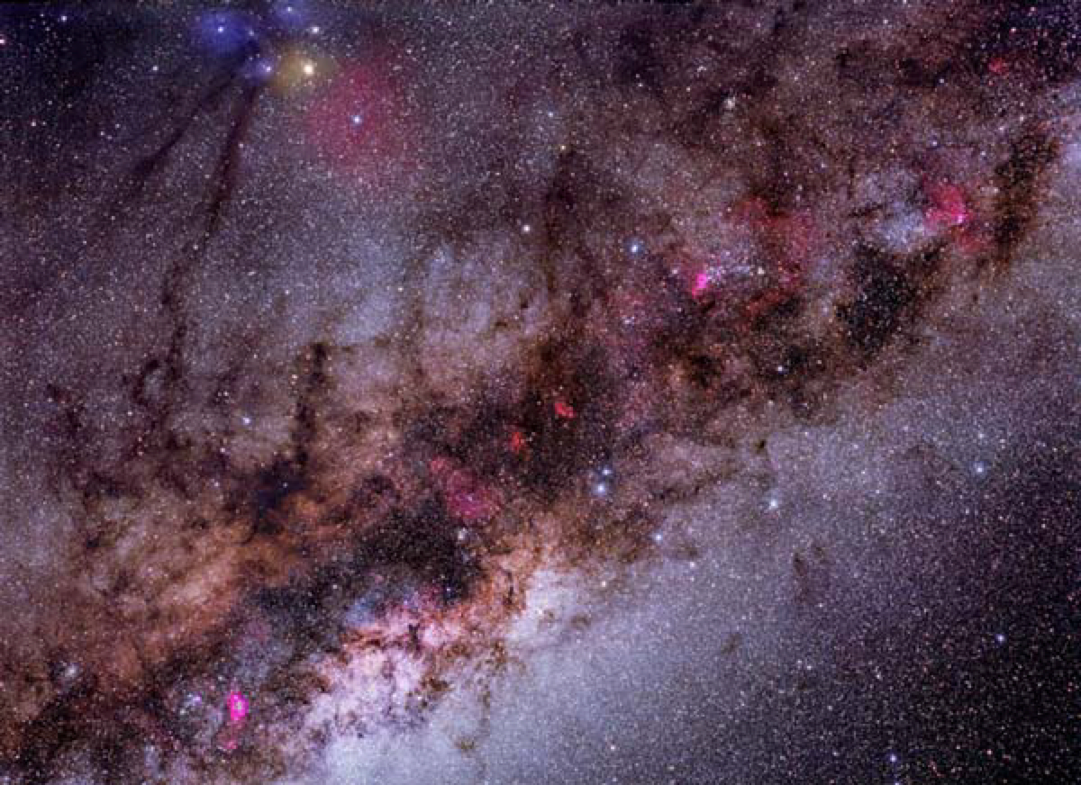
The Milky Way
The Milky Way
(a simple camera picture)

Slide 14
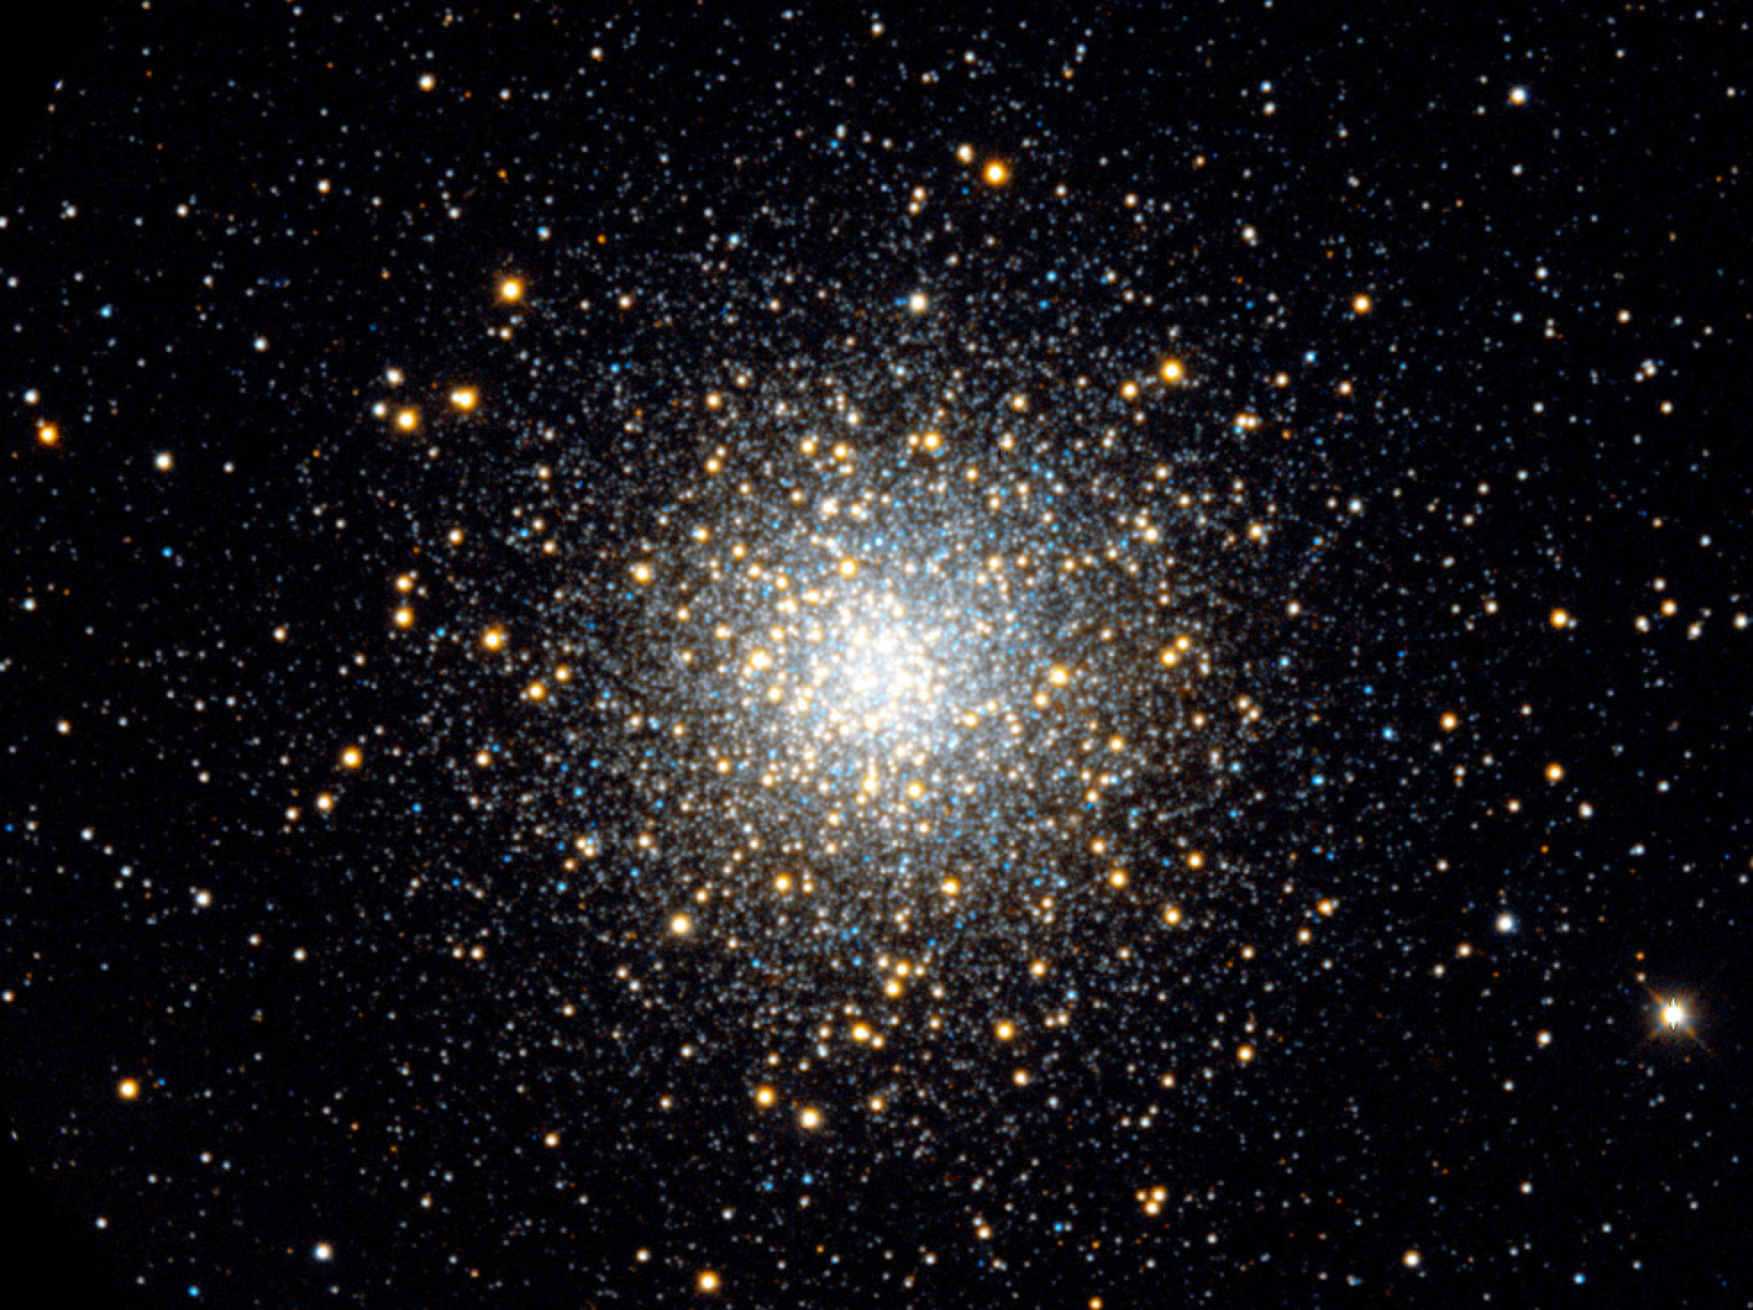
M13
M 13
(A globular cluster)

Slide 15
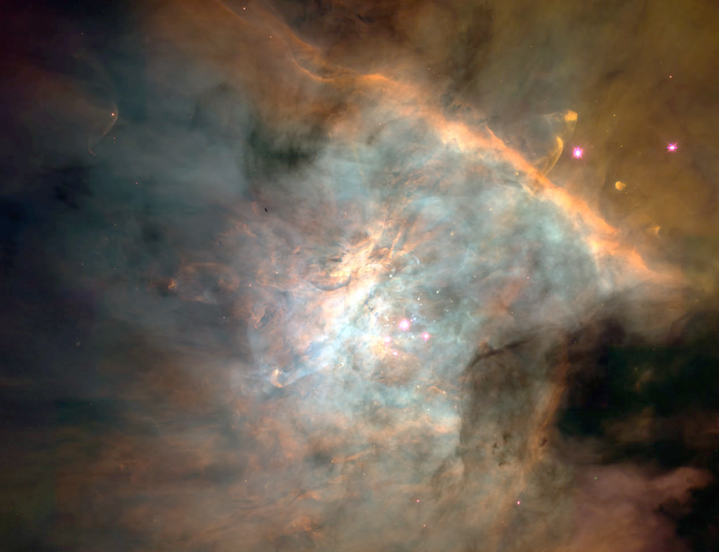
M42
The
Orion
Nebula
(M42)

Slide 16
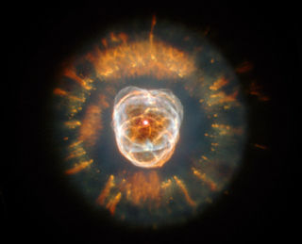
The Eskimo
The Eskimo Nebula

Slide 17
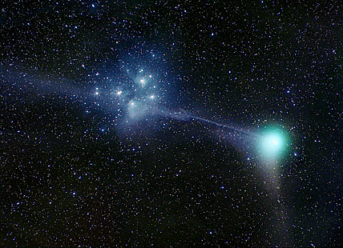
Machholtz & Pleiades
Comet Machholz and the Seven Sisters

Slide 18
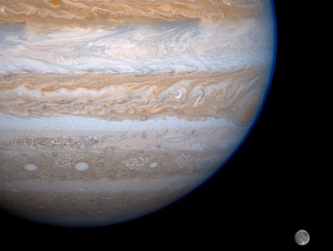
Jupiter and Ganymede
Jupiter with its moon Ganymede

Slide 19
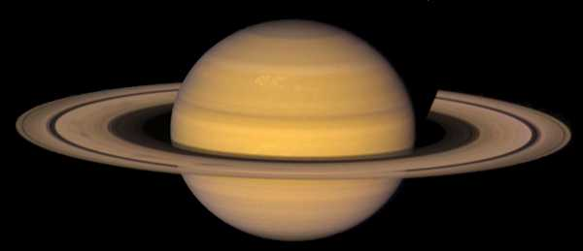
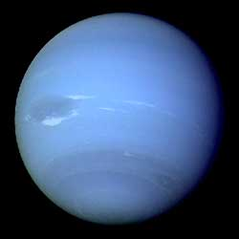
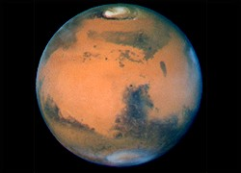
Saturn, Neptune, Mars
Saturn
Neptune
and
Mars

Slide 20
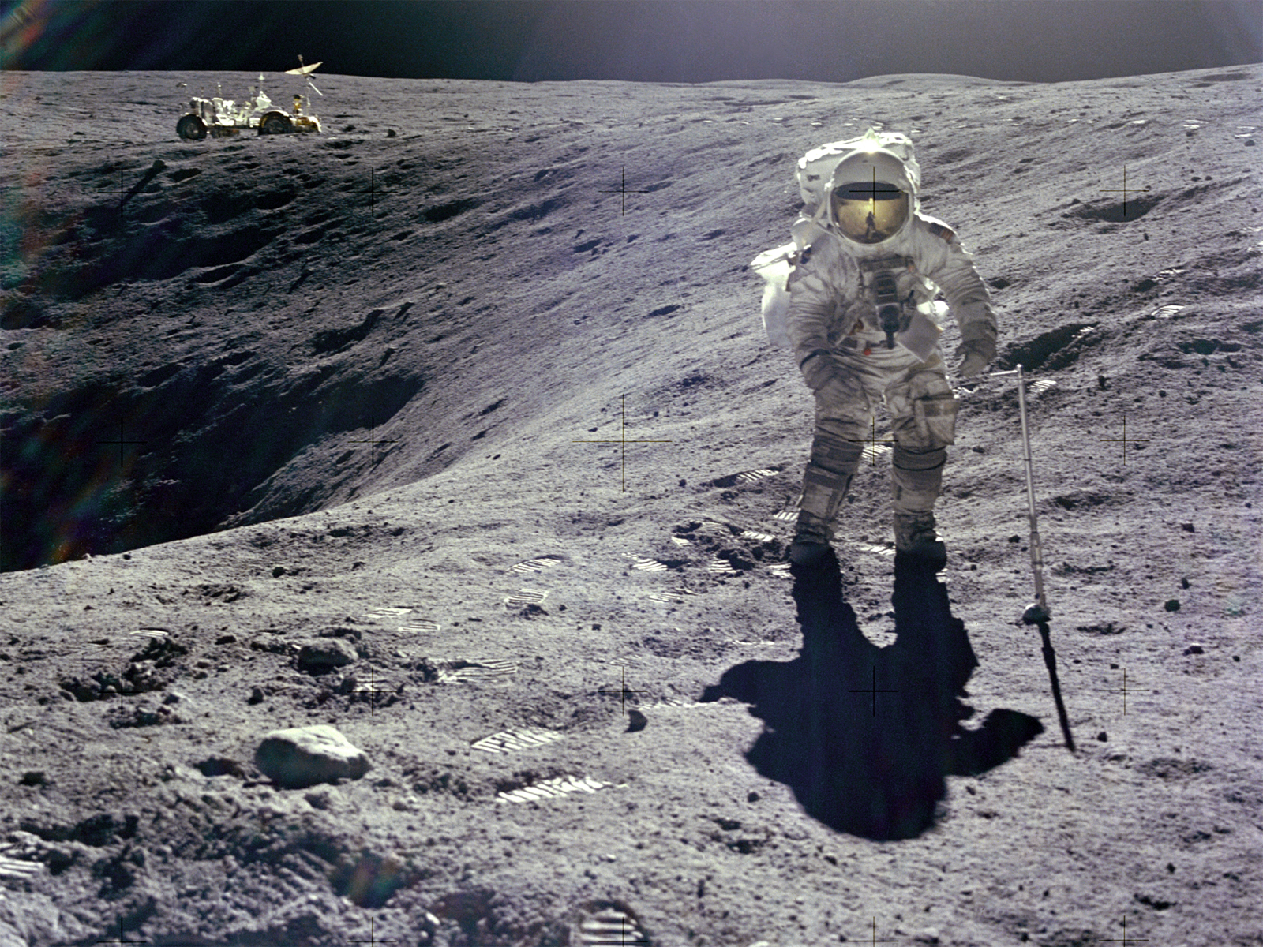
Moon
and finally … the Moon.

Slide 21
Turn in your scantron now
personally!
Don’t.

