Slide 1


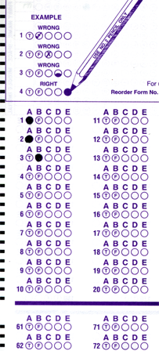
Setup:
Prepare your scantron:
Use
a pencil,
not a pen!
Fill in your name and fill the bubbles under
your name.
LAST NAME FIRST, First name second
Put your 4-digit code instead of “IDENTIFICATION NUMBER”.
--- (The last 4 digits of your OleMiss ID.)
Regular Test 2
Oct. 16, Friday
Material covered:
All since the first test only
Question # 1: answer A
Question # 2: answer B
Question # 3: answer A
Pass/fail test makeup
on Oct. 23, Friday
1:00 pm only.
Reading assignment
Chapter 5, Light and matter, pp. 137 – 164
Please take a moment to mute your cell phone!

Slide 2
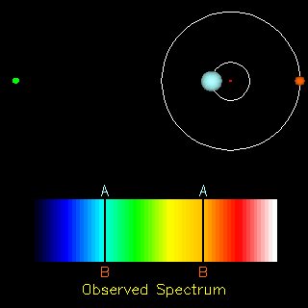
Stars - single and double
• Half of the stars are doubles
• Singles, doubles, triples, small clusters, large clusters
• All stars are born in clusters
but get “expelled” pretty soon after birth (~200 million years)
Situations and their names:
• Binaries – noticeably orbiting
(often hard to resolve them : spectroscopic binaries)
• Common proper motion doubles (too far separated to orbit)
• Chance doubles

Slide 3
Questions coming …

Slide 4
Question 4
sec
30
29
28
27
26
25
24
23
22
21
20
18
17
16
15
14
13
12
11
10
9
8
7
6
5
4
3
2
1
0
19
How fast do visual binaries normally revolve
(those double stars that can be seen in the telescope
to orbit each other)?
A Once in a few minutes.
B Once in a few years.
C Once in decades or centuries.
D Once in millions of years.
Next question coming …

Slide 5
Question 5
sec
30
29
28
27
26
25
24
23
22
21
20
18
17
16
15
14
13
12
11
10
9
8
7
6
5
4
3
2
1
0
19
How many double star systems are there?
A Very few: out of the billions of stars in the Galaxy,
only a hundred are doubles.
B Only a few: 99% of stars, like the Sun, are singles.
C About the half of the stars are doubles.
D Almost all stars are doubles.

Slide 6
Example: spectroscopic binaries
Measure:
* Blue/red shift of lines
* Time period
Earth
Calculate:
* Orbital speed
( shift in % of wavelength
= speed in % of speed of light )
* Size of orbit
( time period × speed = 2 r π )
* Mass of stars
( Kepler III: M × T² = r³ )

Slide 7
The mass of stars
:
use binaries
Measure:
a
Period (T) in years
Size of orbit (a) in AU’s
Kepler’s III law tells mass:
M T² = a³
solve this for M
Example:
A binary system has been measured to turn around in 55 years
Stars separated 3 arc second
Parallax is 0.067 arc second.
Use these data to figure out the system:
Distance to stars from parallax: 15 parsecs
a = 45 AU and T = 55 years, plug in and solve equation
mass = 30 solar masses (very big stars)

Slide 8
Questions coming …

Slide 9
Question 6
sec
30
29
28
27
26
25
24
23
22
21
20
18
17
16
15
14
13
12
11
10
9
8
7
6
5
4
3
2
1
0
19
Why are double stars important in astronomy?
A They help us to measure the distance to stars.
B They provide the only way to measure the mass of the stars.
C They help us find out what substances stars are made of.
D They help us find out how fast stars revolve around the center of the Galaxy.
Next question coming …

Slide 10
Question 7
sec
30
29
28
27
26
25
24
23
22
21
20
18
17
16
15
14
13
12
11
10
9
8
7
6
5
4
3
2
1
0
19
How do we know the mass of (some) stars?
A Using measurements of their planets.
B Using measurements of the force of their gravity on spaceships.
C Using the red/blue shift of spectral lines of binary stars.
D Using measurements of their brightness and color.

Slide 11
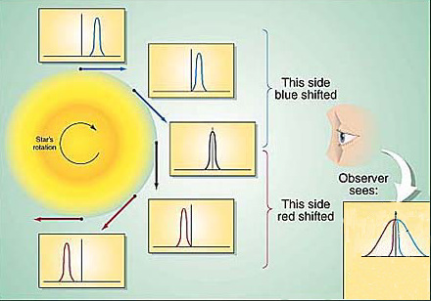
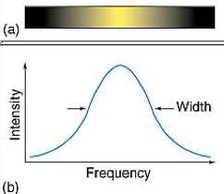
What do spectra tell us?
The details of the spectra tell a lot:
• Chemical composition: which lines are present
• Rotation: broadening (same percent for all lines)
• Movement (towards us or away from us): shift lines (same percent for all lines)
• Strength of magnetic field (if any): split of lines into doublets
• Temperature: relative line strengths of the same atom
For example, H_{α} (level 2 to 3, red) vs. P_{α} (Paschen-α, level 3 to 4, infrared) transition in H atom.
• Gas density (gravity), chaotic wind speed: broadening (varies from atom to atom)
• Mass loss (stellar wind): P Cygni profile (blue-shifted emission + unshifted absorption)
Example: Rotational
line broadening:
(all spectral lines broadened
by the same percent)

Slide 12
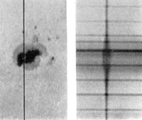
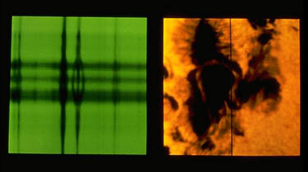
Example: the Zeeman effect
(splitting lines into doublets/triplets by the magnetic field)
shorter longer
wavelength
Zeeman split is strong inside sunspot
(split is proportional magnetic field strength)
on this picture, maximum magnetic field strength is
~ 1 Tesla (10 times stronger than a household magnet)
extends to an area size of the US
Spectrograph’s slit
Excludes light outside this line

Slide 13
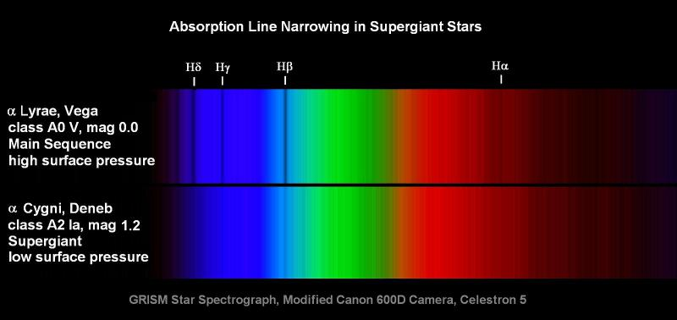
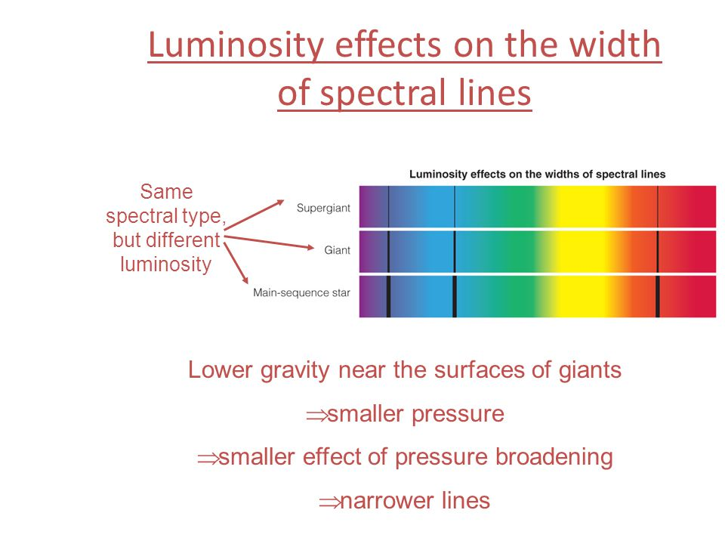
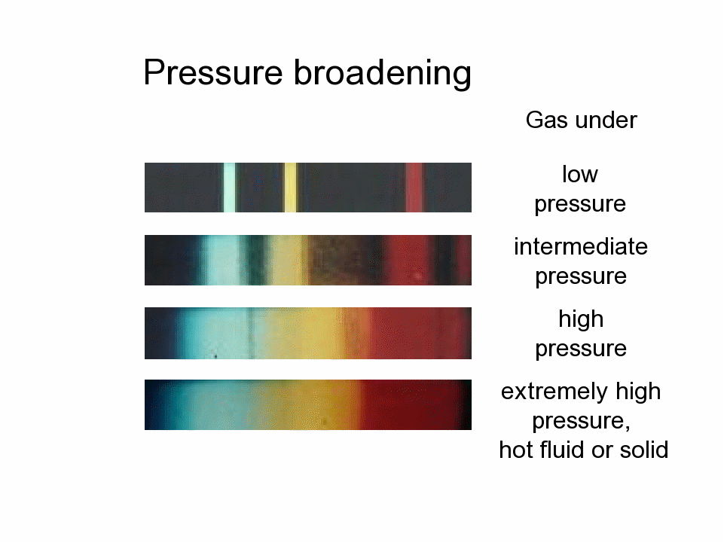
Example: pressure broadening
(giant stars have narrow lines)
The spectrum tells us the surface gravity (i.e. luminosity class)

Slide 14
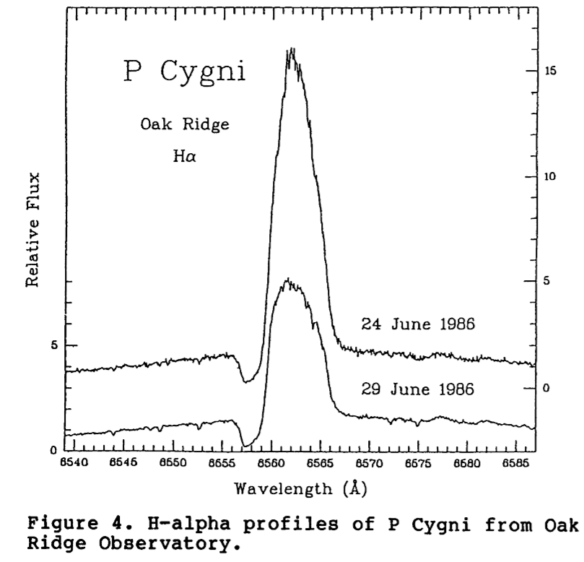
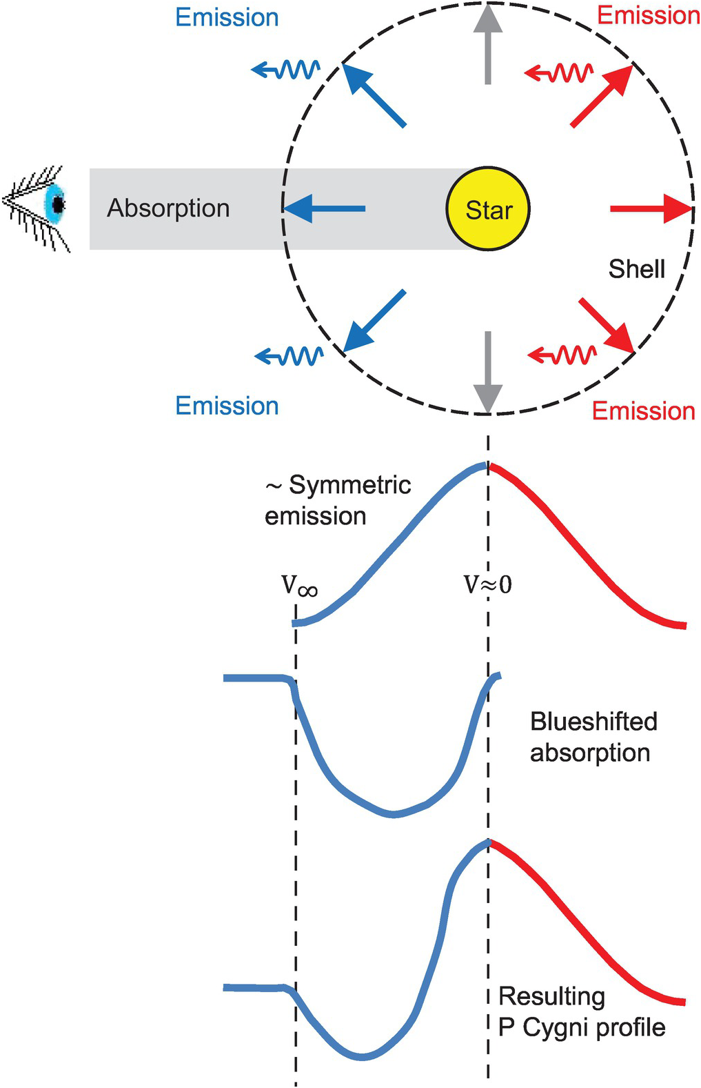
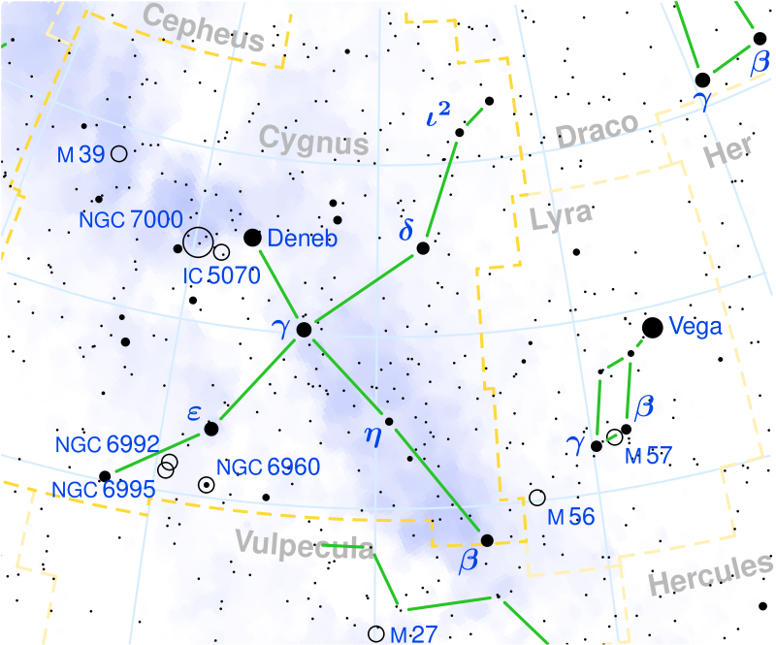
Example:
P Cygni profile
Stellar wind’s effect
on the profile
of a spectral line:
Blue absorption, red emission
Seen only when
a star’s stellar wind is strong
(i.e. a lot of mass loss)
“P Cygni” is a variable star designation.

