Slide 1


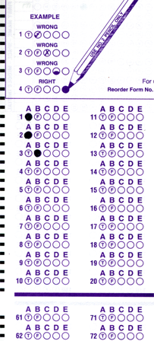
Setup:
Prepare your scantron:
Use
a pencil,
not a pen!
Fill in your name and fill the bubbles under
your name.
LAST NAME FIRST, First name second
Put your 4-digit code instead of “IDENTIFICATION NUMBER”.
--- (The last 4 digits of your OleMiss ID.)
Question # 1: answer A
Question # 2: answer D
Question # 3: answer F
Reading assignment
Chapter 5, Light and matter, pp. 137 – 164
Please take a moment to mute your cell phone!

Slide 2
Review questions coming …

Slide 3
Question 4
This question counts double!
sec
30
29
28
27
26
25
24
23
22
21
20
18
17
16
15
14
13
12
11
10
9
8
7
6
5
4
3
2
1
0
19
What causes sunspots?
A Dark matter is brought up from inside the Sun by convection.
B Cold matter is brought up from inside the Sun by convection.
C The magnetic field of the Sun locally stops convection.
D After a solar flare the area cools off.
E Dark clouds locally block sunlight.
Next question coming …

Slide 4
Question 5
This question counts double!
sec
30
29
28
27
26
25
24
23
22
21
20
18
17
16
15
14
13
12
11
10
9
8
7
6
5
4
3
2
1
0
19
What is a prominence?
A Warm gas held up over the photosphere by magnetic field lines, visible at the edge of the sun through a narrowband filter.
B A large explosion, visible in the middle of the solar disk.
C A large explosion, visible at the edge of the solar disk with any telescope.
D A large explosion, only visible from space.
E The solar disk looks grainy due to convection.
Next question coming …

Slide 5
Question 6
This question counts double!
sec
30
29
28
27
26
25
24
23
22
21
20
18
17
16
15
14
13
12
11
10
9
8
7
6
5
4
3
2
1
0
19
What gives the energy to a solar flare?
A Hot bubles coming out of the depth of the Sun.
B Convection in the photosphere.
C Chemical or nuclear reactions.
D Infalling asteroids burning up in the Sun.
E Magnetic reconnection.
Next question coming …

Slide 6
Question 7
This question counts double!
sec
30
29
28
27
26
25
24
23
22
21
20
18
17
16
15
14
13
12
11
10
9
8
7
6
5
4
3
2
1
0
19
The solar wind comes out mostly through …
A sunspots.
B coronal holes.
C the photosphere, evenly everywhere.
D prominences.
E flares.
Next question coming …

Slide 7
Question 8
This question counts double!
sec
30
29
28
27
26
25
24
23
22
21
20
18
17
16
15
14
13
12
11
10
9
8
7
6
5
4
3
2
1
0
19
How long does it take from solar maximum to solar maximum?
A 1 day
B 1 month
C 1 year
D 11 years
E 5 billion years.

Slide 8
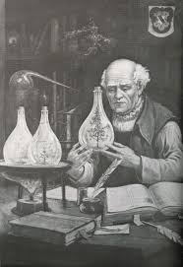
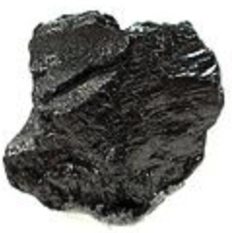

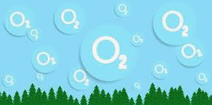
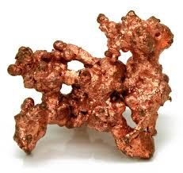
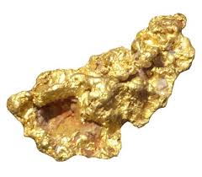
What is in an atom?
WRONG:
Wrong answer:
protons, electrons, neutrons
Why important?
makes you confuse nuclear with chemical
Why different?
energy: ~1 eV (chemical) vs. ~1 MeV (nuclear)
(1 electronvolt) (1 million eV)
Consequence:
- nuclei change only in very extreme situations
(reactors, atomic bombs, centers of stars
+ tiny amounts in radioactive decays)
e⁻
n⁰
e⁻
p⁺
e⁻
p⁺
e⁻
n⁰
e⁻
Proven wrong:
Rutherford
1909
Paracelsus
(alchemist, ~ 1500)
Carbon
Won’t happen
Oxygen
Copper
Gold
Didn’t work

Slide 9
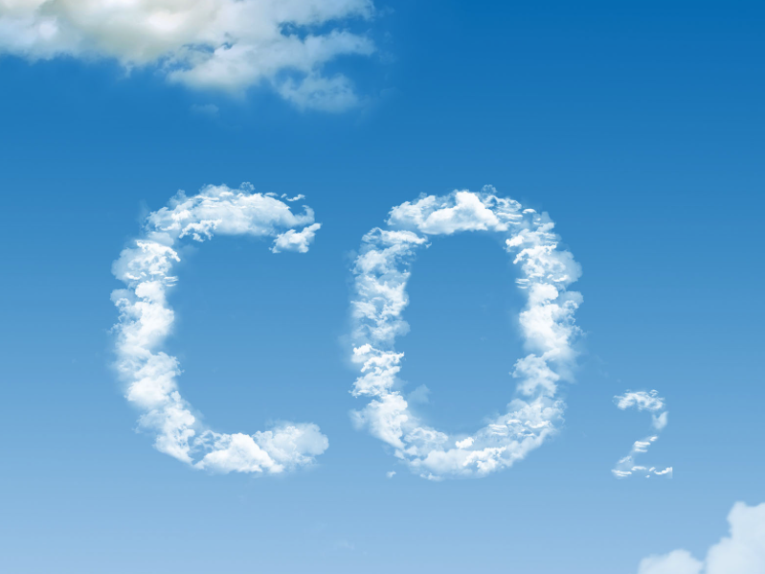
What is in an atom?
Correct
but not to scale:
nucleus shown too large
Correct answer:
One nucleus + electrons
Correct sizes:
nucleus = 1 unit size
atom = 50,000 units size
(size of atom = electrons’ orbits)
The nucleus is an extremely tiny thing
in the center of an atom, like a point!
(even though most of the mass
of the atom is in the nucleus)
e⁻
electron (-)
nucleus (++++++)
Nuclei are preserved:
C
(case of carbon in drawing)
The electric charge of
the nucleus tells
which
chemical element
it is.
Carbon dioxide
Carbon + oxygen
CO₂ C + O₂

Slide 10
Questions coming …

Slide 11
Question 9
sec
30
29
28
27
26
25
24
23
22
21
20
18
17
16
15
14
13
12
11
10
9
8
7
6
5
4
3
2
1
0
19
The constituents of atoms are:
A Protons, electrons and neutrons.
B Chemical compounds.
C Molecules of various sorts.
D Electrons and protons.
E One nucleus and electrons.
Next question coming …

Slide 12
Question 10
sec
30
29
28
27
26
25
24
23
22
21
20
18
17
16
15
14
13
12
11
10
9
8
7
6
5
4
3
2
1
0
19
Can a chemical process turn hydrogen into helium?
A Yes, but only at very hot temperature.
B Yes, and that is the process that keeps the Sun hot.
C No, because too much energy is needed to change one nucleus into another.
D No, because a chemical process can turn hydrogen only into oxygen.

Slide 13
Phases
The phases of matter
• Solid
• Liquid (only under pressure – rarely in astronomy)
• Gas
Hot matter:
T > 1,000 - 2,000 K molecules fall apart into atoms (gas)
T > 2,000 - 3,000 K atoms are ionized (plasma)
More accurately:
hydrogen
H⁺ at 10,000 K
He⁺ at 20,000K ; He⁺⁺ at 40,000K
C⁺ , N⁺ , O⁺ , ... at ~2,000K
…
C ⁺⁺⁺⁺⁺⁺ , N ⁺⁺⁺⁺⁺⁺⁺ , O ⁺⁺⁺⁺⁺⁺⁺, … at >50,000K
→
helium
→
once ionized
called metals
→
fully ionized

Slide 14
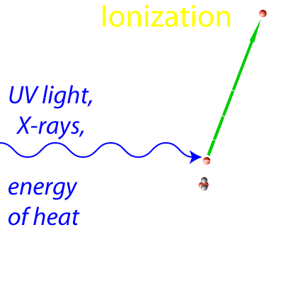
What is plasma?
• Matter with a lot of ionized atoms.
⇒ Feels magnetic field
Examples: Flame
Lightening bolt
Substance of the stars
The Solar wind
Hot interstellar matter
_______________________________________________________
What is interstellar matter made of?
• when gas: H₂, H, H+, and other atoms, ions, and molecules
• when solid grains (“dust”): ice, carbon (‘soot’), silicates (“rock”)

Slide 15
Questions coming …

Slide 16
Question 11
sec
30
29
28
27
26
25
24
23
22
21
20
18
17
16
15
14
13
12
11
10
9
8
7
6
5
4
3
2
1
0
19
What is plasma?
A Substance under tremendous pressure.
B Liquid or gas containing chemical compounds.
C Gas containing (at least a portion of) ionized atoms.
D Fully ionized gas.
E A gas of purely neutral hydrogen atoms.
Next question coming …

Slide 17
Question 12
sec
30
29
28
27
26
25
24
23
22
21
20
18
17
16
15
14
13
12
11
10
9
8
7
6
5
4
3
2
1
0
19
What is ionization?
A Molecules fall apart into atoms due to heat.
Glowing gas is formed.
B Nuclear processes in stars produce dangerous radiation.
C Atomic nuclei fall apart into neutrons and protons.
A neutron star results.
D Atoms lose (some of) their electrons due to heat or UV
radiation. The substance becomes plasma.

Slide 18
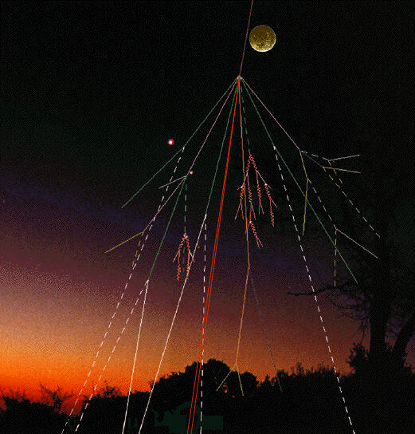
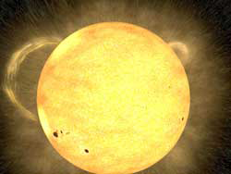
Cosmic rays
From Deep Space (??)
The Solar Wind
protons, electrons
Earth’s
atmosphere and magnetic field
absorb them
(dangerous for astronauts)
very energetic protons & nuclei
Break up into showers
of many less energetic particles
in the atmosphere.
(always present: causes mutations)

Slide 19
Question coming …

Slide 20
Question 13
sec
45
40
35
30
25
19
18
17
16
15
14
13
12
11
10
9
8
7
6
4
3
2
1
0
20
(45)
5
Which of the following causes a noticeable amount of radiation, present on Earth?
The Solar Wind.
“Deep Space” cosmic rays.
Radiation from nuclear reactors.
Radiation from naturally occurring decays.
A I and III.
B II.
C I, II and III.
D None of the above.
E All of the above.

