Slide 1



Setup:
Prepare your scantron:
Use
a pencil,
not a pen!
Fill in your name and fill the bubbles under
your name.
LAST NAME FIRST, First name second
Put your 4-digit code instead of “IDENTIFICATION NUMBER”.
--- (The last 4 digits of your OleMiss ID.)
Question # 1: answer A
Question # 2: answer B
Question # 3: answer B
Recall reading assignment
Angular size; arcseconds (pp. 27-28)
Parallax, parsecs, absolute magnitude, distance modulus (pp. 489-493)
Please take a moment to mute your cell phone!

Slide 2
Review questions coming …

Slide 3
Question 4
This question counts double!
sec
30
29
28
27
26
25
24
23
22
21
20
18
17
16
15
14
13
12
11
10
9
8
7
6
5
4
3
2
1
0
19
How large does Jupiter look in the telescope?
A 1 as
B 40 as
C 10,000 miles
D 4 inches
E 6 astronomical units
Next question coming …

Slide 4
Question 5
This question counts double!
sec
30
29
28
27
26
25
24
23
22
21
20
18
17
16
15
14
13
12
11
10
9
8
7
6
5
4
3
2
1
0
19
Which of the following is the brightness of a just-noticeable star with a professional telescope?
A 1 mg
B 6 mg
C 11 mg
D 24 mg
E 64 mg
Next question coming …

Slide 5
Question 6
This question counts double!
sec
30
29
28
27
26
25
24
23
22
21
20
18
17
16
15
14
13
12
11
10
9
8
7
6
5
4
3
2
1
0
19
How bright are the Big Dipper’s (seven) stars?
A -1 mg
B 0-1 mg
C 2-3 mg
D 5-6 mg
E 13-14 mg

Slide 6

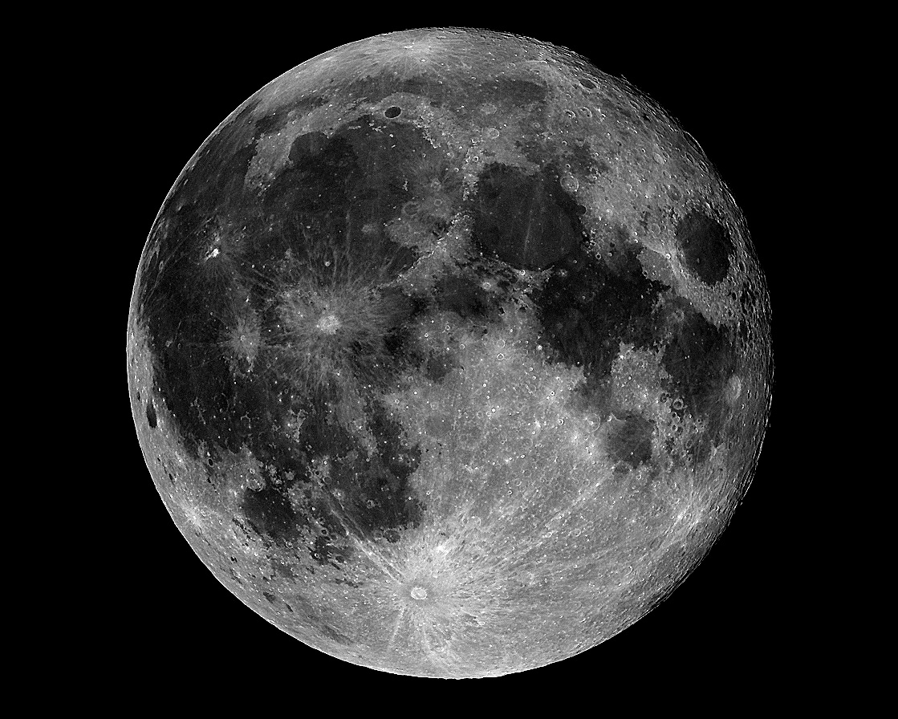
Resolution
Resolution of the human eye is 1 am = 60 as.
Anything smaller than the resolution is
invisible or looks only like a dot (if bright)
Stars are points in
all telescopes:
Calculated size of a star:
~ 0.001 as,
Resolution of best telescope:
~ 0.1 as.
Much more detail is visible
Resolution of a simple telescope is ~ 1 as

Slide 7
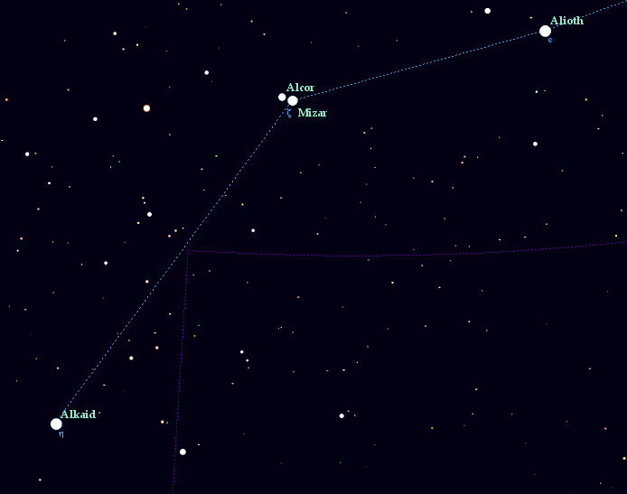
Example for resolution: Alcor and Mizar
In a telescope’s view
Alcor
25 am
25 am
Mizar A & B
14 as
The handle of the Big Dipper:
the middle star is a double
How far apart are Alcor and Mizar?
25 am

Slide 8
Questions coming …

Slide 9
Question 7
sec
30
29
28
27
26
25
24
23
22
21
20
18
17
16
15
14
13
12
11
10
9
8
7
6
5
4
3
2
1
0
19
How do stars look in the largest telescope of the world?
A Like large disks.
B Disks with clouds visible on them.
C Tiny disks with a few starspots.
D Points (no details visible).
E They are “star-shaped” with rays emanating from them.
Next question coming …

Slide 10
Question 8
sec
30
29
28
27
26
25
24
23
22
21
20
18
17
16
15
14
13
12
11
10
9
8
7
6
5
4
3
2
1
0
19
The two stars Alcor and Mizar are easily separated by the human eye.
This means that they must be farther apart than …
A a few degrees
B one arc minute.
C a few light years.
D a few million kilometers.
E a million light years.

Slide 11
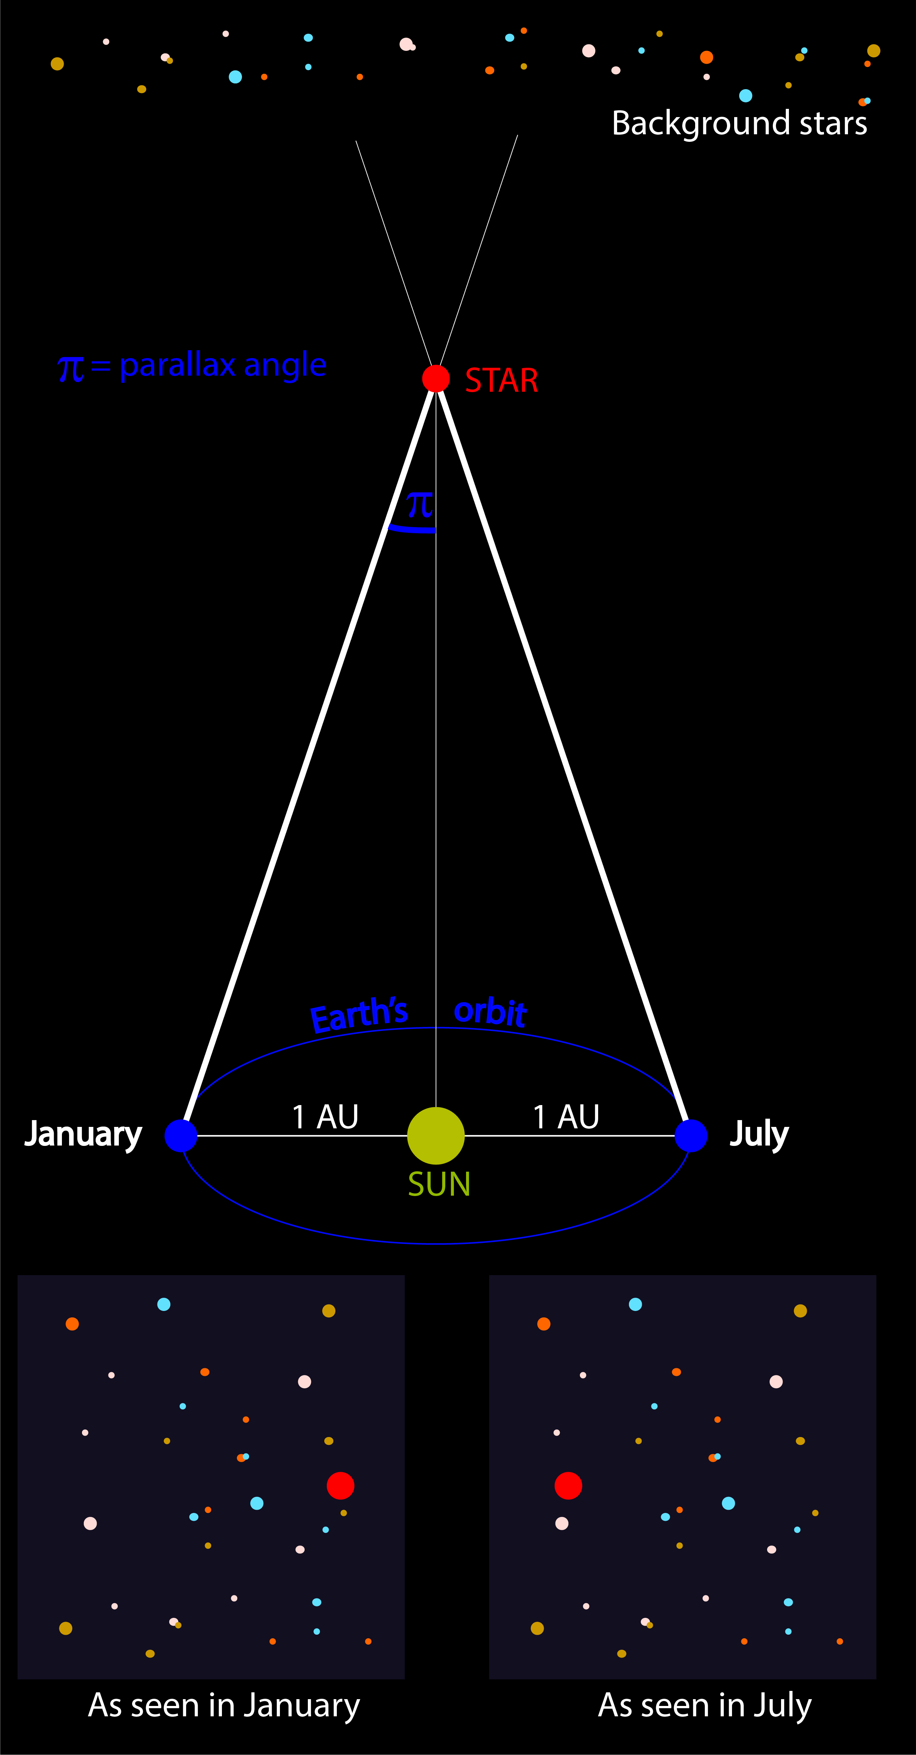
Parallax
How do we know
the distance to the stars?
(Close-by stars, for a start.)
• Close-by stars seem to move on tiny ellipses,
once a year
• Reflection of the motion of Earth around the Sun
• Most (far-away) stars move very little
Measure parallax:
the closer the star, the larger the ellipse
Parallax = 1 as ↔ distance 1 parsec (pc)
1 pc = 3.26 light years
Formula: distance[pc] = 1/parallax[as]
Practical limit on precision: Gaia spacecraft
• 0.1 mas (limits distance to ~ 2 kpc,
a bit beyond the Solar neighborhood)
• stars brighter than 17 mg

Slide 12
Parallax
The closer the star, the larger the ellipse
Parallax = 1 as ↔ distance 1 parsec (pc)
1 pc = 3.26 light years
Formula: distance[pc] = 1/parallax[as]
• Close-by stars seem to move on
tiny ellipses, once a year
Note: 1 mas = 0.001 as
Examples:
Proxima Centauri: distance 4 ly = 1.3 pc (very close)
parallax 0.7 as (observable with a large telescope)
Regulus (α Leonis): distance 79 ly = 24 pc (in Solar Neighborhood)
parallax 0.04 as
Betelgeuse (α Orionis): distance 520 ly = 160 pc (still in Solar Neighborhood)
parallax 6.3 mas (tiny but still observable)
Center of the Galaxy: distance 25,000 ly = 8,000 pc
parallax 0.125 mas (unobservably tiny)
Andromeda galaxy: distance 2 million ly = 700,000 pc
parallax 0.00013 mas (unobservably tiny)

Slide 13
Questions coming …

Slide 14
Question 9
sec
30
29
28
27
26
25
24
23
22
21
20
18
17
16
15
14
13
12
11
10
9
8
7
6
5
4
3
2
1
0
19
What is parallax?
A Far away stars appear dimmer in the sky.
B Stars make one loop around the whole sky in one year.
C Stars move in tiny ellipses in the sky, once a year.
D The telescope must follow the star’s apparent daily motion.
Next question coming …

Slide 15
Question 10
sec
30
29
28
27
26
25
24
23
22
21
20
18
17
16
15
14
13
12
11
10
9
8
7
6
5
4
3
2
1
0
19
How large an effect is parallax?
A Very large: stars move all the way around the sky in a year.
B Large. You can see it by the naked eye without any difficulty.
C Tiny. We need a very precise telescope to detect it.
D Extremely tiny, invisible even with the largest telescopes.
Next question coming …

Slide 16
Question 11
sec
45
40
35
30
25
19
18
17
16
15
14
13
12
11
10
9
8
7
6
4
3
2
1
0
20
5
(45)
Polaris, the North Star, has its parallax measured
as 0.01 arc seconds. How far is it?
A One parsec. (That would be ~ 3 light years.)
B A tenth of a parsec. (That would be ~ 1/3 of a light year.)
C A hundred parsecs. (That would be ~ 300 light years.)
D Ten parsecs. (That would be ~ 30 light years.)
E A thousand parsecs. (That would be ~ 3000 light years.)

Slide 17
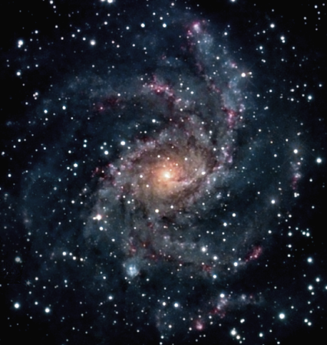
Apparent and absolute brightness
Recall:
A parsec (pc) is a unit of distance, 3.26 light years.
Why this unit?
Because the orbit of Earth looks 1 arc sec radius from the distance of 1 pc.
How bright it looks
(m)
How bright it really is
(M)
Solar neighborhood (~100 pc)
A star’s absolute magnitude is
how bright it would look
from 10 pc (32.6 light years) away.
The Sun: M = 5^{mg}
(an average star)

Slide 18
Questions coming …

Slide 19
Question 12
sec
30
29
28
27
26
25
24
23
22
21
20
18
17
16
15
14
13
12
11
10
9
8
7
6
5
4
3
2
1
0
19
What is absolute magnitude of a star?
A It is how bright the star looks from the center of the Galaxy.
B It is how bright the star would look from a distance of 10 parsecs.
C It is how bright the star was when it was born.
D It is how bright the star looks in very good weather.
E It is how bright the star looks from space.
Next question coming …

Slide 20
Question 13
sec
30
29
28
27
26
25
24
23
22
21
20
18
17
16
15
14
13
12
11
10
9
8
7
6
5
4
3
2
1
0
19
How bright would the Sun look in the sky
from a distance of 10 parsecs?
A -12^{mg} (as bright as the full Moon).
B 1^{mg} (as bright as the brightest stars in the sky).
C 5^{mg} (barely visible to the naked eye).
D 15^{mg} (very faint).
E Invisible: we cannot see that far.
Next question coming …

Slide 21
Question 14
sec
30
29
28
27
26
25
24
23
22
21
20
18
17
16
15
14
13
12
11
10
9
8
7
6
5
4
3
2
1
0
19
Polaris, the North Star, is m = 2^{mg}, not particularly
bright. Its absolute magnitude is M = - 4^{mg}.
If you imagine Polaris placed where the Sun is now,
would it look brighter, or fainter than the Sun?
A Ten thousand times brighter.
B Somewhat brighter.
C About the same.
D Somewhat fainter.
E Ten thousand times fainter.

Slide 22
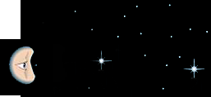
Distance makes stars dimmer
The rule: 2.5 times as far away, looks 2^{mg} dimmer
Star A and star B have the same absolute magnitude M = 5^{mg}
Star B is 10 pc away: apparent magnitude m = 5^{mg}
Star A is 25 pc away: apparent magnitude m = 7^{mg}
Reality:
Looks like:
10 pc
B
B
25 pc
A
A

Slide 23
Distance modulus
The distance modulus
Relation: M (abs. magn.), m (appt. magn.), d (distance in pc)
Meaning of relation: the farther a star, the fainter it looks
Distance modulus: Δ = m – M
Relation to distance: Δ = 5 × lg d - 5
or: d = 10^{Δ/5+1}
How to use this?
Suppose you know two of:
d (the distance),
m (the apparent brightness),
M (the absolute magnitude
one can calculate the third.
Centauri suppose we know the apparent brightness m = 1.3^{mg} (a bright star)
and the distance 4 light years = 1.3 pc (very close to us)
=> distance modulus Δ = 5 × lg d - 5 = - 4.4 mg
=> absolute magnitude M = m – Δ = 5.7^{mg} , (star a bit ‘smaller’ than the Sun)
Centauri suppose we know the apparent brightness m = 3.5^{mg} (reasonably bright)
and the absolute magnitude M = -10.1^{mg} (a globular cluster)
=> distance modulus Δ = m – M = 13.6 mg
=> distance d = 10^{Δ/5+1} = 5200 pc = 17,000 light years
(very far from us, halfway to the center of the Galaxy)

Slide 24
Questions coming …

Slide 25
Question 15
sec
30
29
28
27
26
25
24
23
22
21
20
18
17
16
15
14
13
12
11
10
9
8
7
6
5
4
3
2
1
0
19
What is distance modulus?
A The distance to a star in parsecs.
B The distance to a star in light years.
C The difference between apparent and absolute magnitude.
D The reciprocal of a star’s parallax.
E The total energy radiated by a star every second.
Next question coming …

Slide 26
Question 16
sec
30
29
28
27
26
25
24
23
22
21
20
18
17
16
15
14
13
12
11
10
9
8
7
6
5
4
3
2
1
0
19
What quantity can be calculated from distance
modulus without any additional input?
A The apparent magnitude.
B The absolute magnitude.
C The speed of motion.
D The diameter.
E The distance.
Next question coming …

Slide 27
Question 17
sec
30
29
28
27
26
25
24
23
22
21
20
18
17
16
15
14
13
12
11
10
9
8
7
6
5
4
3
2
1
0
19
In order to calculate the distance to a star, what data do you need in addition to its apparent magnitude?
A Its size (as in miles).
B Its size (as in arc seconds).
C Its speed of motion.
D Its absolute magnitude.
E Its temperature.

