Slide 1
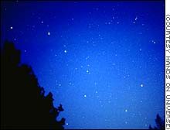
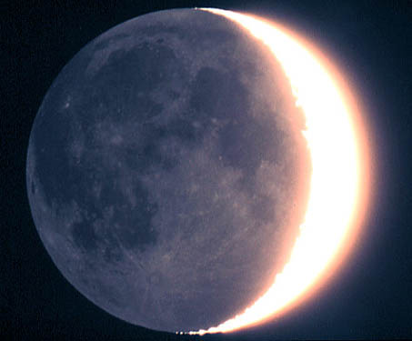
Angular sizes
How large is the Big Dipper?
25⁰ apparent size
Stretch out your hand:
1 cm = 1º
25º
1º = 60 am (minute of arc)
1 am = 60 as (second of arc)
How large is the Moon?
1/2 ⁰ apparent size
1/2º = 30 am = 1800 as
0.5º

Slide 2
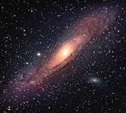
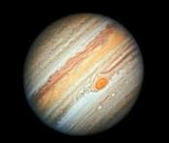

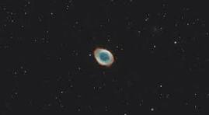
Examples:
How large is this galaxy?
3 degrees ~ 10,000 as
(That is,
how large does
each of these look?)
How large is Jupiter?
40 as
How large is Neptune?
2.4 as
How large is this planetary nebula?
85 as

Slide 3
Questions coming …

Slide 4
Question 13
sec
30
29
28
27
26
25
24
23
22
21
20
18
17
16
15
14
13
12
11
10
9
8
7
6
5
4
3
2
1
0
19
How large does the Moon appear in the sky?
A A few inches.
B A few thousand miles.
C A few arc seconds.
D A light year.
E A half a degree.
Next question coming …

Slide 5
Question 14
sec
30
29
28
27
26
25
24
23
22
21
20
18
17
16
15
14
13
12
11
10
9
8
7
6
5
4
3
2
1
0
19
How large is the Big Dipper?
A A few miles.
B A few light years.
C Five million light years.
D More than twenty degrees.
E A half a degree.

