Slide 1
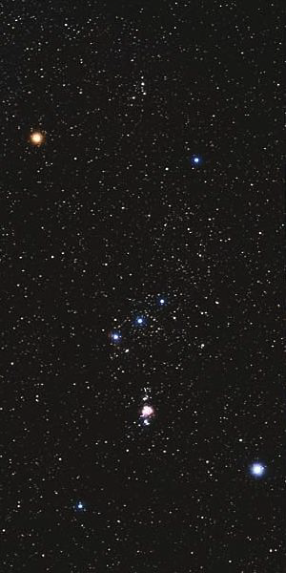
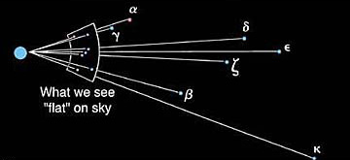
Constellations and designations of stars
Constellation = random collection
of stars (figure)
α
γ
Stars’ names:
Greek letter + constellation name
Orionis (= Betelgeuse)
γ Orionis (⇒ No special name)
α Canis Majoris (= Sirius)
ζ
β
κ

Slide 2
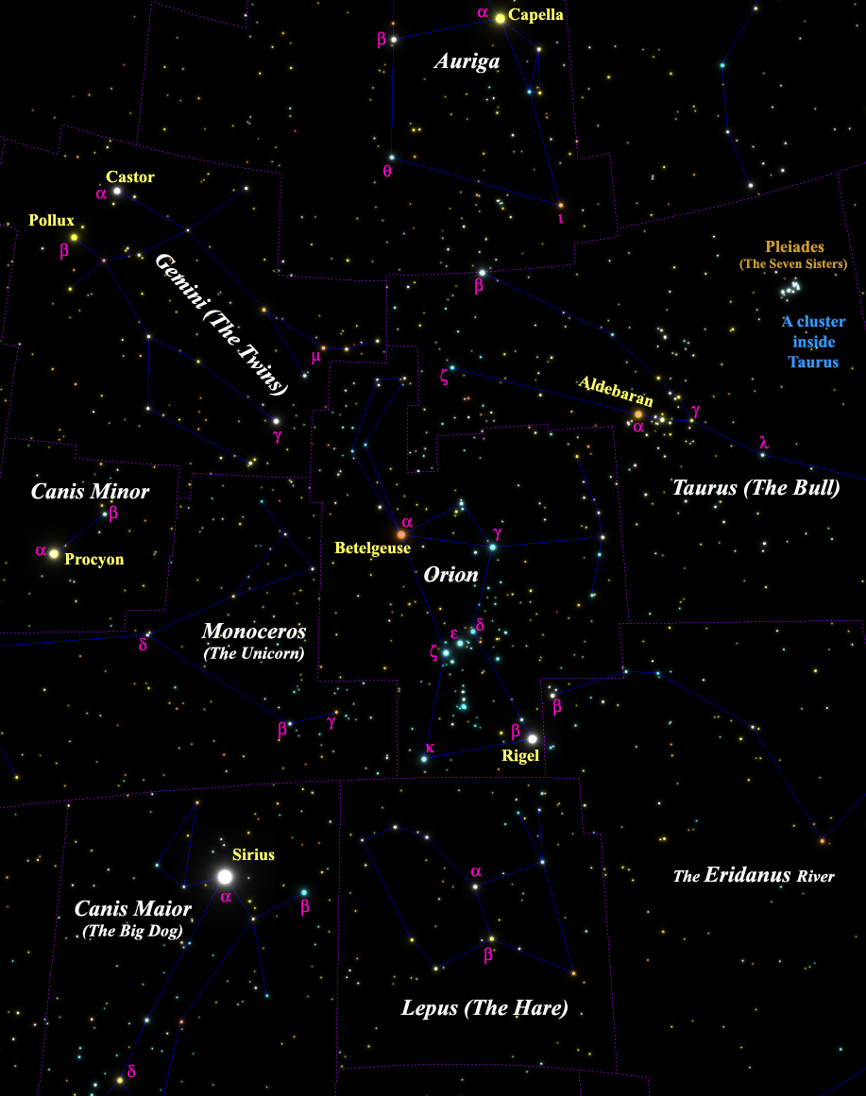
More star names - examples
Find:
Leporis
Geminorum
Tauri
A few distances:
Canis Maioris - 9 ly
β Canis Maioris - 500 ly
δ Canis Maioris - 1,800 ly
Canis Maioris - 430 ly
95% of the 5,000 naked-eye stars are at 50 to 500 ly:
in the solar neighborhood.

Slide 3
Questions coming …

Slide 4
Question 7
sec
30
29
28
27
26
25
24
23
22
21
20
18
17
16
15
14
13
12
11
10
9
8
7
6
5
4
3
2
1
0
19
What is β Canis Maioris?
A The name of a bright star.
B The name of a planet.
C The name of a constellation.
D A galaxy.
E The name of a moon revolving
around the planet α Canis Maioris.
Next question coming …

Slide 5
Question 8
sec
30
29
28
27
26
25
24
23
22
21
20
18
17
16
15
14
13
12
11
10
9
8
7
6
5
4
3
2
1
0
19
The Pleiades (the “Seven Sisters”) is …
A A constellation.
B A star.
C Not a constellation, but it is a star cluster inside
the constellation of Taurus.
D A constellation, which is the same thing as a star cluster.
E A collection of seven random stars, unrelated to each other.

Slide 6
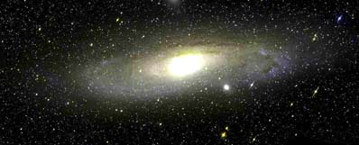
(Hipparchos
~ 170 BC)
Understand brightness of stars: the magnitude scale
An m = 10^{mg,} star,
need
an amateur telescope
to see it
The Andromeda Galaxy
m = 3^{mg} in total
An m = 17^{mg,} star,
need
a professional telescope
to see it
Magnitudes mean brightness:
• The larger the number, the fainter the object
• One magnitude difference means a lot dimmer (2.5 times)
A fifth magnitude star: m = 5^{mg,},
just visible to the naked eye
A third magnitude star: m = 3^{mg}
A second magnitude star: m = 2^{mg}
__
I
A first magnitude star: m = 1^{mg}
m = -2.5 × lg
I
Vega

