Slide 1
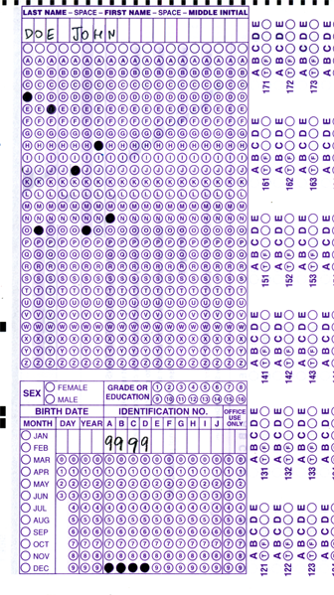

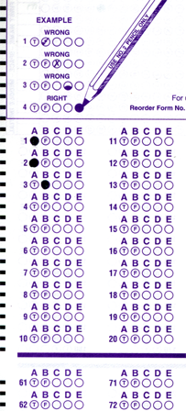
Setup:
Prepare your scantron:
Use
a pencil,
not a pen!
Fill in your name and fill the bubbles under
your name.
LAST NAME FIRST, First name second
Put your 4-digit code instead of “IDENTIFICATION NUMBER”.
--- (The last 4 digits of your OleMiss ID.)
Don’t forget: you’ll need
a new scantron for next class!
Question # 1: answer A
Question # 2: answer A
Question # 3: answer B
Reading assignment
Chapter 1, The Universe, pp. 1 – 23
(skip the math)
Please take a moment to mute your cell phone!

Slide 2
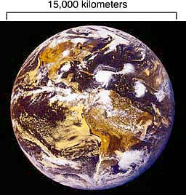
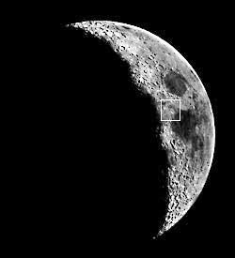
The hierarchy of the Universe, Step 1
The hierarchy of the Universe
Step 1:
Memorize this, please: ~13,000 km
Size : 12,756 km = 7972 miles
Size: 3476 km
Earth
Moon
Distance: 384,400 km

Slide 3
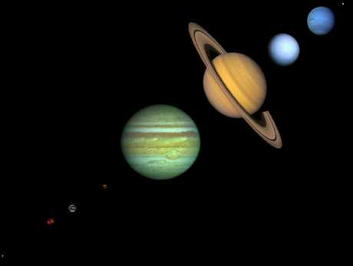
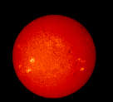
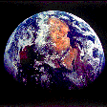
The hierarchy of the Universe, Step 2
Step 2: the Solar System
The
Sun
is a
STAR
Planets
The planets revolve around the Sun
and reflect sunlight
(asteroids and comets, too, except they are much smaller)
Distance = 150 million km
= 1 AU
Earth
Distance = 400,000 km
(Astronomical Unit)
Memorize this, please!

Slide 4
Questions coming …

Slide 5
Question 4
sec
30
29
28
27
26
25
24
23
22
21
20
18
17
16
15
14
13
12
11
10
9
8
7
6
5
4
3
2
1
0
19
How many stars are there in the Solar System?
A None
B One
C Nine
D Six thousand
E Billions
Next question coming …

Slide 6
Question 5
sec
30
29
28
27
26
25
24
23
22
21
20
18
17
16
15
14
13
12
11
10
9
8
7
6
5
4
3
2
1
0
19
A comet orbits around …
A nothing
B Earth
C the Sun
D a planet
E the center of the Galaxy

Slide 7



The hierarchy of the Universe, Step 3
Step 3: Stars
Each star may come with its own planets
(we cannot see these planets directly: too small and far away)
Star
Star
Sun
Star
Distance = a few light years
1 light year = 10,000 billion km (= 10¹³ km)
Star
Star
The closest star (except the Sun): Proxima Centauri - 4 light years

Slide 8
Questions coming …

Slide 9
Question 6
sec
30
29
28
27
26
25
24
23
22
21
20
18
17
16
15
14
13
12
11
10
9
8
7
6
5
4
3
2
1
0
19
What is a light year?
A A time as long as the lifetime of a star.
B A long time. Stars live a lot longer than one light year.
C A distance. The closest stars are a few light years away.
D A large distance. The distance between stars is much
less than one light year.
E A large distance. The size of the whole Universe is a
few light years.

Slide 10
Question 7
sec
30
29
28
27
26
25
24
23
22
21
20
18
17
16
15
14
13
12
11
10
9
8
7
6
5
4
3
2
1
0
19
Where do stars and planets get their light from?
A all from the Sun
B stars: from the Galaxy, planets: from the Sun
C all glow on their own
D all from the Galaxy
E none of these answers are correct: stars glow on their own, planets get their light from the Sun

Slide 11
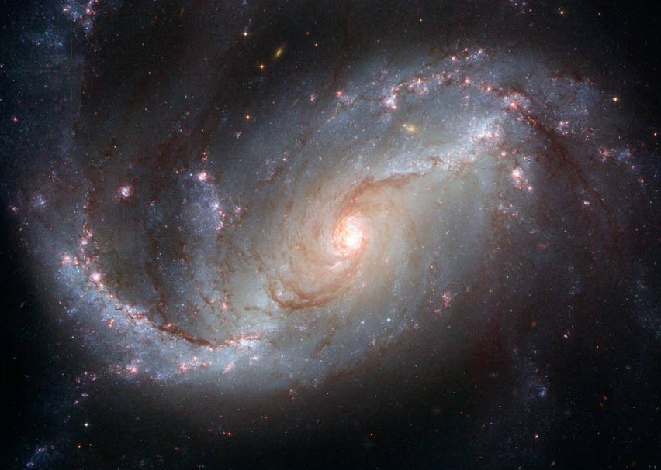
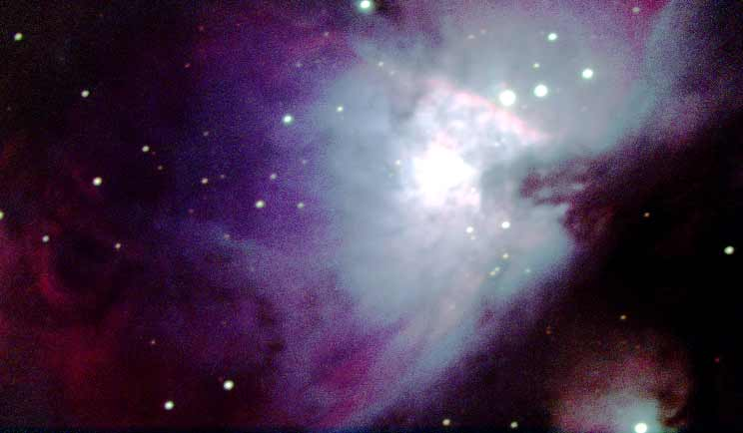
The hierarchy of the Universe, Step 4
~ 100,000 light years
Consists of
~ 100 billion
stars and a
little rare gas
between
the stars.
Where this gas
is a little less rare,
it glows
and is called
a nebula:
The
Milky
Way
is a
galaxy:
the
Galaxy
Sun
Step 4: the Milky Way

Slide 12
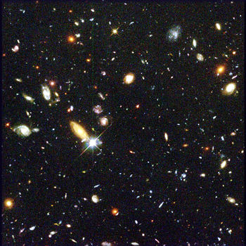
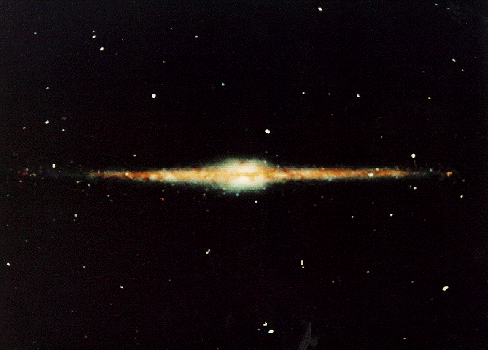
The hierarchy of the Universe, Step 5
Step 5: The whole Universe
Consists of
~ 1000 billion
galaxies.
Radius:
14 billion light years
The
Milky Way
is like this
Distance = 400,000 km

Slide 13
Questions coming …

Slide 14
Question 8
sec
30
29
28
27
26
25
24
23
22
21
20
18
17
16
15
14
13
12
11
10
9
8
7
6
5
4
3
2
1
0
19
Which of the following is wrong?
A The Universe consists of galaxies.
B Galaxies consist of stars.
C The solar system consists of one star and eight planets.
D Planets get their light from their stars.
E All the above is correct.
Next question coming …

Slide 15
Question 9
sec
30
29
28
27
26
25
24
23
22
21
20
18
17
16
15
14
13
12
11
10
9
8
7
6
5
4
3
2
1
0
19
Where is the Sun located in the Universe?
A In space, far away from all galaxies.
B In the center of the Galaxy.
C In a nondescript location in the Galaxy.
D In the middle of a large spiral arm of the Galaxy.
E In the center of the Universe.

