Slide 1

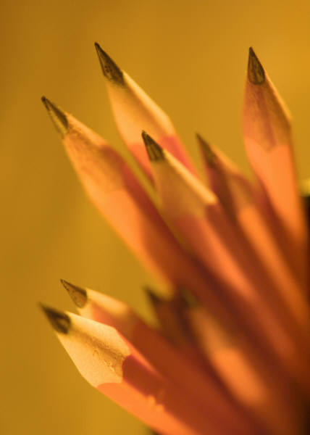
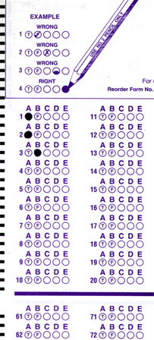
Setup:
Prepare your scantron:
Use
a pencil,
not a pen!
Fill in your name and fill the bubbles under
your name.
LAST NAME FIRST, First name second
Put your 4-digit code instead of “IDENTIFICATION NUMBER”.
--- (The last 4 digits of your OleMiss ID.)
Recall last reading assignment
Telescopes, Chapter 6, pp. 165-189
Question # 1: answer B
Question # 2: answer E
Question # 3: answer B
Final test times:
- Wednesday 12:00-2:00
- Thursday 4:00-6:00
TA evaluations today
Please take a moment to mute your cell phone!

Slide 2
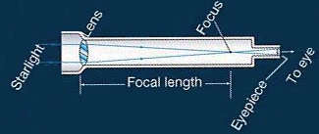
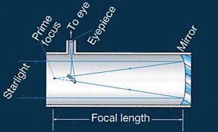
Astronomical telescopes
How do they work?
Use eyepiece to
watch image
Refractor:
Lens collects light
Use eyepiece to
watch image
Reflector:
Mirror collects light
Diameter:
2”-5” toy
6”-30” amateur
3’-10’ professional
10’-33’ super
Large lens/mirror collects much light -
the diameter of the telescope
is the important indicator.

Slide 3
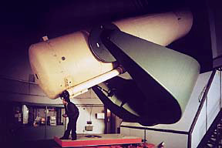
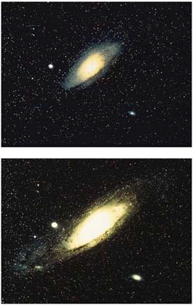
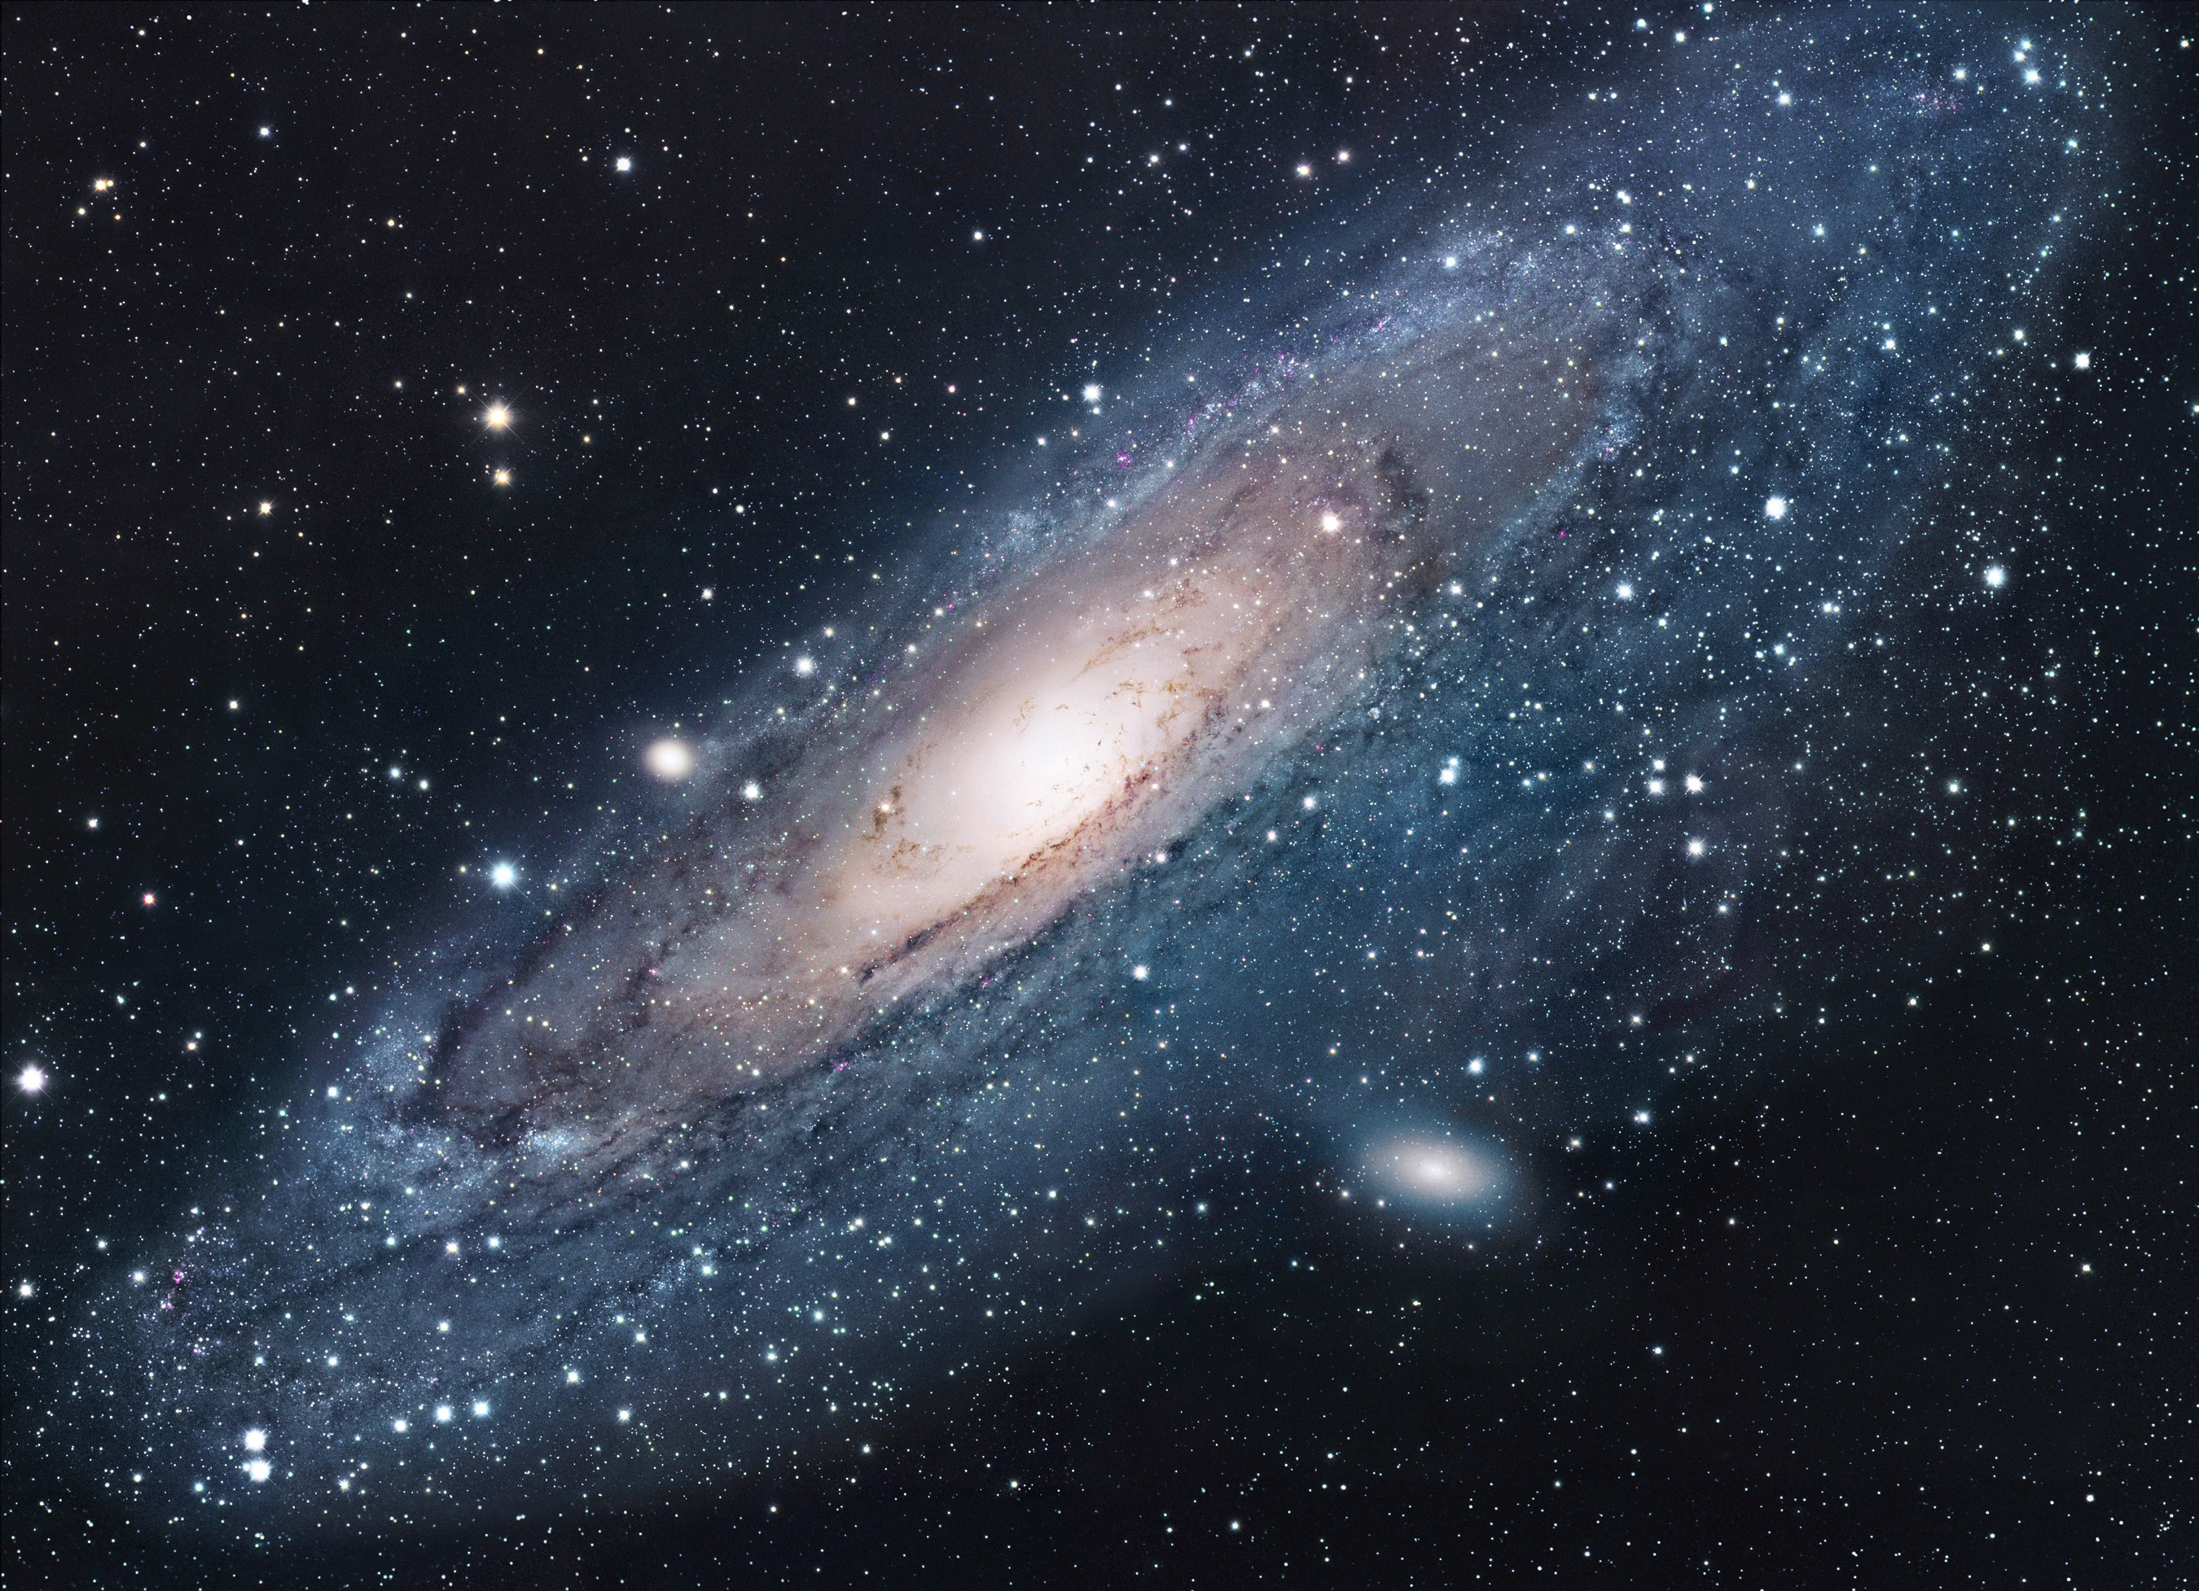
Why do we need telescopes?
To collect much light
- need large diameter
To make small objects look large
- need magnification
Limits to light collection:
Diameter ~ 10 m (30 feet) would be too heavy to hold
(Three larger ones with segmented mirrors are being built.)
little light
Limits to magnification:
“Seeing” - stars jump around (related to twinkling)
- caused by air turbulence
much light

Slide 4
Questions coming …

Slide 5
Question 4
sec
30
29
28
27
26
25
24
23
22
21
20
18
17
16
15
14
13
12
11
10
9
8
7
6
5
4
3
2
1
0
19
Which of the following is the most important measure of a telescope?
A The magnification.
B The diameter of its mirror (or lens).
C The focal length of its mirror (or lens).
D The length of the telescope.
E The distance of the farthest object it can see.
Next question coming …

Slide 6
Question 5
sec
30
29
28
27
26
25
24
23
22
21
20
18
17
16
15
14
13
12
11
10
9
8
7
6
5
4
3
2
1
0
19
The largest telescope we have at Ole Miss
is 15 inches. What category is that?
A Large professional.
B Average professional.
C A decent amateur size.
D A small amateur size.
E Uselessly small for astronomy.

Slide 7

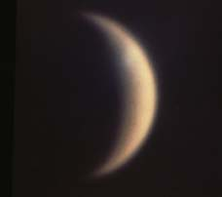
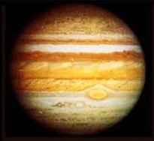
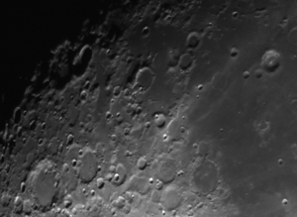
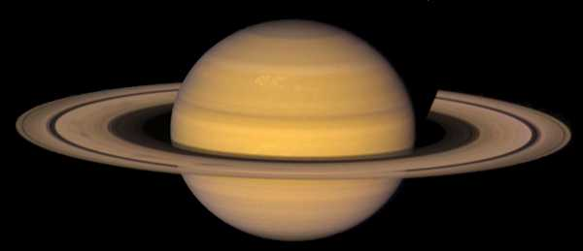
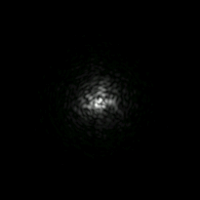
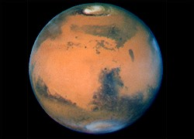
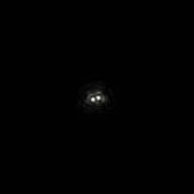
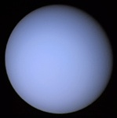
Seeing
: air moves →
stars jump around and twinkle
• 2 to 4 arc seconds in Mississippi
• 1 arc second in good location
• 0.4 arc second on Mauna Kea, Hawaii
Compare sizes:
30 as
Size of “seeing”
Venus
Jup
Sat
Mars
Uranus
Seeing limits magnification to a few hundred at best
Look at a
double star
in good and
in bad
weather:
Bad
seeing
Good
seeing

Slide 8
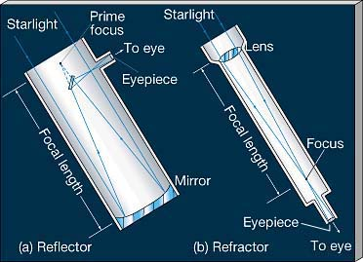
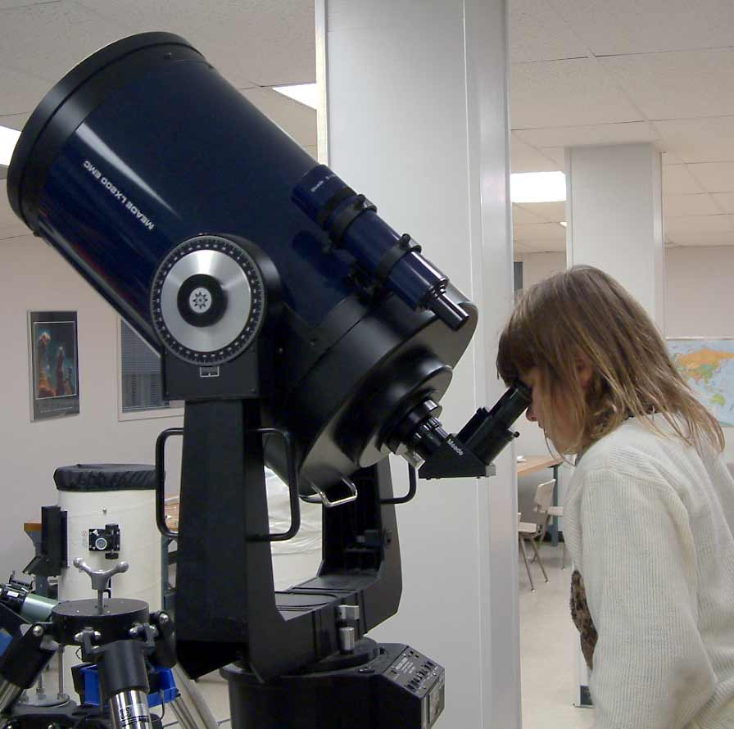
Magnification computed
M = f_{objective}/f_{eyepiece}
Example:
Meade, diameter = 12 inches, f_{obj} = 3048 mm
Resolution: 0.4 as (optical)
1-2 as atmospheric
With f=26 mm eyepiece, M = 117 x
With f=10 mm eyepiece, M = 305 x
With f = 4 mm eyepiece, M = 762 x
Which ones make sense?

Slide 9
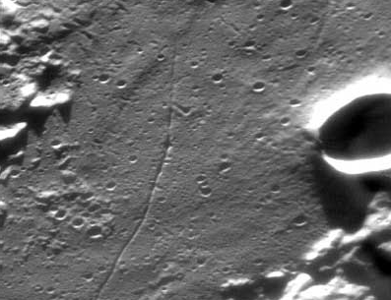
Smallest detail Moon
The smallest detail we can see on the Moon
Crater Cameron
a 1 mile wide rille
(looks 1 as wide)

Slide 10
Questions coming …

Slide 11
Question 6
sec
30
29
28
27
26
25
24
23
22
21
20
18
17
16
15
14
13
12
11
10
9
8
7
6
5
4
3
2
1
0
19
What is seeing?
A The amount of air starlight passes through to reach our eyes.
B The diameter of the blur caused by the atmosphere.
C The amount of light passing through the atmosphere.
D The brightness of a star as it appears to us in the sky.
Next question coming …

Slide 12
Question 7
sec
30
29
28
27
26
25
24
23
22
21
20
18
17
16
15
14
13
12
11
10
9
8
7
6
5
4
3
2
1
0
19
Which of the following limits the magnification of all but the smallest telescopes?
A Optical effects.
B Quality of the lens/mirror.
C Seeing.
D The shaking of the telescope mount.
E Inaccurate tracking.
Next question coming …

Slide 13
Question 8
sec
30
29
28
27
26
25
24
23
22
21
20
18
17
16
15
14
13
12
11
10
9
8
7
6
5
4
3
2
1
0
19
How small is the smallest detail we can still discern on the Moon with a very good telescope?
A 100 miles.
B 1 mile.
C 10 feet.
D 1 foot.
E 1 inch.
Next question coming …

Slide 14
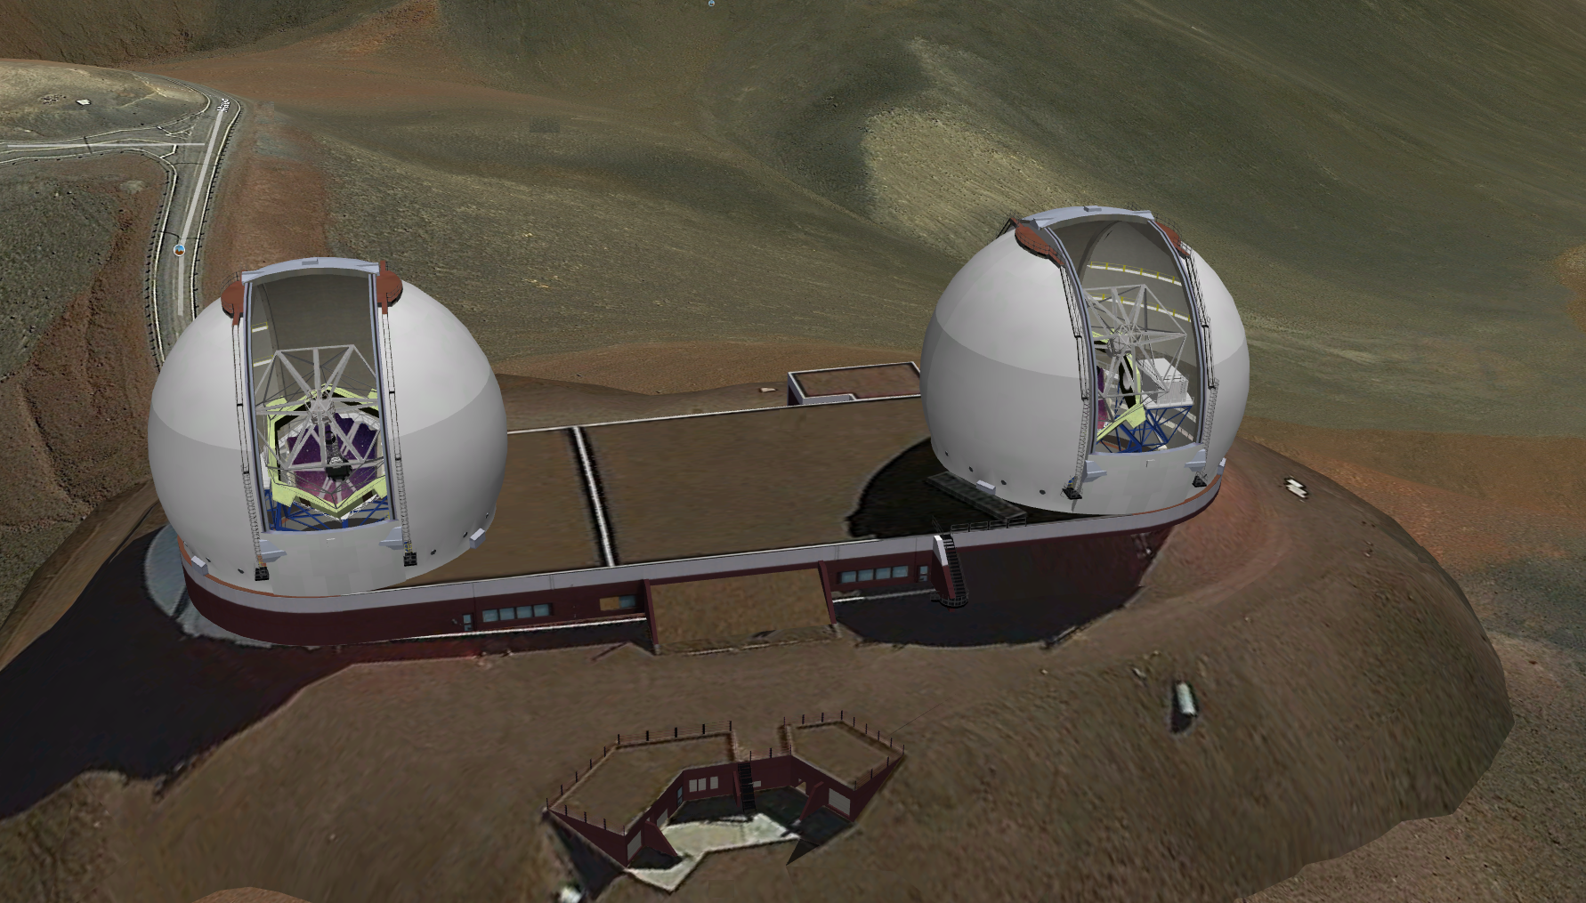
The 10-m Keck telescopes on Mauna Kea, Hawaii
$192 million; first light: 1993

Slide 15
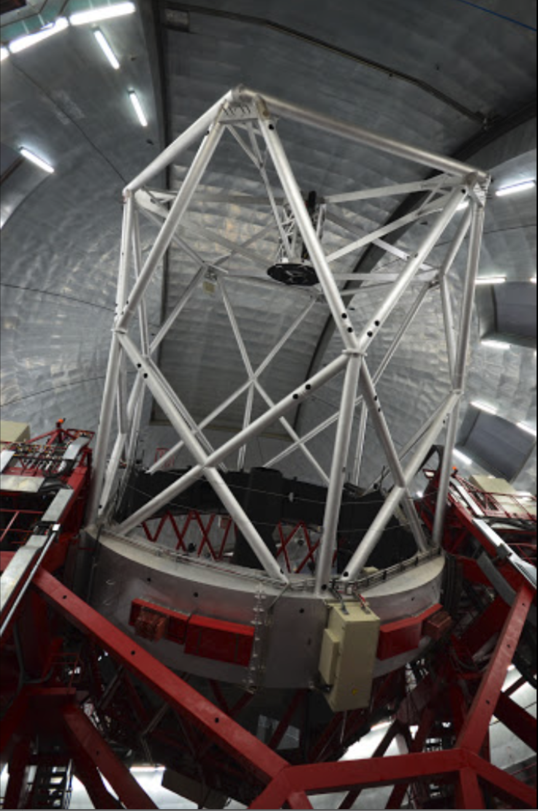
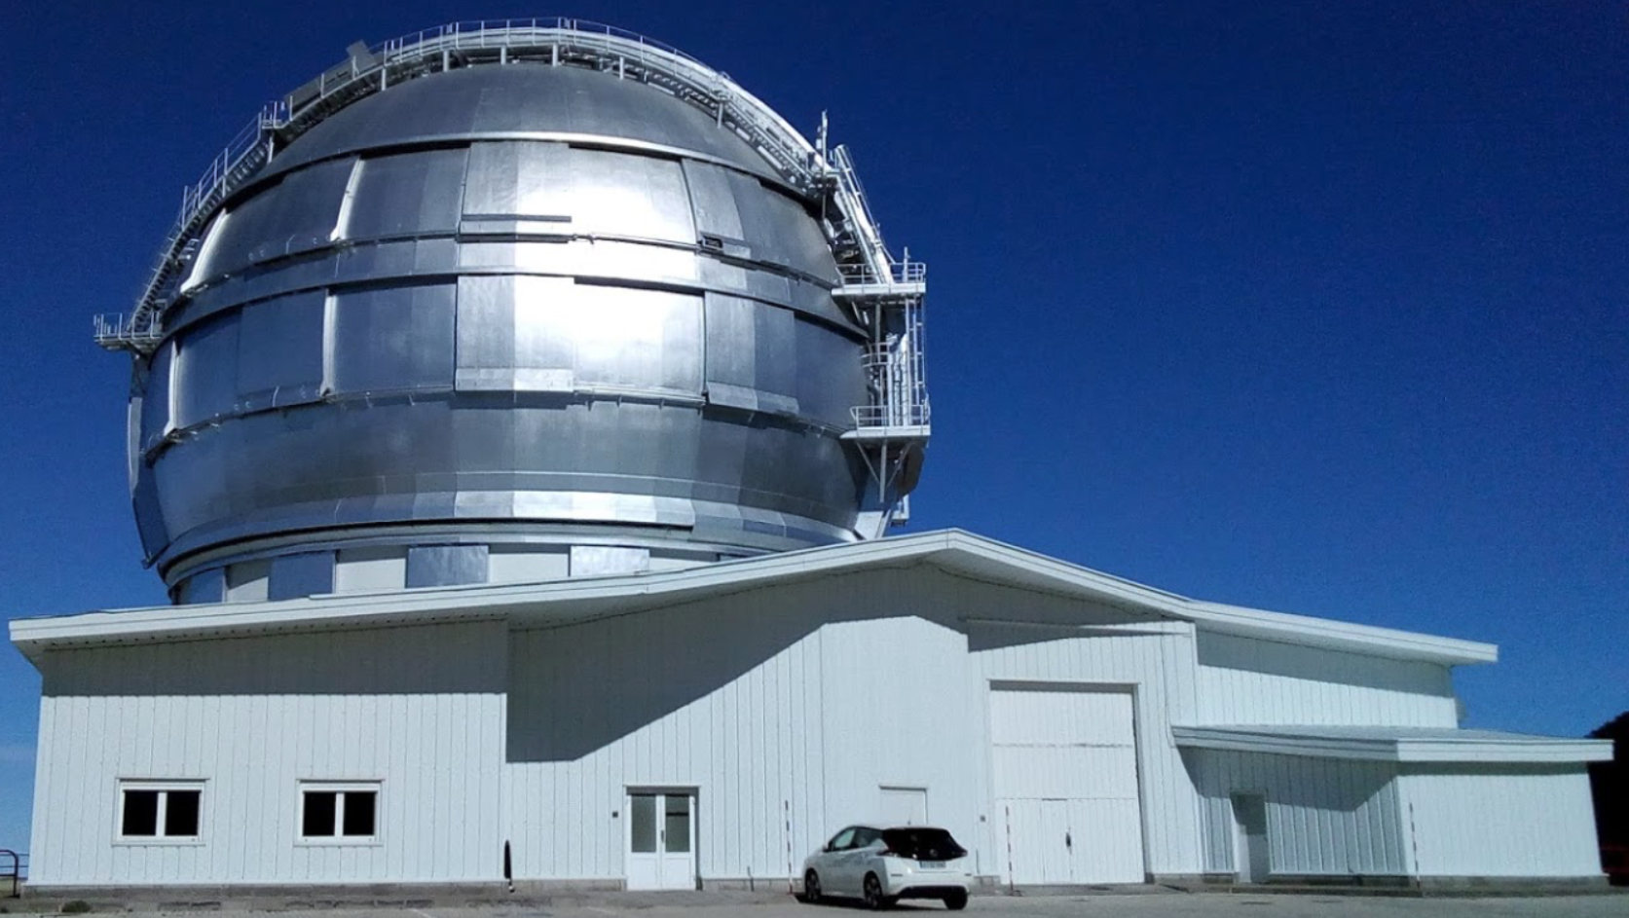
The largest telescope
in the world:
Gran Telescopo Canarias
La Palma Island (Spain)
Diameter: 10.4 m
Worth: $180 million
First light: 2007

Slide 16
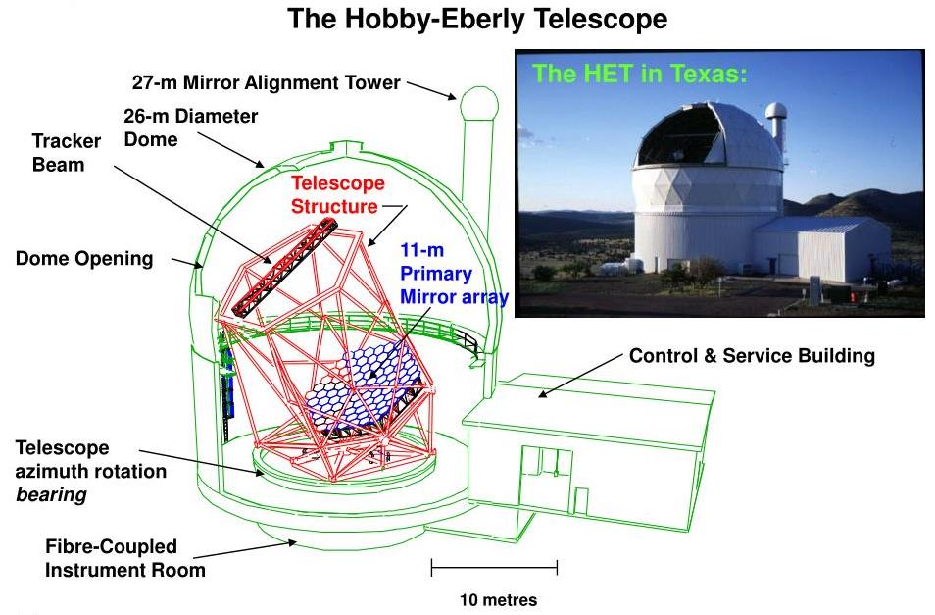
A large telescope with limited motion (58º up) in the Texas desert:
Equivalent diameter: 10 m. Worth: $1 million in 1939 dollars

Slide 17
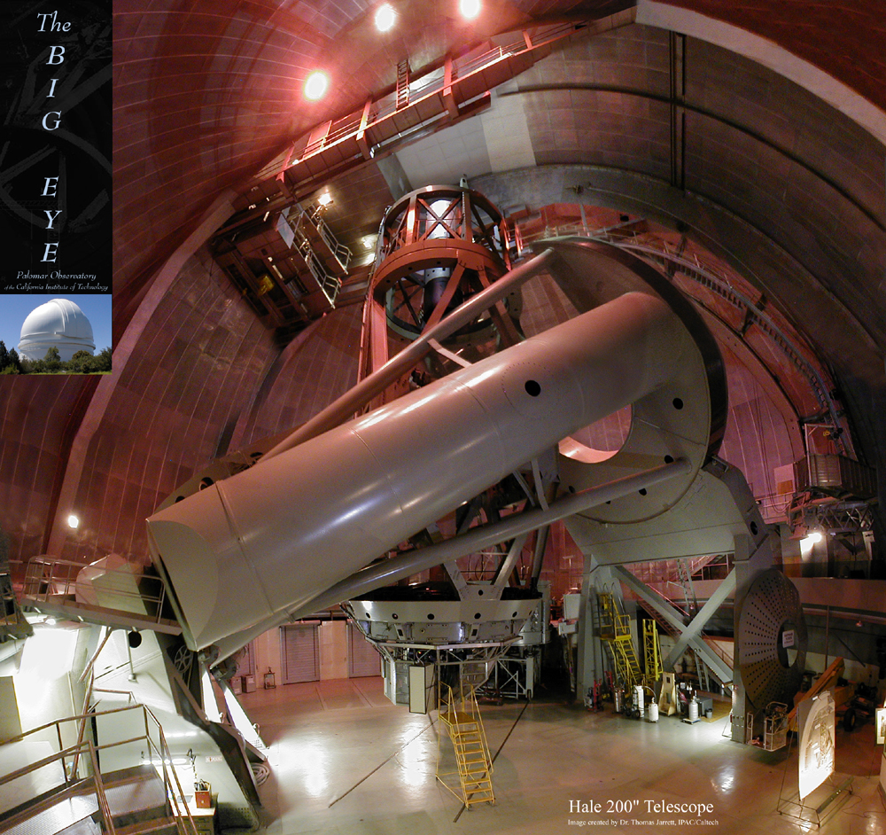
Mt. Palomar
Flagship for a half a century:
(1948-92)
Mt. Palomar Observatory
Observer in cage
California
SW of LA
Diameter:
5 m
Length of tube:
16 m
Main mirror

Slide 18
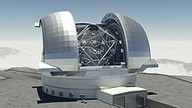
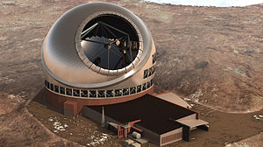
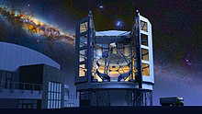
Under construction …
Extremely Large Telescope
Cerro Armazones, Chile
2025 ?
€1.3 billion
Effective diameter: 39.2 m
Thirty Meter Telescope
Mauna Kea, Hawaii
2027 ?
$1.4 billion
Effective diameter: 30 m
Giant Magellan Telescope
Las Campanas, Chile
2025 ?
$ 1 billion
Effective diameter: 24.5 m

Slide 19
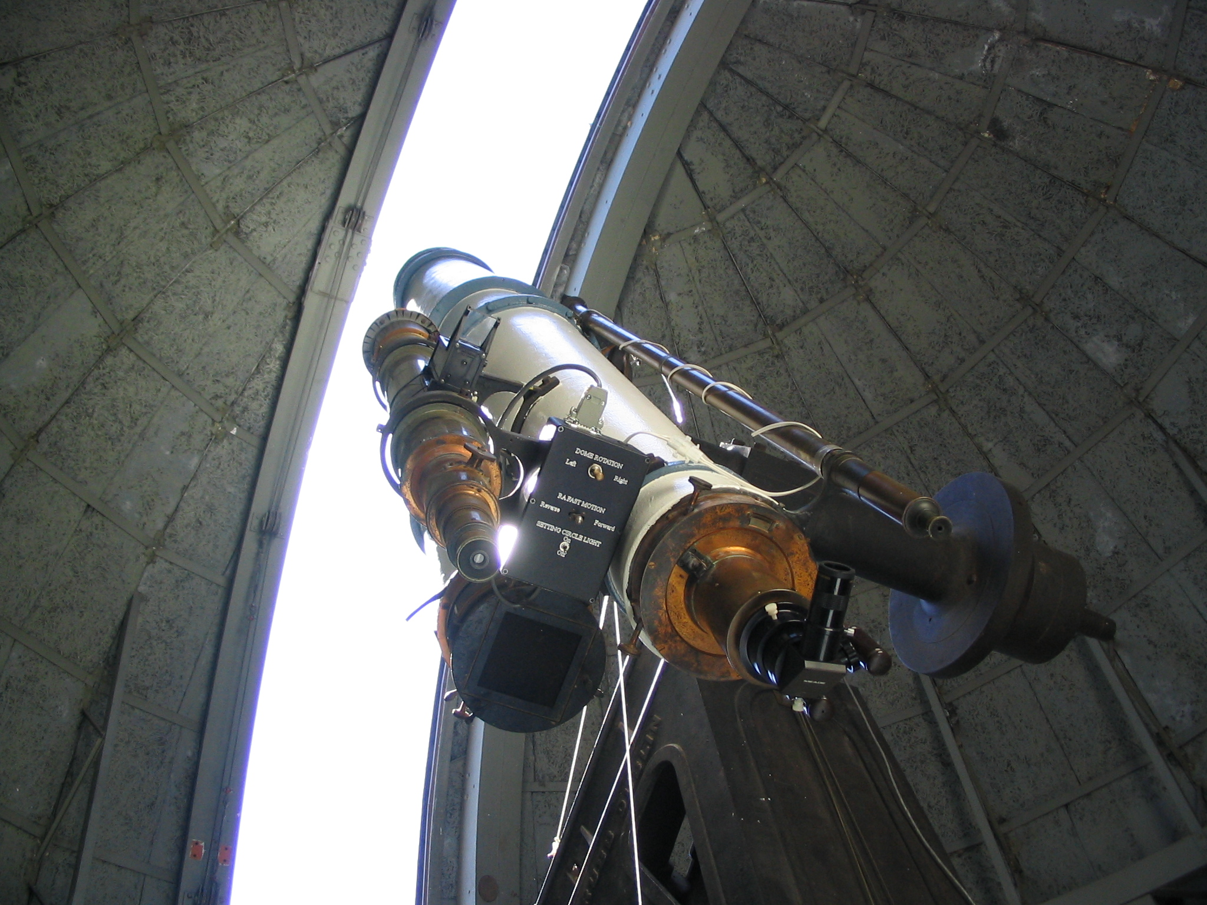
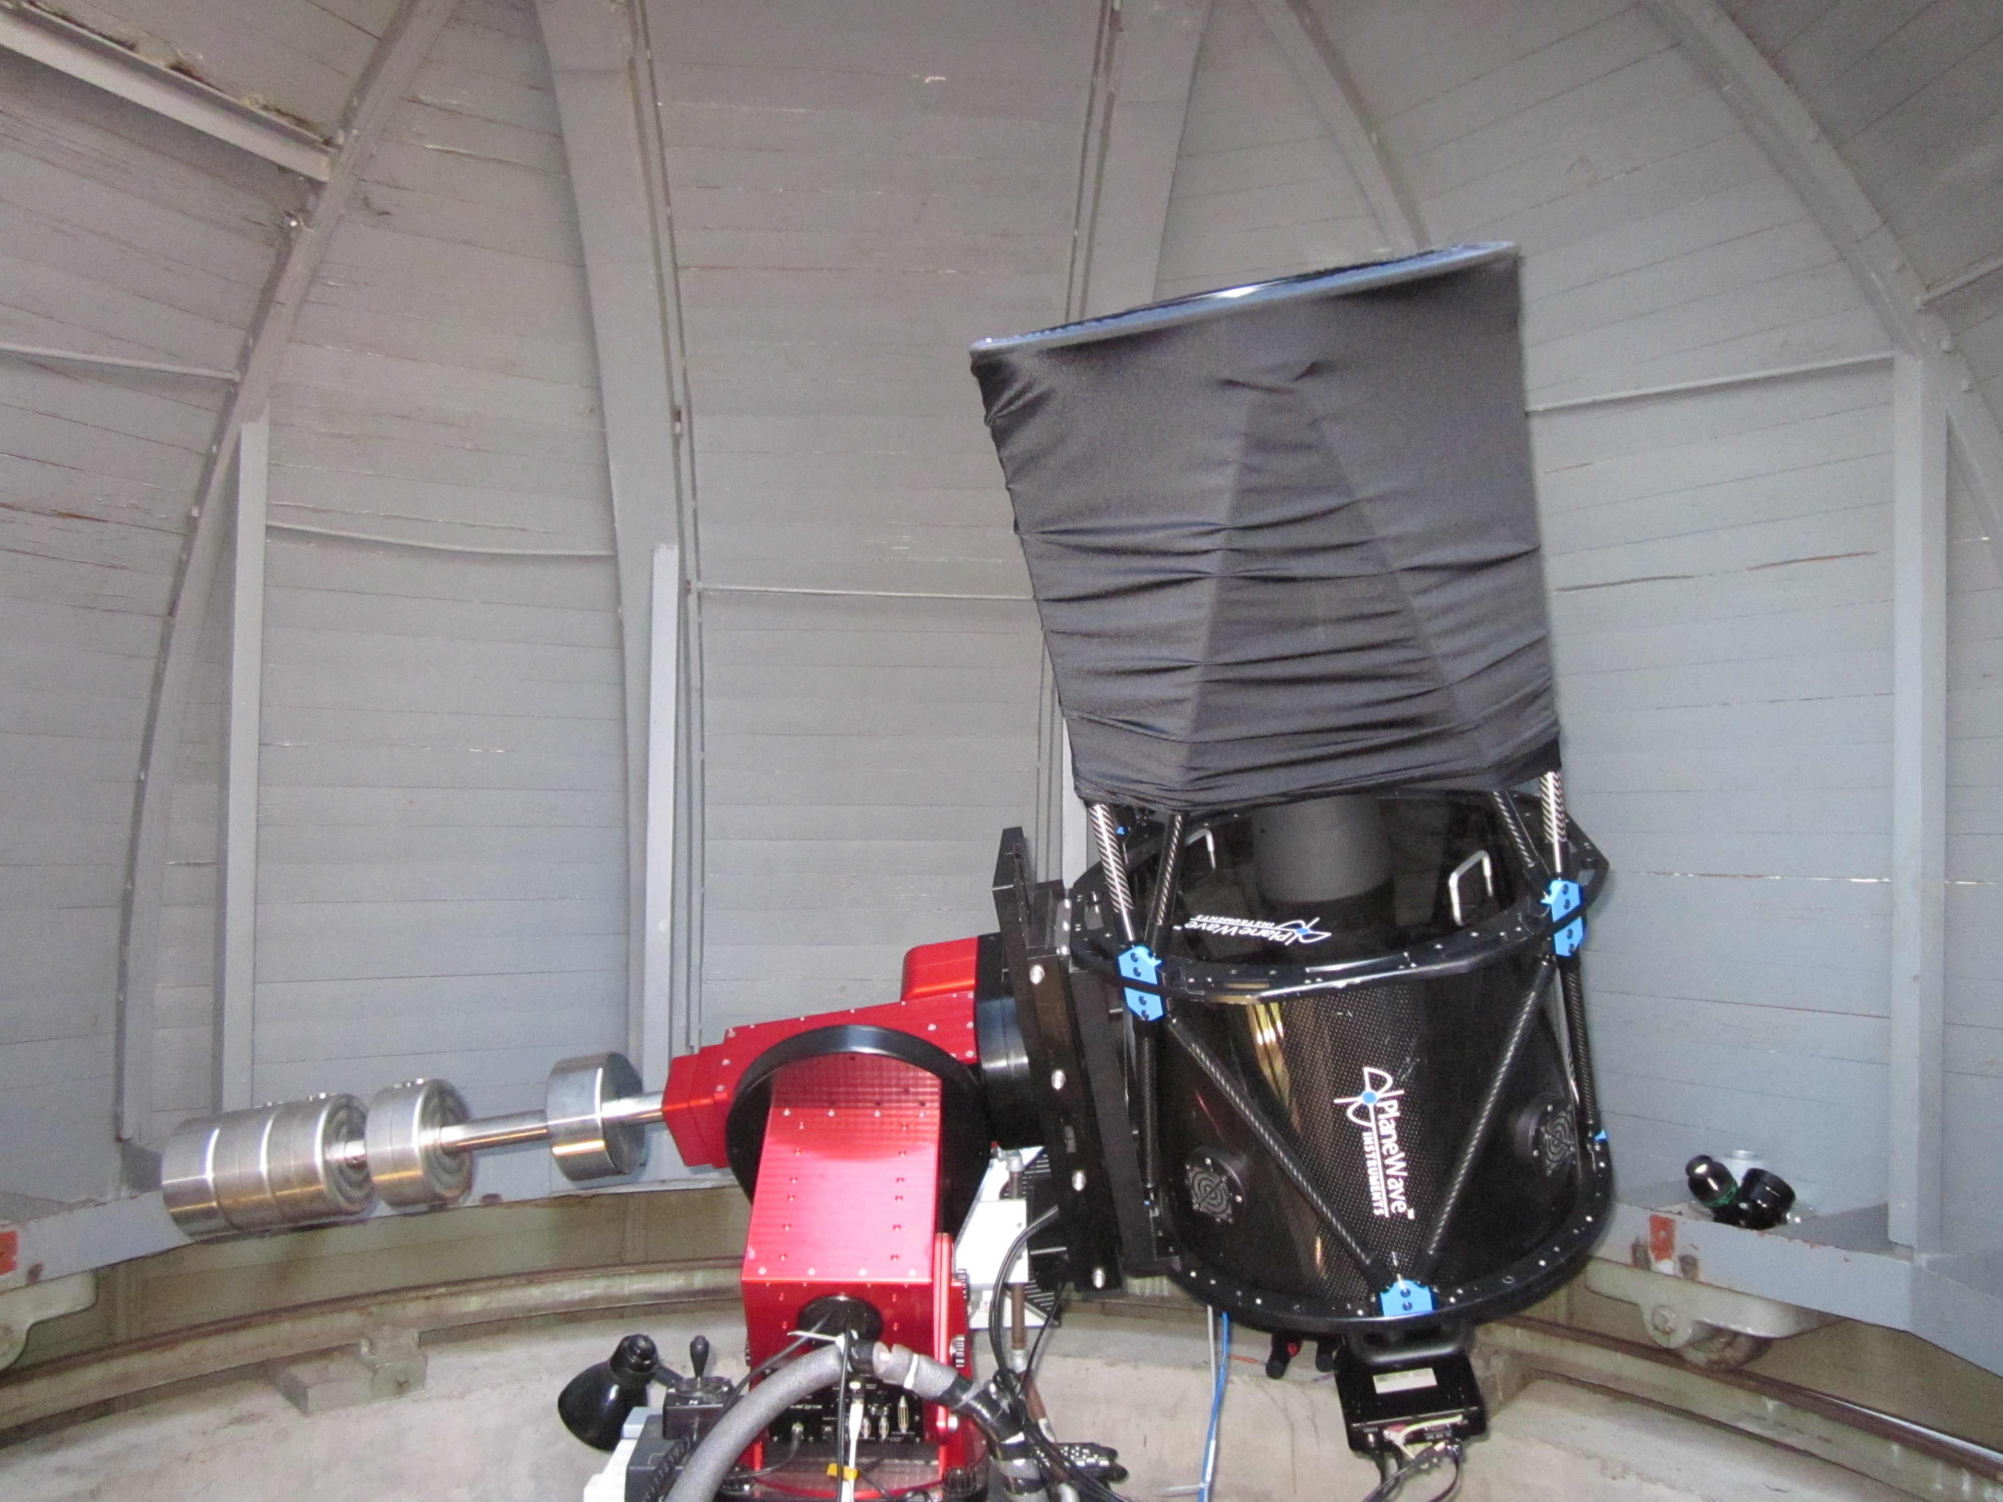
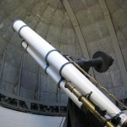
The 17” CDK telescope
(little but modern)
in the little dome
Fully photographic use:
CCD camera installed
The Grubb Refractor
in the
large dome
(1892)
Diameter
15”

Slide 20
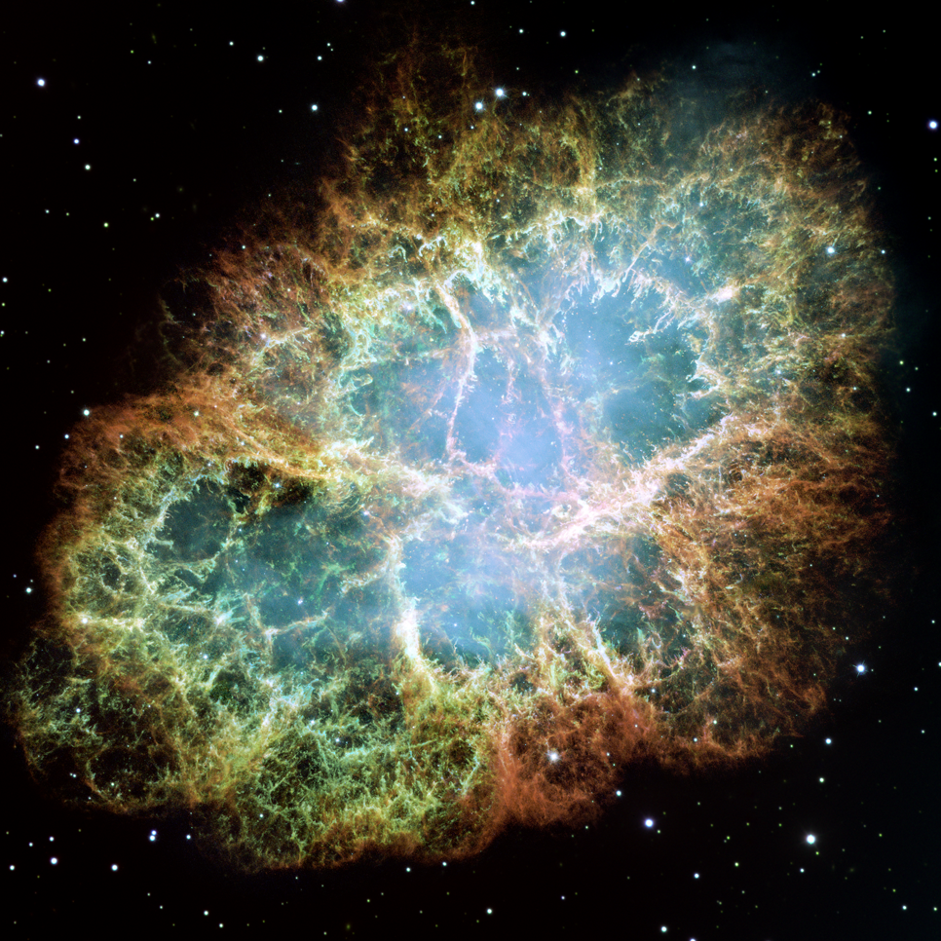
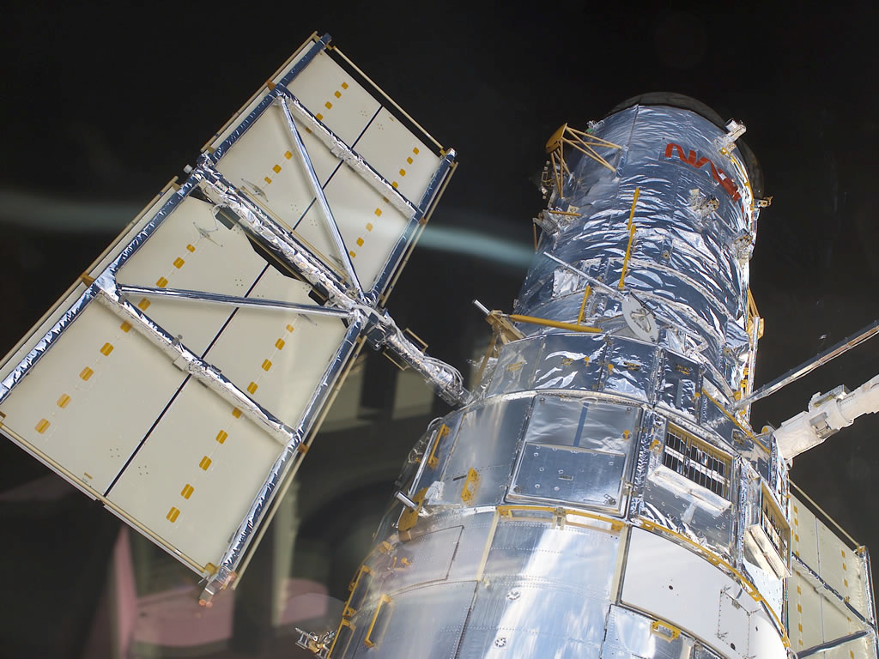
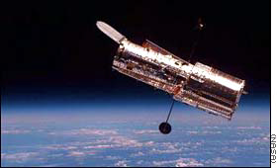
The Hubble
How do you fight seeing?
(3) Put your telescope on a spaceship:
seeing: 0 as
Hubble Space Telescope is a “small” telescope
Diameter: 2 m; resolution: 0.06 as
More discoveries than all other
telescopes combined.

Slide 21
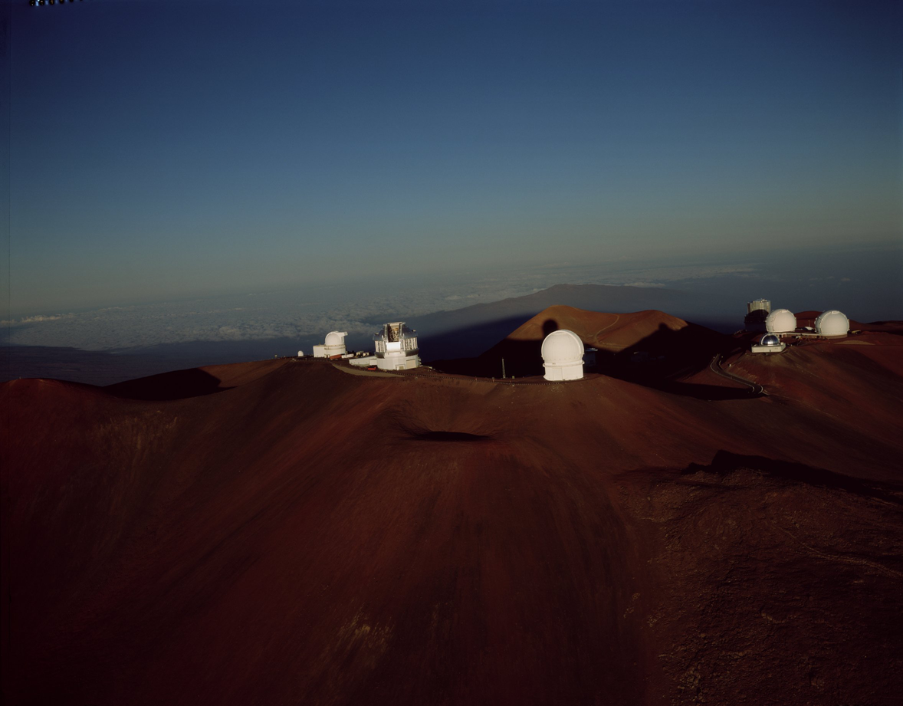
Mauna Kea
M
A
U
N
A
K
E
A

Slide 22
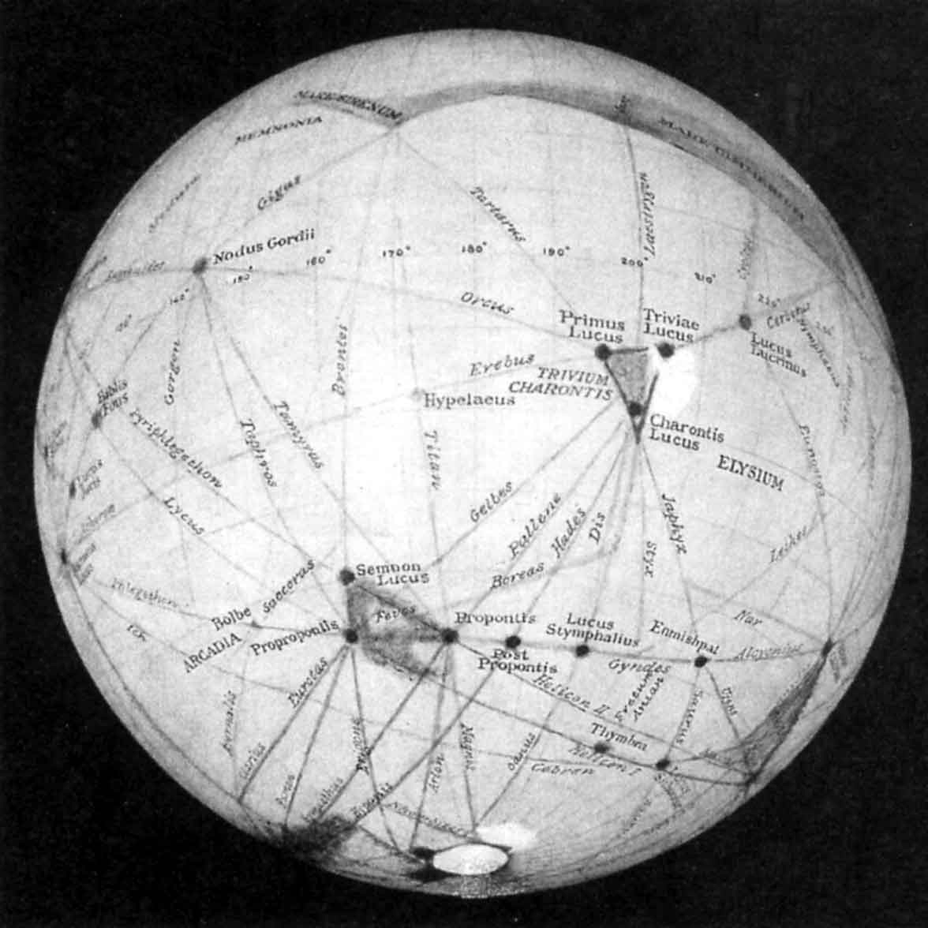
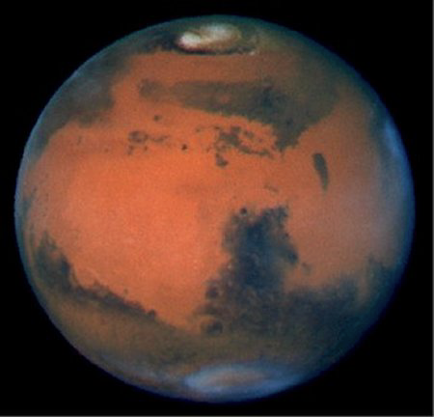
Visual vs. CCD
The professional way of doing astronomy: picture taking and imaging
(1) Visual observation: always unreliable
Recall the canals on Mars - G. Schiaparelli &P. Lowell

