Slide 1



Setup:
Prepare your scantron:
Use
a pencil,
not a pen!
Fill in your name and fill the bubbles under
your name.
LAST NAME FIRST, First name second
Put your 4-digit code instead of “IDENTIFICATION NUMBER”.
--- (The last 4 digits of your OleMiss ID.)
Question # 1: answer B
Question # 2: answer D
Question # 3: answer D
Last reading assignment
Telescopes, Chapter 6, pp. 165-189
Please take a moment to mute your cell phone!

Slide 2
Review questions coming …

Slide 3
Review question 4
sec
30
29
28
27
26
25
24
23
22
21
20
18
17
16
15
14
13
12
11
10
9
8
7
6
5
4
3
2
1
0
19
What is the scientific status of the “Big Bang theory”?
(Correctly named: Big Bang Cosmology)
A It is a generally accepted theory (proven).
B It has been disproved by observations.
C It is not sure: there is not enough evidence to prove it.
D It is a religious theory and as such cannot be proven. It is a question of faith.
Next question coming …

Slide 4
Review question 5
sec
30
29
28
27
26
25
24
23
22
21
20
18
17
16
15
14
13
12
11
10
9
8
7
6
5
4
3
2
1
0
19
The very early universe was …
A Cold.
B Dark.
C Hot.
D Large.
Next question coming …

Slide 5
Review question 6
sec
30
29
28
27
26
25
24
23
22
21
20
18
17
16
15
14
13
12
11
10
9
8
7
6
5
4
3
2
1
0
19
A Gpc (gigaparsec) is …
A 1 thousand parsecs.
B 1 million parsecs.
C 1 billion parsecs.
D 1 trillion parsecs.
E Not a definite number, only indicating “very far”.
Next question coming …

Slide 6
Review question 7
sec
30
29
28
27
26
25
24
23
22
21
20
18
17
16
15
14
13
12
11
10
9
8
7
6
5
4
3
2
1
0
19
What is
“cosmic microwave background radiation”
(the CMB)?
A X-ray radiation from unknown sources in space.
B Radio waves that have originated at the early stages of the universe.
C Radiation from planets of the solar system.
D Radiation from inside Earth.

Slide 7
The evolution of the Universe
Name | Time after big bang | z | Density | Tempera- ture | What is happening?
Big Bang | 0 | ∞ | ∞ | ∞ | Booom!!
Inflation | 10⁻³⁶-10⁻³² sec |  |  | 10²⁸ to 10²² K | Universe expands 10²⁶ times
Primordial nucleosynthesis | ~ 3 min | ~3x10¹³ |  | ~ 10⁹ K | H→He fusion 76%-H, 24%-He
Matter domination starts | 47 kyr | 3300 | 8.9x10⁻²⁰ g/cm³ | 9000 K | Gravity of matter overtakes gravity of photons
Decoupling | 370 ky | 1100 | 3.3x10⁻²¹ g/cm³ | 3000 K | Universe becomes transparent Beginning of ‘dark age’
First stars and galaxies | ~ 200 Myr | ~ 15 | 1.0x10⁻²⁶ g/cm³ | ~ 40 K | End of ‘dark age’
Reionization | ~ 200 Myr | ~ 15 | 1.0x10⁻²⁶ g/cm³ | ~ 40 K | Interstellar hydrogen becomes ionized from quasar’s UV
Dark energy domination starts | 9.6 Gyr | 0.39 | 1.3x10⁻²⁹ g/cm³ | 3.79 K | Gravity of dark energy overtakes gravity of matter
Now | 13.8 Gyr | 0 | 9.2x10⁻³⁰ g/cm³ | 2.73 K

Slide 8
Modifications to Hubble’s law due to the gravity of:
Regular (barionic) matter (5% total)
- stars (0.3%)
- interstellar gas&dust (0.2%)
- intergalactic gas (4.5%)
Only a small portion of regular matter is stars!
Dark matter (27%)
Most dark matter is in the halos of galaxies
Must consist of heavy particles
(“=cold”, required by the speed of structure formation)
Dark energy (cosmological constant, 68%)
Makes the Universe accelerate
GR says: amount not changing (=cosmological constant)
Effect insigficant in early universe, taking over gravity only after z<1.

Slide 9
Questions coming …

Slide 10
Question 8
sec
30
29
28
27
26
25
24
23
22
21
20
18
17
16
15
14
13
12
11
10
9
8
7
6
5
4
3
2
1
0
19
What types of things contribute to the gravity of the whole Universe today?
A Only barionic matter.
B Regular matter, dark matter, dark energy.
C Regular matter, dark matter, dark energy and radiation.
D Nothing: the gravity of the Universe is constant.
Next question coming …

Slide 11
Question 9
sec
30
29
28
27
26
25
24
23
22
21
20
18
17
16
15
14
13
12
11
10
9
8
7
6
5
4
3
2
1
0
19
What portion of the total mass of the Universe is in stars?
A 0.001%
B 0.3%
C 10%
D 99%
E 100%

Slide 12
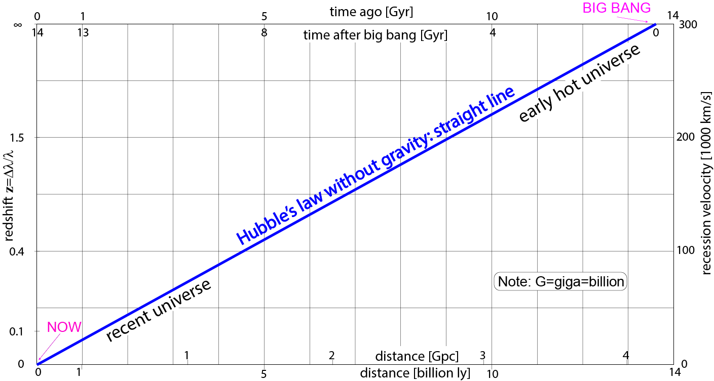
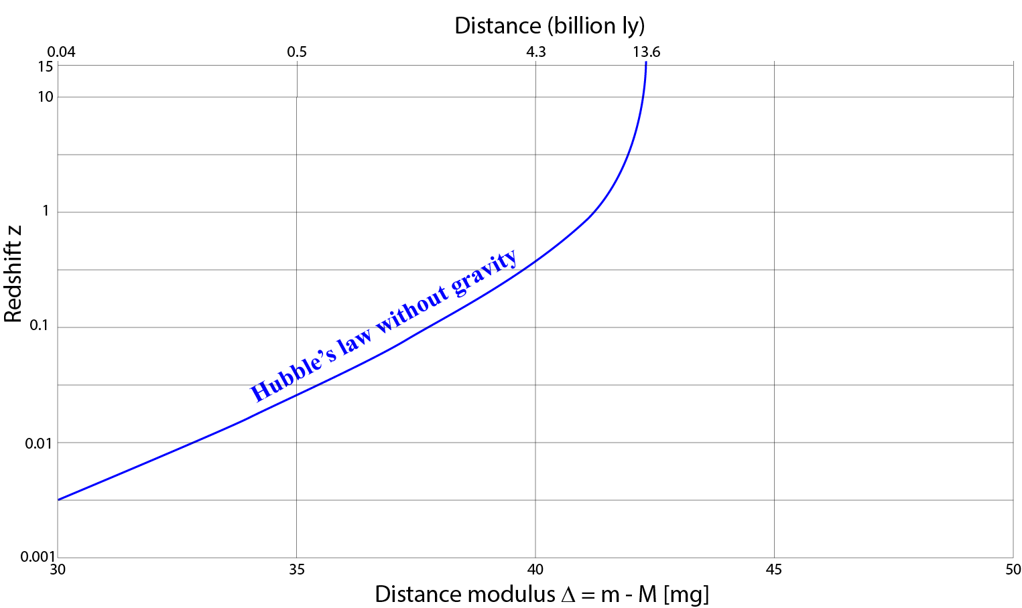
Use distance modulus
as a proxy for distance
Note:
• z and Δ are directly observed
• ‘straight line’ appears curved
(Same graph but
Δ plotted
instead of distance)
A type-Ia SN
would be
+21^{mg} here
A type-Ia SN
would be
+11^{mg} here

Slide 13
Questions coming …

Slide 14
Question 10
sec
30
29
28
27
26
25
24
23
22
21
20
18
17
16
15
14
13
12
11
10
9
8
7
6
5
4
3
2
1
0
19
There are two directly observable quantities that can be plotted for representing the Hubble curve.
Which are these?
A Recession velocity and redshift.
B Distance and redshift.
C Distance modulus and redshift.
D Distance and color.

Slide 15
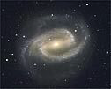
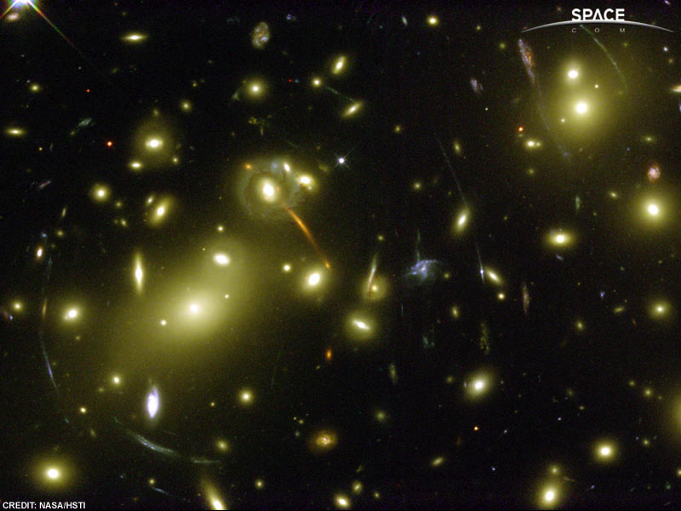
Dark matter in galaxies
Dark matter in and around galaxies
A galaxy rotates too fast Galaxy clusters are stable
far from the center - There must be stronger gravity
- contradicts law of gravity than the gravity of all the stars
- unless: there is invisible mass inside galaxy
Gravitational lensing:
too much mass
- There must be stronger gravity
What is dark matter made of?
Who knows?
(Brown dwarfs, Planets without stars,
New elementary particles, ...)

Slide 16
Question 11
sec
30
29
28
27
26
25
24
23
22
21
20
18
17
16
15
14
13
12
11
10
9
8
7
6
5
4
3
2
1
0
19
What observations indicate the presence of dark matter?
A Rotation of galaxies, stability of galaxy clusters, and gravitational lensing.
B Rotation of galaxies alone.
C Gravitational lensing and the stability of galaxy clusters.
D There is no such observation because dark matter is dark.

Slide 17
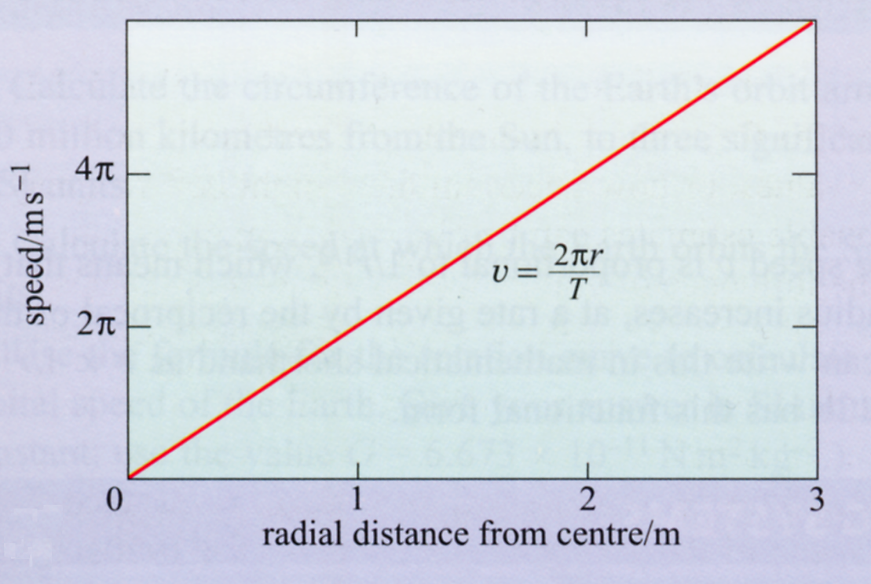
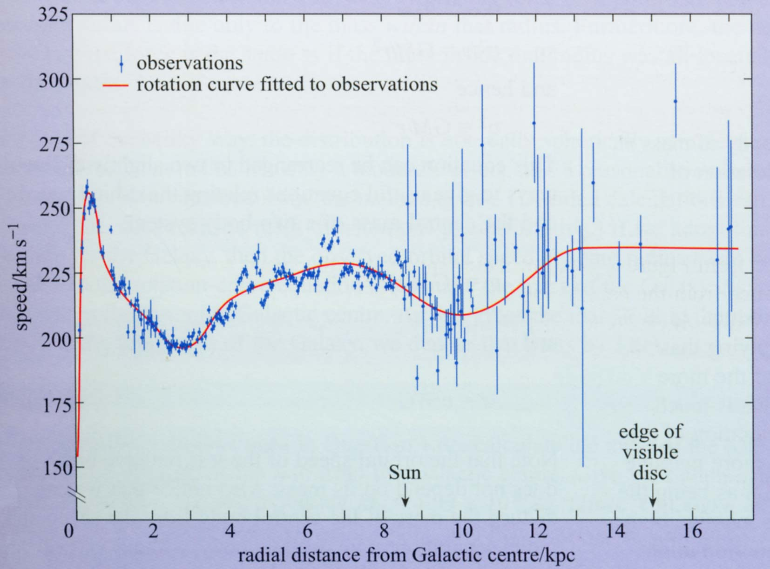
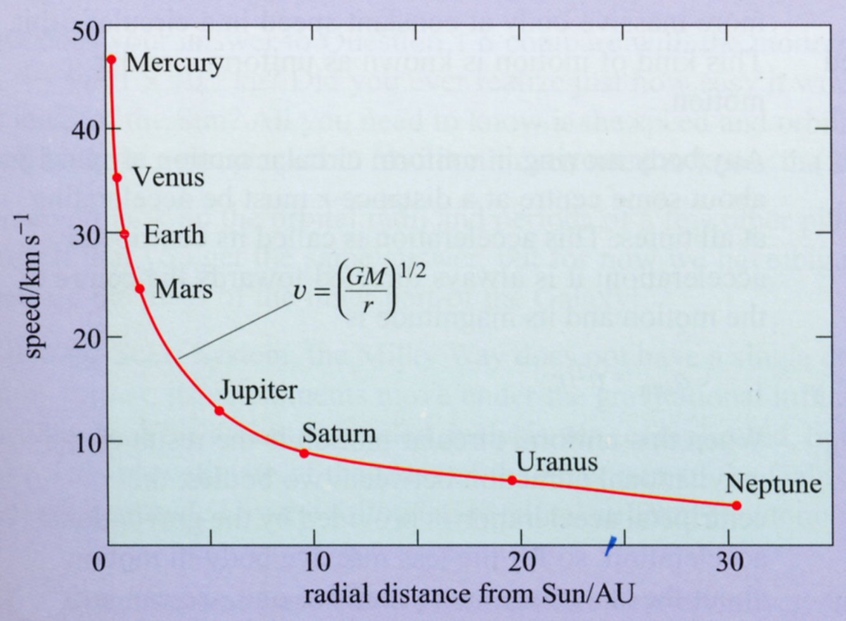
Rotation curve of the Galaxy
Rotation curve
: the Galaxy
Measure the speed of stars
as they revolve around the center of the Galaxy
Rigid
body
Invisible matter
must be present!
(“Dark matter”)
One
big
mass

Slide 18
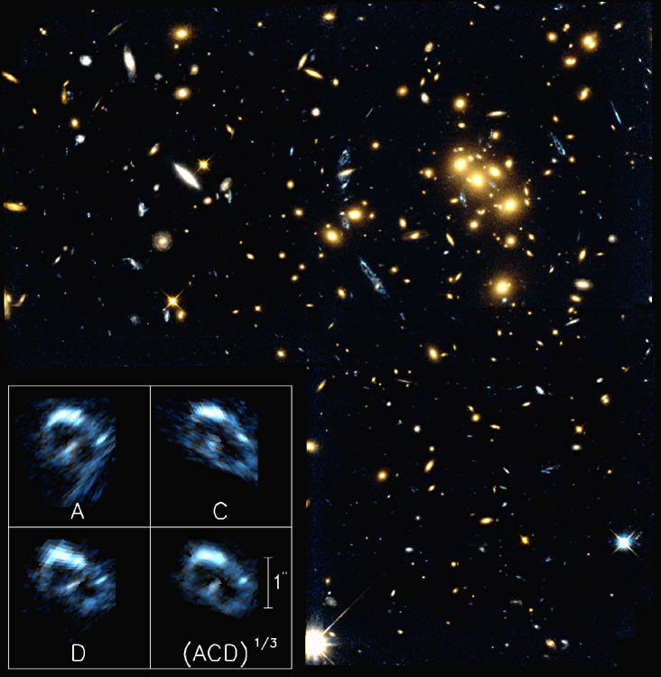
More gravitational lensing
Gravitational lensing:
Einstein rings
A foreground galaxy cluster
breaks up the light
of a far-away galaxy
Note:
There is much more dark matter than
stars in a galaxy
Galaxies are like:
“a few stars in a big blob of dark matter”

Slide 19
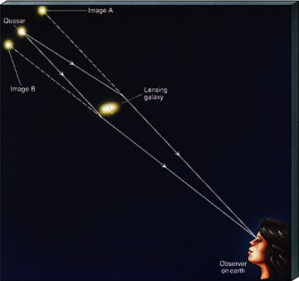
Explain gravitational lensing
Explain what happens:
Image B
Gravity of a galaxy
* bends light of
objects behind it
* distorts image of
distant objects
Source
Lensing
galaxy
Image A
Gravitational lensing allows
an independent determination
of the mass of the lensing galaxy
One can tell
how much dark matter
in that galaxy
Observer
on Earth

Slide 20
Questions coming …

Slide 21
Question 12
sec
30
29
28
27
26
25
24
23
22
21
20
18
17
16
15
14
13
12
11
10
9
8
7
6
5
4
3
2
1
0
19
What is gravitational lensing?
A The gravity of the sun bends the light of a far-away galaxy, and makes it look brighter.
B The gravity of a foreground galaxy bends the light of a far-away galaxy.
C The gravity of a foreground galaxy makes far-away stars appear brighter.
D The gravity of a foreground galaxy makes far-away stars appear dimmer.
E The gravity of a foreground star makes far-away galaxies appear distorted.

Slide 22
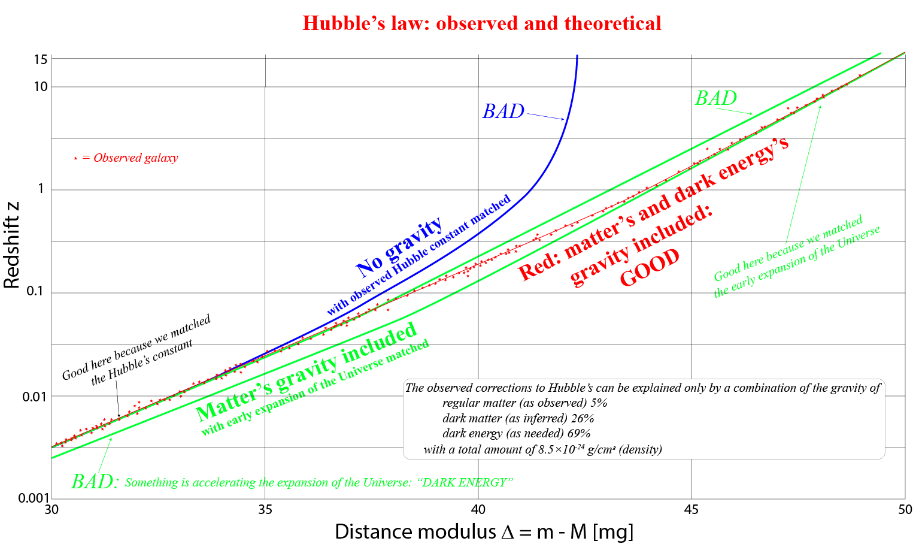
Barionic and dark matter alone are not enough
to explain the observed corrections to Hubble’s law:
dark energy is needed
What is ‘dark energy’? A constant ‘force’ that makes the Universe expand.

Slide 23
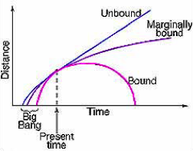
Will the Universe continue to expand forever?
Slowdown of expansion is
caused by gravity
due to all matter.
How much matter is there?
Density > critical : “crunch”
Density < critical : “unbound
expansion”
Critical density
=
6 atoms/m³
The discovery of dark energy changes this picture.
It turns all these curves ”up” in time,
but in space the above picture is still good.
Visible matter + “Dark matter” + “Dark energy” = found almost to equal critical:
borderline - very close to spacially flat universe

Slide 24
Questions coming …

Slide 25
Question 13
sec
30
29
28
27
26
25
24
23
22
21
20
18
17
16
15
14
13
12
11
10
9
8
7
6
5
4
3
2
1
0
19
What determines if the Universe will continue to
expand forever or will turn back and collapse again?
A Whether the average density of the Universe is more or less than a critical value.
B Whether the temperature of intergalactic gas is hotter or colder than a critical value.
C Whether stars in galaxies all blow up as supernovae.
D It depends on the amount of radiation in interstellar space faith.
Next question coming …

Slide 26
Question 14
sec
30
29
28
27
26
25
24
23
22
21
20
18
17
16
15
14
13
12
11
10
9
8
7
6
5
4
3
2
1
0
19
Observations indicate that the density of the Universe (with dark matter and dark energy included) is …
A Much more than the critical density, so the Universe will eventually collapse in a ‘Big Crunch’.
B Equal to the critical density within ± uncertainty.
C Much less than the critical density, so the Universe will never collapse in a ‘Big Crunch’.
Next question coming …

Slide 27
Question 15
sec
30
29
28
27
26
25
24
23
22
21
20
18
17
16
15
14
13
12
11
10
9
8
7
6
5
4
3
2
1
0
19
What is the scientific status of the “Big Bang” theory?
A It is a generally accepted theory (proven).
B It has been disproved by observations.
C It is not sure: there is not enough evidence to prove it.
D It is a religious theory and as such cannot be proven. It is a question of faith.

