Slide 1



Setup:
Prepare your scantron:
Use
a pencil,
not a pen!
Fill in your name and fill the bubbles under
your name.
LAST NAME FIRST, First name second
Put your 4-digit code instead of “IDENTIFICATION NUMBER”.
--- (The last 4 digits of your OleMiss ID.)
Test 3 is coming up on Friday!!
(Hubble’s law from Oct. 8 is included.)
Question # 1: answer B
Question # 2: answer D
Question # 3: answer B
Reading assignment
Galaxy evolution, Chapter 21, pp. 627-647
(A superficial reading will suffice)
Please take a moment to mute your cell phone!

Slide 2
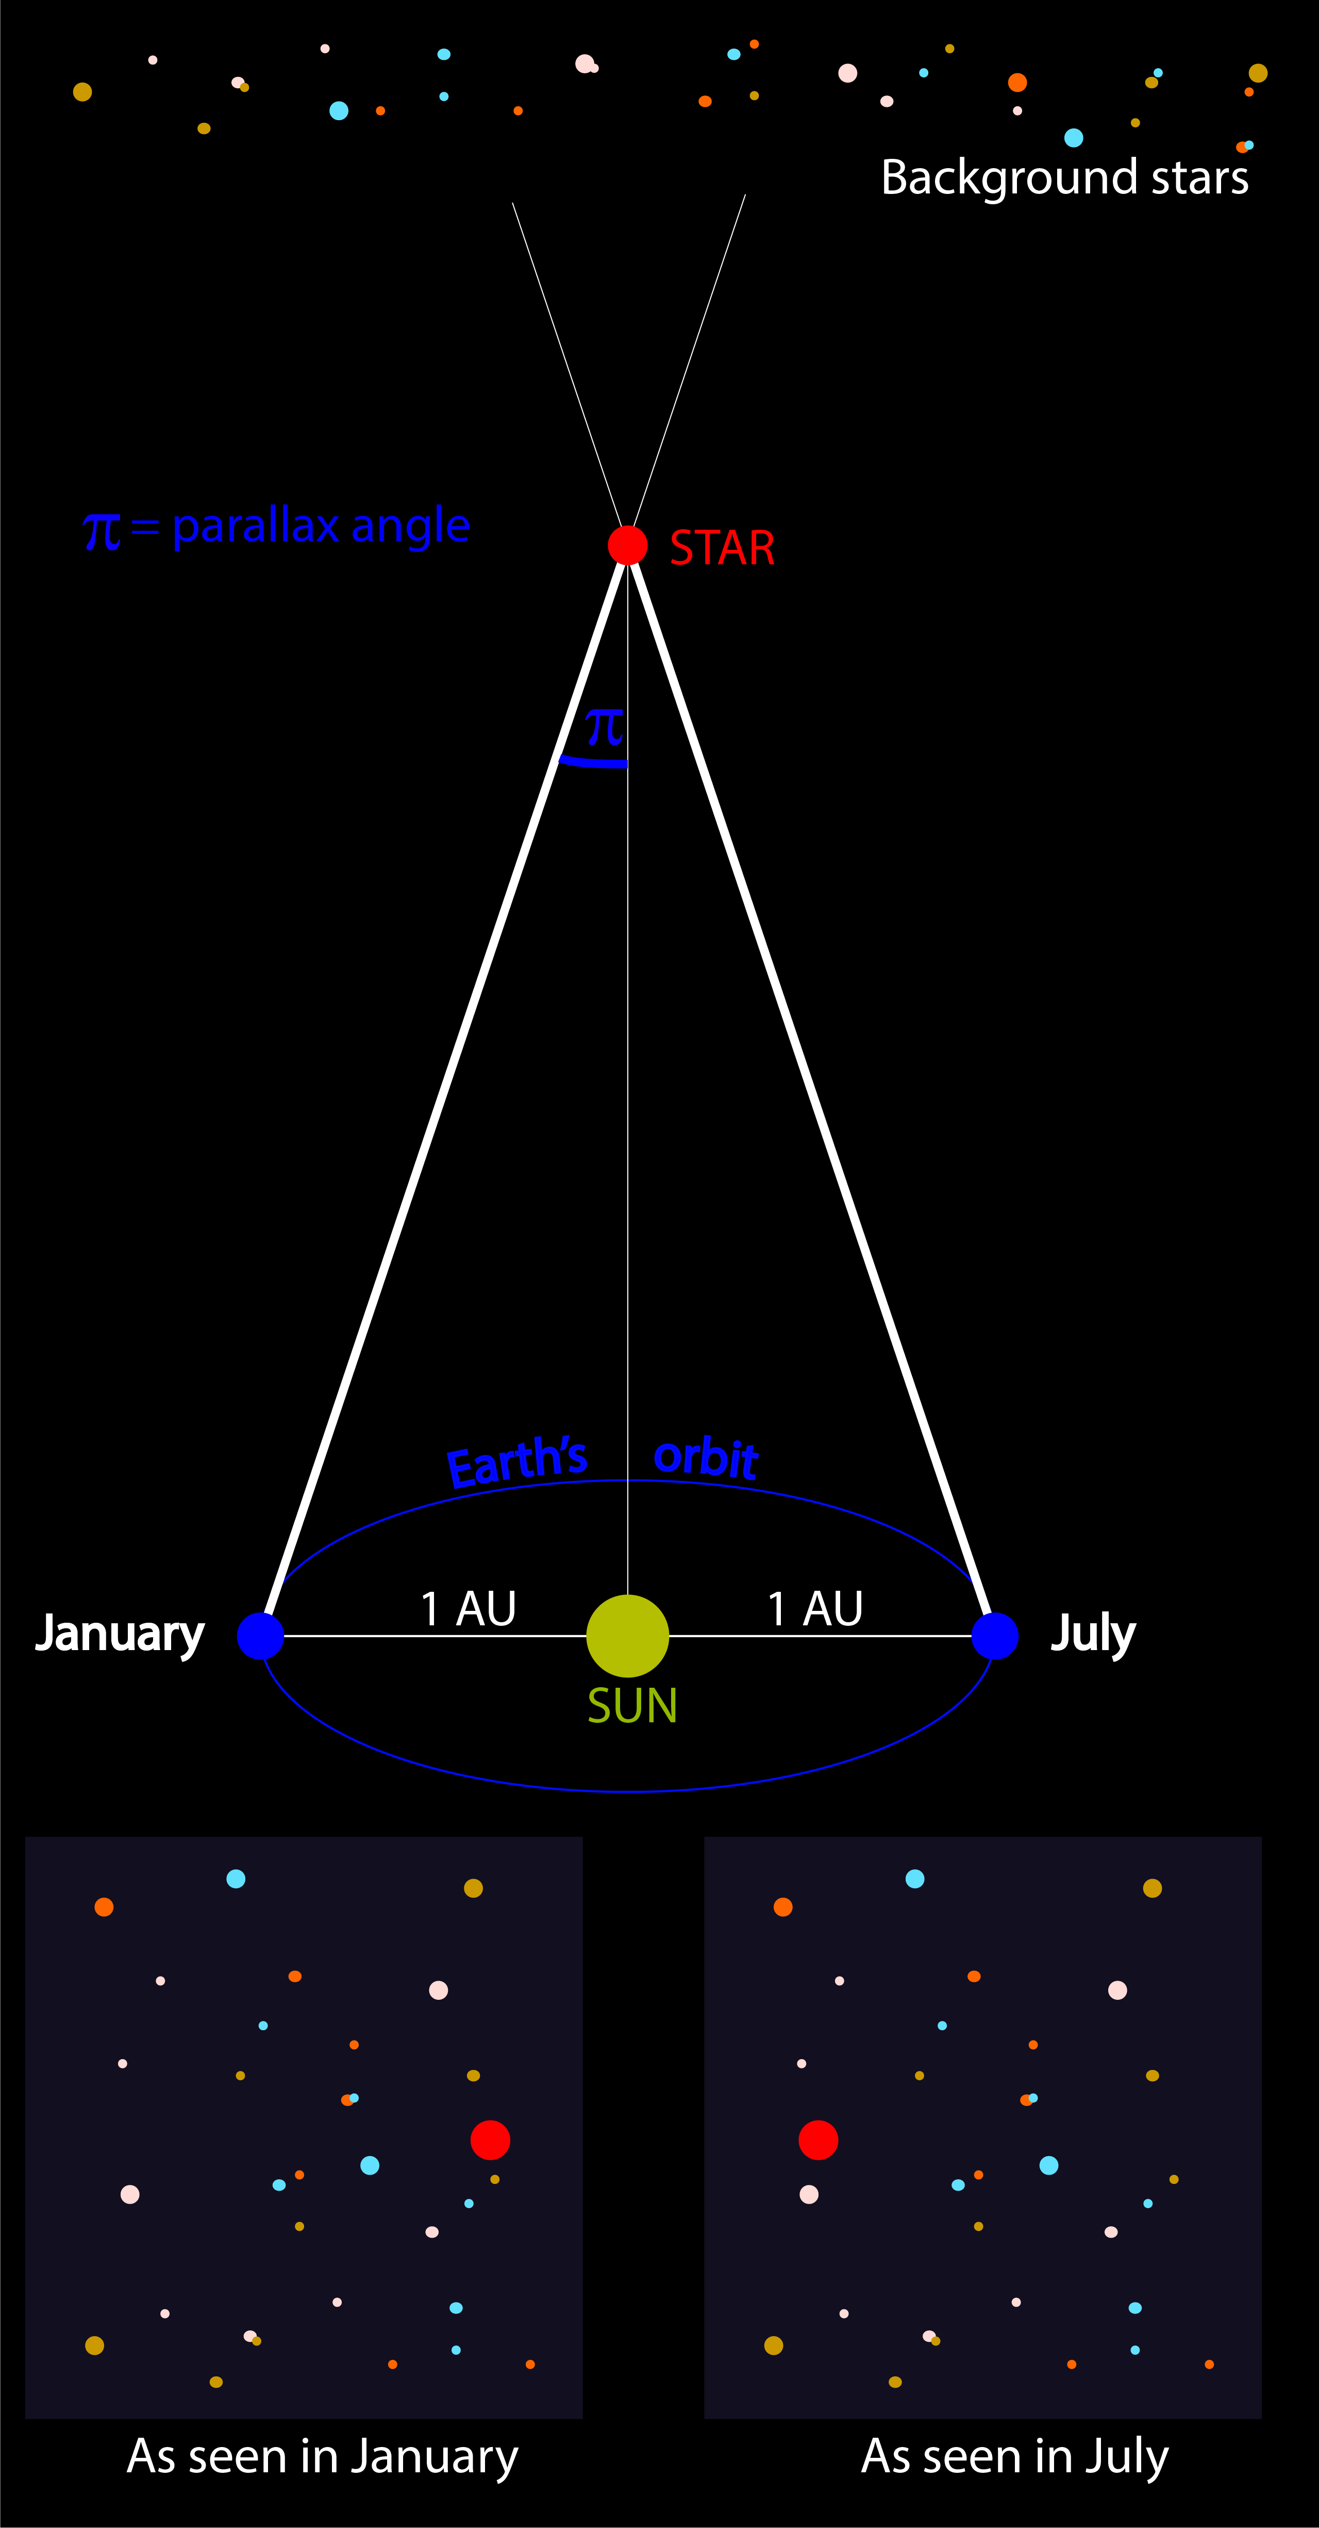
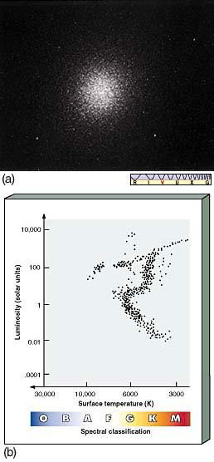
Extragalactic distances
d [pc] = 1/π[as]
Recall - inside the galaxy:
1 - Parallax
Works mainly in ‘our side’ of the Galaxy only
Robust: not affected by interstellar dust
2 - Main sequence fitting of clusters
Must correct for interstellar extinction (±20% error)
Uses ‘standard candle’ method with main sequence as the ‘candles’
Recall:
Determine M of the standard candle
Determine m from observation
Correct m for interstellar extinction
Distance modulus Δ=m-M
- Convert to distance d=10^{Δ/5+1}[pc]
Outside the Galaxy:
1 - Cepheids (within 100 Mpc)
2 - Hubble’s curve (beyond 20 Mpc)
3 - Type Ia SN (everywhere but few SN’s)

Slide 3
Questions coming …

Slide 4
Question 4
sec
30
29
28
27
26
25
24
23
22
21
20
18
17
16
15
14
13
12
11
10
9
8
7
6
5
4
3
2
1
0
19
Which method is used most often to determine distances to galaxies farther than 20 Mpc?
A Main sequence fitting.
B Parallax.
C Cepheids.
D Using Hubble’s law.
E Type-Ia SNe.
Next question coming …

Slide 5
Question 5
sec
30
29
28
27
26
25
24
23
22
21
20
18
17
16
15
14
13
12
11
10
9
8
7
6
5
4
3
2
1
0
19
What is the ‘standard candle’ method for the
determination of distances?
A Measure the speed of motion of a star in the sky and calculate the distance from this data.
B Measure the color of a star and read off its distance from the HRD.
C Measure the size of the parallax circle (or ellipse) in the sky and its reciprocal tells the distance.
D Measure the absolute magnitude (M) for an object whose apparent magnitude (m) we know, then calculate the distance.
E Measure the apparent magnitude (m) for an object whose absolute magnitude (M) we know, then calculate the distance.

Slide 6
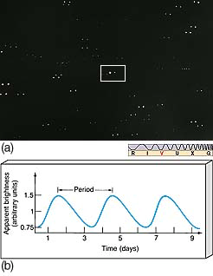
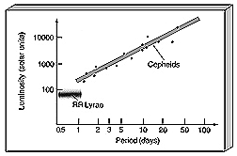
Cepheids
Distance to galaxies within ~ 100 million light years: using Cepheids
Cepheids -
pulsating variables
Period-brightness relationship
period - easy to observe
read off brightness -
get distance
Works for the neighboring
galaxies.

Slide 7
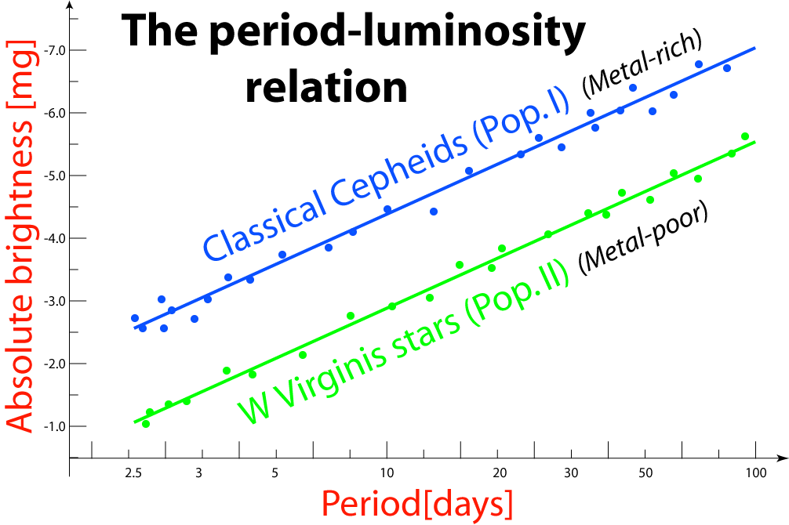
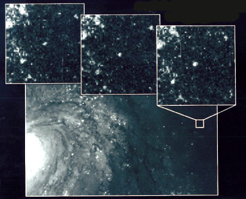
The Cepheid method
Measure the distance to the Andromeda Galaxy using Cepheids
• Cepheids are
very bright pulsating variables
• Period of pulsation is related
to absolute brightness
• Measure apparent brightness ==>
deduce distance
Example: Cepheids in M31
• Read off period (3.2 days for this one)
• Read off absolute brightness
(1000 solar = -2.5 mg for this one)
• Measure apparent brightness
(21.5 mg for this one)
• Distance modulus is 24 mg, distance is
600,000 pc = 2 million light years

Slide 8
Questions coming …

Slide 9
Question 6
sec
30
29
28
27
26
25
24
23
22
21
20
18
17
16
15
14
13
12
11
10
9
8
7
6
5
4
3
2
1
0
19
What is a Cepheid?
A A meteor shower.
B A planet.
C A star.
D A galaxy.
E A comet.
Next question coming …

Slide 10
Question 7
sec
30
29
28
27
26
25
24
23
22
21
20
18
17
16
15
14
13
12
11
10
9
8
7
6
5
4
3
2
1
0
19
What property of a Cepheid variable is related to its absolute brightness?
A The spectral type.
B The length of the period.
C The size (diameter).
D The surface temperature.
E The redshift of spectral lines.
Next question coming …

Slide 11
Question 8
sec
30
29
28
27
26
25
24
23
22
21
20
18
17
16
15
14
13
12
11
10
9
8
7
6
5
4
3
2
1
0
19
Which method is most accurate to determine
the distance to neighboring galaxies
(such as the Andromeda Galaxy)?
A Parallax.
B Cepheids.
C Using the HRD.
D Redshift.
E Radar.

Slide 12
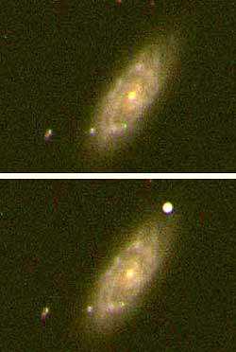
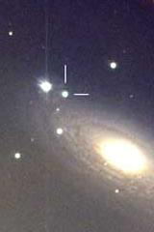
How far does the SN method reach?
Distance to far-away galaxies: using Type-Ia SNe
As far as we see the galaxies!
A type-Ia supernova at 14 billion ly
(“other end” of the universe)
would be +24 mg in brightness,
easily visible with a professional telescope
But …
it takes a few centuries
to see a type-Ia SN in
any particular galaxy
CGCG089 (200 Mly)
NGC2841 (40 Mly)

Slide 13
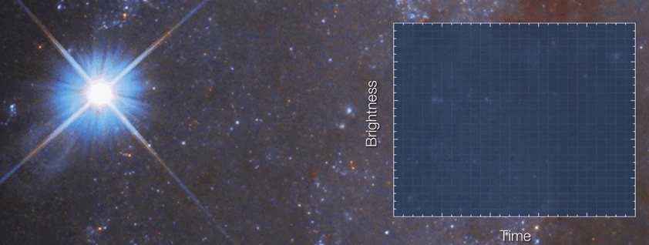
How does this work?
- the ‘standard candle’ method.
1. Measure brightness ‘m’ in maximum
2. All Type-Ia SN’e have M = -19.3mg
3. Distance modulus Δ = m-M
4. Convert to distance d = 10^{Δ/5+1} [pc]
How do you know it is Type-Ia?
- all Type-Ia’s have a similar-shaped light curve
How

Slide 14
Questions coming …

Slide 15
Question 9
sec
30
29
28
27
26
25
24
23
22
21
20
18
17
16
15
14
13
12
11
10
9
8
7
6
5
4
3
2
1
0
19
Why are Type-Ia SNe useful to determine the distance
to galaxies, other than the fact that they are very
bright? Because …
A they have a well-established period-luminosity relation.
B their motion in the sky can be easily measured.
C they all have the same absolute brightness.
D their parallaxes can be easily measured.
E their redshift is easy to measure.
Next question coming …

Slide 16
Question 10
sec
30
29
28
27
26
25
24
23
22
21
20
18
17
16
15
14
13
12
11
10
9
8
7
6
5
4
3
2
1
0
19
Why are type-Ia supernovae very
important in astronomy?
A Because they become black holes.
B They produce all the heavy elements.
C They can be used to measure the distance to extremely far-away galaxies.
D They become pulsars, which allow a very precise measurement of their rotational period.
E They are the end stage of all not-too-heavy stars like the Sun.

