Slide 1



Setup:
Prepare your scantron:
Use
a pencil,
not a pen!
Fill in your name and fill the bubbles under
your name.
LAST NAME FIRST, First name second
Put your 4-digit code instead of “IDENTIFICATION NUMBER”.
--- (The last 4 digits of your OleMiss ID.)
Question # 1: answer B
Question # 2: answer C
Question # 3: answer E
Recall reading assignment
Galaxies: ours and others, Chapters 19-20, pp. 580-626
(A superficial reading will suffice)
Please take a moment to mute your cell phone!

Slide 2
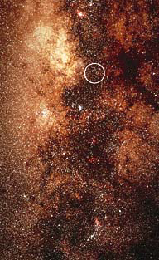
What is in the center of the Galaxy
What is in the center
of our Galaxy?
Nothing in visible light:
Interstellar dust covers it all.
A strong radio source:
Sagittarius-A

Slide 3
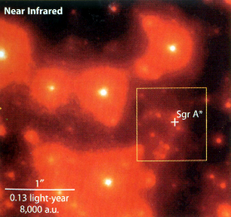
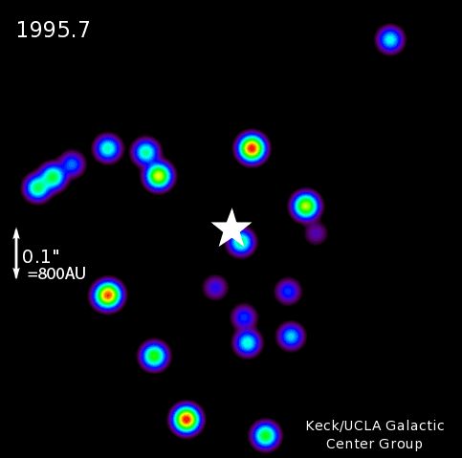
Galactic center details
A detailed image in infrared
(λ=2.2 μm; IR can see through dust)
Stars move around over the years:
a huge mass must be hiding
there, invisible.
One star goes as close as 90 AU:
the thing must be
much smaller than that.
Must be a supermassive black hole
(4.3 million M_{Sun}, size = 0.2 AU )
** NOT AN ACTIVE NUCLEUS **
Comment – the “diameter” of a black hole
is one mile for each solar mass

Slide 4
Questions coming …

Slide 5
Question 4
sec
30
29
28
27
26
25
24
23
22
21
20
18
17
16
15
14
13
12
11
10
9
8
7
6
5
4
3
2
1
0
19
What is in the center of the Galaxy?
A No object (empty space).
B A large globular cluster.
C A very large star.
D A huge black hole.
E The Sun.
Next question coming …

Slide 6
Question 5
sec
30
29
28
27
26
25
24
23
22
21
20
18
17
16
15
14
13
12
11
10
9
8
7
6
5
4
3
2
1
0
19
How do we know what is in the center of the Galaxy?
A We observe fast-moving stars orbiting around it.
B It is visible as a bright star.
C It spits out jets of hot gas.
D Its magnetic field affects the light of stars behind it.
Next question coming …

Slide 7
Question 6
sec
30
29
28
27
26
25
24
23
22
21
20
18
17
16
15
14
13
12
11
10
9
8
7
6
5
4
3
2
1
0
19
Why is it hard to figure out what is
in the center of the Galaxy?
A Because the center of the Galaxy is a black hole, and it is invisible.
B Because there is much obscuring interstellar dust between us and it.
C Because the center of the Galaxy is too far away for astronomers to see.
D Because the center of the Galaxy is too hot and it radiates only in X-rays.
E Because the center of the Galaxy is the Sun.

Slide 8
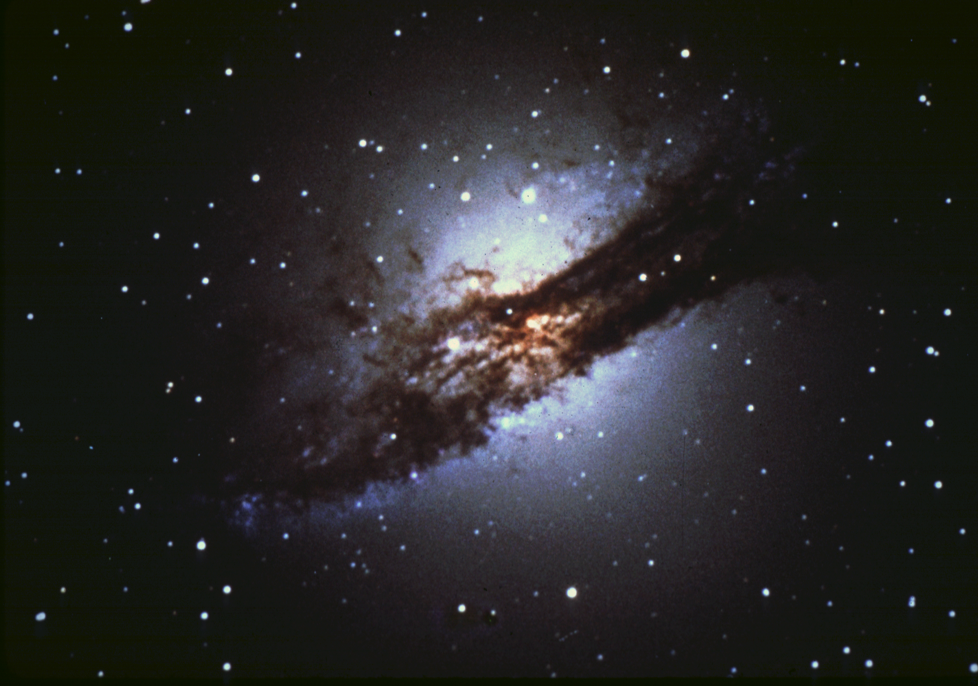

Centaurus A: active nucleus
A galaxy with an active nucleus: Centaurus A
Unusual object:
* elliptical galaxy with a dust lane
* strong radio source
Optical image + X-ray image in red:
Jet of hot gas flying out of the nucleus
at 200,000 km/s
Optical image (NGC 5128):
Colliding galaxies (elliptical + spiral)
Black hole in the elliptical’s nucleus
gobbling up
interstellar gas from the spiral

Slide 9
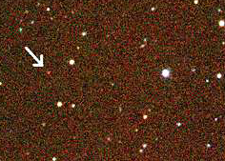
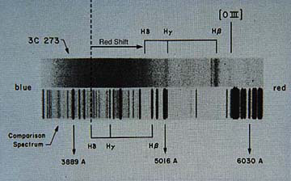
3 C 273: Quasar
Galaxies with very bright active nuclei: QUASAR’s
Discovery in 1959:
A very strong radio source: 3C 273
Optical: a faint, 13^{mg}, variable star
Spectrum: unidentifiable spectral lines
Changes brightness
in a matter
of minutes.
The resolution (1963):
Very strong redshift, 16%
But that means:
Recedes very fast
Is a galaxy
Very distant object
2.5 billion ly away
Must be very bright:
M = - 26.7^{mg} (!!!)
As bright as a 100 galaxies!
(Yet at small as a few AU’s.)

Slide 10
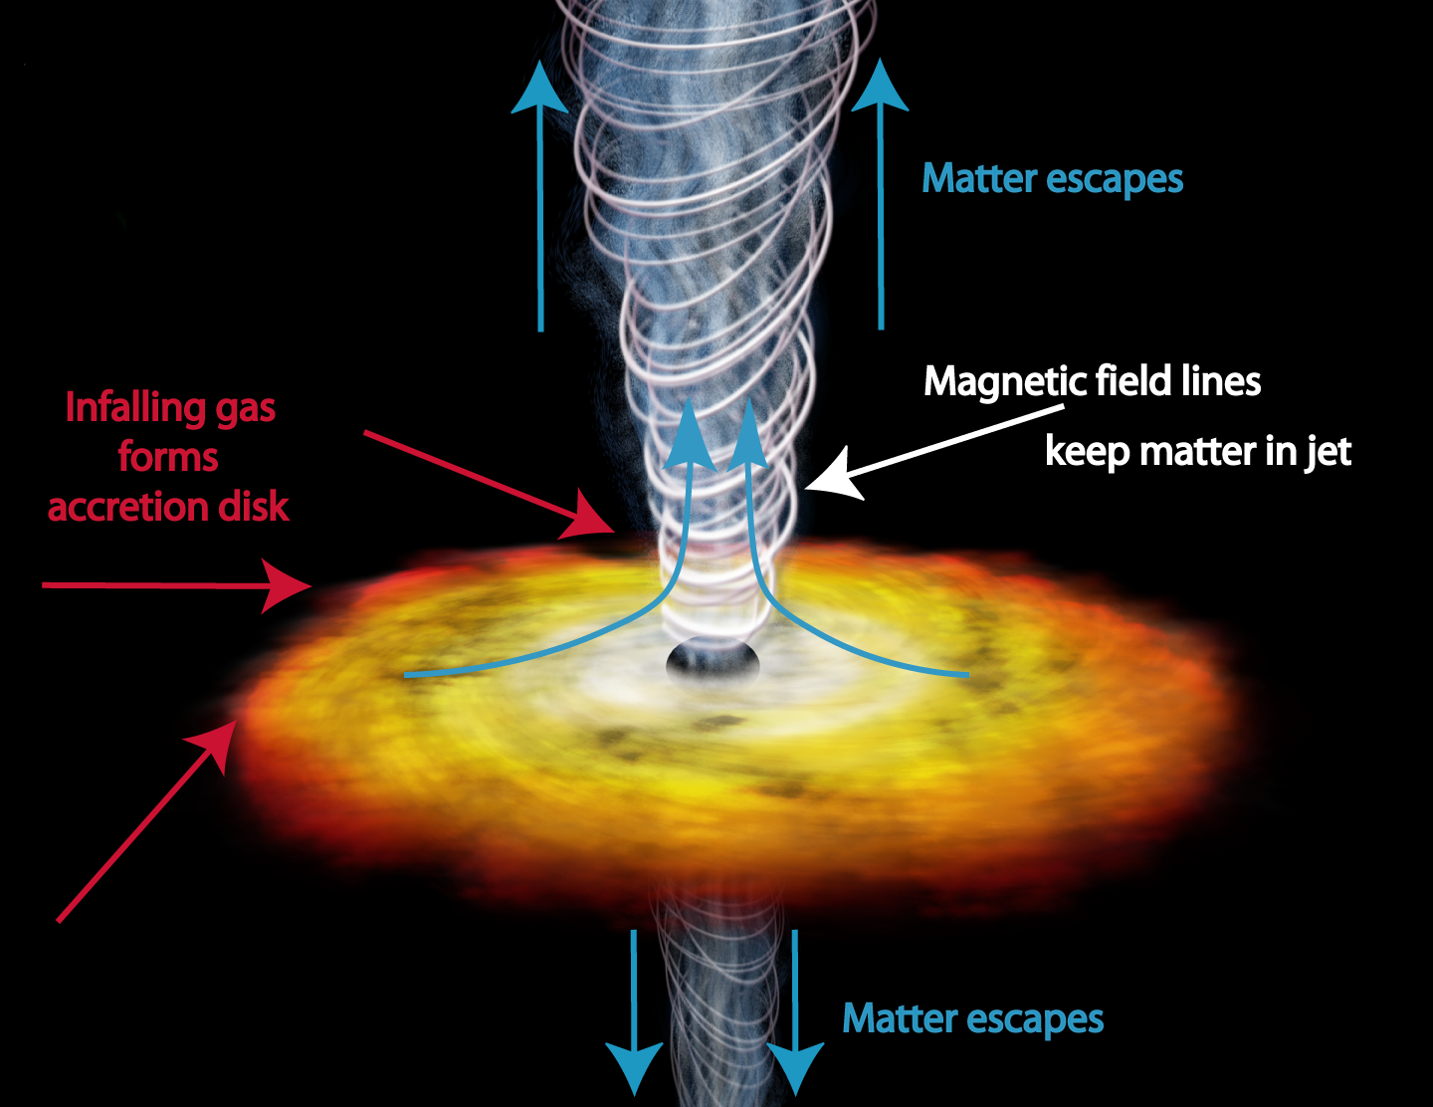
What are quasars?
One more clue:
There are no quasars close to us (the closest is ~ 1 billion ly away)
The farther you look the younger the object (by billions of years, in this case)
Quasars are nuclei of young galaxies
(with time they must ‘settle down’ to normal galactic nuclei)
What are quasars?
Only one possible answer:
Supermassive black holes
with 1 to 10 solar mass worth
of ISM falling on it yearly.
Black hole mass:
~ 10 million solar
If the black hole spins fast:
It will spit back some of the
infalling gas along the axis.

Slide 11
Questions coming …

Slide 12
Question 7
sec
30
29
28
27
26
25
24
23
22
21
20
18
17
16
15
14
13
12
11
10
9
8
7
6
5
4
3
2
1
0
19
What are quasars?
A Stars that change their brightness.
B One sort of supernova remnants.
C Active nuclei of young and distant galaxies.
D Planets where radiation is strong.
Next question coming …

Slide 13
Question 8
sec
30
29
28
27
26
25
24
23
22
21
20
18
17
16
15
14
13
12
11
10
9
8
7
6
5
4
3
2
1
0
19
How do we know that quasars must be huge black holes?
A Because they are invisible.
B Because stars vanish around them.
C Because their gravitational pull has been detected.
D Because the amount of energy they radiate cannot be produced in any other object.
Next question coming …

Slide 14
Question 9
sec
30
29
28
27
26
25
24
23
22
21
20
18
17
16
15
14
13
12
11
10
9
8
7
6
5
4
3
2
1
0
19
What is an active galactic nucleus?
A A black hole that spits out hot gas whenever anything falls into it.
B An invisible but huge black hole.
C A large gas cloud. All stars of the galaxy have been formed from it.
D The center of a planetary nebula.
E A black hole that make in-falling gas radiate just before it falls into the black hole.

