Slide 1



Setup:
Prepare your scantron:
Use
a pencil,
not a pen!
Fill in your name and fill the bubbles under
your name.
LAST NAME FIRST, First name second
Put your 4-digit code instead of “IDENTIFICATION NUMBER”.
--- (The last 4 digits of your OleMiss ID.)
Test 2 on Friday, Oct. 24
(With picture questions!)
Question # 1: answer B
Question # 2: answer B
Question # 3: answer B
Recall reading assignment
The graveyard, Chapter 18, pp. 557-579
Please take a moment to mute your cell phone!

Slide 2
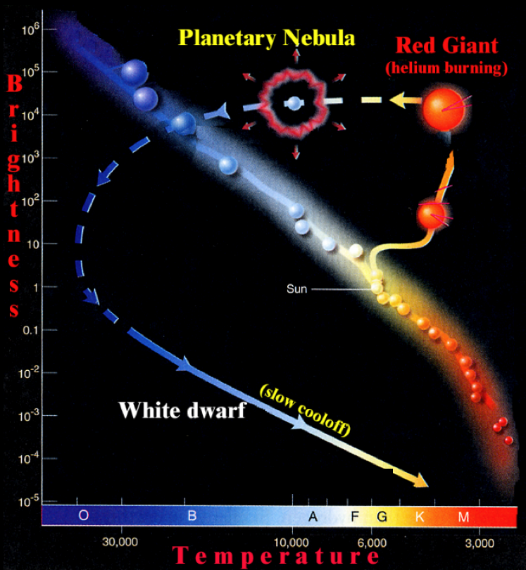
Stellar evolution (Sun-like)
Stellar
Evolution
Evolution
Of
Sun-like stars
(Mass < 1.44 M)
AGB
AGB
(asymptotic giant branch)
• Huge envelope
• Strong stellar wind
• Mass loss
(half of the star’s mass)

Slide 3
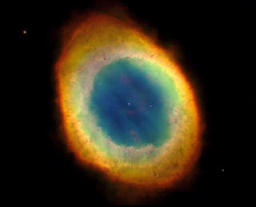
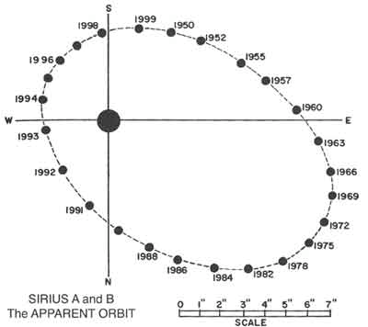
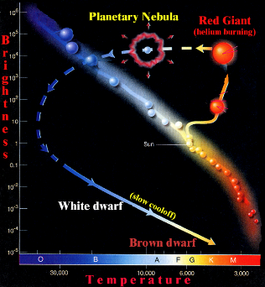
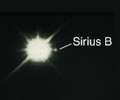
“Sun-like” means
Mass < 1.44 Solar Mass
after mass loss
(i.e. M_{ZAMS}<8M☉)
Sun-like stars:
throw off a planetary nebula
No more heat is produced
nothing to keep the star from collapsing
collapse it does → becomes tiny
heats up in collapse → glows white
Reveals the
white dwarf
Very small (Earth-size)
Very dense
Very slowly cooling
Example: Sirius B

Slide 4
Questions coming …

Slide 5
Question 4
sec
30
29
28
27
26
25
24
23
22
21
20
18
17
16
15
14
13
12
11
10
9
8
7
6
5
4
3
2
1
0
19
Which of the following would become a planetary
nebula, and when?
A A one solar mass star, when its hydrogen is used up.
B A one solar mass star, when all its fuel is used up.
C A ten solar mass star, when its hydrogen is used up.
D A ten solar mass star, when all its fuel is used up.
Next question coming …

Slide 6
Question 5
sec
30
29
28
27
26
25
24
23
22
21
20
18
17
16
15
14
13
12
11
10
9
8
7
6
5
4
3
2
1
0
19
The central star of a planetary nebula is
A a main sequence star.
B a red dwarf.
C a white dwarf.
D a blue giant.
E a red giant.

Slide 7
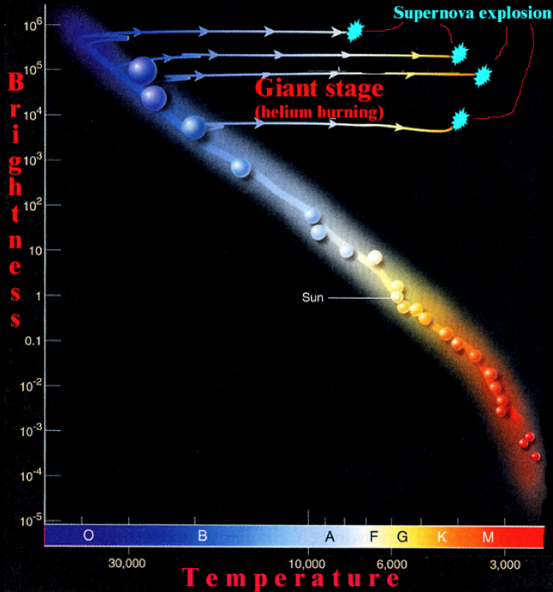
Stellar evolution (massive)
Stellar
Evolution
Evolution
of
massive stars
(Mass > 1.44 M)

Slide 8
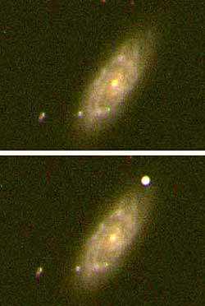
Heavy stars:
when center is all iron,
blow up as supernovae
(further fusion would not produce more heat):
No more heat is produced to hold up against gravity
core collapses
blows up
during blowup, all heavier elements
are produced
“Heavy” means
Mass > 1.44 Solar Masses
The Chandrashekar limit.
SUPERNOVA
Outshines a whole galaxy (for a few days)
All heavy elements
(anything heavier than iron)
come from SN explosions!

Slide 9
Questions coming …

Slide 10
Question 6
sec
30
29
28
27
26
25
24
23
22
21
20
18
17
16
15
14
13
12
11
10
9
8
7
6
5
4
3
2
1
0
19
What is a supernova?
A A new planet.
B A planet blowing up.
C A newly born star.
D A Sun-sized star blowing up.
E A larger-than-the-Sun star blowing up.
Next question coming …

Slide 11
Question 7
sec
30
29
28
27
26
25
24
23
22
21
20
18
17
16
15
14
13
12
11
10
9
8
7
6
5
4
3
2
1
0
19
Which stars end their lives blow up as supernovae?
A Those that are heavier than 1.4 times the Sun.
B All.
C Only a few exceptional stars.
D Supernovae are not blowing-up stars at all.
E Only double stars.

Slide 12
Pathways
Evolutionary pathways and the production of chemical elements
Sun-like stars (mass < 1.44 solar): timeline for 1 solar mass
1. H → He on the main sequence 10 billion years
2. He → C, O, Si, …, Fe in hot core of red giant 1 billion years
3. Planetary nebula thrown off 10,000 years
4. White dwarf cooling off “forever”
Gas thrown off will become part of newly born stars
(a mix of all chemical elements, but not the heavy ones)
Heavy stars (mass > 1.44 solar): timeline for 10 solar mass
1. H → He on the main sequence 10 million years
2. He → C, O, Si, …, Fe in hot core of red giant 1 million years
3. Supernova explosion (Au, Ag, Pb, U, … built) 10 seconds
4. Tiny but very dense remainder cooling off “forever”
(pulsar or black hole or nothing at all)
Gas thrown off will become part of newly born stars
(a mix of all chemical elements, including heavy ones)

Slide 13
Questions coming …

Slide 14
Question 8
sec
45
40
35
30
25
19
18
17
16
15
14
13
12
11
10
9
8
7
6
4
3
2
1
0
20
5
45
How long is the ‘lifetime’ of a very large and a very
small star and how does it end?
A 100 M☉ star: 100 billion years, ends in a supernova
0.1 M☉ star: 1 million years, ends in a white dwarf
B 100 M☉ star: 100 billion years, ends in a white dwarf
0.1 M☉ star: 1 million years, ends in a supernova
C 100 M☉ star: 1 million years, ends in a white dwarf
0.1 M☉ star: 100 billion years, ends in a supernova
D 100 M☉ star: 1 million years, ends in a supernova
0.1 M☉ star: 100 billion years, ends in a white dwarf
E 100 M☉ star: 1 million years, ends in a supernova
0.1 M☉ star: 100 billion years, ends in a supernova
Next question coming …

Slide 15
Question 9
sec
30
29
28
27
26
25
24
23
22
21
20
18
17
16
15
14
13
12
11
10
9
8
7
6
5
4
3
2
1
0
19
Where have the gold, found on Earth, been formed?
A is a white dwarf.
B in the Sun.
C in a red giant.
D in an exploding supernova.
E inside Earth.

