Slide 1


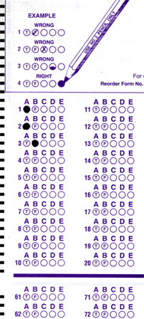
Setup:
Prepare your scantron:
Use
a pencil,
not a pen!
Fill in your name and fill the bubbles under
your name.
LAST NAME FIRST, First name second
Put your 4-digit code instead of “IDENTIFICATION NUMBER”.
--- (The last 4 digits of your OleMiss ID.)
Test 2 on Friday, Oct. 24
(With picture questions!)
Question # 1: answer B
Question # 2: answer A
Question # 3: answer E
Reading assignment
The graveyard, Chapter 18, pp. 557-579
Please take a moment to mute your cell phone!

Slide 2
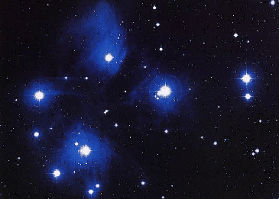
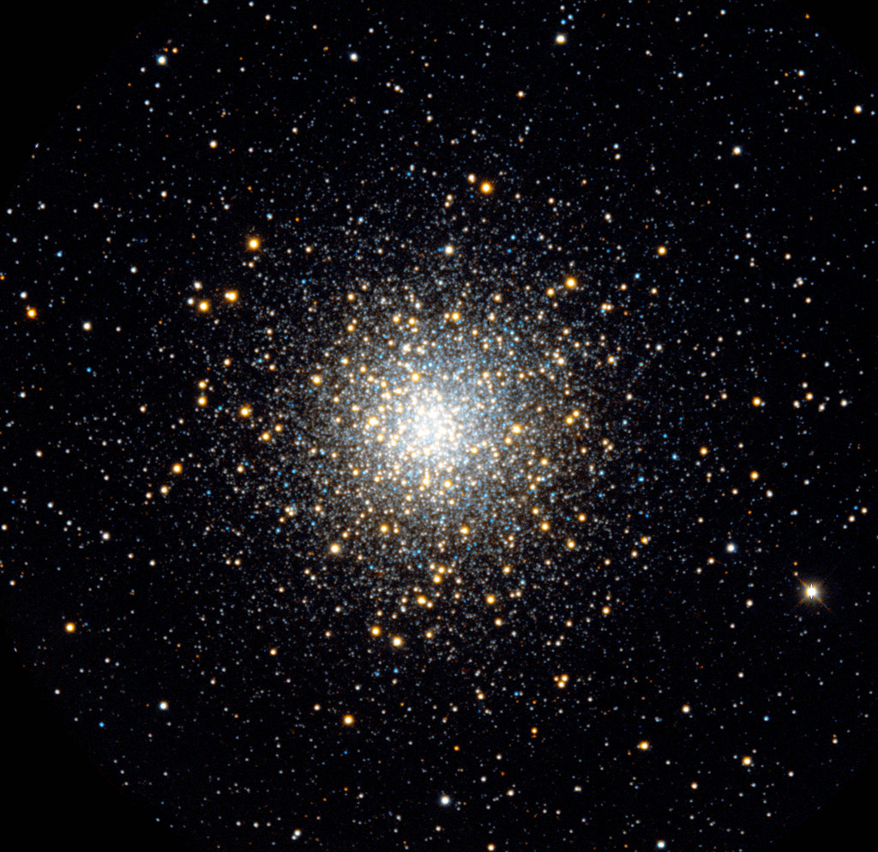
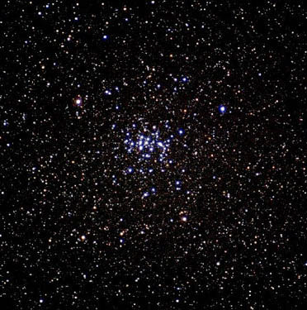
Use for clusters
An application of theHRD : star clusters
Recall what they are: a bunch of stars together
• close to each other (less than a light year)
• all part or our Galaxy
The Pleiades
(M45)
A globular cluster
(M10)
The Beehive
(M44)
Two open clusters

Slide 3
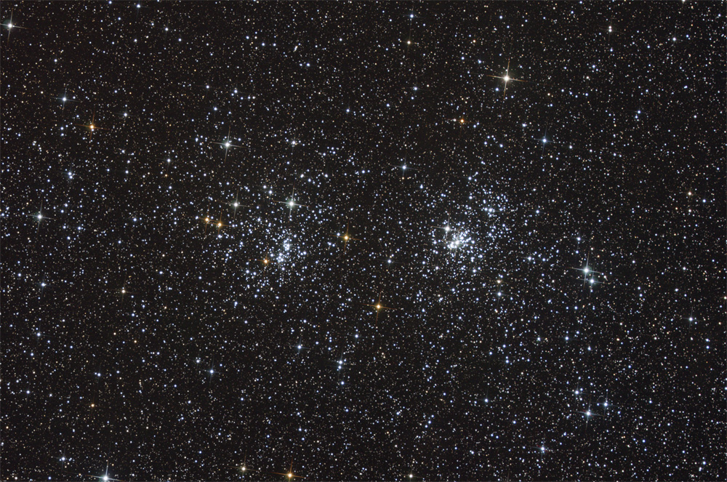

Slide 4
Questions coming …

Slide 5
Question 4
sec
30
29
28
27
26
25
24
23
22
21
20
18
17
16
15
14
13
12
11
10
9
8
7
6
5
4
3
2
1
0
19
What is a star cluster made of?
A Galaxies.
B It is a cloud of gas.
C Many stars.
D Interstellar dust.
Next question coming …

Slide 6
Question 5
sec
30
29
28
27
26
25
24
23
22
21
20
18
17
16
15
14
13
12
11
10
9
8
7
6
5
4
3
2
1
0
19
Which one contains more stars, an open cluster
or a globular cluster?
A An open cluster.
B A globular cluster.
C The same.
D Neither, because both are gas clouds.

Slide 7
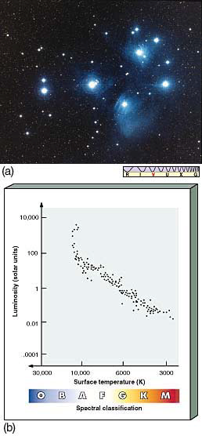
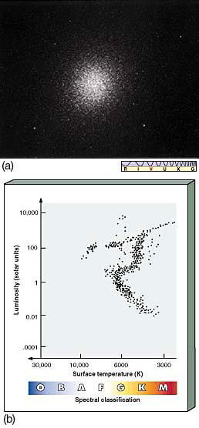
Clusters are useful for studying stars: same distance, same age
Prepare HRD of all stars of a cluster:
Find:
• Many stars on the main sequence
• Above a “turnoff”, stars are
to the right of the main sequence
Meaning:
something happened to these
(these stars are the brightest
in the cluster)
Jump ahead:
they have used up
all their hydrogen in their cores
Place of turnoff indicates age:
• Pleiades is young
• ω Cen is old
Pleiades
ω Centauri

Slide 8
Questions coming …

Slide 9
Question 6
sec
30
29
28
27
26
25
24
23
22
21
20
18
17
16
15
14
13
12
11
10
9
8
7
6
5
4
3
2
1
0
19
What can you read off the Hertzsprung-Russell
diagram (HRD) of a star cluster?
A How bright it is.
B How old it is.
C How large it is.
D How far it is.
E How dense it is.
Next question coming …

Slide 10
Question 7
sec
30
29
28
27
26
25
24
23
22
21
20
18
17
16
15
14
13
12
11
10
9
8
7
6
5
4
3
2
1
0
19
What is different about those stars in a cluster that are located off (above) the main sequence?
QUESTION INCORRECT - CANCELLED
A How bright it is.
B How old it is.
C How large it is.
D How far it is.
E How dense it is.

Slide 11
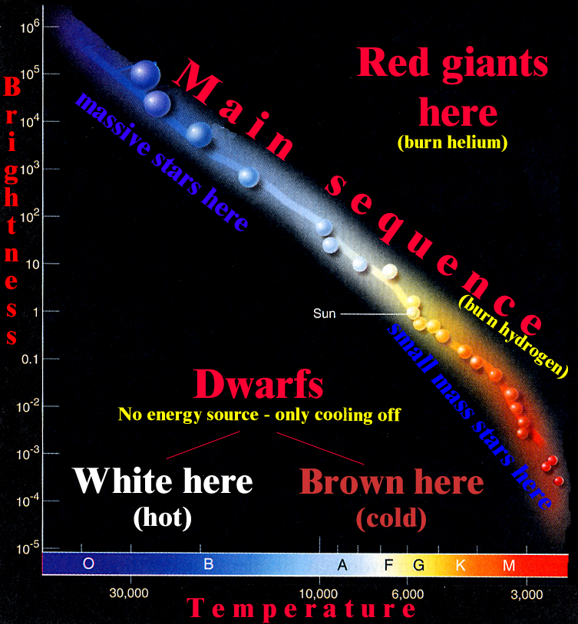
Stellar masses
The significance of stellar mass
Mass tells:
• rate of evolution
• location on main sequence
• whether star blows up as supernova
The heaviest star: 100 M
Short life very bright blue, hot dies as a
(1 million yrs) (-10 mg) (O5) _{SN}
10,000 times faster
Uses its fuel,
compared to the Sun,
The lightest star: 0.1 M
Long life very faint red, lukewarm dies as a
(100 billion yrs) (+15 mg) (M5) white dwarf
1,000 times slower

Slide 12
Questions coming …

Slide 13
Question 8
sec
30
29
28
27
26
25
24
23
22
21
20
18
17
16
15
14
13
12
11
10
9
8
7
6
5
4
3
2
1
0
19
What determines the length of life of a star?
A All stars live the same length of time.
B The temperature in its center.
C Its chemical composition.
D Its mass.
E Its magnetic field.
Next question coming …

Slide 14
Question 9
sec
30
29
28
27
26
25
24
23
22
21
20
18
17
16
15
14
13
12
11
10
9
8
7
6
5
4
3
2
1
0
19
A hot, blue star on the main sequence is …
A heavy
B faint
C far away
D burning helium
E has no fuel left to burn

