Slide 1


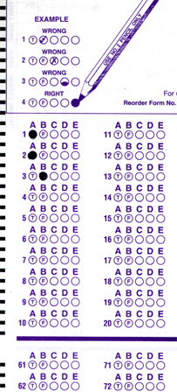
Setup:
Prepare your scantron:
Use
a pencil,
not a pen!
Fill in your name and fill the bubbles under
your name.
LAST NAME FIRST, First name second
Put your 4-digit code instead of “IDENTIFICATION NUMBER”.
--- (The last 4 digits of your OleMiss ID.)
• Pass/fail test on Friday, Oct. 10.
Question # 1: answer A
Question # 2: answer E
Question # 3: answer D
Reading assignment
Hubble’s law, pp. 613-620
(Only skim the math)
Please take a moment to mute your cell phone!

Slide 2
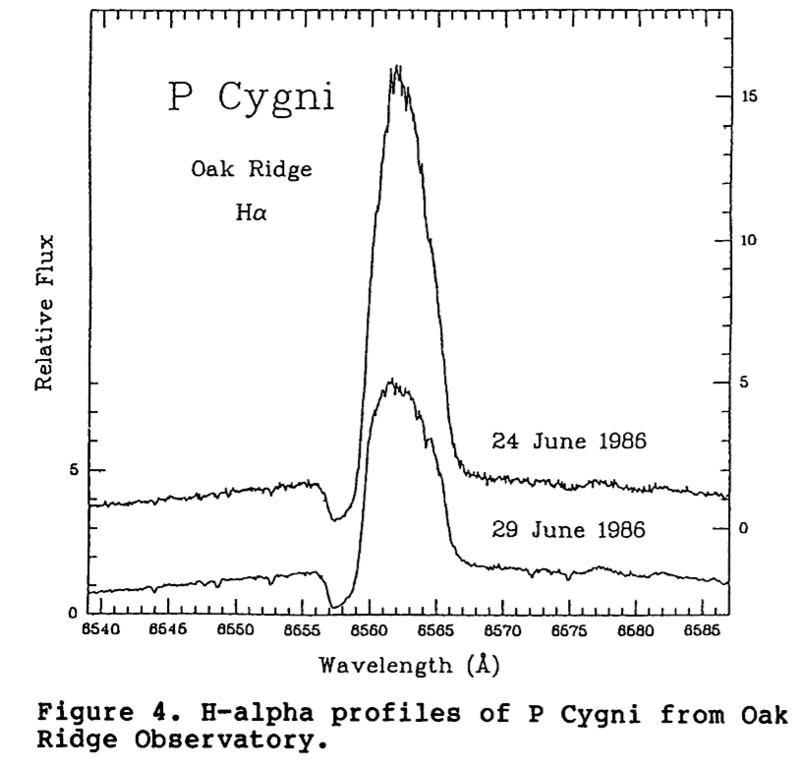
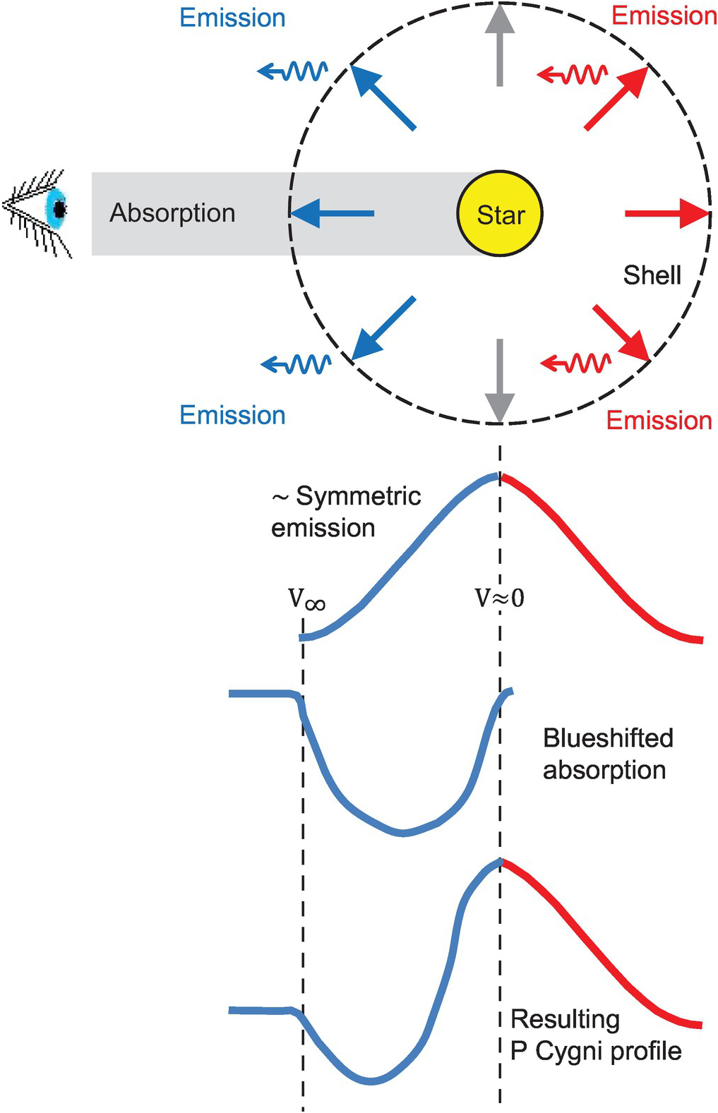
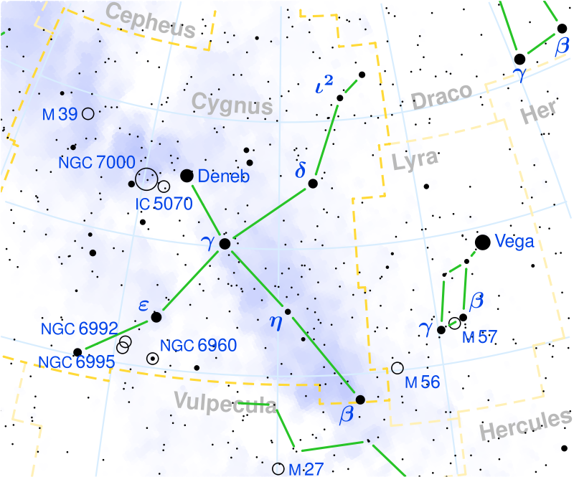
Example:
P Cygni profile
Stellar wind’s effect
on the profile
of a spectral line:
Blue absorption, red emission
Seen only when
a star’s stellar wind is strong
(i.e. a lot of mass loss)
“P Cygni” is a variable star designation.

Slide 3
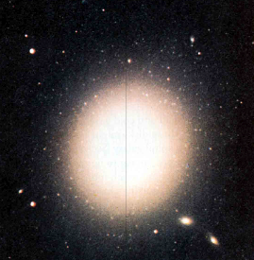
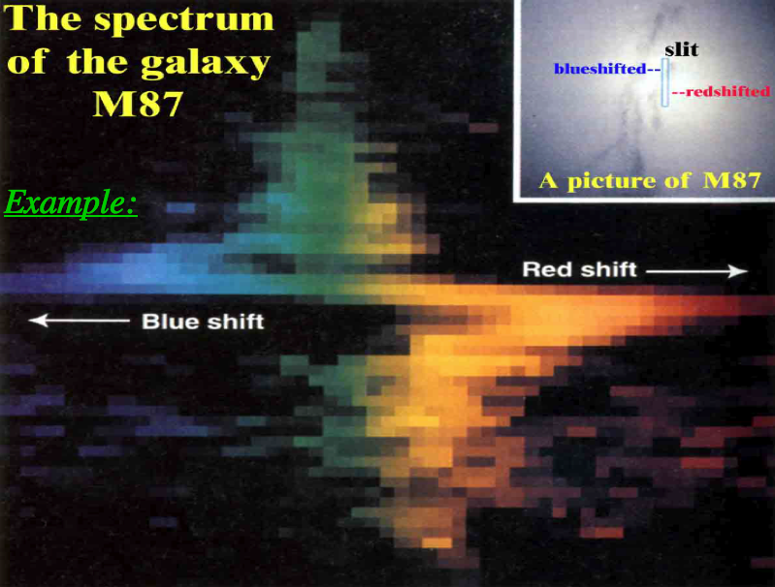
Example: a rotating galaxy
The top of the slit shows blueshift -
- stars there are moving towards us
The bottom of the slit shows redshift -
- stars there are moving away:
Example:
Top of slit moves
our way
Bottom of slit moves
away from us
Rotation is fastest
in the middle
(Colors are fake – this is a small part of the spectrum only!)

