Slide 1



Setup:
Prepare your scantron:
Use
a pencil,
not a pen!
Fill in your name and fill the bubbles under
your name.
LAST NAME FIRST, First name second
Put your 4-digit code instead of “IDENTIFICATION NUMBER”.
--- (The last 4 digits of your OleMiss ID.)
• Pass/fail test on Friday, Oct. 10.
Question # 1: answer A
Question # 2: answer E
Question # 3: answer B
Recall reading assignment
Chapter 5, Light and matter, pp. 137 – 164
Please take a moment to mute your cell phone!

Slide 2
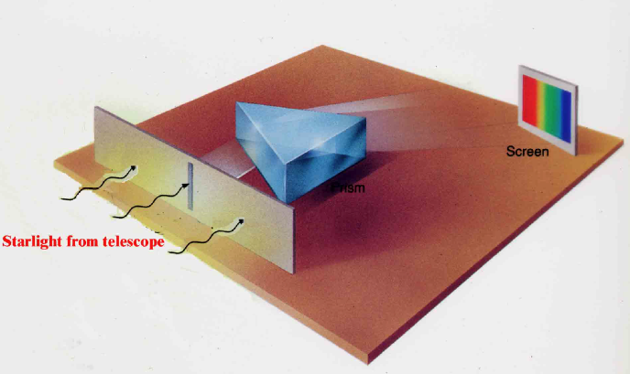
The spectroscope
The device that resolves the colors of light:
the spectroscope
(Joseph von Fraunhofer, 1814)
• Light from telescope enters
slit (to block off stray light)
• Prism (or grating) separates
the colors
• Produces spectrum
on a screen/on a film
(Put this device in a box and
attach it to the telescope)
Spectrum: each color is a “line”
Surprise:
The spectrum of the Sun
has black lines:
Some colors are missing!
(Fraunhofer-lines)

Slide 3


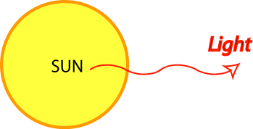
The spectrum of the Sun
Hα
(Color and b/w version of the same thing.)
Hβ
Hγ
Absorption lines (“Frauenhofer-lines”),
many in hydrogen wavelengths
Here: colder gas takes out a few colors
Solar atmosphere

Slide 4
Questions coming …

Slide 5
Question 4
sec
30
29
28
27
26
25
24
23
22
21
20
18
17
16
15
14
13
12
11
10
9
8
7
6
5
4
3
2
1
0
19
The spectrum of the Sun consists of
A a few bright lines only.
B dark lines over a bright continuum.
C dark bands of light with bright centers, over a bright continuum.
D a continuous bright spectrum like a rainbow.
E a few bright bands with dark centers.
Next question coming …

Slide 6
Question 5
sec
30
29
28
27
26
25
24
23
22
21
20
18
17
16
15
14
13
12
11
10
9
8
7
6
5
4
3
2
1
0
19
What are Fraunhofer lines?
A linear clouds in the disc of Jupiter.
B emission lines in the spectrum of a diffuse nebula.
C absorption lines in the spectrum of the Sun.
D dark lines connecting red spots on Mars.
E fake spectral lines in a spectroscope due to diffraction of light.

Slide 7



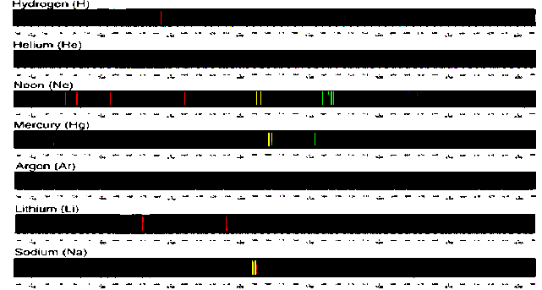
Recall the types of spectra
Continuous spectrum
(thermal glow)
Absorption spectrum
(cold gas illuminated from behind)
Emission spectrum
(by rarified gas: fluorescence)
Each chemical element
has its own spectral lines:
A good way to tell
the chemical composition
of a star!

Slide 8
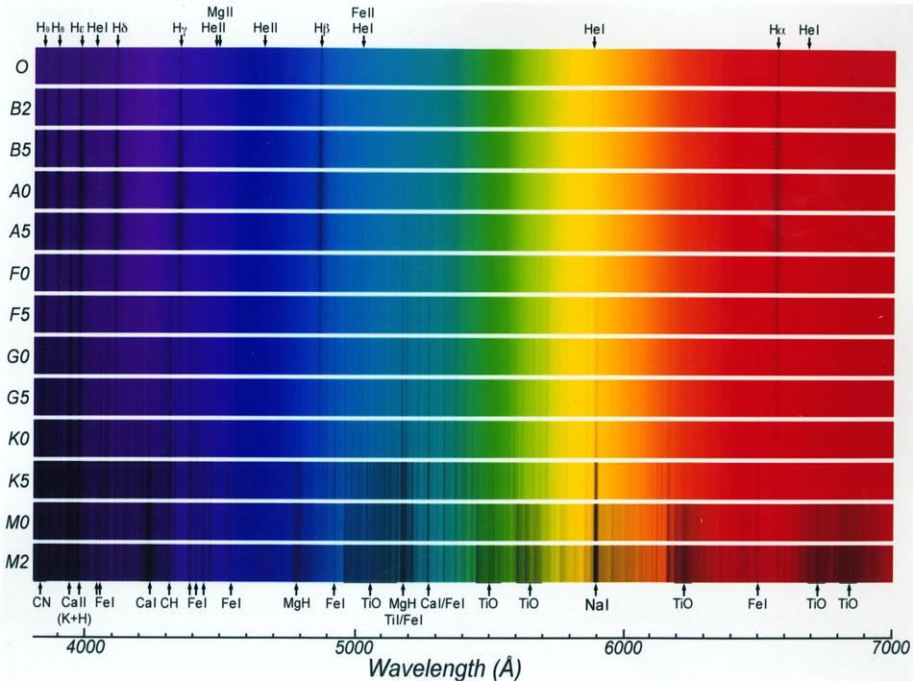
The spectra of stars – the effect of photospheric temperature
Example: hydrogen lines are strongest in A0 stars (at 10000K) – explain why?
20,000K
9,000K
6,000K
3,000K

Slide 9
Questions coming …

Slide 10
Question 6
sec
30
29
28
27
26
25
24
23
22
21
20
18
17
16
15
14
13
12
11
10
9
8
7
6
5
4
3
2
1
0
19
How do we tell precisely the spectral type of stars?
Based on …
A a calculation of the star’s brightness.
B the overall color of the star.
C which spectral lines are strongest.
D the width (or profile) of spectral lines.
E the Doppler-shift in individual spectral lines.
Next question coming …

Slide 11
Question 7
sec
30
29
28
27
26
25
24
23
22
21
20
18
17
16
15
14
13
12
11
10
9
8
7
6
5
4
3
2
1
0
19
Metal lines are strongest in a star’s spectrum
when the star is … ?
A Hottest.
B Coldest.
C Largest.
D Smallest.
E Closest.

Slide 12
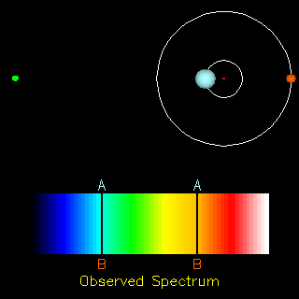
Example: spectroscopic binaries
Measure:
* Blue/red shift of lines
* Time period
Earth
Calculate:
* Orbital speed
( shift in % of wavelength
= speed in % of speed of light )
* Size of orbit
( time period × speed = 2 r π )
* Mass of stars
( Kepler III: M × T² = r³ )

Slide 13
Questions coming …

Slide 14
Question 8
sec
30
29
28
27
26
25
24
23
22
21
20
18
17
16
15
14
13
12
11
10
9
8
7
6
5
4
3
2
1
0
19
How do we know the mass of (some) stars?
A Using measurements of their planets.
B Using measurements of the force of their gravity on spaceships.
C Using the red/blue shift of spectral lines of double stars.
D Using measurements of their brightness and color.

Slide 15
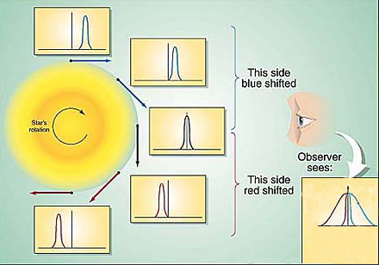
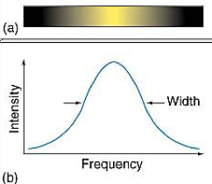
What do spectra tell us?
The details of the spectra tell a lot:
• Chemical composition: which lines are present
• Rotation: broadening (same percent for all lines)
• Movement (towards us or away from us): shift lines (same percent for all lines)
• Strength of magnetic field (if any): split of lines into doublets
• Temperature: relative line strengths of the same atom
For example, H_{α} (level 2 to 3, red) vs. P_{α} (Paschen-α, level 3 to 4, infrared) transition in H atom.
• Gas density (gravity), chaotic wind speed: broadening (varies from atom to atom)
• Mass loss (stellar wind): P Cygni profile (blue-shifted emission + unshifted absorption)
Example: Rotational
line broadening:
(all spectral lines broadened
by the same percent)

Slide 16
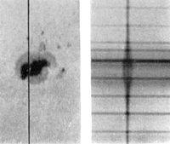
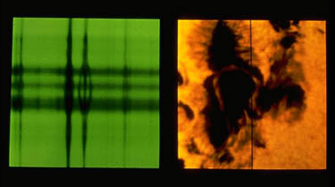
Example: the Zeeman effect
(splitting lines into doublets/triplets by the magnetic field)
shorter longer
wavelength
Zeeman split is strong inside sunspot
(split is proportional magnetic field strength)
on this picture, maximum magnetic field strength is
~ 1 Tesla (10 times stronger than a household magnet)
extends to an area size of the US
Spectrograph’s slit
Excludes light outside this line

Slide 17
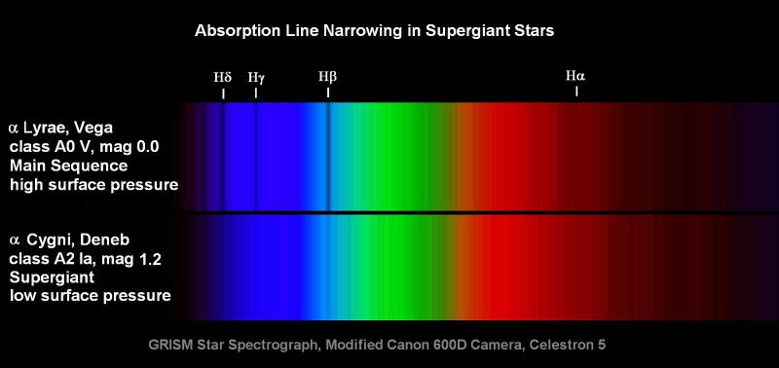
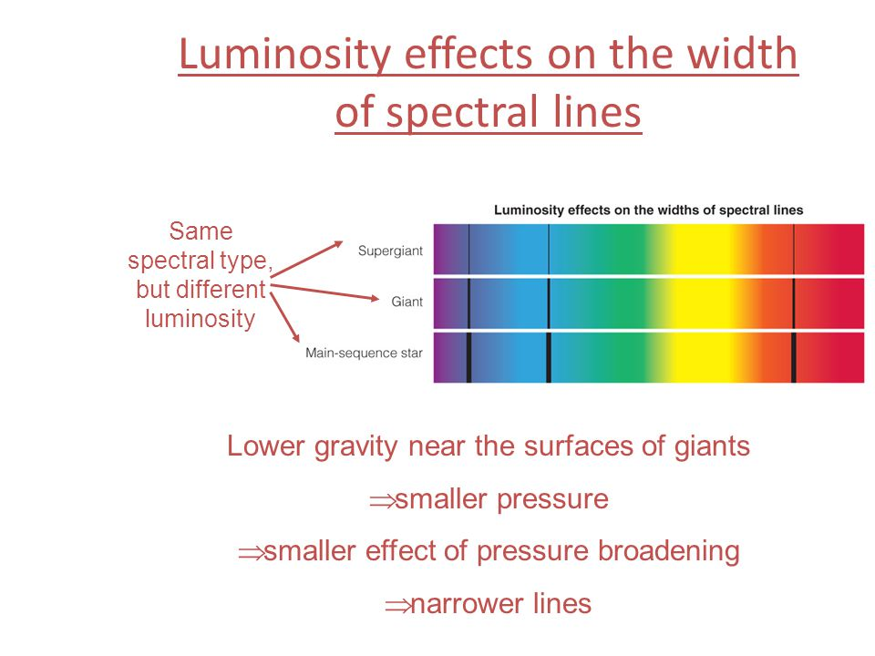
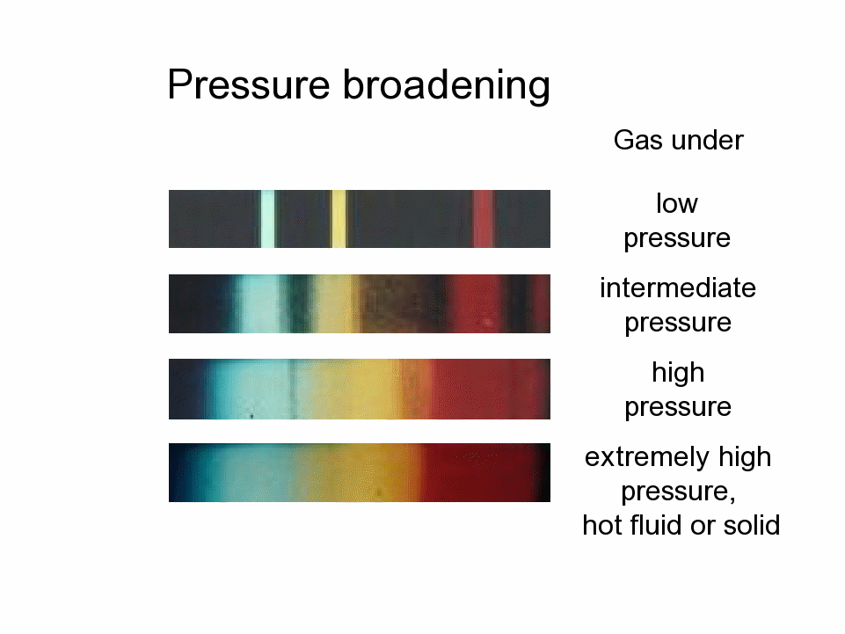
Example: pressure broadening
(giant stars have narrow lines)
The spectrum tells us the surface gravity (i.e. luminosity class)

Slide 18
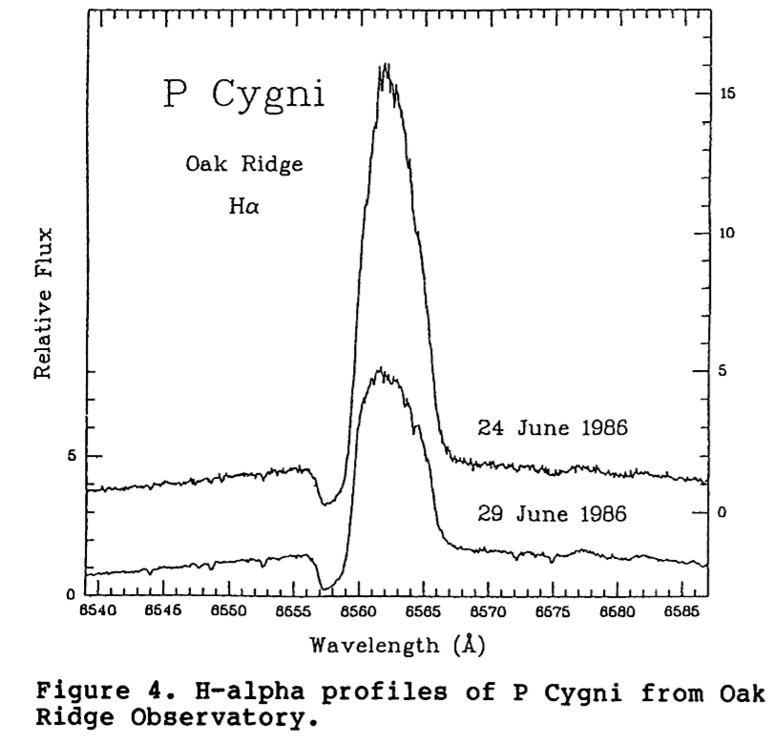
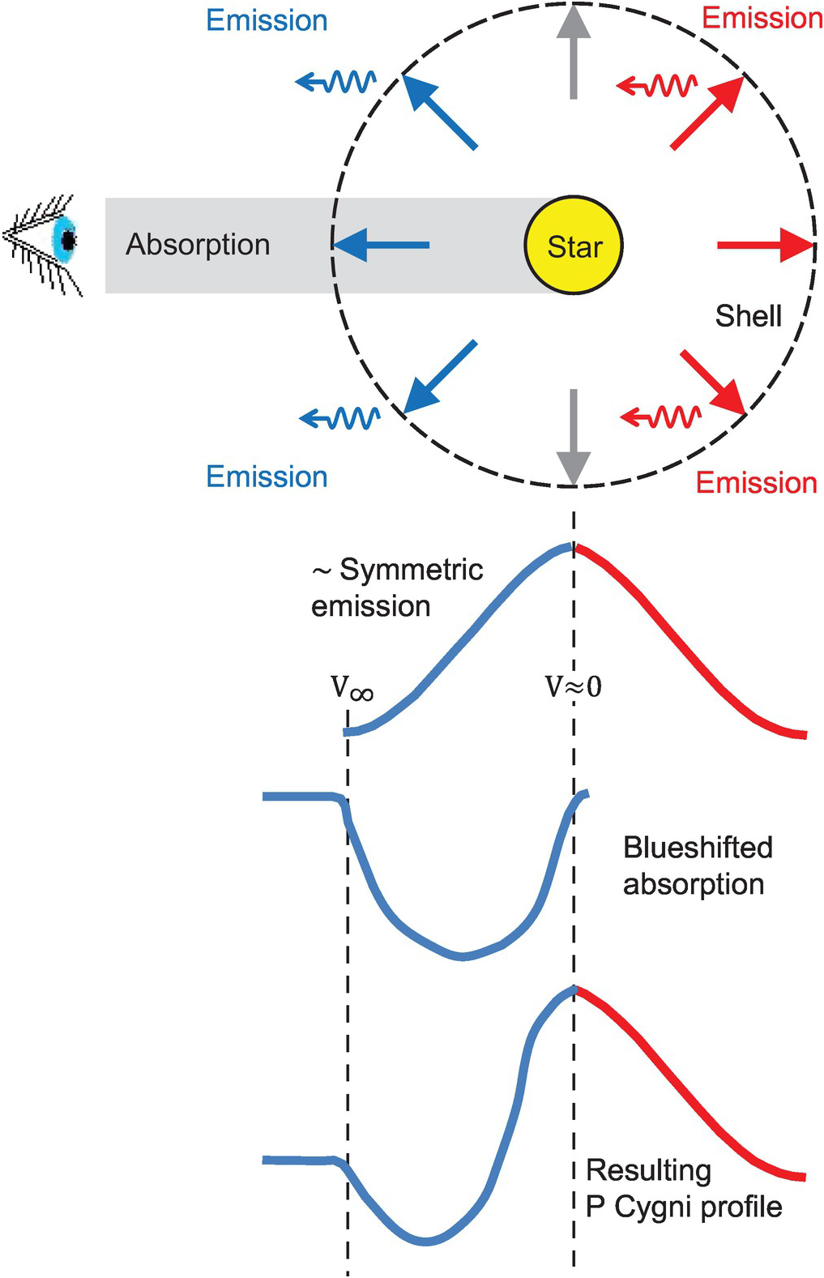
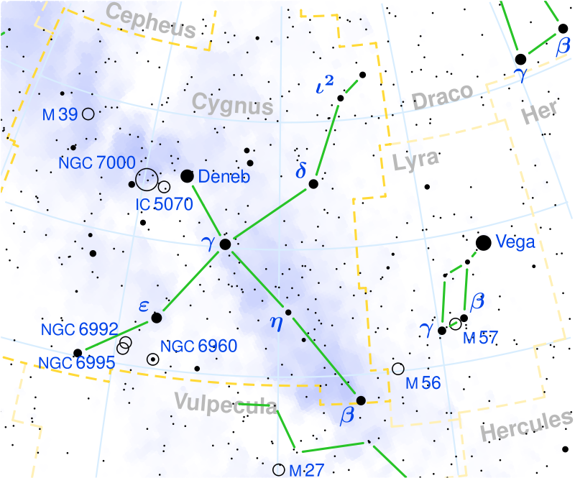
Example:
P Cygni profile
Stellar wind’s effect
on the profile
of a spectral line:
Blue absorption, red emission
Seen only when
a star’s stellar wind is strong
(i.e. a lot of mass loss)
“P Cygni” is a variable star designation.

Slide 19
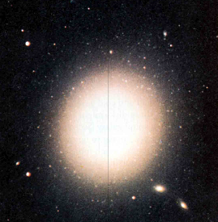
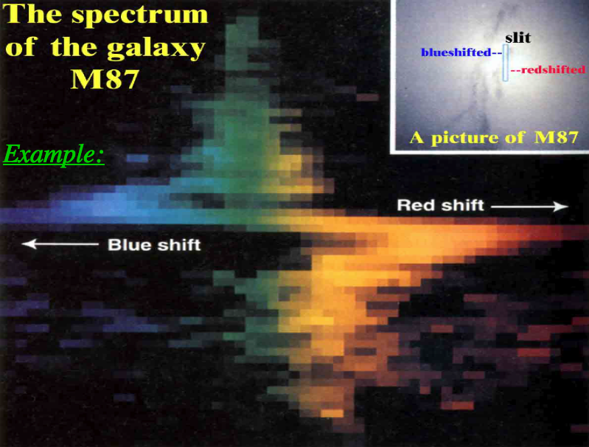
Example: a rotating galaxy
The top of the slit shows blueshift -
- stars there are moving towards us
The bottom of the slit shows redshift -
- stars there are moving away:
Example:
Top of slit moves
our way
Bottom of slit moves
away from us
Rotation is fastest
in the middle
(Colors are fake – this is a small part of the spectrum only!)

