Slide 1



Setup:
Prepare your scantron:
Use
a pencil,
not a pen!
Fill in your name and fill the bubbles under
your name.
LAST NAME FIRST, First name second
Put your 4-digit code instead of “IDENTIFICATION NUMBER”.
--- (The last 4 digits of your OleMiss ID.)
Recall reading assignment
Chapter 5, Light and matter, pp. 137 – 164
Question # 1: answer A
Question # 2: answer D
Question # 3: answer E
• Pass/fail test on Friday, Oct. 10.
• The solutions to Test 1 are available, click ‘tests’ on the website.
Please take a moment to mute your cell phone!

Slide 2
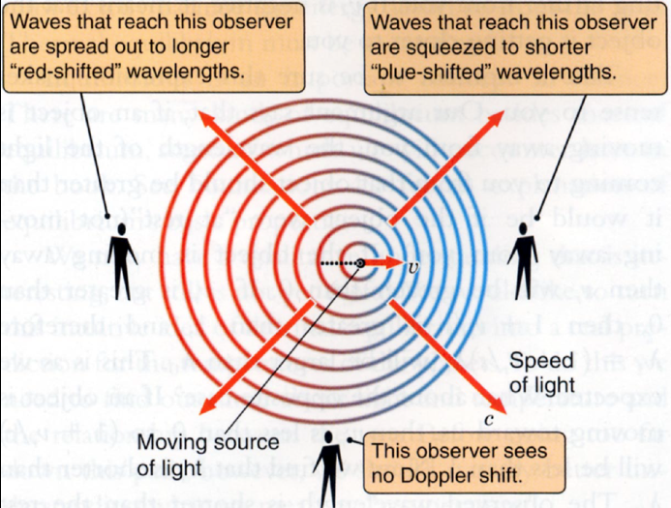
The Doppler effect
The effect of motion on spectral lines:
• Light source moves towards observer: spectral lines are shifted towards blue
• Light source moves away from observer: spectral lines are shifted towards red
• Light source moves sideways: no change
How large is the
Doppler effect?
Usually tiny.
% shift in λ =
speed in % of
the speed of light
Realistic example:
30 km/s 0.01% shift
(this is the orbital speed of Earth)

Slide 3
Questions coming …

Slide 4
Question 4
sec
45
40
35
30
25
19
18
17
16
15
14
13
12
11
10
9
8
7
6
4
3
2
1
0
20
5
What is the Doppler effect?
A Stars move on tiny circles in the sky, once a year.
B The stars appear red when they are rising or setting.
C Far-away stars appear red because the Universe is expanding.
D The spectral lines of a star are shifted towards red, if the star is moving away from us, and towards blue, if the star is approaching us.
E A fast moving star’s spectral lines are shifted towards red, independently of the direction of motion.
Next question coming …

Slide 5
Question 5
sec
30
29
28
27
26
25
24
23
22
21
20
18
17
16
15
14
13
12
11
10
9
8
7
6
5
4
3
2
1
0
19
Which of the following happens to the sound of the whistle coming from a train approaching us at high speed?
A It becomes lower-pitched.
B It becomes higher-pitched.
C It becomes less loud.
D It becomes more loud.

Slide 6



The spectrum of another star
Hα
The Sun
Hβ
Hγ
Polaris
Spectral lines shifted towards blue:
Polaris is approaching us
Measure shift: find radial speed
17 km/s
Why are the spectral lines shifted? -- the Doppler effect

Slide 7
Question coming …

Slide 8
Question 6
sec
30
29
28
27
26
25
24
23
22
21
20
18
17
16
15
14
13
12
11
10
9
8
7
6
5
4
3
2
1
0
19
In what are spectra of other stars different from
the Sun’s?
A The same spectral lines are there in every star’s
spectra, but they may be shifted if the star is moving.
B Different spectral lines may be visible, in addition
to Doppler-shift.
C All stars have the same spectrum because they are all made of gas.
D The spectrum is the same, except that the blue part of hotter stars’ spectra is brighter.

