Slide 1


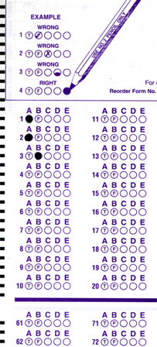
Setup:
Prepare your scantron:
Use
a pencil,
not a pen!
Fill in your name and fill the bubbles under
your name.
LAST NAME FIRST, First name second
Put your 4-digit code instead of “IDENTIFICATION NUMBER”.
--- (The last 4 digits of your OleMiss ID.)
Recall reading assignment
Angular size; arcseconds (pp. 27-28)
Parallax, parsecs, absolute magnitude, distance modulus (pp. 489-493)
Question # 1: answer A
Question # 2: answer D
Question # 3: answer A
• Test on Friday, Sept. 26
• Any student may choose to come to take the 1:00 or the 3:00 pm test.
Please take a moment to mute your cell phone!

Slide 2
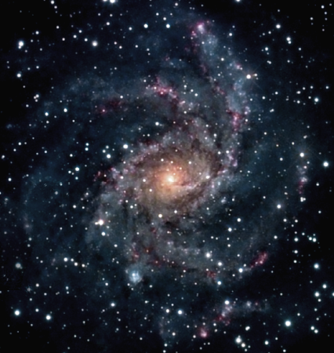
Recall: apparent and absolute brightness
Recall:
A parsec (pc) is a unit of distance, 3.26 light years.
Why this unit?
Because the orbit of Earth looks 1 arc sec radius from the distance of 1 pc.
How bright it looks
(m)
How bright it really is
(M)
Solar neighborhood (~100 pc)
A star’s absolute magnitude is
how bright it would look
from 10 pc (32.6 light years) away.
The Sun: M = 5^{mg}
(an average star)

Slide 3
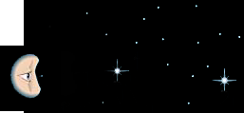
Distance makes stars dimmer
The rule: 2.5 times as far away, looks 2^{mg} dimmer
Star A and star B have the same absolute magnitude M = 5^{mg}
Star B is 10 pc away: apparent magnitude m = 5^{mg}
Star A is 25 pc away: apparent magnitude m = 7^{mg}
Reality:
Looks like:
10 pc
B
B
25 pc
A
A

Slide 4
Distance modulus
The distance modulus
Relation: M (abs. magn.), m (appt. magn.), d (distance in pc)
Meaning of relation: the farther a star, the fainter it looks
Distance modulus: Δ = m – M
Relation to distance: Δ = 5 × lg d - 5
or: d = 10^{Δ/5+1}
How to use this?
Suppose you know two of:
d (the distance),
m (the apparent brightness),
M (the absolute magnitude
one can calculate the third.
Centauri suppose we know the apparent brightness m = 1.3^{mg} (a bright star)
and the distance 4 light years = 1.3 pc (very close to us)
=> distance modulus Δ = 5 × lg d - 5 = - 4.4 mg
=> absolute magnitude M = m – Δ = 5.7^{mg} , (star a bit ‘smaller’ than the Sun)
Centauri suppose we know the apparent brightness m = 3.5^{mg} (reasonably bright)
and the absolute magnitude M = -10.1^{mg} (a globular cluster)
=> distance modulus Δ = m – M = 13.6 mg
=> distance d = 10^{Δ/5+1} = 5200 pc = 17,000 light years
(very far from us, halfway to the center of the Galaxy)

Slide 5
Questions coming …

Slide 6
Question 4
sec
30
29
28
27
26
25
24
23
22
21
20
18
17
16
15
14
13
12
11
10
9
8
7
6
5
4
3
2
1
0
19
What is distance modulus?
A The distance to a star in parsecs.
B The distance to a star in light years.
C The difference between apparent and absolute magnitude.
D The reciprocal of a star’s parallax.
E The total energy radiated by a star every second.
Next question coming …

Slide 7
Question 5
sec
30
29
28
27
26
25
24
23
22
21
20
18
17
16
15
14
13
12
11
10
9
8
7
6
5
4
3
2
1
0
19
What quantity can be calculated from distance
modulus without any additional input?
A The apparent magnitude.
B The absolute magnitude.
C The speed of motion.
D The diameter.
E The distance.
Next question coming …

Slide 8
Question 6
sec
30
29
28
27
26
25
24
23
22
21
20
18
17
16
15
14
13
12
11
10
9
8
7
6
5
4
3
2
1
0
19
In order to calculate the distance to a star, what data do you need in addition to its apparent magnitude?
A Its size (as in miles).
B Its size (as in arc seconds).
C Its speed of motion.
D Its absolute magnitude.
E Its temperature.

