Slide 1

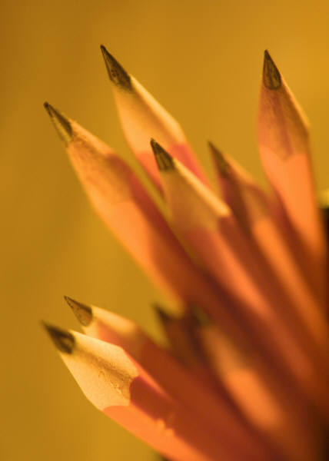
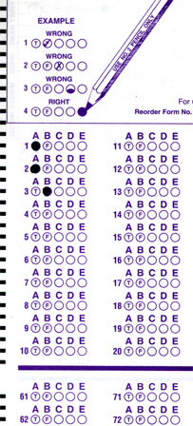
Setup:
Prepare your scantron:
Use
a pencil,
not a pen!
Fill in your name and fill the bubbles under
your name.
LAST NAME FIRST, First name second
Put your 4-digit code instead of “IDENTIFICATION NUMBER”.
--- (The last 4 digits of your OleMiss ID.)
• Labs: DS visit this week
(weather permitting)
• Test on Friday, Sept. 26
Question # 1: answer A
Question # 2: answer C
Question # 3: answer B
Recall reading assignment
Chapter 14, The Sun, pp. 466 – 487
Please take a moment to mute your cell phone!

Slide 2
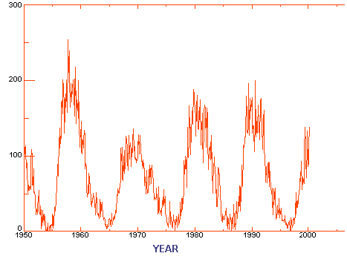
The 11 year solar cycle
(# of spots) +
10 x
(# of groups)

Slide 3
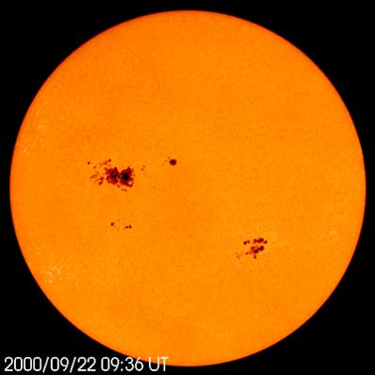
Solar maximum
Solar
maximum
• Many large sunspots
• Flares
• Prominences
• Eruptions
➔
Weather affected strongly

Slide 4
Questions coming …

Slide 5
Question 4
sec
45
40
35
30
25
19
18
17
16
15
14
13
12
11
10
9
8
7
6
4
3
2
1
0
20
5
What is the “solar cycle”?
A Every eleven years the Sun is more active and has a
lot of sunspot, followed by years of relative quiet.
B Once in year sunspots cause disruptions in the
magnetic field of Earth.
C Nuclear reactions heat up the Sun hotter than normal for a few
months every year, and this causes summer.
D Holes in the surface of the Sun where we see deep into the Sun.
E The energy production in the Sun oscillates with a
period of a few hundred years.
Next question coming …

Slide 6
Question 5
sec
45
40
35
30
25
19
18
17
16
15
14
13
12
11
10
9
8
7
6
4
3
2
1
0
20
5
How long is the “sunspot cycle”?
A 1 day.
B 1 year.
C 11 years.
D 4 billion years.
E 11 billion years.

Slide 7
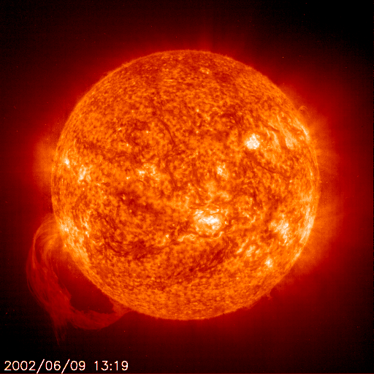
Prominences
(H_{α} filter)
Gas follows
Magnetic
field lines

Slide 8
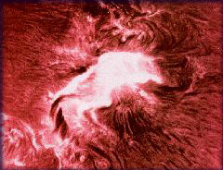
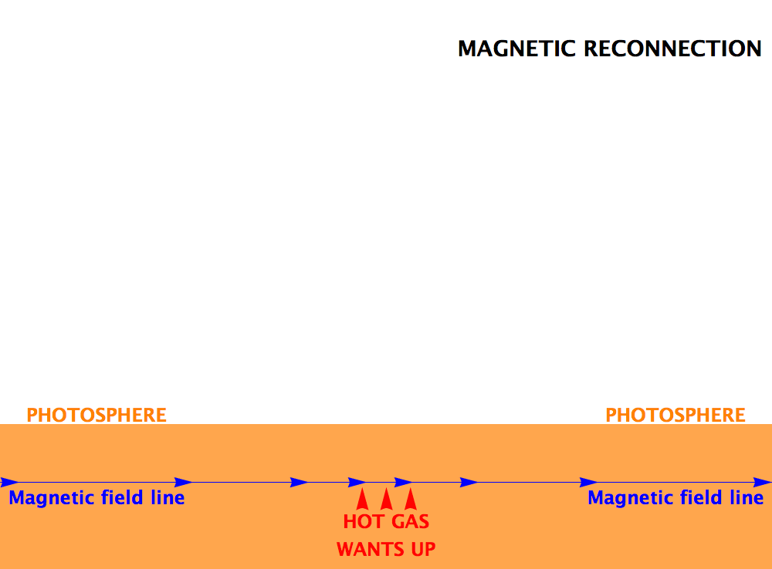
Solar flares
Note: flares show much better
on H_{α}-filtered images
A flare:
a small region in the photosphere suddenly
heats up and shines for ~ ten minutes
Magnetic reconnection
releases heat
Rare event:
once in a month at solar maximum
flare lives for ten minutes
A flare is not a CME (eruption)
– may or may not start one
Do not confuse flares with prominences:
• flares are rare and short lived, violent
• prominences (and filaments) are
‘levitating’ gas over the photosphere

Slide 9
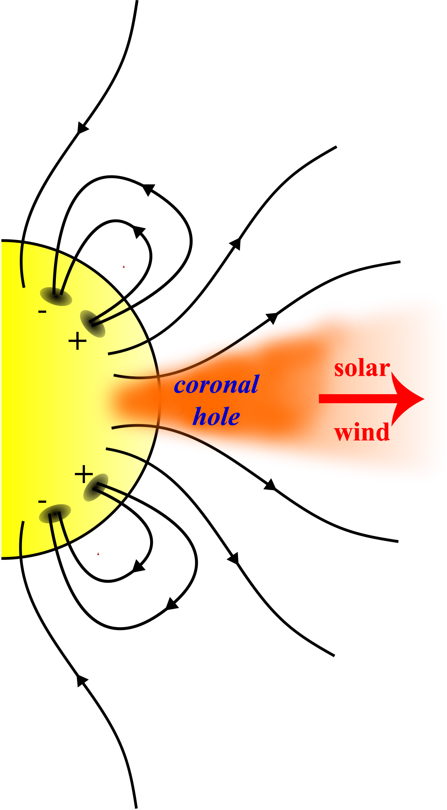
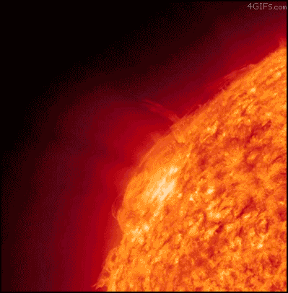
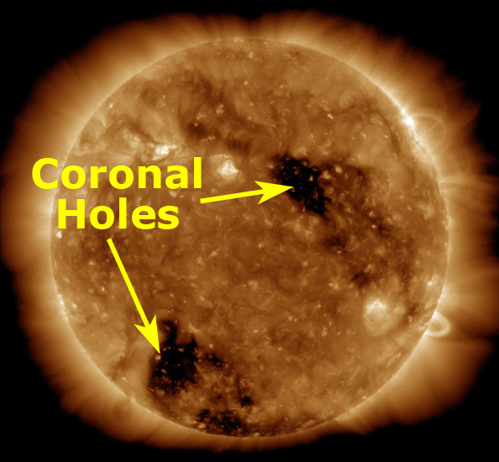
Coronal mass ejection
(CME)
May or may not be associated with a solar flare
If this matter hits earth, we get a ’magnetic storm’: aurora, power lines endangered, radiation in the Van Allen belts
Coronal hole:
An open magnetic
field pattern
The main source
of the solar wind

Slide 10
Questions coming …

Slide 11
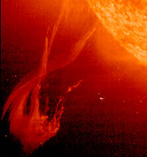
Question 6
sec
30
29
28
27
26
25
24
23
22
21
20
18
17
16
15
14
13
12
11
10
9
8
7
6
5
4
3
2
1
0
19
What is in the picture?
A A sunspot.
B A prominence.
C A solar flare.
Next question coming …

Slide 12
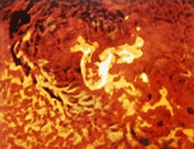
Question 7
sec
30
29
28
27
26
25
24
23
22
21
20
18
17
16
15
14
13
12
11
10
9
8
7
6
5
4
3
2
1
0
19
What is in the picture?
A A sunspot.
B A prominence.
C A solar flare.
Next question coming …

Slide 13
Question 8
sec
30
29
28
27
26
25
24
23
22
21
20
18
17
16
15
14
13
12
11
10
9
8
7
6
5
4
3
2
1
0
19
Look at the Sun through a telescope in regular light
(no color filter) at a random time.
You have a good chance of seeing the following:
A Sunspots, solar flares and prominences.
B Sunspots, solar flares.
C Sunspots.
D Sunspots and prominences.
E Solar flares and prominences.

Slide 14
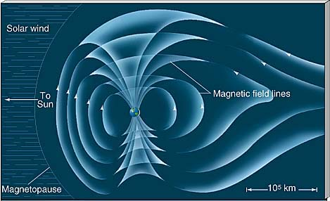
What if an eruption hits Earth?
Charged matter from the Sun is deflected by Earth’s magnetic field towards the Arctic and Antarctica

Slide 15
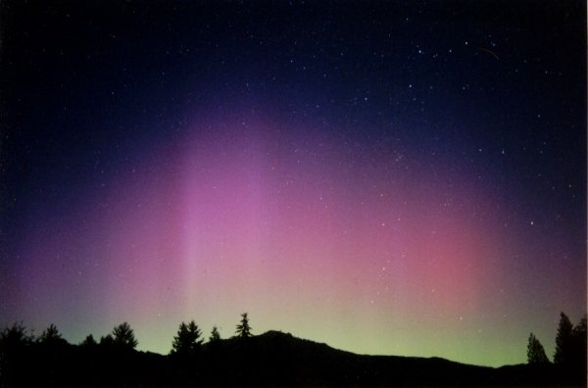
Aurora Borealis& Australis

Slide 16
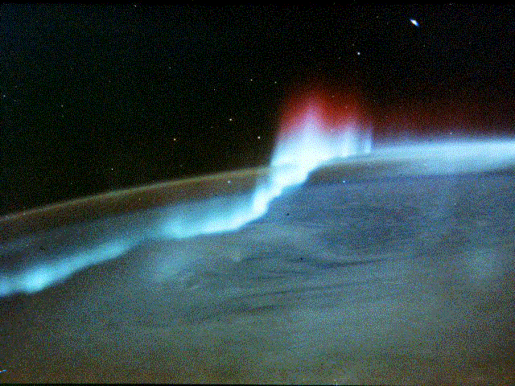
Aurora Borealis& Australis
(from space)

Slide 17
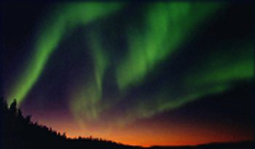
Green aurora
Aurora Borealis in Canada

Slide 18
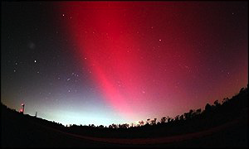
Red aurora
Red aurora
the color varies because the energy of the charged particles varies.
Watch Themis movie!

Slide 19
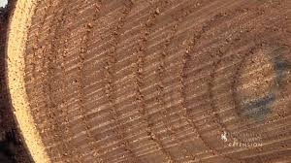
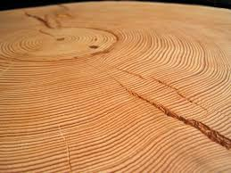
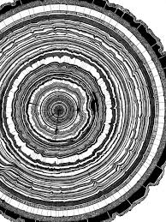
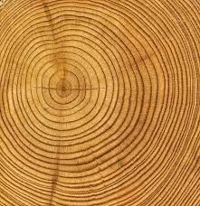
Tree rings and the solar cycle
Years around
sunspot maxima
are rainier

Slide 20
Questions coming …

Slide 21
Question 9
sec
30
29
28
27
26
25
24
23
22
21
20
18
17
16
15
14
13
12
11
10
9
8
7
6
5
4
3
2
1
0
19
What causes aurora?
A Exhaust gases from spacecraft.
B Charged particles, freed up when atomic bombs blow up.
C Cosmic radiation from distant galaxies.
D The Sun spits out charged particles and they hit Earth.
E The asteroid belt shines in reflected sunlight.
Next question coming …

Slide 22
Question 10
sec
30
29
28
27
26
25
24
23
22
21
20
18
17
16
15
14
13
12
11
10
9
8
7
6
5
4
3
2
1
0
19
What happens when a solar eruption hits Earth?
A Hurricanes arise.
B Lightening and thunder is caused.
C Volcanoes erupt.
D Shooting stars fall from the sky.
E Aurora flares up, and the upper atmosphere’s chemistry changes.
Next question coming …

Slide 23
Question 11
sec
30
29
28
27
26
25
24
23
22
21
20
18
17
16
15
14
13
12
11
10
9
8
7
6
5
4
3
2
1
0
19
How do sunspots affect us on Earth?
A The magnetic field of sunspots directly affects humans and animals.
B Sunspots make the Sun less hot, which results in cold weather.
C Sunspots don’t but an active sun’s ’wind’ turns the weather rainier.
D Sunspots cause aurora, which in turns affects our mood.
E There is no effect whatsoever of sunspots on humans.

