Slide 1
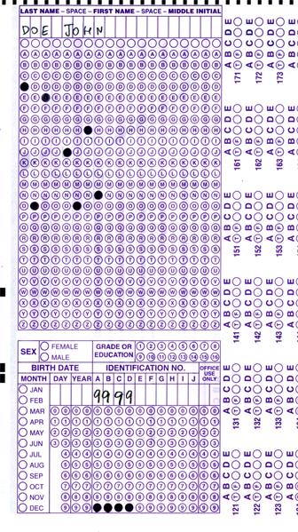


Setup:
Prepare your scantron:
Use
a pencil,
not a pen!
Fill in your name and fill the bubbles under
your name.
LAST NAME FIRST, First name second
Put your 4-digit code instead of “IDENTIFICATION NUMBER”.
--- (The last 4 digits of your OleMiss ID.)
Don’t forget: you’ll need
a new scantron for class on Wednesday!
Question # 1: answer A
Question # 2: answer A
Question # 3: answer B
Reading assignment
Chapter 1, The Universe, pp. 1 – 23
(skip the math)
Please take a moment to mute your cell phone!

Slide 2
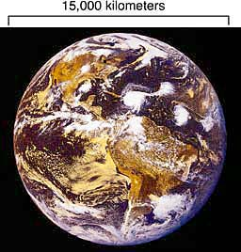
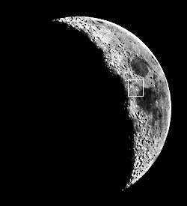
The hierarchy of the Universe, Step 1
The hierarchy of the Universe
Step 1:
Memorize this, please: ~13,000 km
Size : 12,756 km = 7972 miles
Size: 3476 km
Earth
Moon
Distance: 384,400 km

Slide 3
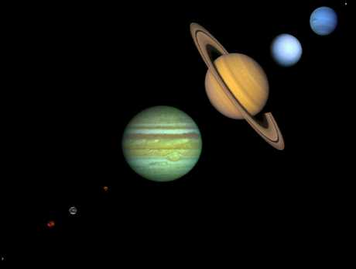
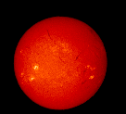
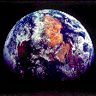
The hierarchy of the Universe, Step 2
Step 2: the Solar System
The
Sun
is a
STAR
Planets
The planets revolve around the Sun
and reflect sunlight
(asteroids and comets, too, except they are much smaller)
Distance = 150 million km
= 1 AU
Earth
Distance = 400,000 km
(Astronomical Unit)
Memorize this, please!

Slide 4
Questions coming …

Slide 5
Question 4
sec
30
29
28
27
26
25
24
23
22
21
20
18
17
16
15
14
13
12
11
10
9
8
7
6
5
4
3
2
1
0
19
How many stars are there in the Solar System?
A None
B One
C Nine
D Six thousand
E Billions
Next question coming …

Slide 6
Question 5
sec
30
29
28
27
26
25
24
23
22
21
20
18
17
16
15
14
13
12
11
10
9
8
7
6
5
4
3
2
1
0
19
A comet orbits around …
A nothing
B Earth
C the Sun
D a planet
E the center of the Galaxy

Slide 7



The hierarchy of the Universe, Step 3
Step 3: Stars
Each star may come with its own planets
(we cannot see these planets directly: too small and far away)
Star
Star
Sun
Star
Distance = a few light years
1 light year = 10,000 billion km (= 10¹³ km)
Star
Star
The closest star (except the Sun): Proxima Centauri - 4 light years

Slide 8
Questions coming …

Slide 9
Question 6
sec
30
29
28
27
26
25
24
23
22
21
20
18
17
16
15
14
13
12
11
10
9
8
7
6
5
4
3
2
1
0
19
What is a light year?
A A time as long as the lifetime of a star.
B A long time. Stars live a lot longer than one light year.
C A distance. The closest stars are a few light years away.
D A large distance. The distance between stars is much
less than one light year.
E A large distance. The size of the whole Universe is a
few light years.

Slide 10
Question 7
sec
30
29
28
27
26
25
24
23
22
21
20
18
17
16
15
14
13
12
11
10
9
8
7
6
5
4
3
2
1
0
19
Where do stars and planets get their light from?
A a star: from the Sun, a planet: on its own
B a star: glows on its own, a planet: glows on its own
C a star: from the Sun, a planet: from the Sun
D a star: glows on its own, a planet: from the Sun
E a star: from the Galaxy, a planet: from the Sun

Slide 11
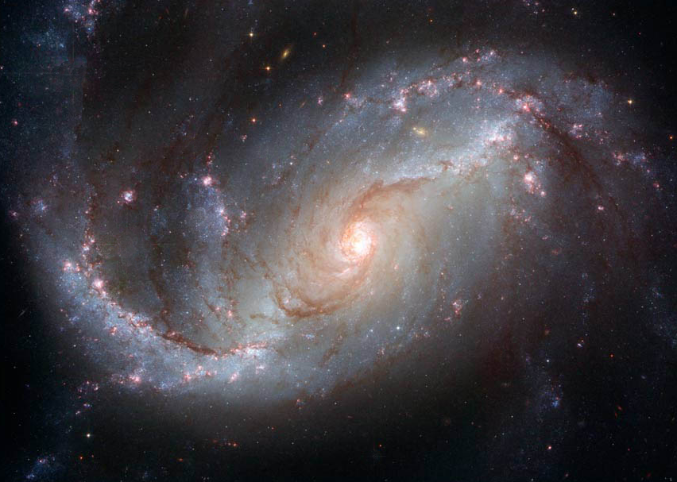
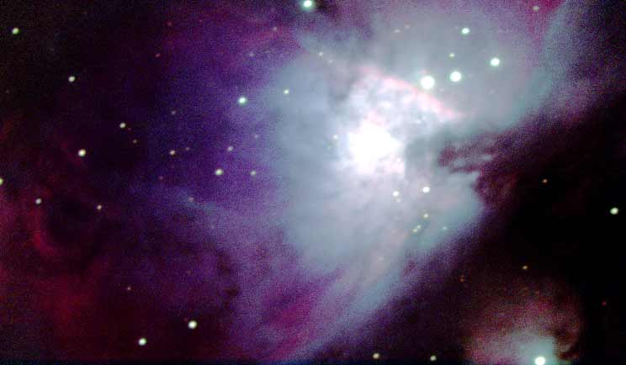
The hierarchy of the Universe, Step 4
~ 100,000 light years
Consists of
~ 100 billion
stars and a
little rare gas
between
the stars.
Where this gas
is a little less rare,
it glows
and is called
a nebula:
The
Milky
Way
is a
galaxy:
the
Galaxy
Sun
Step 4: the Milky Way

Slide 12
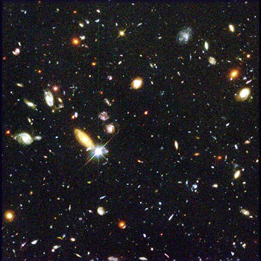
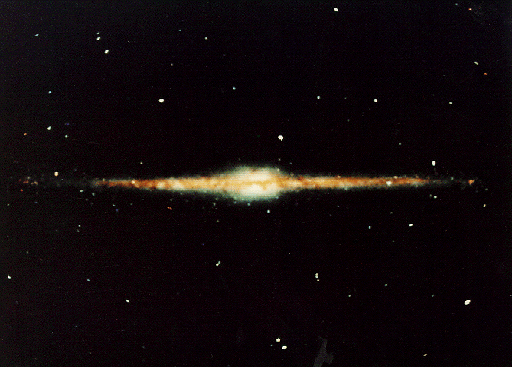
The hierarchy of the Universe, Step 5
Step 5: The whole Universe
Consists of
~ 1000 billion
galaxies.
Radius:
14 billion light years
The
Milky Way
Distance = 400,000 km

Slide 13
Questions coming …

Slide 14
Question 8
sec
30
29
28
27
26
25
24
23
22
21
20
18
17
16
15
14
13
12
11
10
9
8
7
6
5
4
3
2
1
0
19
Which of the following is wrong?
A The Universe consists of galaxies.
B Galaxies consist of stars.
C The solar system consists of one star and eight planets.
D Planets get their light from their stars.
E All the above is correct.
Next question coming …

Slide 15
Question 9
sec
30
29
28
27
26
25
24
23
22
21
20
18
17
16
15
14
13
12
11
10
9
8
7
6
5
4
3
2
1
0
19
Where is the Sun located in the Universe?
A In space, far away from all galaxies.
B In the center of the Galaxy.
C In a nondescript location in the Galaxy.
D In the middle of a large spiral arm of the Galaxy.
E In the center of the Universe.

Slide 16
The age of the Universe
The “one year” model
14 billion years ago: The ‘birth’ of the Universe - the Big Bang
100,000 years later: galaxies and first stars form
4.5 billion years ago: the Sun is born
100 million years later: the planets form
500 million years later: the planets cool off & pick up debris
0.2-0.065 billion years ago: age of the dinosaurs
0.03 billion years ago: oldest monkeys
0.00004 billion years ago: homo sapiens
0.000012 billion years ago: last ice age ended
0.000005 billion years ago: history
Jan 1
Aug 1
Aug 3
Aug 13
Dec 24 - Dec 29, 7 am
(=200 - 65 million)
Dec 31, 5:13 am
(=30 million)
Dec 31, 11:58:30 pm
(=40 thousand)
Dec 31, 11:59:33 pm
(=12 thousand)
(-->villages)
Dec 31, 11:59:49 pm
(=5 thousand)

Slide 17
Questions coming …

Slide 18
Question 10
sec
30
29
28
27
26
25
24
23
22
21
20
18
17
16
15
14
13
12
11
10
9
8
7
6
5
4
3
2
1
0
19
How old is the Universe?
A 1,400 years.
B 14,000 yeas.
C 14,000,000 years.
D 14,000,000,000 years.
E 14,000,000,000,000 years.
Next question coming …

Slide 19
Question 11
sec
30
29
28
27
26
25
24
23
22
21
20
18
17
16
15
14
13
12
11
10
9
8
7
6
5
4
3
2
1
0
19
How old is the Sun?
A 4,500 years.
B 45,000 years.
C 4,500,000 years.
D 4,500,000,000 years.
E 4,500,000,000,000 years.
Next question coming …

Slide 20
Question 12
sec
30
29
28
27
26
25
24
23
22
21
20
18
17
16
15
14
13
12
11
10
9
8
7
6
5
4
3
2
1
0
19
How long after the Sun was Earth formed,
compared to the age of the Sun?
A Earth was formed soon after of the Sun.
B Earth was formed half time between the formation
of the Sun and the present.
C Earth was formed much more recently than the Sun was.
D Earth was formed long before the Sun
and was captured by its gravity.
E Earth was formed a short time before the Sun did.

