Slide 1



Setup:
Prepare your scantron:
Use
a pencil,
not a pen!
Fill in your name and fill the bubbles under
your name.
LAST NAME FIRST, First name second
Put your 4-digit code instead of “IDENTIFICATION NUMBER”.
--- (The last 4 digits of your OleMiss ID.)
Question # 1: answer A
Question # 2: answer E
Question # 3: answer A
Final Test: May 4 (Monday)
4:00 – 6:00 pm
Test is comprehensive
Please take a moment to mute your cell phone!

Slide 2
The evolution of the Universe
Name | Time after big bang | z | Density | Tempera- ture | What is happening?
Big Bang | 0 | ∞ | ∞ | ∞ | Booom!!
Inflation | 10⁻³⁶-10⁻³² sec |  |  | 10²⁸ to 10²² K | Universe expands 10²⁶ times
Primordial nucleosynthesis | ~ 3 min | ~3x10¹³ |  | ~ 10⁹ K | H→He fusion 76%-H, 24%-He
Matter domination starts | 47 kyr | 3300 | 8.9x10⁻²⁰ g/cm³ | 9000 K | Gravity of matter overtakes gravity of photons
Decoupling | 370 ky | 1100 | 3.3x10⁻²¹ g/cm³ | 3000 K | Universe becomes transparent Beginning of ‘dark age’
First stars and galaxies | ~ 200 Myr | ~ 15 | 1.0x10⁻²⁶ g/cm³ | ~ 40 K | End of ‘dark age’
Reionization | ~ 200 Myr | ~ 15 | 1.0x10⁻²⁶ g/cm³ | ~ 40 K | Interstellar hydrogen becomes ionized from quasar’s UV
Dark energy domination starts | 9.6 Gyr | 0.39 | 1.3x10⁻²⁹ g/cm³ | 3.79 K | Gravity of dark energy overtakes gravity of matter
Now | 13.8 Gyr | 0 | 9.2x10⁻³⁰ g/cm³ | 2.73 K

Slide 3
The story of the Universe (cosmology) and the Big Bang
The logic:
1: Observation –Hubble’s law : far-away galaxies are redshifted
proportionally to their distance
(If redshift is correctly interpreted as the Doppler effect, the Universe is expanding and
it all started in the Big Bang 14 billion years ago.)
2: Theory – General Relativity: Einstein ~1912, law of
gravity-space-time
(Requires either an expanding Universe and a Big Bang or a contracting Universe and
a Big Crunch or both.)
3: Circumstantial evidence: no stars are older than 10-12 billion yrs
4: The early Universe was small, hot, and evenly spread-out gas
(Expanding, cooling, and forming structure ever since
structure formation is due to gravitational collapse – gravity is always attractive.)

Slide 4
5: Observable predictions: Today we are sure this is all correct.
a: Redshift of far-away galaxies – details of the Hubble curve
b: Cosmic background radiation – including details of strength,
spectrum, even distribution, wave pattern over the sky
c: Primordial nucleosynthesis made/left
~25% He, ~75% H, not much else
d: Old galaxies were different (smaller, more star formation,
larger number of AGN’s/quasars) – evolutionary effects
e: Etc.

Slide 5
Modifications to Hubble’s law due to the gravity of:
Regular (barionic) matter (5% total)
- stars (0.3%)
- interstellar gas&dust (0.2%)
- intergalactic gas (4.5%)
Only a small portion of regular matter is stars!
Dark matter (27%)
Most dark matter is in the haloes of galaxies
Must consist of heavy particles
(“=cold”, required by the speed of structure formation)
Dark energy (cosmological constant, 68%)
Makes the Universe accelerate
GR says: amount not changing (=cosmological constant)
Effect insigficant in early universe, taking over gravity only after z<1.

Slide 6
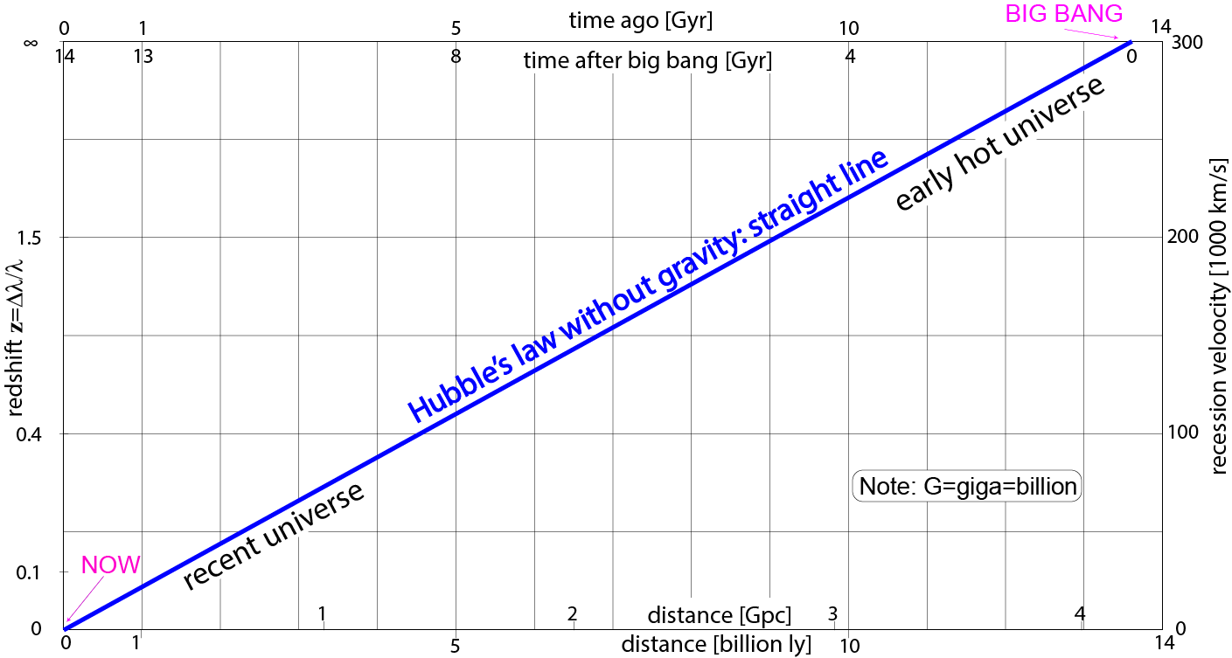
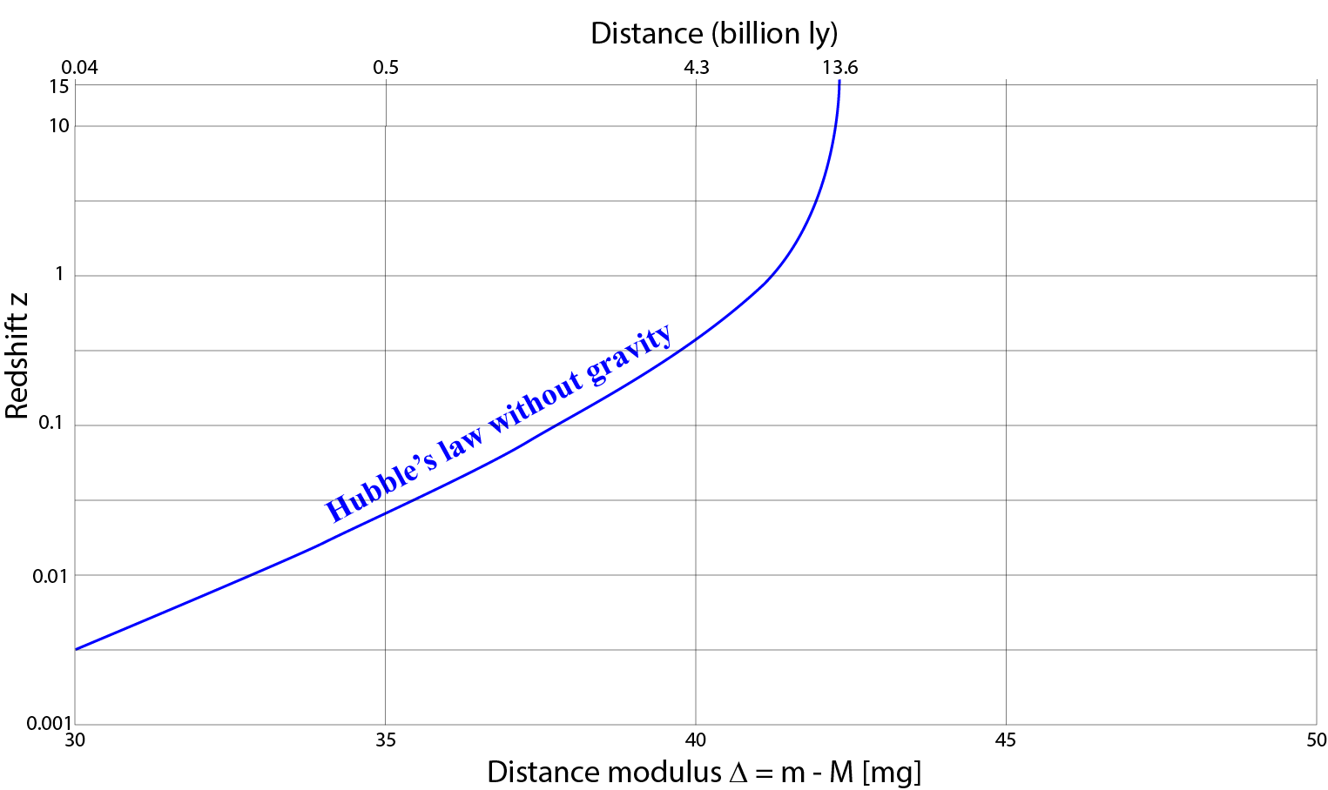
Use distance modulus
as a proxy for distance
Note:
• z and Δ are directly observed
• ‘straight line’ appears curved
(Same graph but
Δ plotted
instead of distance)
A type-Ia SN
would be
+21^{mg} here
A type-Ia SN
would be
+11^{mg} here

Slide 7
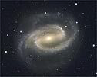
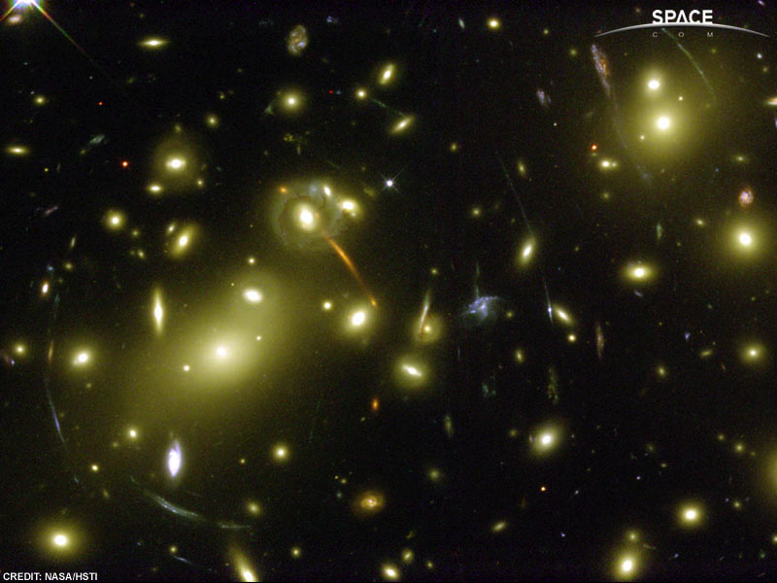
Dark matter in galaxies
Dark matter in and around galaxies
A galaxy rotates too fast Galaxy clusters are stable
far from the center - There must be stronger gravity
- contradicts law of gravity than the gravity of all the stars
- unless: there is invisible mass inside galaxy
Gravitational lensing:
too much mass
- There must be stronger gravity
What is dark matter made of?
Who knows?
(Brown dwarfs, Planets without stars,
New elementary particles, ...)

Slide 8
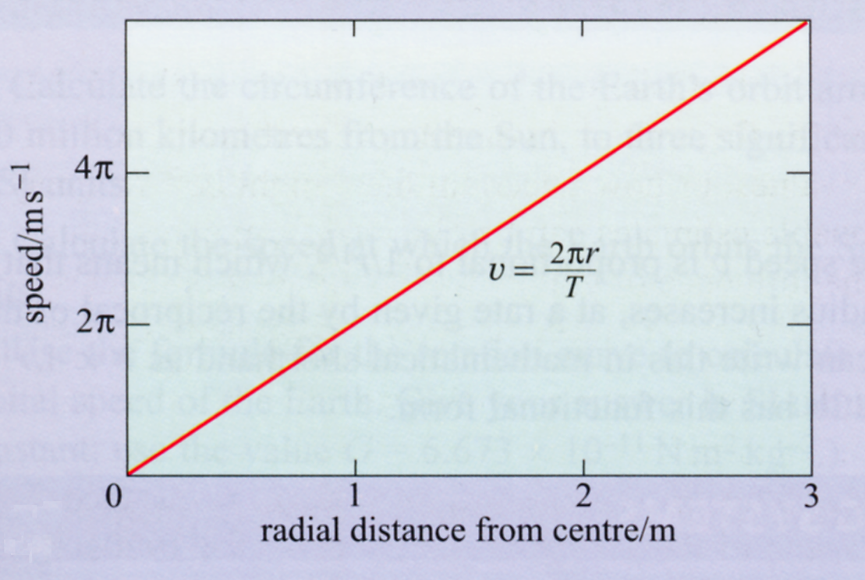
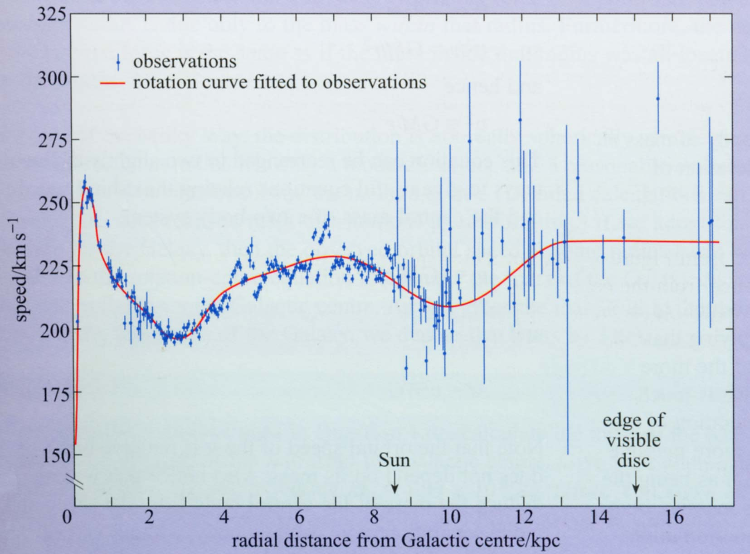
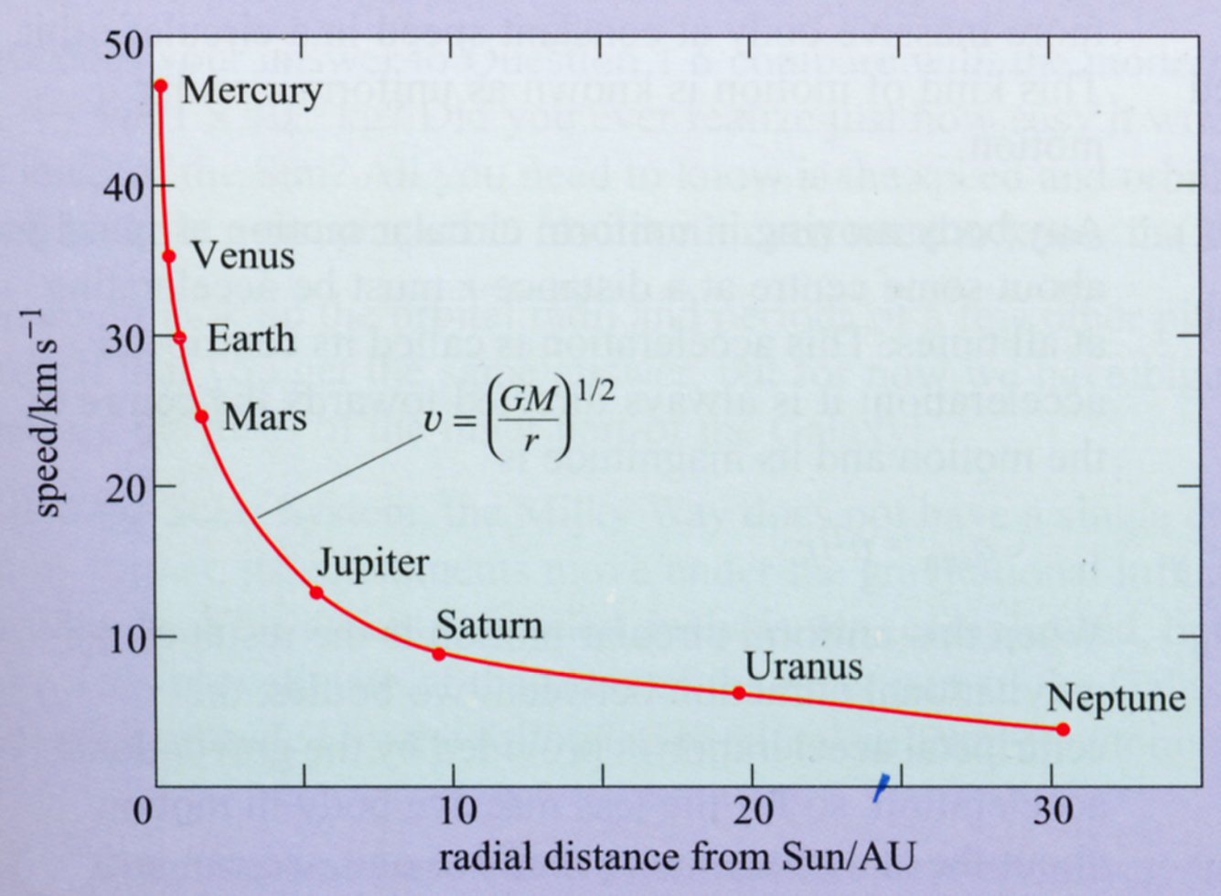
Rotation curve of the Galaxy
Rotation curve
: the Galaxy
Measure the speed of stars
as they revolve around the center of the Galaxy
Rigid
body
Invisible matter
must be present!
(“Dark matter”)
One
big
mass

Slide 9
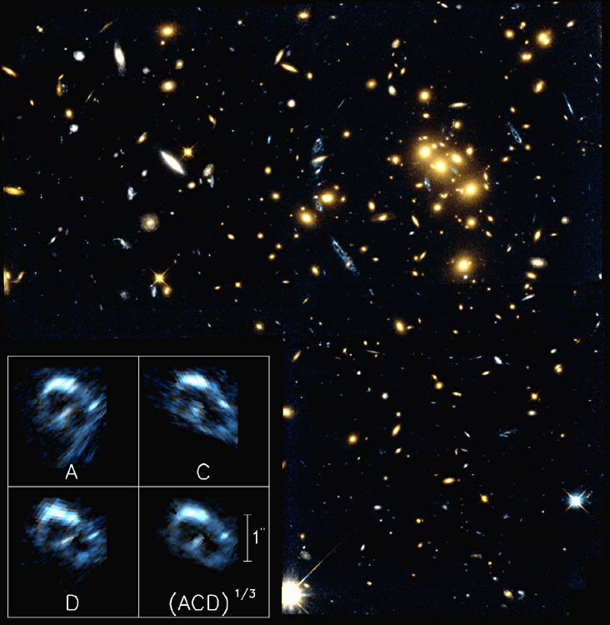
More gravitational lensing
Gravitational lensing:
Einstein rings
A foreground galaxy cluster
breaks up the light
of a far-away galaxy
Note:
There is much more dark matter than
stars in a galaxy
Galaxies are like:
“a few stars in a big blob of dark matter”

Slide 10
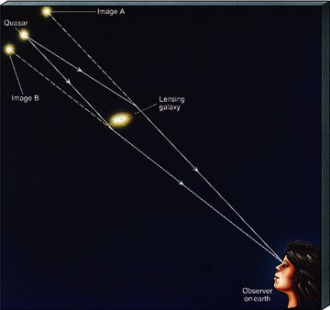
Explain gravitational lensing
Explain what happens:
Image B
Gravity of a galaxy
* bends light of
objects behind it
* distorts image of
distant objects
Source
Lensing
galaxy
Image A
Gravitational lensing allows
an independent determination
of the mass of the lensing galaxy
One can tell
how much dark matter
in that galaxy
Observer
on Earth

Slide 11
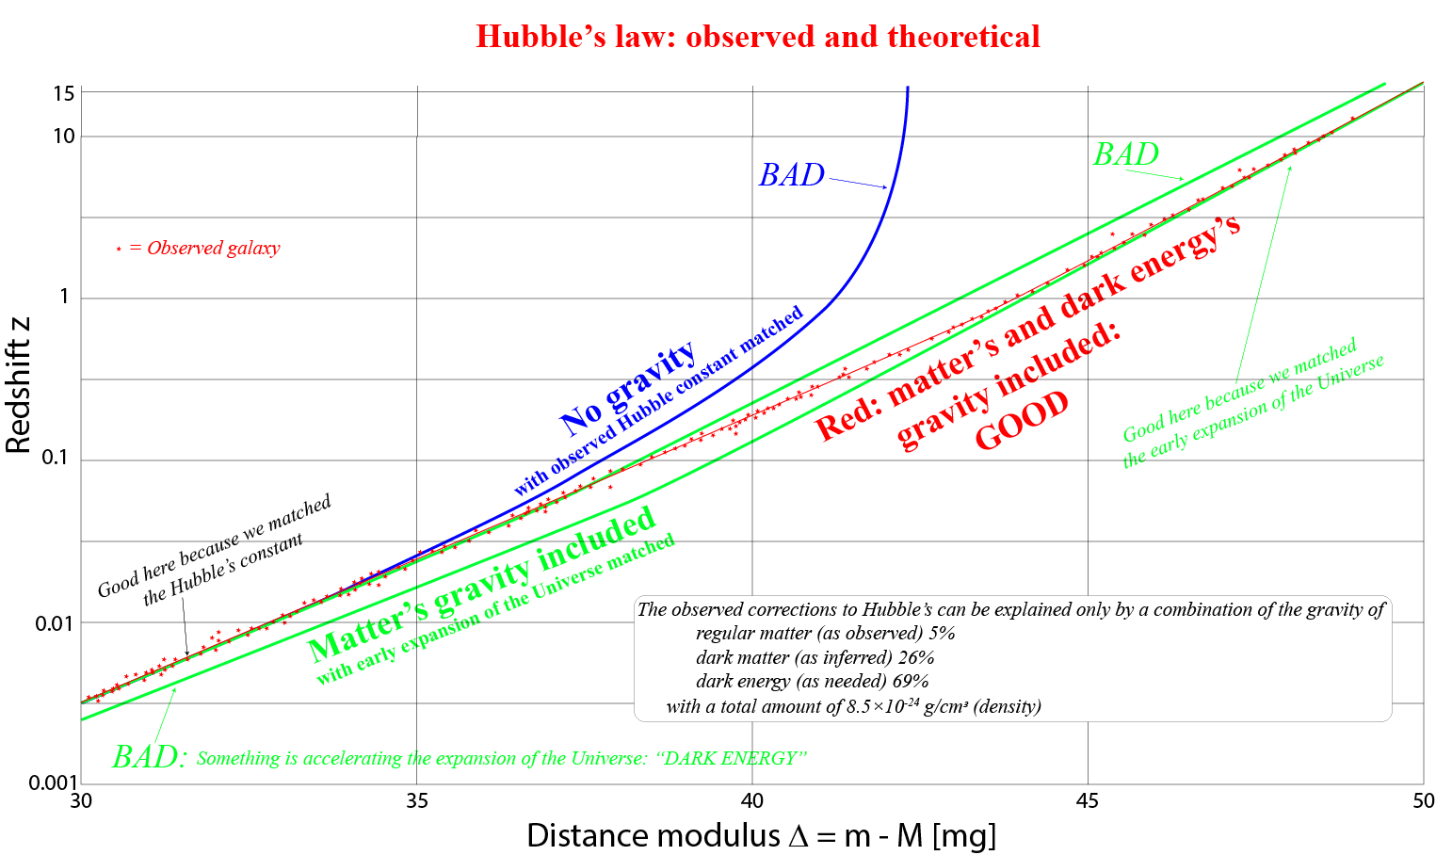
Barionic and dark matter alone are not enough
to explain the observed corrections to Hubble’s law:
dark energy is needed
What is ‘dark energy’? A constant ‘force’ that makes the Universe expand.

Slide 12
Questions coming …

Slide 13
Question 4
sec
30
29
28
27
26
25
24
23
22
21
20
18
17
16
15
14
13
12
11
10
9
8
7
6
5
4
3
2
1
0
19
How do we know that there is dark matter in galaxy clusters?
A Galaxy clusters are held together by the gravity of some unseen mass.
B Clusters of galaxies contain too many members.
C Clusters of galaxies block the light stronger than one would expect by counting the galaxies only.
Next question coming …

Slide 14
Question 5
sec
45
40
35
30
25
19
18
17
16
15
14
13
12
11
10
9
8
7
6
4
3
2
1
0
20
5
45
What is dark matter and how do we know it exists?
A Dark matter is yet unknown substance between
the stars. We know it because of its gravity.
B Dark matter is the substance of planets orbiting other stars. We know it because they block the light of the stars when they pass in front of them.
C Dark matter is gas and/or dust between stars. We know it because it blocks or scatters the light of stars and nebulae behind it.
Next question coming …

Slide 15
Question 6
sec
30
29
28
27
26
25
24
23
22
21
20
18
17
16
15
14
13
12
11
10
9
8
7
6
5
4
3
2
1
0
19
Where is “Dark Matter” located?
A In the Sun.
B In the Solar System.
C It can be produced in laboratory experiments.
D In space inside galaxies.
E In space between galaxies.

Slide 16
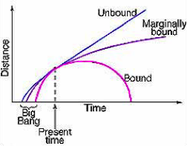
Will the Universe continue to expand forever?
Slowdown of expansion is
caused by gravity
due to all matter.
How much matter is there?
Density > critical : “crunch”
Density < critical : “unbound
expansion”
Critical density
=
6 atoms/m³
The discovery of dark energy changes this picture.
It turns all these curves ”up” in time,
but in space the above picture is still good.
Visible matter + “Dark matter” + “Dark energy” = found almost to equal critical:
borderline - very close to spacially flat universe

Slide 17
REMAINS TO DO:
REVIEW THE FIRST THREE SLIDES

