Slide 1
The evolution of the Universe
Name | Time after big bang | z | Density | Tempera- ture | What is happening?
Big Bang | 0 | ∞ | ∞ | ∞ | Booom!!
Inflation | 10⁻³⁶-10⁻³² sec |  |  | 10²⁸ to 10²² K | Universe expands 10²⁶ times
Primordial nucleosynthesis | ~ 3 min | ~3x10¹³ |  | ~ 10⁹ K | H→He fusion 76%-H, 24%-He
Matter domination starts | 47 kyr | 3300 | 8.9x10⁻²⁰ g/cm³ | 9000 K | Gravity of matter overtakes gravity of photons
Decoupling | 370 ky | 1100 | 3.3x10⁻²¹ g/cm³ | 3000 K | Universe becomes transparent Beginning of ‘dark age’
First stars and galaxies | ~ 200 Myr | ~ 15 | 1.0x10⁻²⁶ g/cm³ | ~ 40 K | End of ‘dark age’
Reionization | ~ 200 Myr | ~ 15 | 1.0x10⁻²⁶ g/cm³ | ~ 40 K | Interstellar hydrogen becomes ionized from quasar’s UV
Dark energy domination starts | 9.6 Gyr | 0.39 | 1.3x10⁻²⁹ g/cm³ | 3.79 K | Gravity of dark energy overtakes gravity of matter
Now | 13.8 Gyr | 0 | 9.2x10⁻³⁰ g/cm³ | 2.73 K

Slide 2
The story of the Universe (cosmology) and the Big Bang
The logic:
1: Observation –Hubble’s law : far-away galaxies are redshifted
proportionally to their distance
(If redshift is correctly interpreted as the Doppler effect, the Universe is expanding and
it all started in the Big Bang 14 billion years ago.)
2: Theory – General Relativity: Einstein ~1912, law of
gravity-space-time
(Requires either an expanding Universe and a Big Bang or a contracting Universe and
a Big Crunch or both.)
3: Circumstantial evidence: no stars are older than 10-12 billion yrs
4: The early Universe was small, hot, and evenly spread-out gas
(Expanding, cooling, and forming structure ever since
structure formation is due to gravitational collapse – gravity is always attractive.)

Slide 3
5: Observable predictions: Today we are sure this is all correct.
a: Redshift of far-away galaxies – details of the Hubble curve
b: Cosmic background radiation – including details of strength,
spectrum, even distribution, wave pattern over the sky
c: Primordial nucleosynthesis made/left
~25% He, ~75% H, not much else
d: Old galaxies were different (smaller, more star formation,
larger number of AGN’s/quasars) – evolutionary effects
e: Etc.

Slide 4
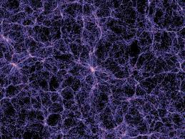
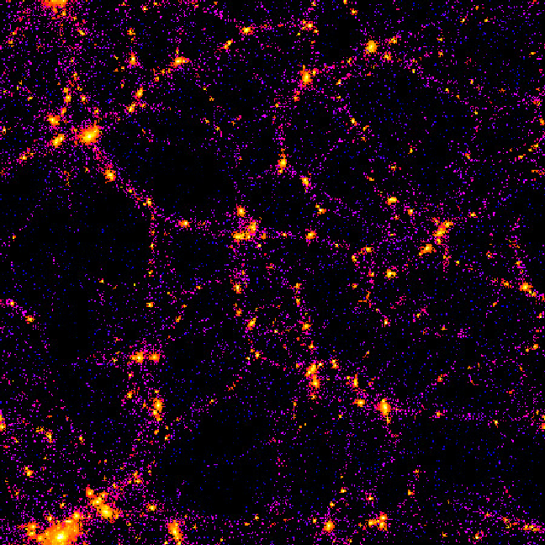
First stars and galaxies:
At t≈200 Myr, z≈15, T≈40K, enough time has passed for gravity
to start forming structure
Gas forms sheets, filaments, blobs and makes galaxies where dense
(Each bright dot is a galaxy or a galaxy cluster)

Slide 5
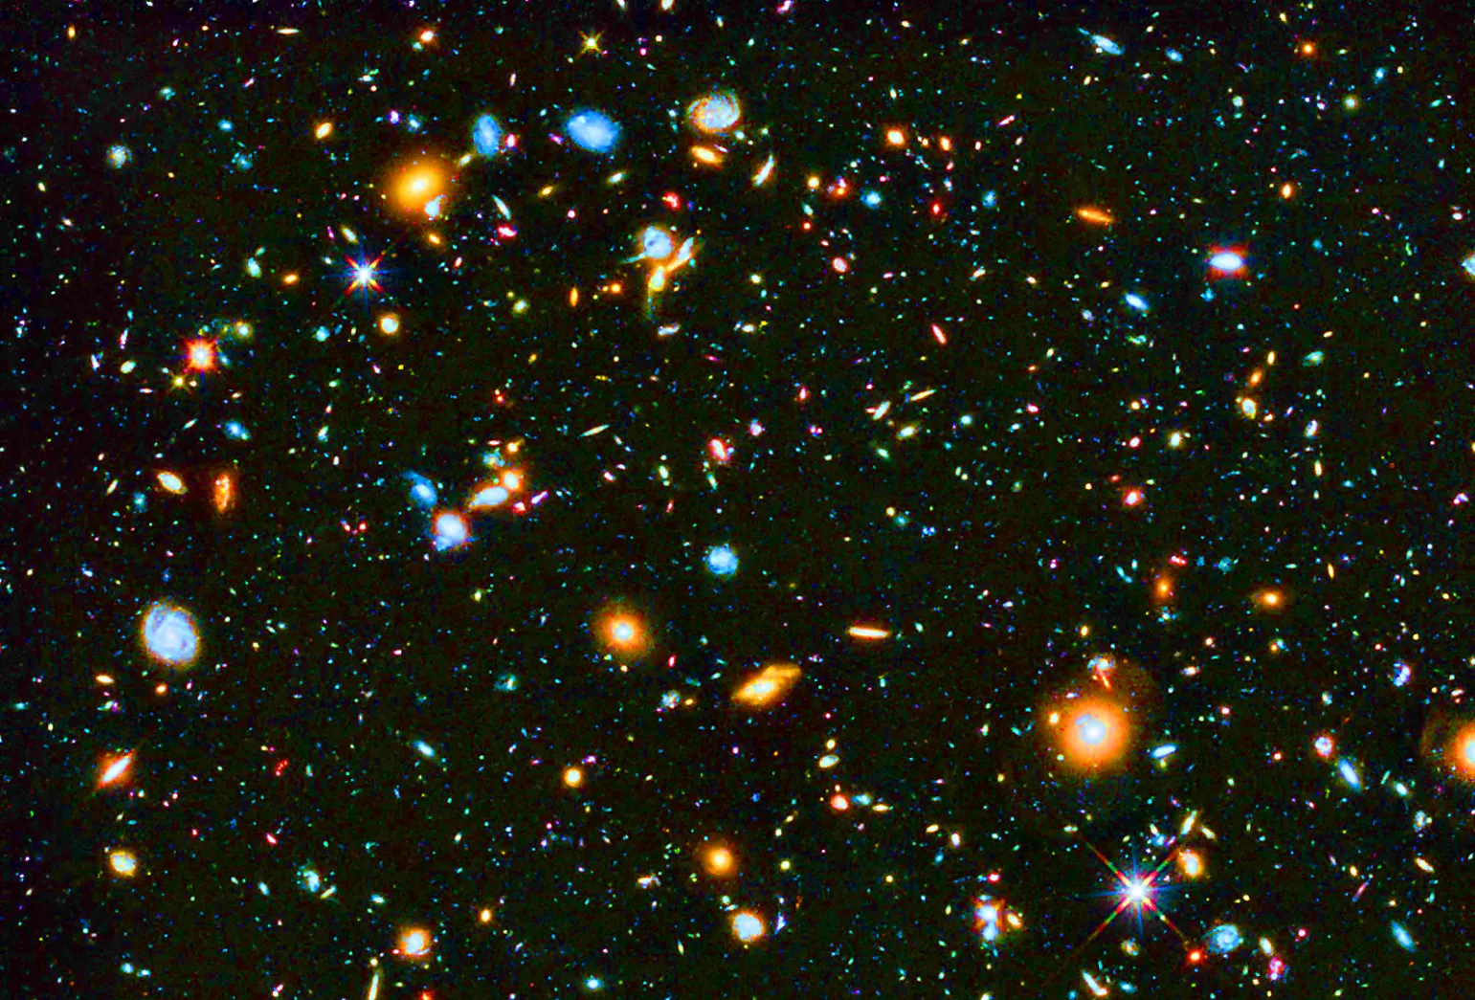
First galaxies are very small and grow by collisions
Reionization:
First quasars’ (and stars’) UV ionizes intergalactic H⁰ into H⁺ and e⁻.
From then on, star formation is only possible inside galaxies.

Slide 6
Modifications to Hubble’s law due to the gravity of:
Regular (barionic) matter (5% total)
- stars (0.3%)
- interstellar gas&dust (0.2%)
- intergalactic gas (4.5%)
Only a small portion of regular matter is stars!
Dark matter (27%)
Most dark matter is in the haloes of galaxies
Must consist of heavy particles
(“=cold”, required by the speed of structure formation)
Dark energy (cosmological constant, 68%)
Makes the Universe accelerate
GR says: amount not changing (=cosmological constant)
Effect insigficant in early universe, taking over gravity only after z<1.

Slide 7
Questions coming …

Slide 8
Question 11
sec
45
40
35
30
25
19
18
17
16
15
14
13
12
11
10
9
8
7
6
4
3
2
1
0
20
5
45
How soon after the Big Bang have the first stars been formed?
A 370,000 years ; z = 1,100
B 200 million years ; z = 15
C 1 billion years ; z = 12
D 6,000 years ago ; z = 0.0001

Slide 9
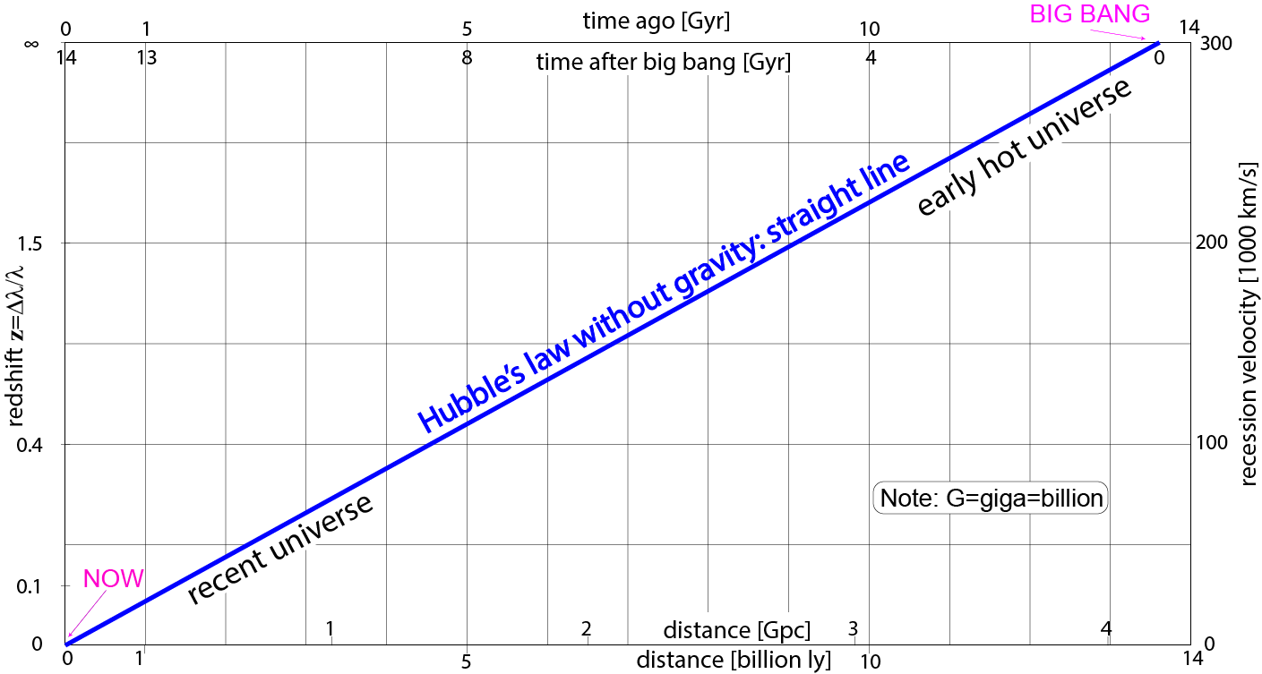
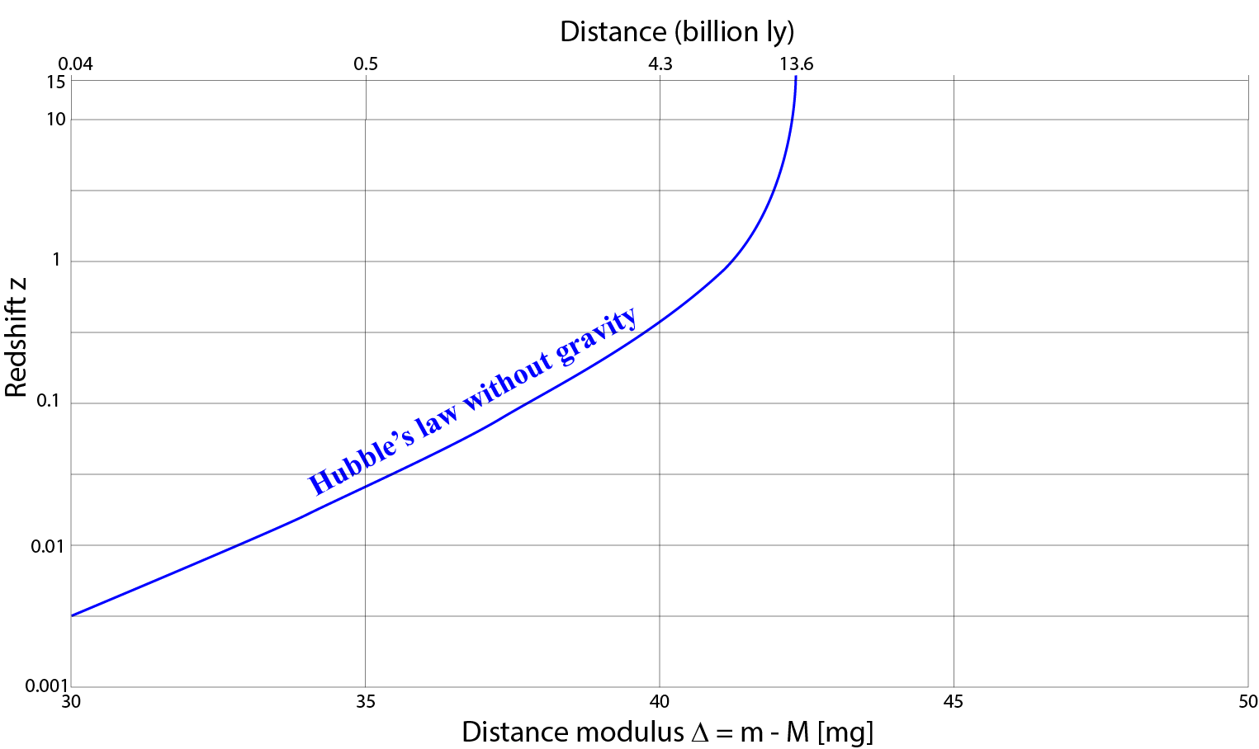
Use distance modulus
as a proxy for distance
Note:
• z and Δ are directly observed
• ‘straight line’ appears curved
(Same graph but
Δ plotted
instead of distance)
A type-Ia SN
would be
+21^{mg} here
A type-Ia SN
would be
+11^{mg} here

