Slide 1
The evolution of the Universe
Name | Time after big bang | z | Density | Tempera- ture | What is happening?
Big Bang | 0 | ∞ | ∞ | ∞ | Booom!!
Inflation | 10⁻³⁶-10⁻³² sec |  |  | 10²⁸ to 10²² K | Universe expands 10²⁶ times
Primordial nucleosynthesis | ~ 3 min | ~3x10¹³ |  | ~ 10⁹ K | H→He fusion 76%-H, 24%-He
Matter domination starts | 47 kyr | 3300 | 8.9x10⁻²⁰ g/cm³ | 9000 K | Gravity of matter overtakes gravity of photons
Decoupling | 370 ky | 1100 | 3.3x10⁻²¹ g/cm³ | 3000 K | Universe becomes transparent Beginning of ‘dark age’
First stars and galaxies | ~ 200 Myr | ~ 15 | 1.0x10⁻²⁶ g/cm³ | ~ 40 K | End of ‘dark age’
Reionization | ~ 200 Myr | ~ 15 | 1.0x10⁻²⁶ g/cm³ | ~ 40 K | Interstellar hydrogen becomes ionized from quasar’s UV
Dark energy domination starts | 9.6 Gyr | 0.39 | 1.3x10⁻²⁹ g/cm³ | 3.79 K | Gravity of dark energy overtakes gravity of matter
Now | 13.8 Gyr | 0 | 9.2x10⁻³⁰ g/cm³ | 2.73 K

Slide 2
The story of the Universe (cosmology) and the Big Bang
The logic:
1: Observation –Hubble’s law : far-away galaxies are redshifted
proportionally to their distance
(If redshift is correctly interpreted as the Doppler effect, the Universe is expanding and
it all started in the Big Bang 14 billion years ago.)
2: Theory – General Relativity: Einstein ~1912, law of
gravity-space-time
(Requires either an expanding Universe and a Big Bang or a contracting Universe and
a Big Crunch or both.)
3: Circumstantial evidence: no stars are older than 10-12 billion yrs
4: The early Universe was small, hot, and evenly spread-out gas
(Expanding, cooling, and forming structure ever since
structure formation is due to gravitational collapse – gravity is always attractive.)

Slide 3
5: Observable predictions: Today we are sure this is all correct.
a: Redshift of far-away galaxies – details of the Hubble curve
b: Cosmic background radiation – including details of strength,
spectrum, even distribution, wave pattern over the sky
c: Primordial nucleosynthesis made/left
~25% He, ~75% H, not much else
d: Old galaxies were different (smaller, more star formation,
larger number of AGN’s/quasars) – evolutionary effects
e: Etc.

Slide 4
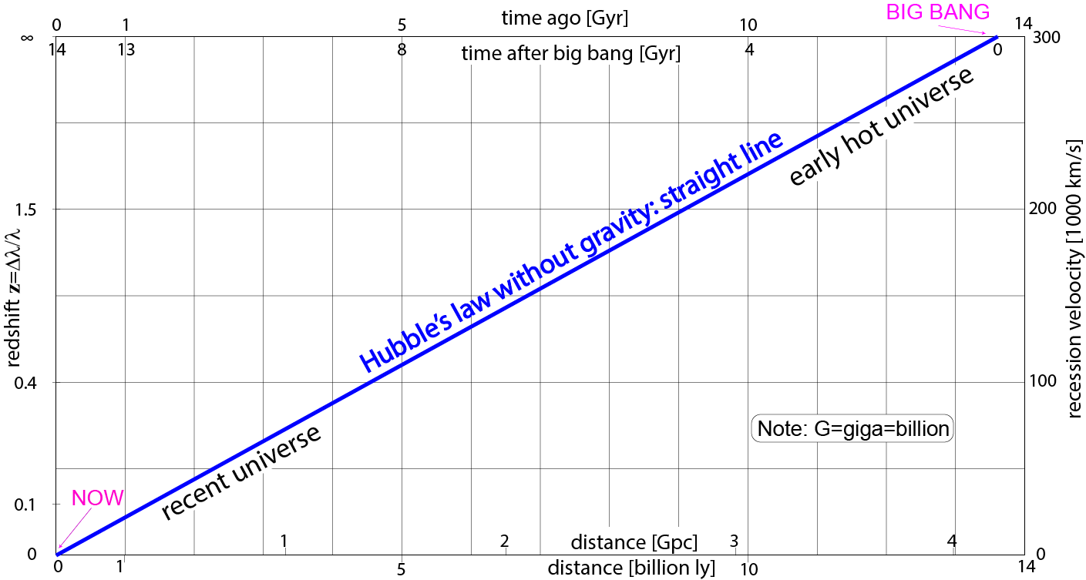
Explain the Hubble plot
Long ago = far away redshift ~ recession velocity
( the big bang is in the sky, ( relativistic correction
14 billion light years away) Δλ/λ = z ≈ v/c = z ✕ ^{1+z/2}/_{1+z(1+z/2)} )
The farthest observed galaxy is at z=12

Slide 5
Questions coming …

Slide 6
Question 6
sec
30
29
28
27
26
25
24
23
22
21
20
18
17
16
15
14
13
12
11
10
9
8
7
6
5
4
3
2
1
0
19
What is the scientific status of the “Big Bang theory”?
(Correctly named: Big Bang Cosmology)
A It is a generally accepted theory (proven).
B It has been disproved by observations.
C It is not sure: there is not enough evidence to prove it.
D It is a religious theory and as such cannot be proven. It is a question of faith.
Next question coming …

Slide 7
Question 7
sec
30
29
28
27
26
25
24
23
22
21
20
18
17
16
15
14
13
12
11
10
9
8
7
6
5
4
3
2
1
0
19
An astronomer is making a statistical analysis of a
1000 far-away galaxies. What observation will s/he make to determine their distances?
A Imaging to determine the size of each galaxy.
B Finding a Type-Ia supernova in each galaxy.
C Finding a core-collapse supernova in each galaxy.
D Spectroscopy to determine redshift.
E Photometry to measure the brightness of each galaxy.
Next question coming …

Slide 8
Question 8
sec
30
29
28
27
26
25
24
23
22
21
20
18
17
16
15
14
13
12
11
10
9
8
7
6
5
4
3
2
1
0
19
What observation is Hubble’s law based on?
A Far-away galaxies look red.
B Spectral lines in the spectra of far-away galaxies are shifted to red.
C Far-away galaxies look smaller and smaller every year.
D Far-away galaxies look fainter and fainter every year.

Slide 9
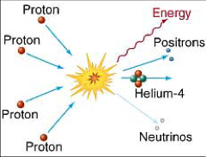
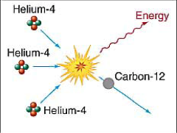
Primordial nucleosynthesis
Before t<3min, T>10⁹K, z>3✕10¹³ all nuclei break up in the heat.
The Universe is an evenly distributed gas of p⁺ and e⁻.
The Universe is cooling: at t≈3min, T=10⁹K, z≈3✕10¹³, H→He fusion starts.
Not enough He
for He→CNO to run
10⁷K
←YES NO→
Too cold
for He→CNO to run
The Universe is cooling: at t≈20min, T≈10⁶K, z≈10¹², H→He fusion ends.
Result: 76% H, 24% He, not much else
All other nuclei were made much later, inside stars.
One great success of ‘Big Bang theory’:
- old stars are 76% H, 24% He and not much else.
- interstellar matter is almost everywhere 76% H, 24% He.

Slide 10
Questions coming …

Slide 11
Question 9
sec
30
29
28
27
26
25
24
23
22
21
20
18
17
16
15
14
13
12
11
10
9
8
7
6
5
4
3
2
1
0
19
When did primordial nucleosynthesis happen?
A Very early after the big bang.
B When the first stars were formed.
C When the first generation of stars blew up.
D When sun-like stars became evolved red giants (AGB stars).
E Very recently (today).
Next question coming …

Slide 12
Question 10
sec
30
29
28
27
26
25
24
23
22
21
20
18
17
16
15
14
13
12
11
10
9
8
7
6
5
4
3
2
1
0
19
What chemical elements did primordial nucleosynthesis produce?
A Hydrogen only.
B Hydrogen and helium.
C Helium only.
D All chemical elements lighter than iron.
E All chemical elements.

Slide 13
Recombination, decoupling and the cosmic microwave background (CMB)
At t~370 kyr , T~3000 K, z~1100 four things happen:
Recombination: universe is cold enough for p⁺e⁻→H⁰ atoms
Decoupling: the Universe becomes transparent
(iii) CMB radiated off
(iv) Dark age begins: still no stars, matter is very uniform H⁰ gas

Slide 14
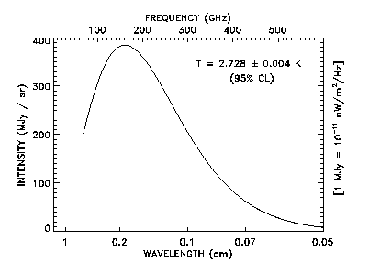
Background radiation
Cosmic background radiation (CMB)
Right after Big bang the Universe was hot:
Gas was dense and it glowed at 3000 K
Light started then but has cooled down
- now 2.7 K (radio waves)
Note: for radiation,
redshift and cooling
are the same thing
(see Wien’s law)
Background radiation
is a relic
of the
originally hot universe:
a proof of
“Big Bang” theory
Very even
(±0.001% variation)
Intensity

Slide 15
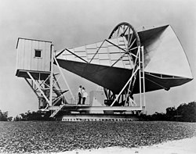
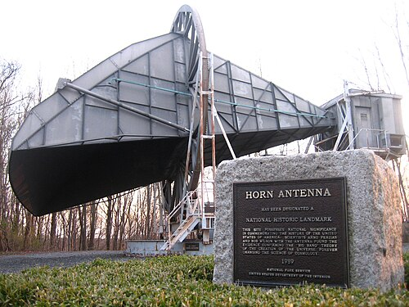
A.A. Penzias, R.W. Wilson, 1965
The Holmdel Horn Antenna, New Jersey
Bell laboratories
Working at 7.35 cm wavelength
Strength of radiation equals to the thermal glow of a 2.7K body

Slide 16
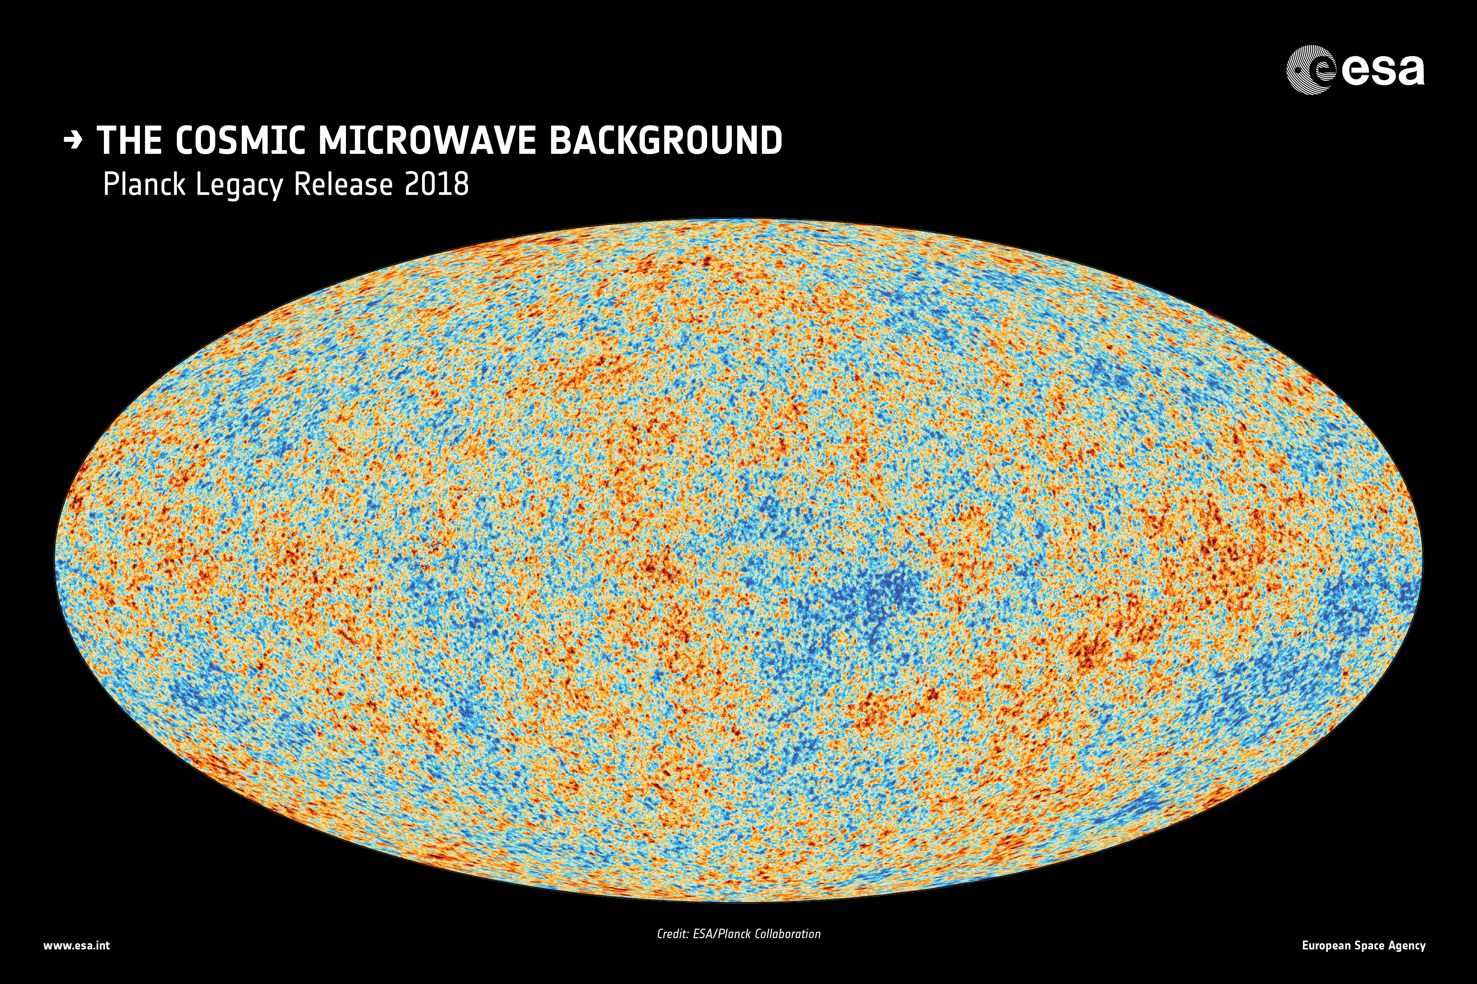
Variation of the temperature of the CMB across the sky by ~ ±0.00001 K
The ‘cold’ spots are the kernels of later galaxies

Slide 17
Questions coming …

Slide 18
Question 11
sec
45
40
35
30
25
19
18
17
16
15
14
13
12
11
10
9
8
7
6
4
3
2
1
0
20
5
45
How is the CMB distributed in the sky?
A Very evenly.
B Some directions it is bright, other directions a bit dimmer.
C The CMB comes only from a few directions.
D All the CMB is coming from one direction only.
Next question coming …

Slide 19
Question 12
sec
30
29
28
27
26
25
24
23
22
21
20
18
17
16
15
14
13
12
11
10
9
8
7
6
5
4
3
2
1
0
19
When the CMB was radiated off, what was its color/temperature?
A X-rays / 10,000,000 K
B Blue-ultraviolet / 100,000 K
C Orange-red / 3,000 K
D Infrared / 300K
E Radio / 3K
Next question coming …

Slide 20
Question 13
sec
30
29
28
27
26
25
24
23
22
21
20
18
17
16
15
14
13
12
11
10
9
8
7
6
5
4
3
2
1
0
19
What is “cosmic background radiation”?
A X-ray radiation from unknown sources in space.
B Radio waves that have originated at the early stages of the universe.
C Radiation from planets of the solar system.
D Radiation from inside Earth.

