Slide 1



Setup:
Prepare your scantron:
Use
a pencil,
not a pen!
Fill in your name and fill the bubbles under
your name.
LAST NAME FIRST, First name second
Put your 4-digit code instead of “IDENTIFICATION NUMBER”.
--- (The last 4 digits of your OleMiss ID.)
Test 3 : April 24 (Friday) 2:00 pm
Question # 1: answer A
Question # 2: answer D
Question # 3: answer D
Recall reading assignment
Part VI, Chapters 19-23, pp. 580-697
Note: the book contains much more than the class, a cursory reading will suffice.
Please take a moment to mute your cell phone!

Slide 2
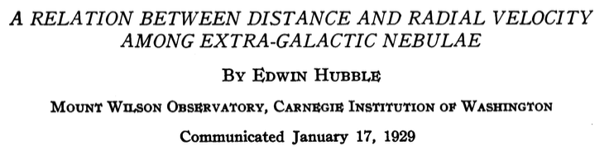

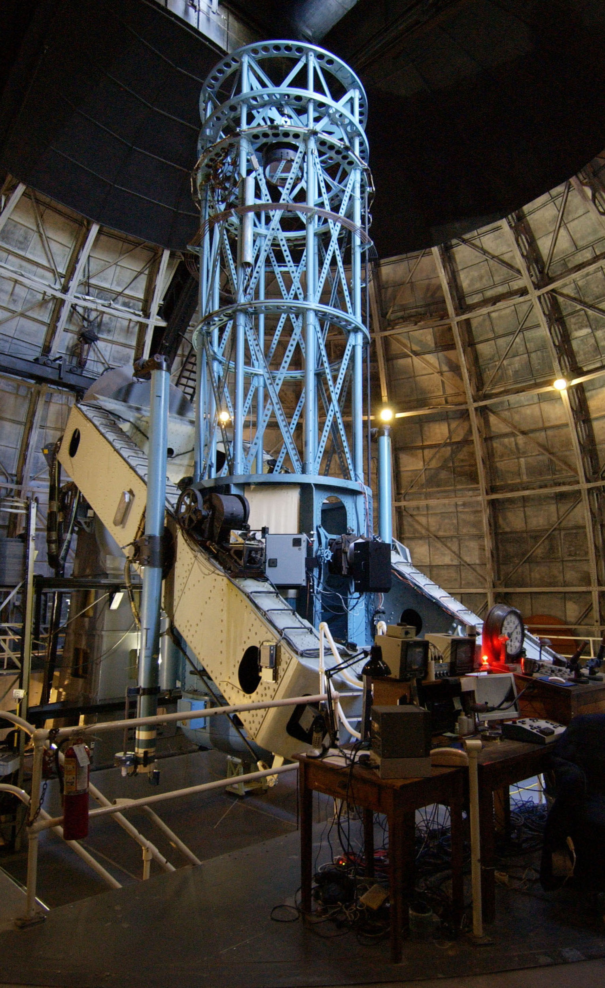
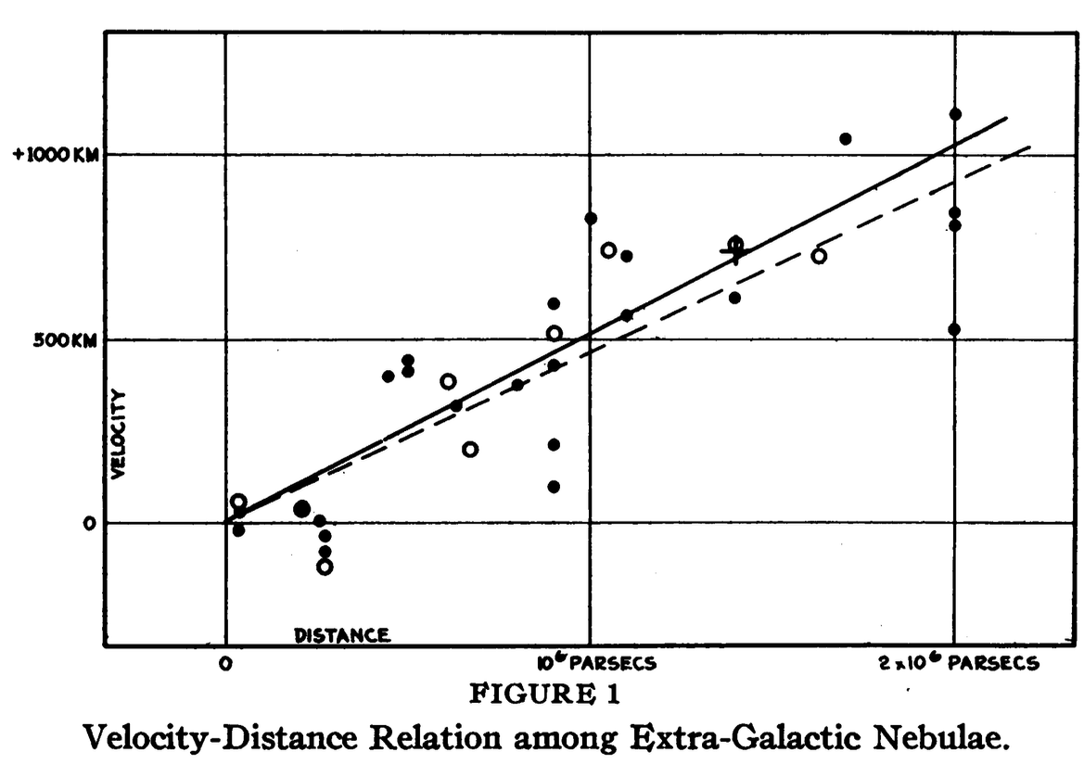
(A pioneering study: the numbers are out of whack
but the conclusion is correct.)
Discovered: - galaxies recede with a speed prop. to their distance
- measured the velocity of the Sun in the galaxy
RECALL

Slide 3
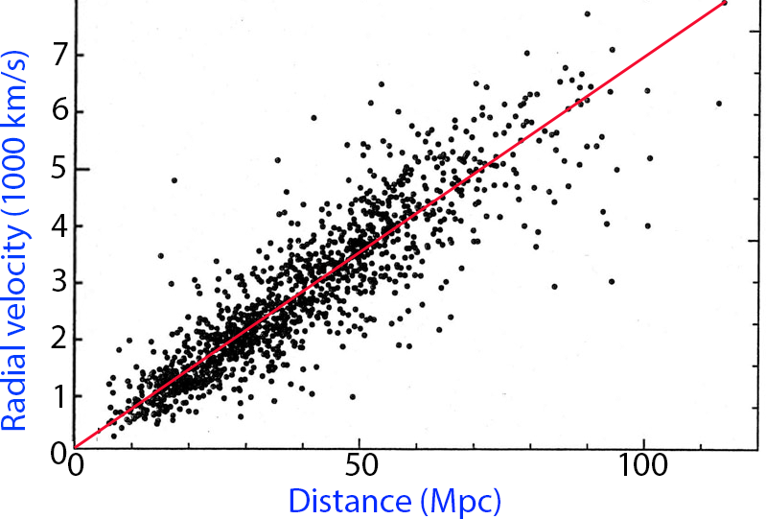
Modern data, 2005, only within 120 Mpc = 400 million light years
Note that this is only a ‘not too far’ part (1/35) of the Universe
Scatter due to the motion of individual galaxies
in addition to Hubble flow
Slope is H= 70 km/s per Mpc
(Hubble’s constant)
Find: 1/H = 14 billion years
Red line is the Hubble flow – the expansion of the Universe

Slide 4
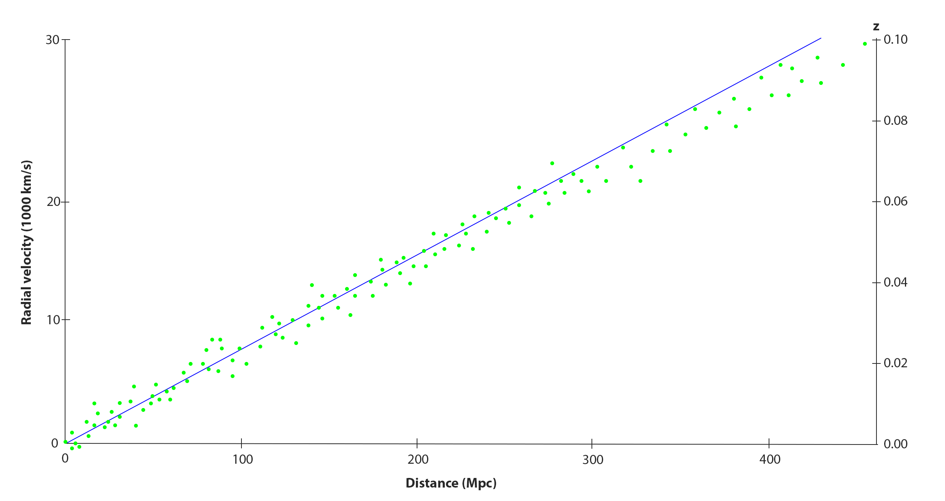
Modern data
There is a scatter of ~ 1000 km/s – Galaxies move on their own
Validity: Hubble’s law is no good for - closeby galaxies (<5-10 Mpc)
- within the Galaxy
Each green dot is a galaxy
At large distances ( > 500Mpc ; z > 0.5) there is a correction
to the Hubble flow due to gravity

Slide 5
Conclusions
• Far away galaxies spectra undergo redshift
• The universe is expanding at a rate of 70 km/sec per Mpc
• Expansion velocity is proportional to distance -> expansion
started at the same time -> Big Bang 14 billion years ago
• Hubble’s law is no good for small distances
• Hubble’s law picks up a correction at very large distances:
the effect of gravity
• This can be used to determine the gravitating matter in the Universe:
dark mater, dark energy, etc.

Slide 6
Questions coming …

Slide 7
Question 4
sec
30
29
28
27
26
25
24
23
22
21
20
18
17
16
15
14
13
12
11
10
9
8
7
6
5
4
3
2
1
0
19
Is it correct to say that the stars of the sky are moving
away from us due to the expansion of the Universe?
A Yes, they are getting twice as far every 14 million years.
B Yes, they are getting twice as far every 14 billion years.
C Yes, they are getting farther away from us at a steady rate (constant speed).
D No, because the motion of the stars in the Galaxy overwhelms the Hubble flow.
E No, because stars are not in the Universe; they are in the Galaxy.
Next question coming …

Slide 8
Question 5
sec
30
29
28
27
26
25
24
23
22
21
20
18
17
16
15
14
13
12
11
10
9
8
7
6
5
4
3
2
1
0
19
How long ago was the Big Bang?
A 1000 billion years.
B 14 billion years.
C 65 million years.
D 11 thousand years.
E 14 million light years.

