Slide 1
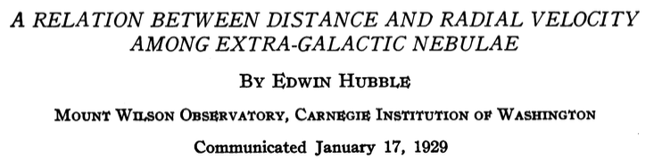

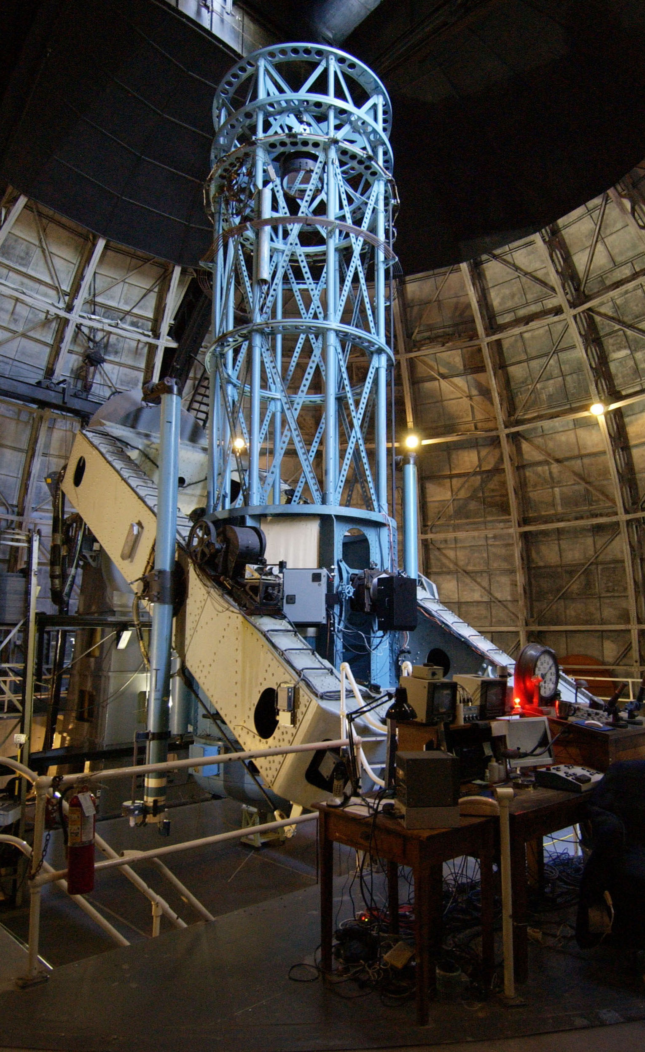
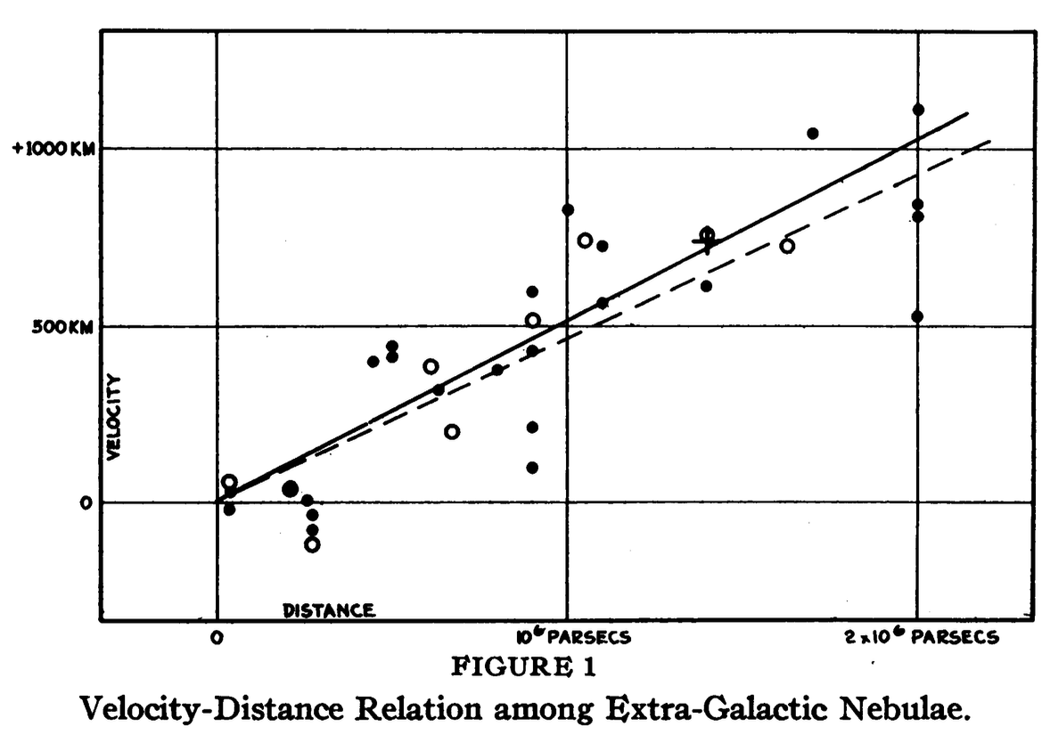
(A pioneering study: the numbers are out of whack
but the conclusion is correct.)
Discovered: - galaxies recede with a speed prop. to their distance
- measured the velocity of the Sun in the galaxy

Slide 2
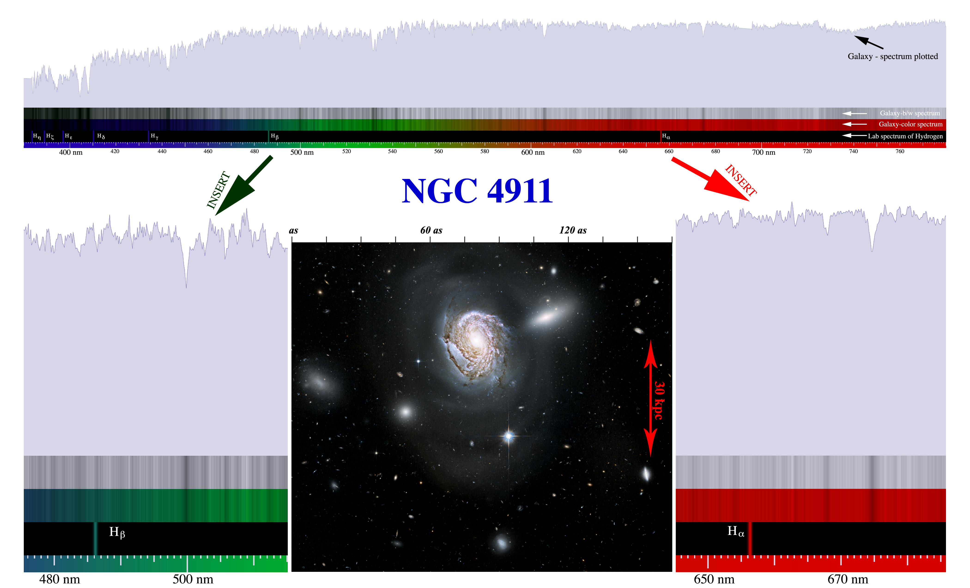
An example of a redshifted spectrum

Slide 3
Questions coming …

Slide 4
Question 7
sec
30
29
28
27
26
25
24
23
22
21
20
18
17
16
15
14
13
12
11
10
9
8
7
6
5
4
3
2
1
0
19
Hubble’s law says that (far away) galaxies spectra undergo the following change:
A The color of the galaxy gets redder.
B Emission lines are redshifted.
C All spectral lines are shifted towards red.
D Absorption lines are redshifted.
E Spectral lines become weeker.
Next question coming …

Slide 5
Question 8
sec
30
29
28
27
26
25
24
23
22
21
20
18
17
16
15
14
13
12
11
10
9
8
7
6
5
4
3
2
1
0
19
The redshift of far-away galaxies is interpreted as
A The Doppler effect – the Universe is expanding.
B The Doppler effect – the Universe is collapsing.
C Photons are absorbed by intergalactic gas.
D Photons are deflected by intergalactic magnetic fields.
E Light from these galaxies takes a long time to arrive.

