Slide 1
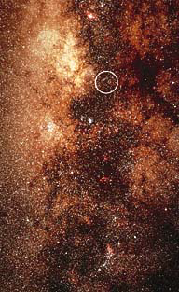
What is in the center of the Galaxy
What is in the center
of our Galaxy?
Nothing in visible light:
Interstellar dust covers it all.
A strong radio source:
Sagittarius-A

Slide 2
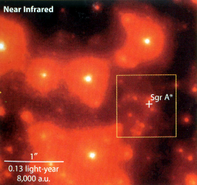
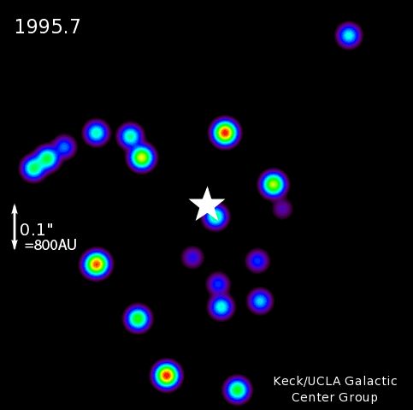
Galactic center details
A detailed image in infrared
(λ=2.2 μm; IR can see through dust)
Stars move around over the years:
a huge mass must be hiding
there, invisible.
One star goes as close as 90 AU:
the thing must be
much smaller than that.
Must be a supermassive black hole
(4.3 million M_{Sun}, size = 0.2 AU )
** NOT AN ACTIVE NUCLEUS **
Comment – the “diameter” of a black hole
is one mile for each solar mass

Slide 3
Questions coming …

Slide 4
Question 9
sec
30
29
28
27
26
25
24
23
22
21
20
18
17
16
15
14
13
12
11
10
9
8
7
6
5
4
3
2
1
0
19
What is in the center of the Galaxy?
A No object (empty space).
B A large globular cluster.
C A very large star.
D A huge black hole.
E The Sun.
Next question coming …

Slide 5
Question 10
sec
30
29
28
27
26
25
24
23
22
21
20
18
17
16
15
14
13
12
11
10
9
8
7
6
5
4
3
2
1
0
19
How do we know what is in the center of the Galaxy?
A We observe fast-moving stars orbiting around it.
B It is visible as a bright star.
C It spits out jets of hot gas.
D Its magnetic field affects the light of stars behind it.
Next question coming …

Slide 6
Question 11
sec
30
29
28
27
26
25
24
23
22
21
20
18
17
16
15
14
13
12
11
10
9
8
7
6
5
4
3
2
1
0
19
Why is it hard to figure out what is
in the center of the Galaxy?
A Because the center of the Galaxy is a black hole, and it is invisible.
B Because there is much obscuring interstellar dust between us and it.
C Because the center of the Galaxy is too far away for astronomers to see.
D Because the center of the Galaxy is too hot and it radiates only in X-rays.
E Because the center of the Galaxy is the Sun.

