Slide 1



Setup:
Prepare your scantron:
Use
a pencil,
not a pen!
Fill in your name and fill the bubbles under
your name.
LAST NAME FIRST, First name second
Put your 4-digit code instead of “IDENTIFICATION NUMBER”.
--- (The last 4 digits of your OleMiss ID.)
Question # 1: answer A
Question # 2: answer D
Question # 3: answer A
Reading assignment
Star Birth, Chapter 16, pp. 513-533
Please take a moment to mute your cell phone!

Slide 2
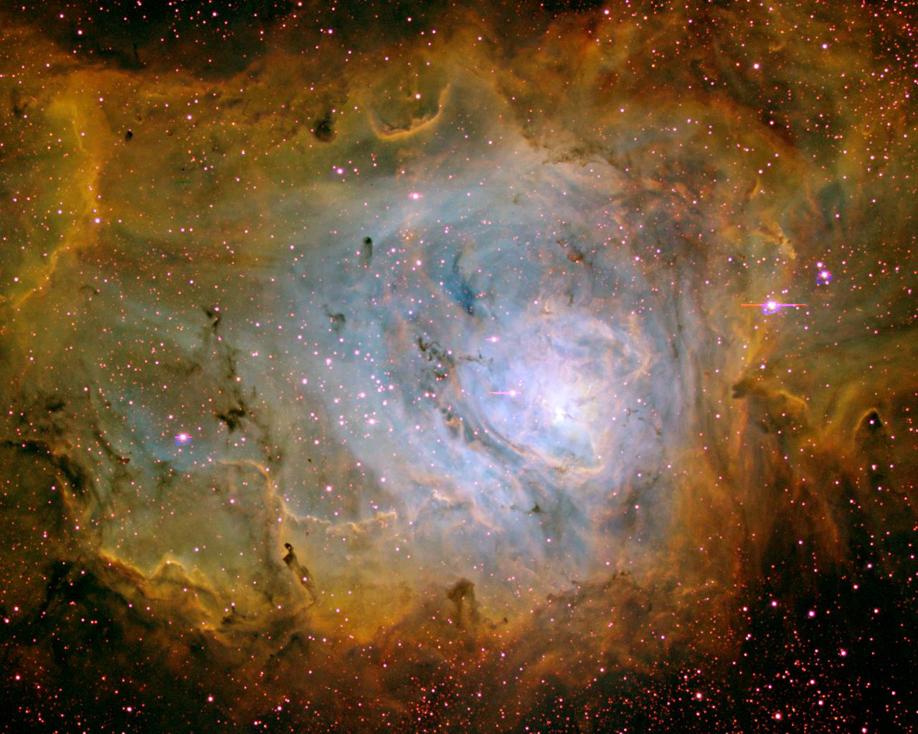
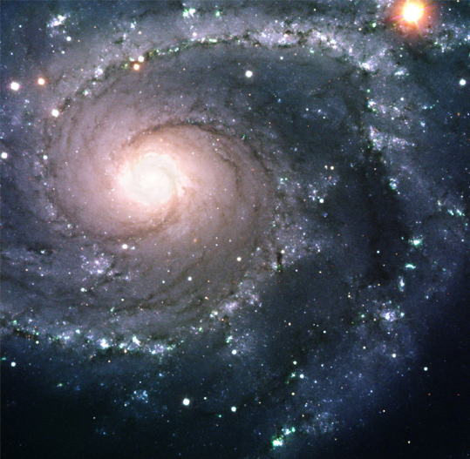
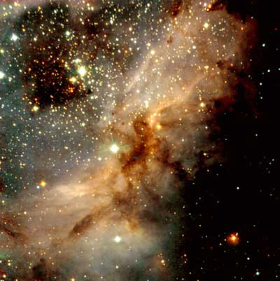
Stars are born in molecular clouds
~ 100 light years in size
Density: 10,000 atoms/cm³
A galaxy (like ours)
[A diffuse nebula is a small part of a molecular cloud that is ionized by embedded hot stars.]

Slide 3
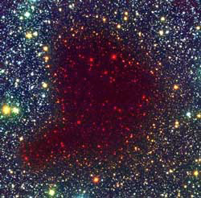
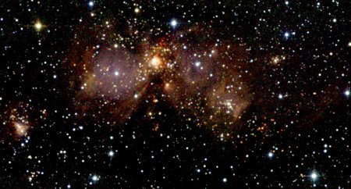
Collapse
Dense regions of a molecular cloud collapse
under their own weight ~ 100 million years
Density: 10⁸ atoms/cm³.
1 - 2 light years
100 light years
A molecular cloud
A Bok globula
(A closeby supernova can help to start the collapse!)

Slide 4
Questions coming …

Slide 5
Question 4
sec
30
29
28
27
26
25
24
23
22
21
20
18
17
16
15
14
13
12
11
10
9
8
7
6
5
4
3
2
1
0
19
What are stars formed from?
A From interstellar gas clouds.
B They are thrown out of the black hole in the center of the Galaxy.
C They were present already when the Universe started.
D They were produced by volcanic activity on planets like Earth.
Next question coming …

Slide 6
Question 5
sec
30
29
28
27
26
25
24
23
22
21
20
18
17
16
15
14
13
12
11
10
9
8
7
6
5
4
3
2
1
0
19
How dense is a molecular cloud, compared to air?
A Much denser, as dense as water.
B About a hundred times denser.
C The same.
D Somewhat less dense.
E Much less dense, even much less dense that what we call ‘vacuum’ in a lab.

Slide 7
Fragmentation
Fragmentation: small regions (size of a star) collapse
faster than the whole cloud: ~ 100, 000 years
Clusters of stars AND double-triple stars are born at a time
Star
1 - 2 light years
Star
Star
A Bok globula

Slide 8
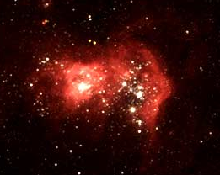
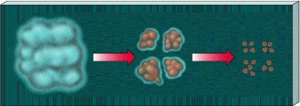
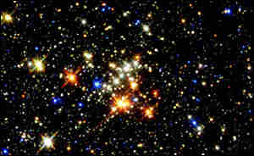
Fragmentation and heat-up
Cloud contracts:
- gets hot
- H ignites
- becomes a star
Smaller pieces collapse faster:
- cloud fragments
- star clusters are born
- binary stars are born
A star forming

Slide 9
Questions coming …

Slide 10
Question 6
sec
30
29
28
27
26
25
24
23
22
21
20
18
17
16
15
14
13
12
11
10
9
8
7
6
5
4
3
2
1
0
19
Will the Orion Nebula collapse into one large star?
A Yes, eventually.
B No, because it is made of gas that has no gravity of its own.
C No, but smaller parts of it will collapse into stars.
D No, because stars are not formed by collapsing gas clouds.
Next question coming …

Slide 11
Question 7
sec
30
29
28
27
26
25
24
23
22
21
20
18
17
16
15
14
13
12
11
10
9
8
7
6
5
4
3
2
1
0
19
Why are there many double stars?
A Because stars are thrown off the center of the Galaxy in bunches.
B Because supernova explosions result in stars split into parts.
C Because a collapsing gas cloud fragments into small pieces.
D Because stars collide so often that they stay stuck together.

Slide 12
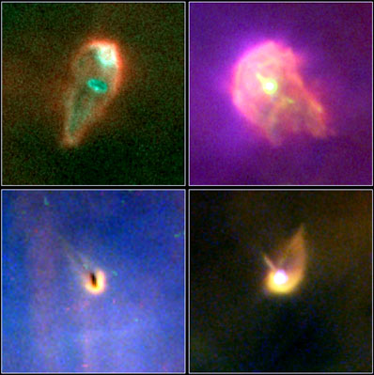
Nebula turns into star
Collapse heats up star - hydrogen ignites
Newly formed star is still unstable
Called a ‘T Tauri’ variable star
Has strong stellar wind, cleans out gas in ~ 100 million yrs
Proto-planetary disks
(~ 100 AU size)
Stars are born in a “cocoon”
of
gas and dust
which
gets collected
into planets
gets blown off
by the star
AND/OR

Slide 13
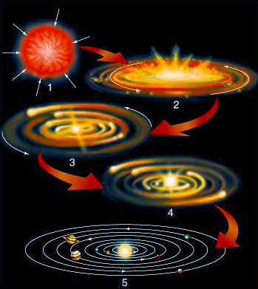
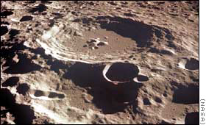
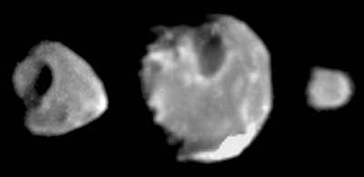
Planets form
Remaining interstellar gas and dust
turns disk shape (friction)
and sticks together into planets
Planets clean up dust/rocks
and feel heavy bombardment
for ~ 1 billion years
get cratered

Slide 14
Questions coming …

Slide 15
Question 8
sec
45
40
35
30
25
19
18
17
16
15
14
13
12
11
10
9
8
7
6
4
3
2
1
0
20
45
5
How are planets formed?
A They are thrown out from the depths of the Sun.
B From the leftover gas and dust after star formation.
C They are formed in the interstellar space and stars capture them when they come close.
D They form from the breakup of the black hole in the center of the Galaxy.
E They form in supernova explosions.
Next question coming …

Slide 16
Question 9
sec
45
40
35
30
25
19
18
17
16
15
14
13
12
11
10
9
8
7
6
4
3
2
1
0
20
45
5
How long after star formation do planets arise?
A Planets are formed at the same time as stars.
B Planets are formed a few thousand years after their stars.
C Planets need about 100 million years to stick together in a protoplanetary disc.
D They form billions of years after their stars.
E There is no relationship, planets may form first, or they may forms long after their stars do.

Slide 17
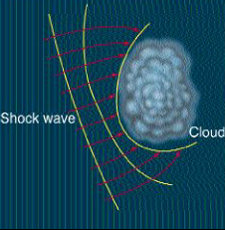
What starts the collapse?
• Once collapse started, gravity of gas increases: accelerating collapse
- but something must start it
• Interstellar clouds are moving around
- dense regions do arise randomly
(just as in normal clouds on Earth – there you get rain)
• For the Sun, proof exists: collapse of cloud was started by
a nearby supernova explosion
The Sun
formed here
SuperNova

Slide 18
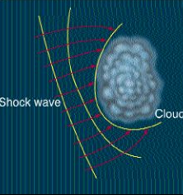
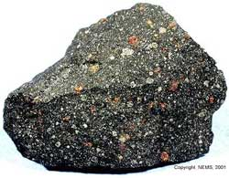
What induced the birth of the Sun?
A close-by supernova! - How do we know? - Xe¹²⁹ in meteorites
• Xe¹²⁹ is found trapped inside meteorites
• Xenon is a noble gas: could not get into meteorites
• Must be a radioactive decay product
• Process: I¹²⁹ ➔ Xe¹²⁹ + e⁻ + ν, half-life = 17 million years
• How did the I¹²⁹ get stuck in meteorites?
– Must have been there when the meteorite froze.
- Within 10-20 million years before the solar system formed,
a SN must have exploded in the vicinity!
The powerful initial push
from a SN is enough
to trigger the collapse
of the solar nebula.
SN

Slide 19
Questions coming …

Slide 20
Question 10
sec
30
29
28
27
26
25
24
23
22
21
20
18
17
16
15
14
13
12
11
10
9
8
7
6
5
4
3
2
1
0
19
What triggered the collapse of the gas cloud that gave birth to the Sun?
A A collision with another star.
B A nearby supernova explosion.
C It was a spontaneous collapse.
D A sudden strengthening of the magnetic field of the Galaxy.
Next question coming …

Slide 21
Question 11
sec
30
29
28
27
26
25
24
23
22
21
20
18
17
16
15
14
13
12
11
10
9
8
7
6
5
4
3
2
1
0
19
What proof do we have about the explosion of a supernova just before the birth of the Sun?
A Radiation damage to the surface of the Moon.
B The existence of gold on Earth.
C The isotope composition of meteorites.
D The existence of oxygen on Earth.

