Slide 1
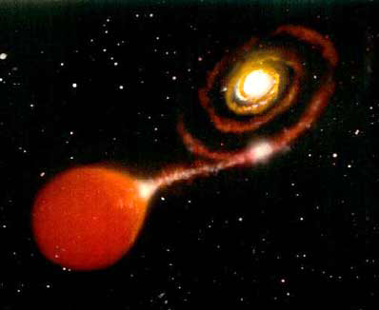
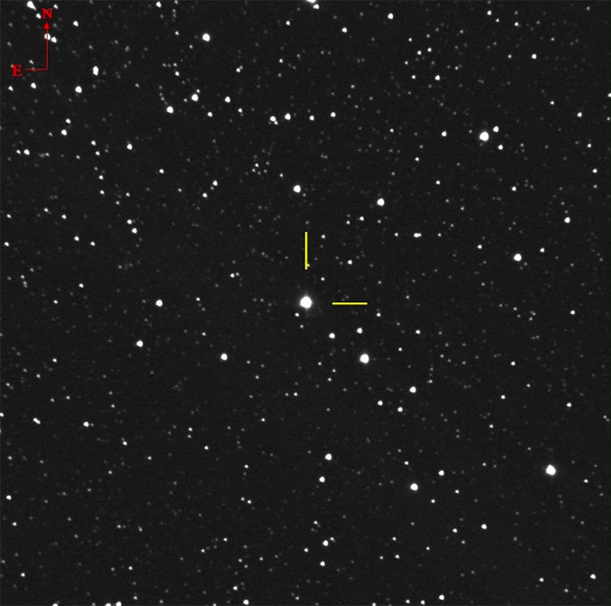
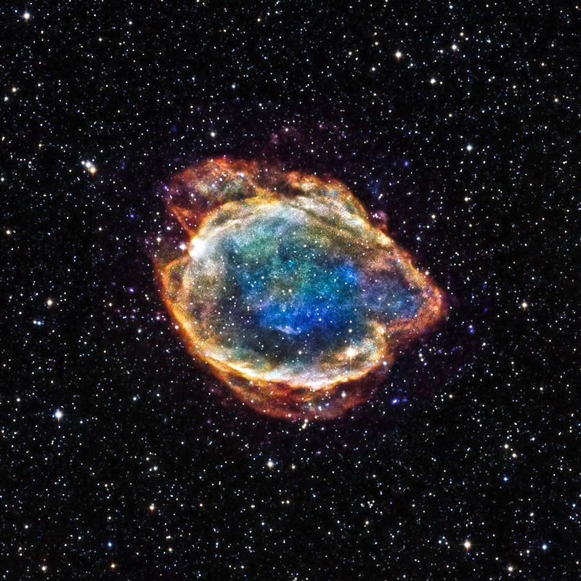
Type-Ia SN
Novae and Type-Ia supernovae
White dwarfs: Normally “decent” objects, slowly cooling off
Density ~ 1,000,000 g/cm³ - atoms touch
When part of a close binary, can produce “fireworks”:
White dwarf steals hydrogen -
H piles up on its hot surface
suddenly ignites: a nova
M=-8^{mg}, a few per year in the Galaxy
White dwarf steals hydrogen -
mass grows over 1.44 solar, collapses: a Type-Ia supernova
M=-19^{mg}, a few per millinea in the Galaxy
Normal star
White dwarf inside
Nova Cassiopeiae 2021
on 3/19/2021
at 7.5mg still brightening
IR+X-ray photo of an old
Type-Ia SN remnant G299.2-2.9

Slide 2
Questions coming …

Slide 3
Question 6
sec
30
29
28
27
26
25
24
23
22
21
20
18
17
16
15
14
13
12
11
10
9
8
7
6
5
4
3
2
1
0
19
Can a white dwarf explode as a supernova?
A It cannot.
B It normally blows up as a supernova after
all its fuel has been exhausted.
C Normally no, but if it collides with another star
in a globular cluster, it may.
D Normally no, but if it receives hydrogen (fuel) from
its companion in a double star system, it may.
Next question coming …

Slide 4
Question 7
sec
45
40
35
30
25
19
18
17
16
15
14
13
12
11
10
9
8
7
6
4
3
2
1
0
20
5
What is a type Ia supernova?
A A planet falling into the Sun.
B A planet falling into a star.
C A very heavy star blowing up when it exhausts all its fuel.
D A double star, the white dwarf component blowing up because
its companion spits matter on it
E A solar-mass star blowing up when it exhausts all its fuel.
Next question coming …

Slide 5
Question 8
sec
30
29
28
27
26
25
24
23
22
21
20
18
17
16
15
14
13
12
11
10
9
8
7
6
5
4
3
2
1
0
19
Why are Type-Ia supernovae useful
for measuring distances?
A Because they have large parallax.
B Because they all have the same absolute brightness.
C Because they move very fast out of their galaxies.
D Because they all have the same chemical composition.

Slide 6
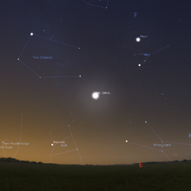
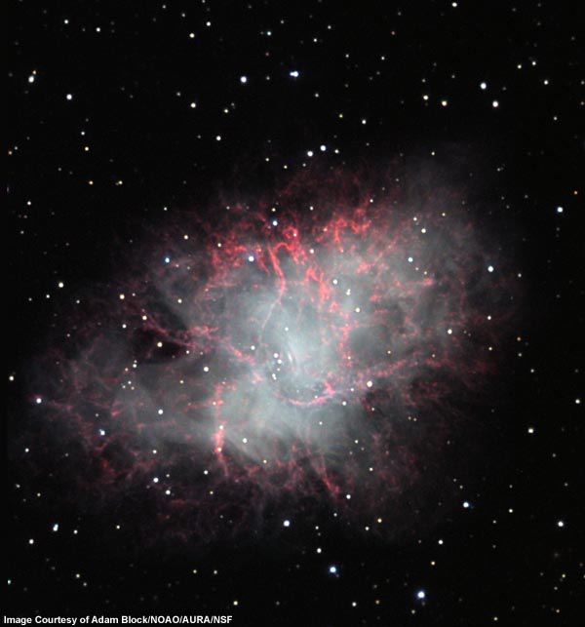

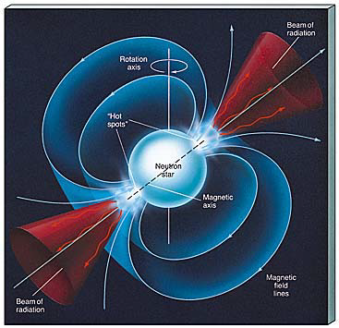
simulated image July 4, 1054
This star blew up 1054 A.D. (Type-II SN)
Now: the “Crab” nebula (M1)
slow motion 100 x
A 5-mile sized very strange object: PULSAR
• extremely dense
• rotates fast
A supernova remnant

Slide 7
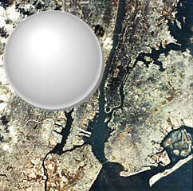
What is a neutron star?
Recoil of a supernova explosion presses together
matter in the very middle
Extremely dense, collapse stopped when
all substance is in one huge atomic nucleus,
made of neutrons only
p⁺ + e⁻ ➔ n
• As small as Manhattan
• As heavy as a small star
• 10¹⁴ g/cm³
• Spins fast (many times a sec)
Pulsar if N/S pole is
directed towards us

Slide 8
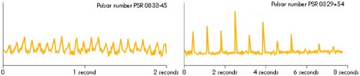
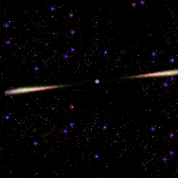
What is a pulsar?
Jocelyn Bell, 1967 - observed radio signals like these
A pulsar is
A spinning neutron star
Spitting out material towards
the magnetic N, S poles
Earth
This charged material makes nebula glow

Slide 9
Question 9
sec
30
29
28
27
26
25
24
23
22
21
20
18
17
16
15
14
13
12
11
10
9
8
7
6
5
4
3
2
1
0
19
Which one is true of a neutron star?
A It is as dense as an atomic nucleus.
B No light can ever leave it.
C It is cold.
D It is huge, as large as a supergiant.
E It is always observed as a pulsar.
Next question coming …

Slide 10
Question 10
sec
45
40
35
30
25
19
18
17
16
15
14
13
12
11
10
9
8
7
6
4
3
2
1
0
20
5
45
What provides the energy for the Crab Nebula to glow?
A Its gas is hot and is radiating off its heat as it is cooling.
B Its gas is collapsing under its gravity, so it is heated up.
C Charged particles emitted from the neutron star.
D A black hole in the middle.
E Hydrogen is fused into helium in the interstellar space.
Next question coming …

Slide 11
Question 11
sec
30
29
28
27
26
25
24
23
22
21
20
18
17
16
15
14
13
12
11
10
9
8
7
6
5
4
3
2
1
0
19
What is a pulsar?
A A star that periodically changes its size.
B A neutron star formed in a supernova explosion.
C A planet emitting radio signals.
D A special type of binary stars.
Next question coming …

Slide 12
Question 12
sec
30
29
28
27
26
25
24
23
22
21
20
18
17
16
15
14
13
12
11
10
9
8
7
6
5
4
3
2
1
0
19
How fast does a typical pulsar spin?
A Many times every second.
B A few times a minute.
C Once a week.
D Once a year.
E Does not spin at all.

