Slide 1



Setup:
Prepare your scantron:
Use
a pencil,
not a pen!
Fill in your name and fill the bubbles under
your name.
LAST NAME FIRST, First name second
Put your 4-digit code instead of “IDENTIFICATION NUMBER”.
--- (The last 4 digits of your OleMiss ID.)
Pass/Fail makeup: April 10, 2:00 pm
(in Lewis Hall basement lab)
Question # 1: answer A
Question # 2: answer C
Question # 3: answer E
Please take a moment to mute your cell phone!

Slide 2
Disk formation
Any gas or dust cloud moving under gravity becomes a disk.
Collisions between particles cease only in a thin disk -
- a thin disk is the only stable ‘shape’
Happens small and large → planet size, star size, galaxy size

Slide 3
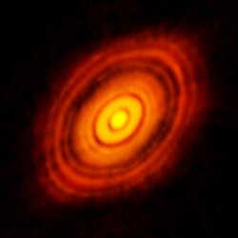
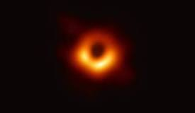
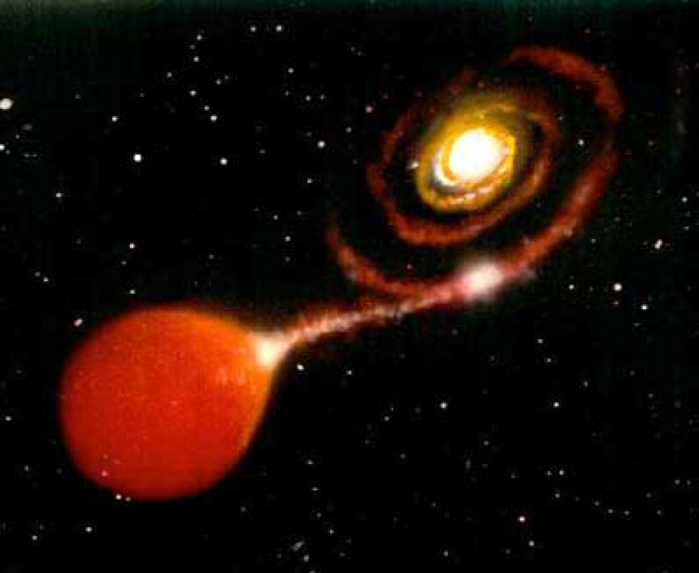
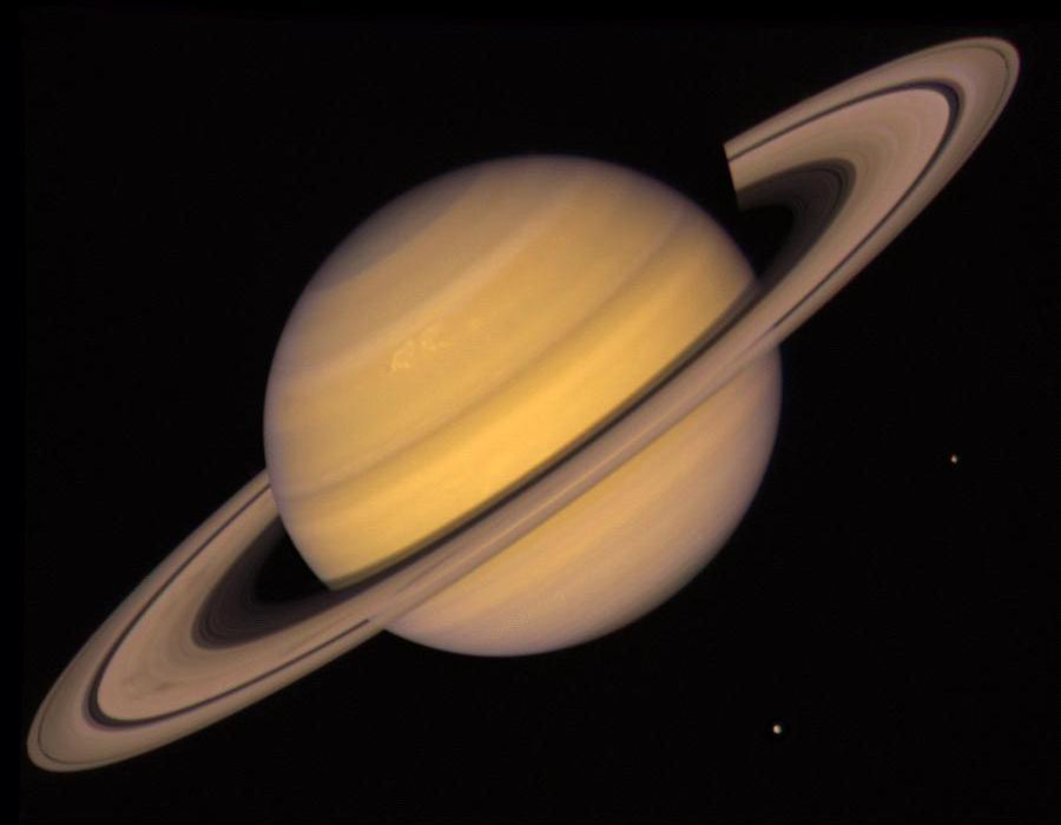
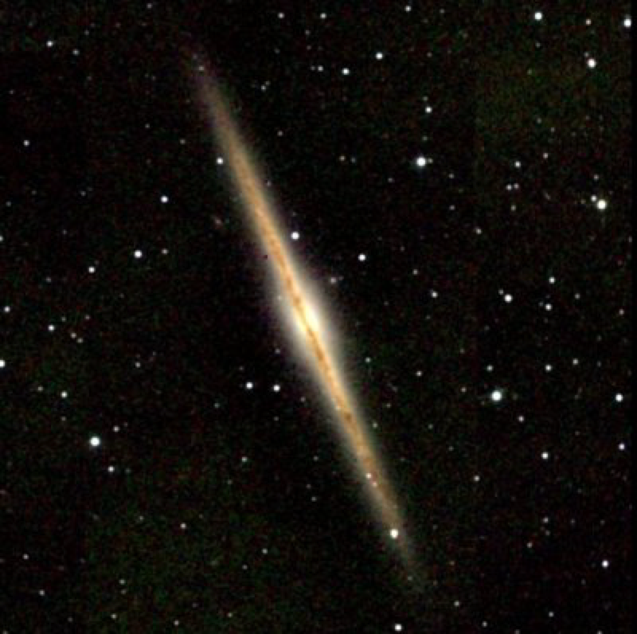
Examples:
Star and planet formation:
protoplanetary disc
Black hole accreting gas:
A double star
(nova;type-Ia supernova)
A galaxy’s
interstellar gas
Saturn’s ring

Slide 4
Questions coming …

Slide 5
Question 4
sec
30
29
28
27
26
25
24
23
22
21
20
18
17
16
15
14
13
12
11
10
9
8
7
6
5
4
3
2
1
0
19
What happens to a spinning ball of gas/dust whose
atoms are on orbit around the center of the ball?
A It always collapses under gravity.
B It keeps spinning forever in the shape of a circle.
C It gets hot from friction.
D It slowly turns into disk shape.
Next question coming …

Slide 6
Question 5
sec
30
29
28
27
26
25
24
23
22
21
20
18
17
16
15
14
13
12
11
10
9
8
7
6
5
4
3
2
1
0
19
A galaxy’s cold interstellar gas is mostly in the disk,
but the stars may not be. Why?
A Because cold gas is heavier and so it falls down to the disk.
B Because gas atoms collide, but stars do not.
C Because disk formation applies only to heavy stars.
D Because stars are hot and so it may rise higher up, away from the disk.
D Because stars are hot and so it may not rise higher up, away from the disk.

