Slide 1



Setup:
Prepare your scantron:
Use
a pencil,
not a pen!
Fill in your name and fill the bubbles under
your name.
LAST NAME FIRST, First name second
Put your 4-digit code instead of “IDENTIFICATION NUMBER”.
--- (The last 4 digits of your OleMiss ID.)
Reading assignment
Angular size; arcseconds (pp. 27-28)
Parallax, parsecs, absolute magnitude, distance modulus (pp. 489-493)
Question # 1: answer A
Question # 2: answer C
Question # 3: answer C
• Labs: Mon-Tue-Wed - DS visit this week (weather permitting)
• Test on Friday, Sept. 26
• Any student may choose to come to take the 1:00 or the 3:00 pm test.
Please take a moment to mute your cell phone!

Slide 2
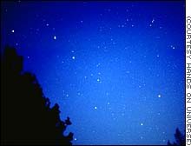
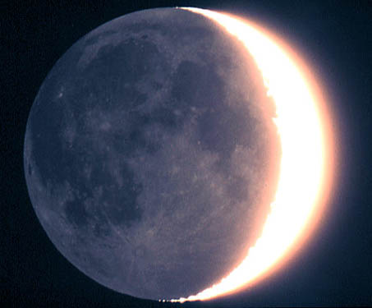
Recall angular sizes
How large is the Big Dipper?
25⁰ apparent size
Stretch out your hand:
1 cm = 1º
25º
1º = 60 am (minute of arc)
1 am = 60 as (second of arc)
How large is the Moon?
1/2 ⁰ apparent size
1/2º = 30 am = 1800 as
0.5º

Slide 3
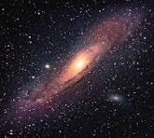
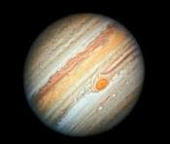

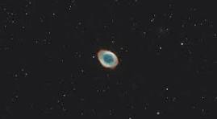
Examples:
How large is this galaxy?
3 degrees ~ 10,000 as
(That is,
how large does
each of these look?)
How large is Jupiter?
40 as
How large is Neptune?
2.4 as
How large is this planetary nebula?
85 as

Slide 4
Questions coming …

Slide 5
Question 4
sec
30
29
28
27
26
25
24
23
22
21
20
18
17
16
15
14
13
12
11
10
9
8
7
6
5
4
3
2
1
0
19
An object’s size is 1 as (arc seconds). Can details be seen on it with the naked eye or with telescopes ?
A Yes, even with the naked eye.
B Yes, but only with a (small) telescope.
C Yes, but only with a large telescope.
D Not really, and if any, only with a very large telescope.
E No; only perhaps from space but not from the Earth.

Slide 6

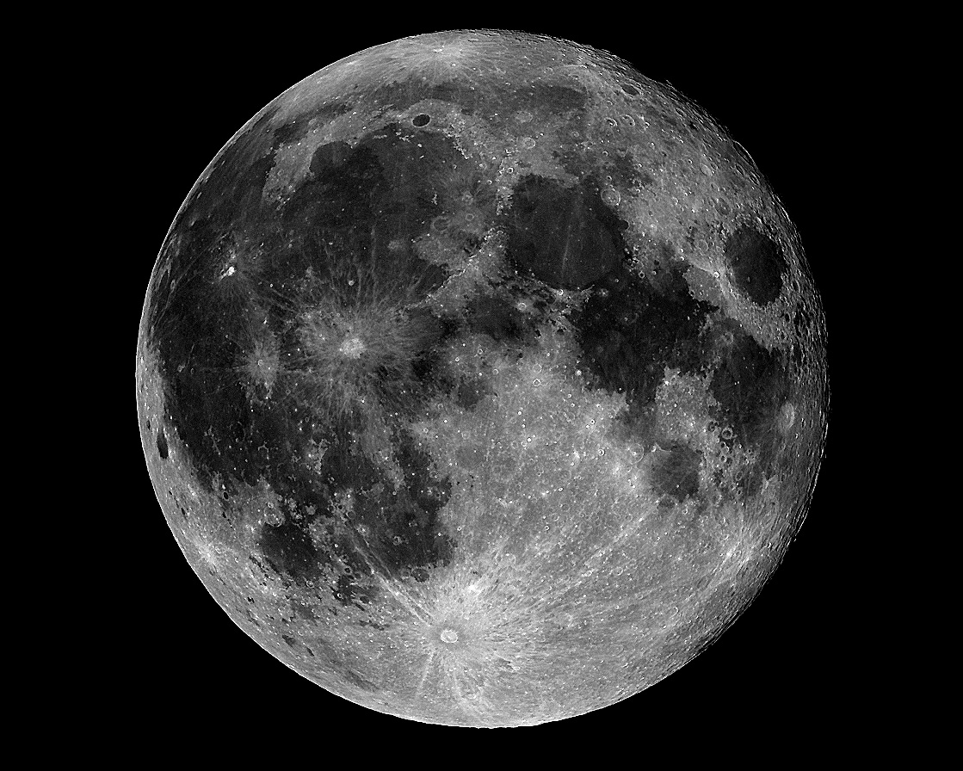
Resolution
Resolution of the human eye is 1 am = 60 as.
Anything smaller than the resolution is
invisible or looks only like a dot (if bright)
Stars are points in
all telescopes:
Calculated size of a star:
~ 0.001 as,
Resolution of best telescope:
~ 0.1 as.
Much more detail is visible
Resolution of a simple telescope is ~ 1 as

Slide 7
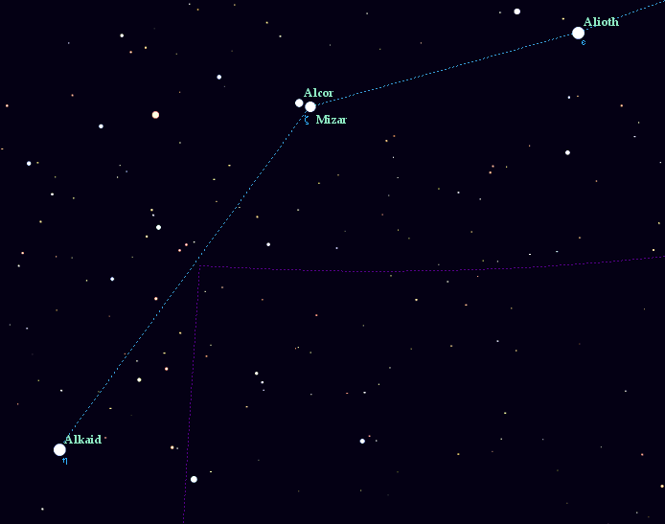
Example for resolution: Alcor and Mizar
In a telescope’s view
Alcor
25 am
25 am
Mizar A & B
14 as
The handle of the Big Dipper:
the middle star is a double
How far apart are Alcor and Mizar?
25 am

Slide 8
Questions coming …

Slide 9
Question 5
sec
30
29
28
27
26
25
24
23
22
21
20
18
17
16
15
14
13
12
11
10
9
8
7
6
5
4
3
2
1
0
19
How do stars look in the largest telescope of the world?
A Like large disks.
B Disks with clouds visible on them.
C Tiny disks with a few starspots.
D Points (no details visible).
E They are “star-shaped” with rays emanating from them.
Next question coming …

Slide 10
Question 6
sec
30
29
28
27
26
25
24
23
22
21
20
18
17
16
15
14
13
12
11
10
9
8
7
6
5
4
3
2
1
0
19
The two stars Alcor and Mizar are easily separated by the human eye.
This means that they must be farther apart than …
A a few degrees
B one arc minute.
C a few light years.
D a few million kilometers.
E a million light years.

Slide 11
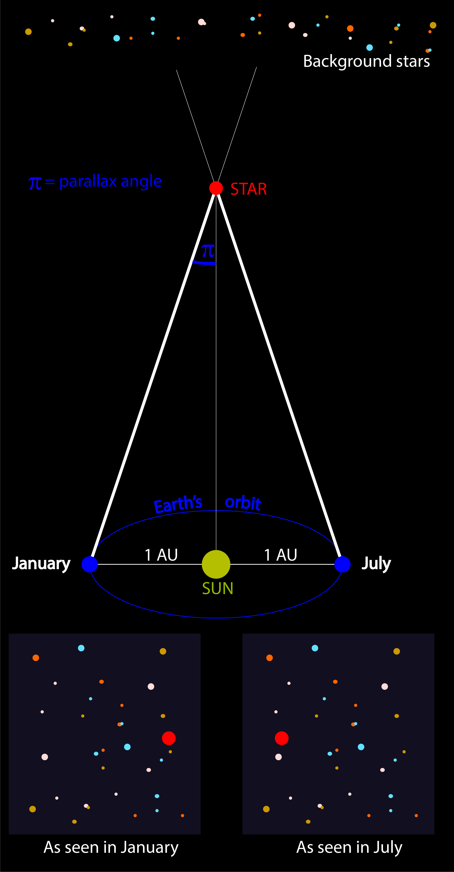
Parallax
How do we know
the distance to the stars?
(Close-by stars, for a start.)
• Close-by stars seem to move on tiny ellipses,
once a year
• Reflection of the motion of Earth around the Sun
• Most (far-away) stars move very little
Measure parallax:
the closer the star, the larger the ellipse
Parallax = 1 as ↔ distance 1 parsec (pc)
1 pc = 3.26 light years
Formula: distance[pc] = 1/parallax[as]
Practical limit on precision: Gaia spacecraft
• 0.1 mas (limits distance to ~ 2 kpc,
a bit beyond the Solar neighborhood)
• stars brighter than 17 mg

Slide 12
Parallax
The closer the star, the larger the ellipse
Parallax = 1 as ↔ distance 1 parsec (pc)
1 pc = 3.26 light years
Formula: distance[pc] = 1/parallax[as]
• Close-by stars seem to move on
tiny ellipses, once a year
Note: 1 mas = 0.001 as
Examples:
Proxima Centauri: distance 4 ly = 1.3 pc (very close)
parallax 0.7 as (observable with a large telescope)
Regulus (α Leonis): distance 79 ly = 24 pc (in Solar Neighborhood)
parallax 0.04 as
Betelgeuse (α Orionis): distance 520 ly = 160 pc (still in Solar Neighborhood)
parallax 6.3 mas (tiny but still observable)
Center of the Galaxy: distance 25,000 ly = 8,000 pc
parallax 0.125 mas (unobservably tiny)
Andromeda galaxy: distance 2 million ly = 700,000 pc
parallax 0.00013 mas (unobservably tiny)

Slide 13
Questions coming …

Slide 14
Question 7
sec
30
29
28
27
26
25
24
23
22
21
20
18
17
16
15
14
13
12
11
10
9
8
7
6
5
4
3
2
1
0
19
What is parallax?
A Far away stars appear dimmer in the sky.
B Stars make one loop around the whole sky in one year.
C Stars move in tiny ellipses in the sky, once a year.
D The telescope must follow the star’s apparent daily motion.
Next question coming …

Slide 15
Question 8
sec
30
29
28
27
26
25
24
23
22
21
20
18
17
16
15
14
13
12
11
10
9
8
7
6
5
4
3
2
1
0
19
How large an effect is parallax?
A Very large: stars move all the way around the sky in a year.
B Large. You can see it by the naked eye without any difficulty.
C Tiny. We need a very precise telescope to detect it.
D Extremely tiny, invisible even with the largest telescopes.
Next question coming …

Slide 16
Question 9
sec
45
40
35
30
25
19
18
17
16
15
14
13
12
11
10
9
8
7
6
4
3
2
1
0
20
5
Polaris, the North Star, has its parallax measured
as 0.01 arc seconds. How far is it?
A One parsec. (That would be ~ 3 light years.)
B A tenth of a parsec. (That would be ~ 1/3 of a light year.)
C A hundred parsecs. (That would be ~ 300 light years.)
D Ten parsecs. (That would be ~ 30 light years.)
E A thousand parsecs. (That would be ~ 3000 light years.)

Slide 17
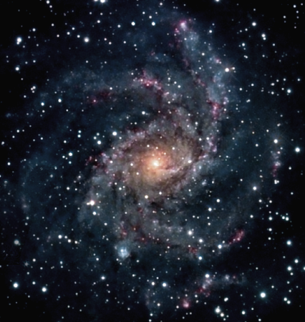
Apparent and absolute brightness
Recall:
A parsec (pc) is a unit of distance, 3.26 light years.
Why this unit?
Because the orbit of Earth looks 1 arc sec radius from the distance of 1 pc.
How bright it looks
(m)
How bright it really is
(M)
Solar neighborhood (~100 pc)
A star’s absolute magnitude is
how bright it would look
from 10 pc (32.6 light years) away.
The Sun: M = 5^{mg}
(an average star)

Slide 18
Questions coming …

Slide 19
Question 10
sec
30
29
28
27
26
25
24
23
22
21
20
18
17
16
15
14
13
12
11
10
9
8
7
6
5
4
3
2
1
0
19
What is absolute magnitude of a star?
A It is how bright the star looks from the center of the Galaxy.
B It is how bright the star would look from a distance of 10 parsecs.
C It is how bright the star was when it was born.
D It is how bright the star looks in very good weather.
E It is how bright the star looks from space.
Next question coming …

Slide 20
Question 11
sec
30
29
28
27
26
25
24
23
22
21
20
18
17
16
15
14
13
12
11
10
9
8
7
6
5
4
3
2
1
0
19
How bright would the Sun look in the sky
from a distance of 10 parsecs?
A -12^{mg} (as bright as the full Moon).
B 1^{mg} (as bright as the brightest stars in the sky).
C 5^{mg} (barely visible to the naked eye).
D 15^{mg} (very faint).
E Invisible: we cannot see that far.
Next question coming …

Slide 21
Question 12
sec
30
29
28
27
26
25
24
23
22
21
20
18
17
16
15
14
13
12
11
10
9
8
7
6
5
4
3
2
1
0
19
Polaris, the North Star, is m = 2^{mg}, not particularly
bright. Its absolute magnitude is M = - 4^{mg}.
If you imagine Polaris placed where the Sun is now,
would it look brighter, or fainter than the Sun?
A Ten thousand times brighter.
B Somewhat brighter.
C About the same.
D Somewhat fainter.
E Ten thousand times fainter.

