Slide 1
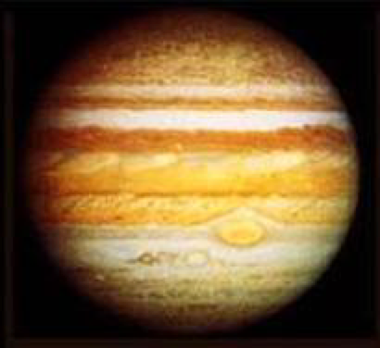
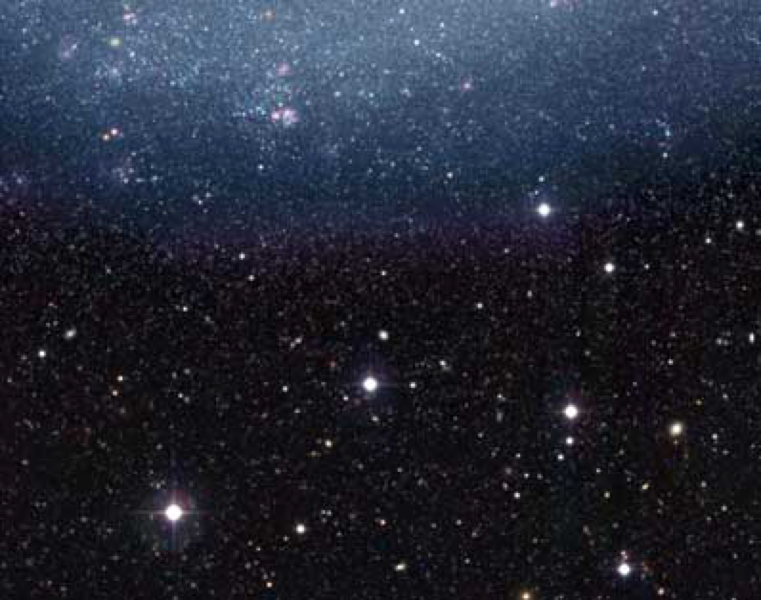
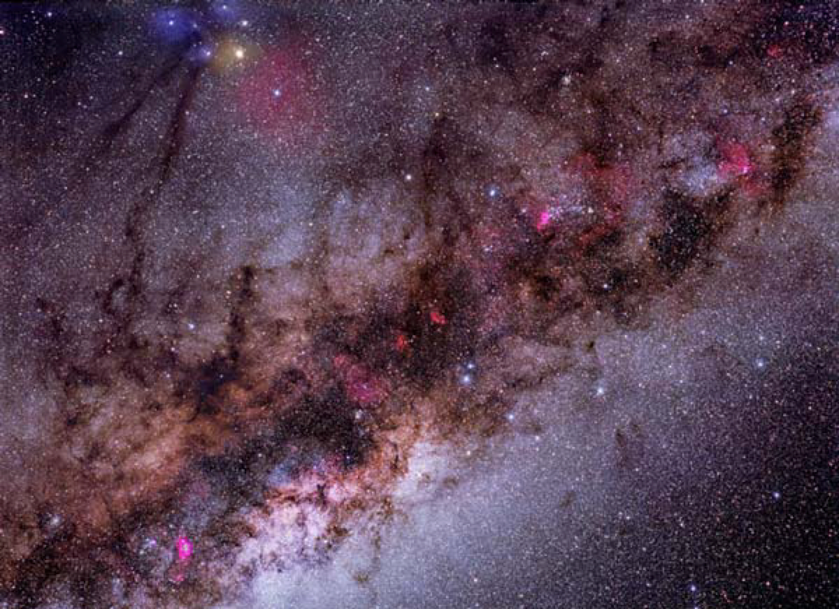
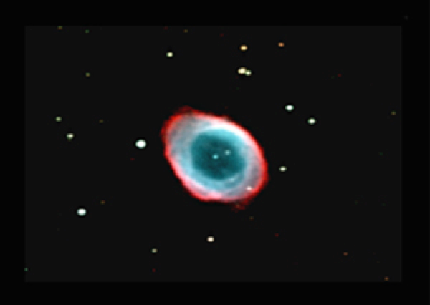
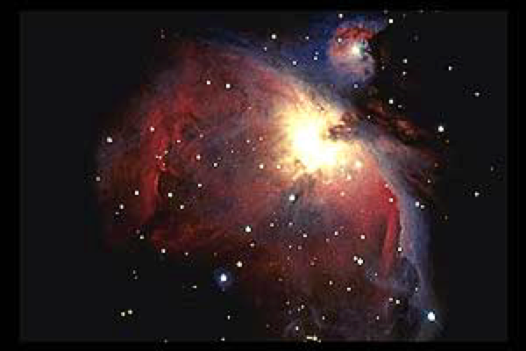
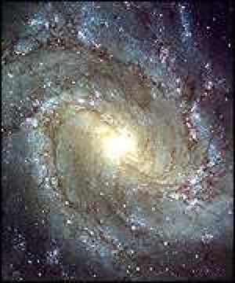
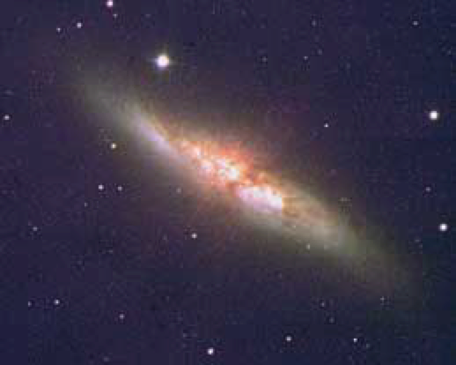
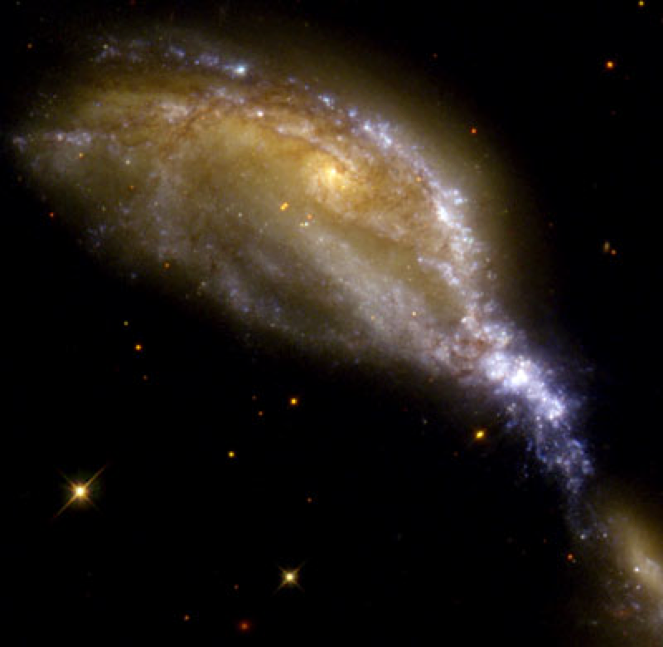
Galaxies
Recall:
all stars with their planets
the Milky Way in the sky
all “nebulae”
are part of our Galaxy …
but there are other galaxies:

Slide 2
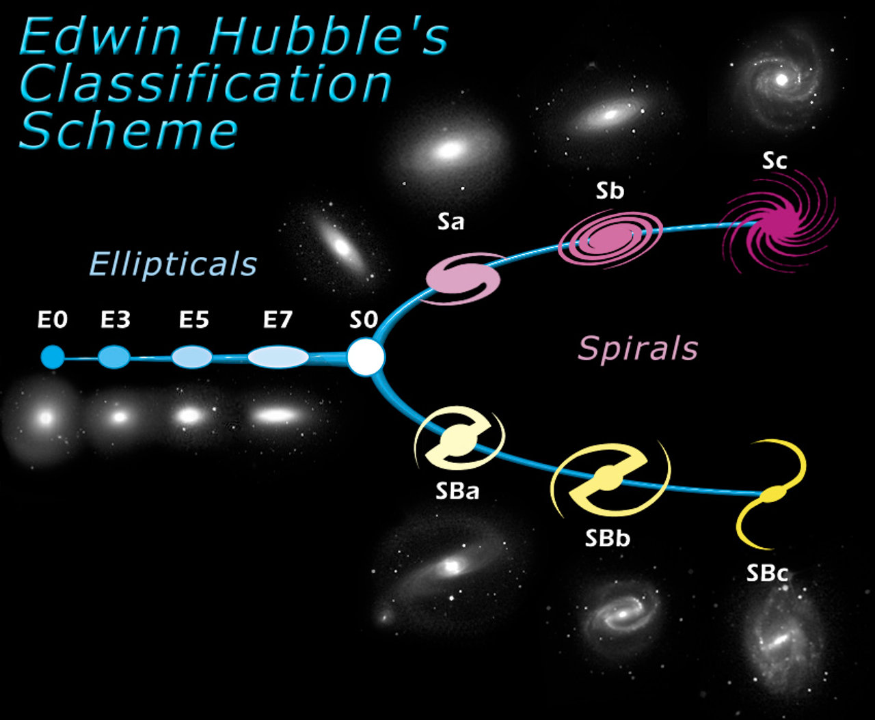
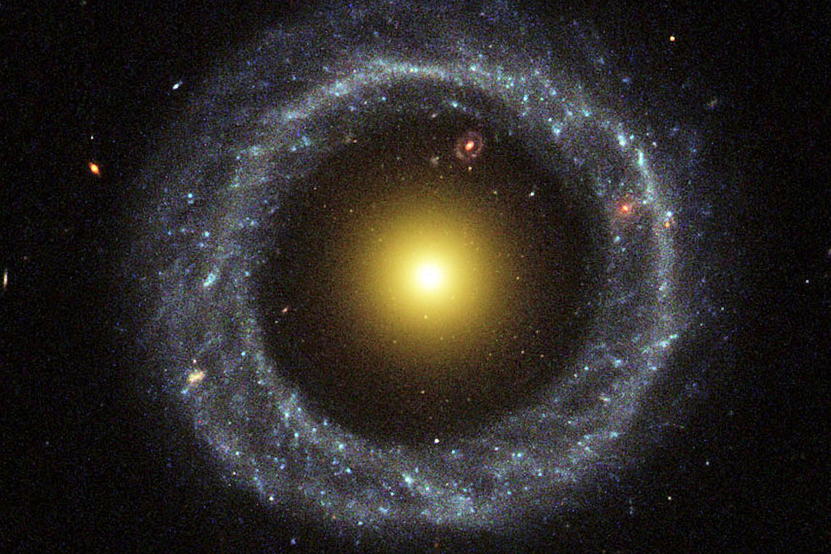
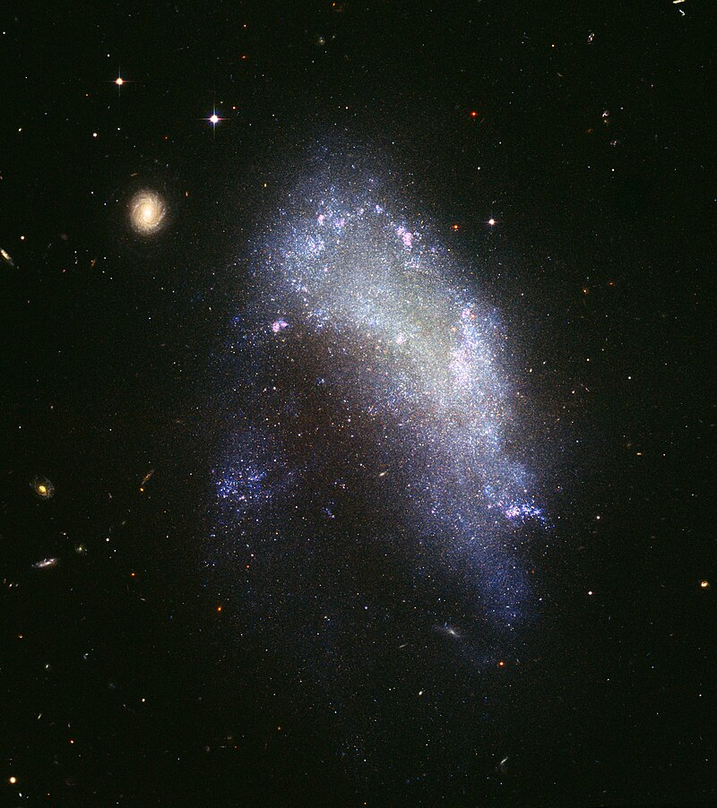
The classification of galaxies
Spiral galaxies
Sa - Sb - Sc
(Our galaxy is SBb)
All sorts of irregular galaxies
I
No interstellar gas:
No star formation today
Barred spiral galaxies
SBa - SBb - SBc
Interstellar gas in spiral arms:
Star formation there

Slide 3
Questions coming …

Slide 4
Question 6
sec
30
29
28
27
26
25
24
23
22
21
20
18
17
16
15
14
13
12
11
10
9
8
7
6
5
4
3
2
1
0
19
What are the three main types of galaxies?
A Elliptical, barred and barless
B Regular, irregular, and spiral
C Irregular, barred spiral and barless spiral
D Elliptical, spiral and irregular
E Colliding, spiral and elliptical
Next question coming …

Slide 5
Question 7
sec
30
29
28
27
26
25
24
23
22
21
20
18
17
16
15
14
13
12
11
10
9
8
7
6
5
4
3
2
1
0
19
What type of a galaxy is ours?
A Elliptical (E3).
B Irregular (I).
C Lenticular (S0)
D Regular spiral (Sb).
E Barred spiral (SBb).

Slide 6
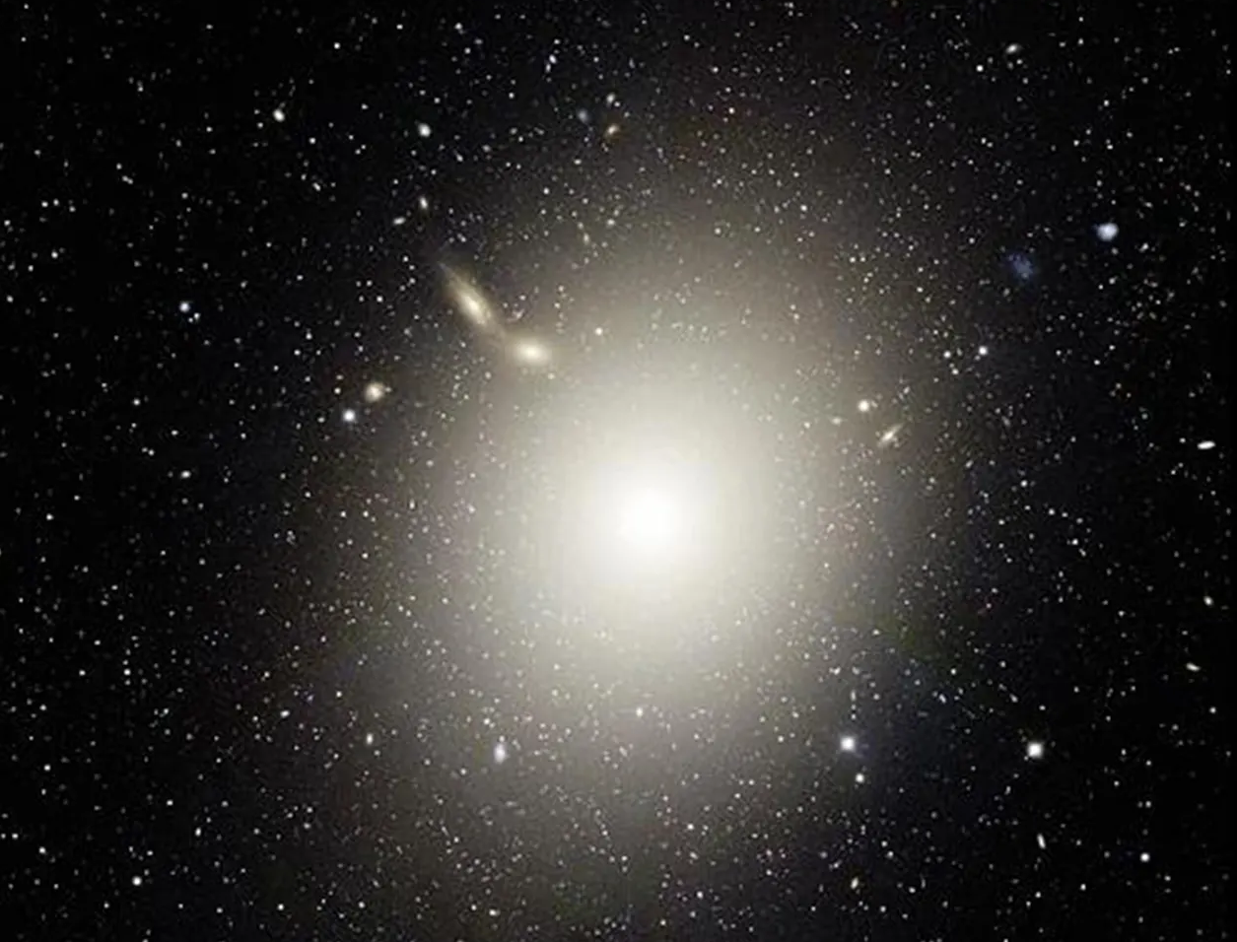
A giant elliptical galaxy – M87

Slide 7
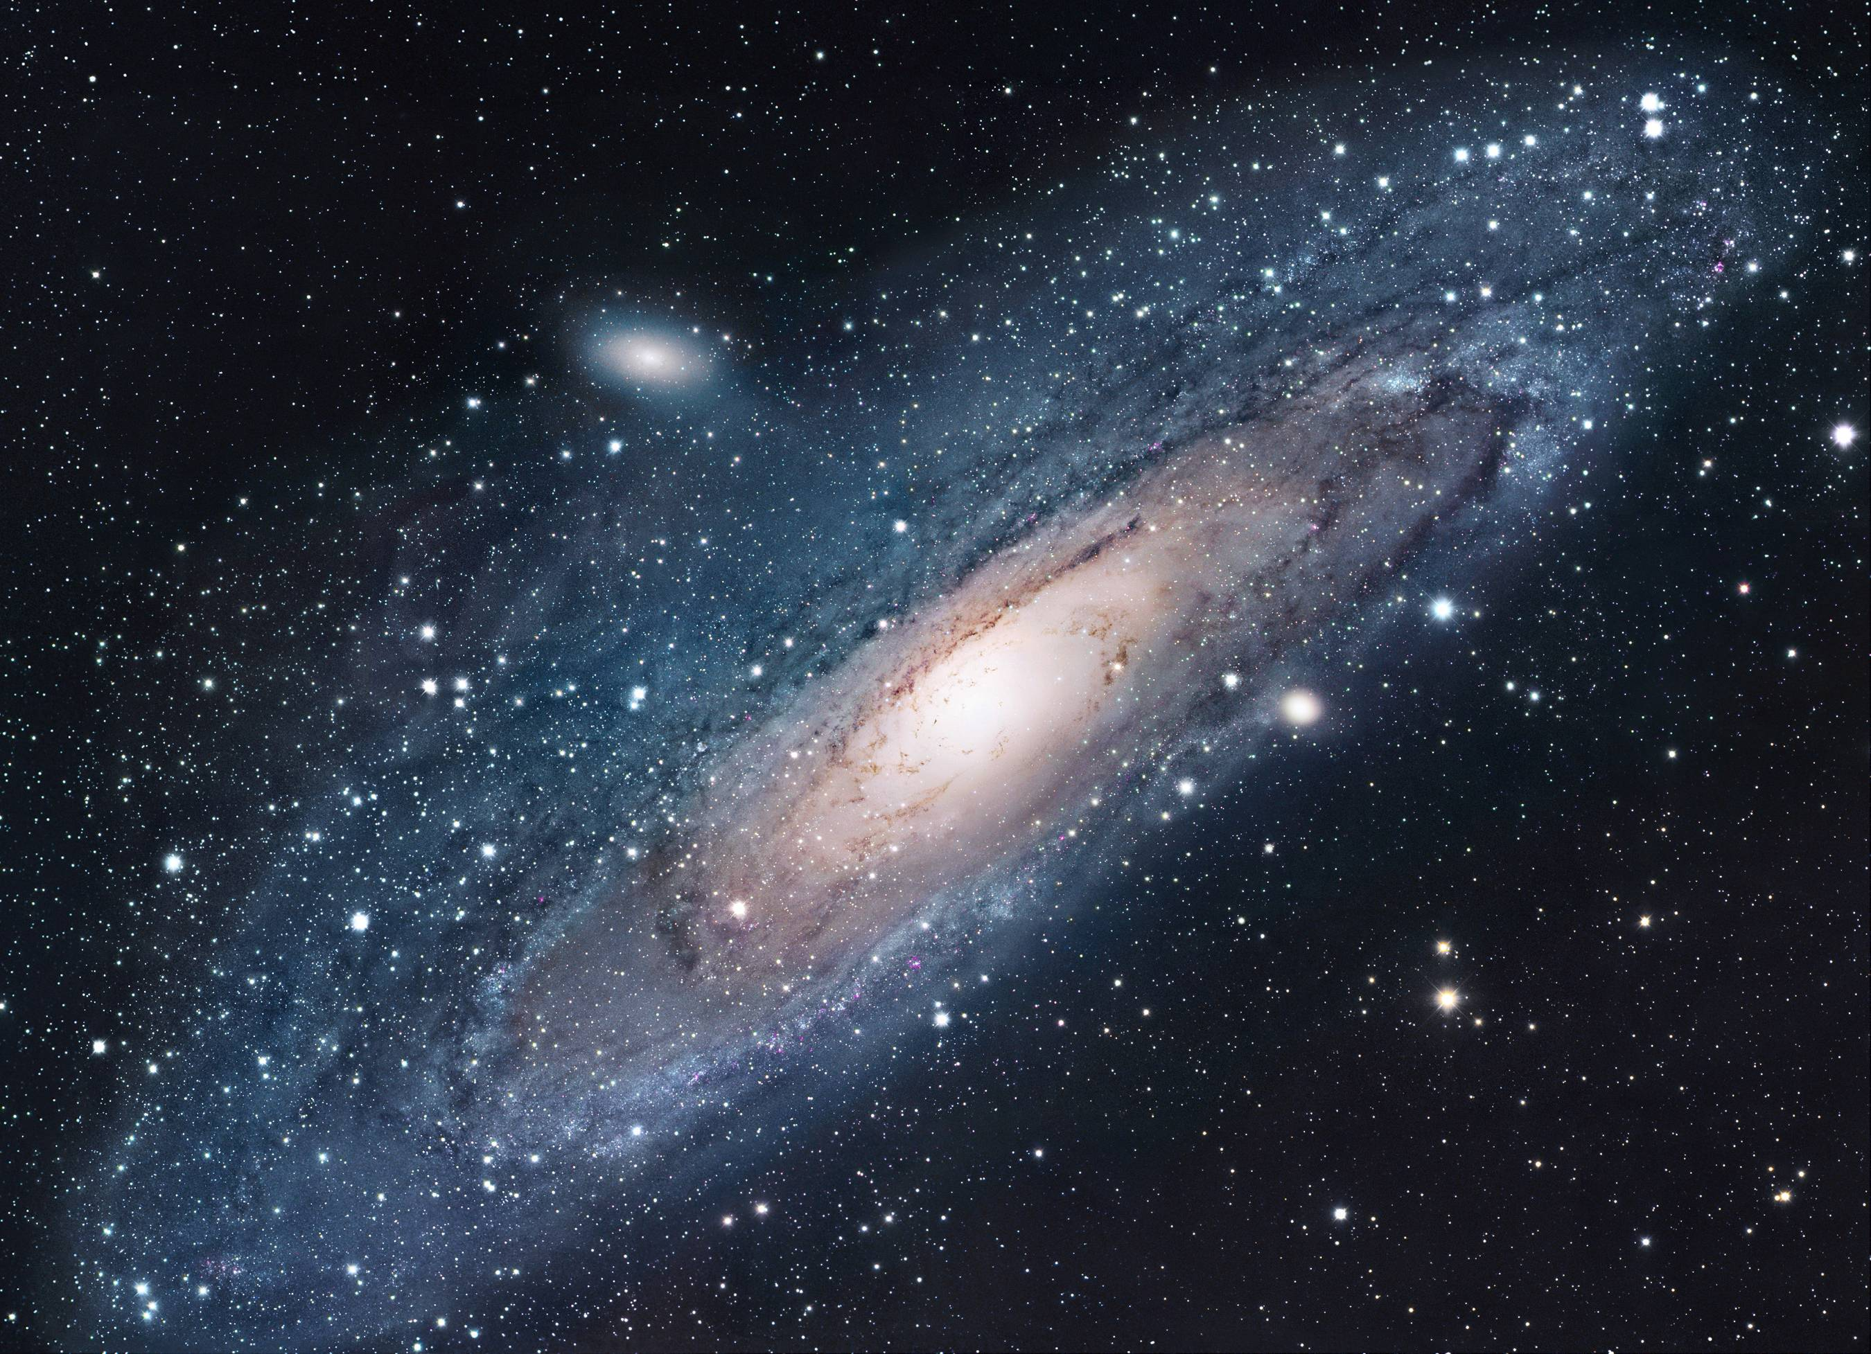
M31
A very close one: the Andromeda Galaxy (M31)
~ 2 million light years

Slide 8
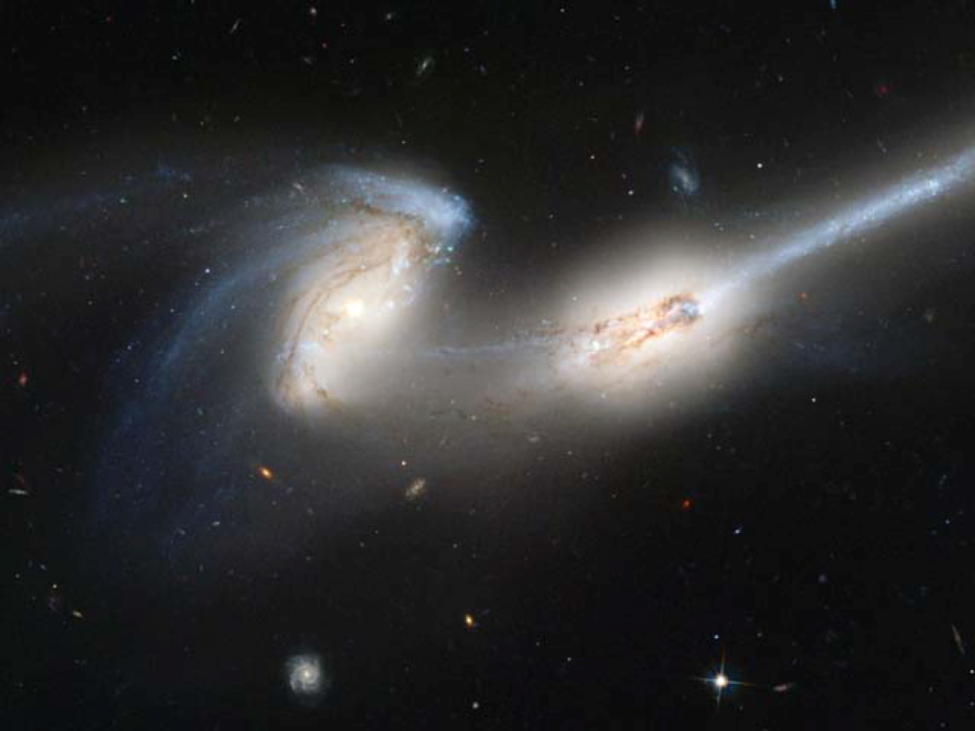
NGC 4676
An irregular galaxy - NGC 4676
A spiral galaxy in the background

Slide 9
Questions coming …

Slide 10
Question 8
sec
30
29
28
27
26
25
24
23
22
21
20
18
17
16
15
14
13
12
11
10
9
8
7
6
5
4
3
2
1
0
19
What happens if two galaxies collide?
A They both blow up.
B Stars hit each other in the collision.
C They pass through each other but the gravity of each galaxy distorts the other.
D They pass through each other without interaction.
Next question coming …

Slide 11
Question 9
sec
45
40
35
30
25
19
18
17
16
15
14
13
12
11
10
9
8
7
6
4
3
2
1
0
20
5
45
How far is the farthest galaxy?
A A few astronomical units: all galaxies are part of the Solar System.
B As far as the far edge of the Milky Way: all galaxies are part of our Milky Way.
C There are galaxies a few million light years away, and there is only empty space beyond that.
D There are galaxies everywhere as far as we can see.

Slide 12
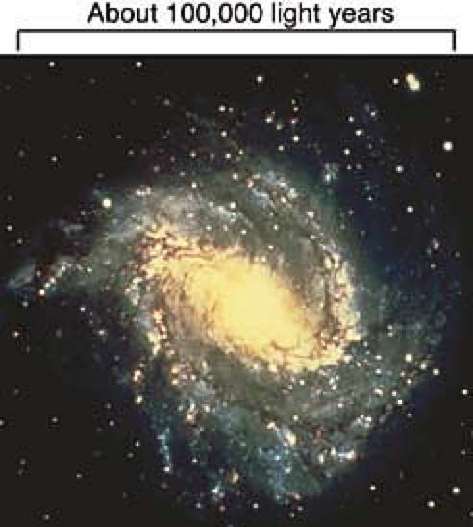
Shape of the Galaxy
The true shape of the Galaxy
The Sun
Held together by gravity
- stars are on orbit around center
Sun - 200 million years
How do we know:
Stars move in the sky
a few arc seconds per century
called “proper” motion

Slide 13
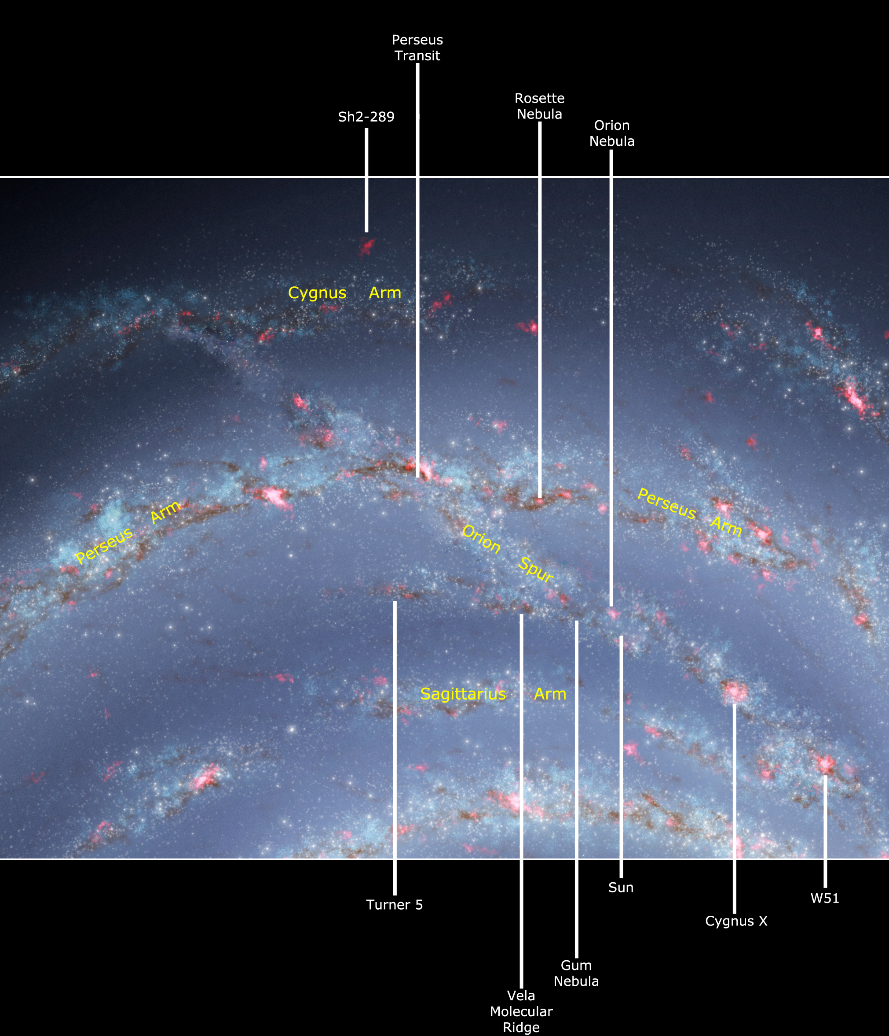
Shape of the Galaxy
Where is the Sun (and Earth)
in the Galaxy?
In a ‘spur’ connecting two spiral arms
(in the middle of a small empty bubble)
Sun

Slide 14
Questions coming …

Slide 15
Question 10
sec
30
29
28
27
26
25
24
23
22
21
20
18
17
16
15
14
13
12
11
10
9
8
7
6
5
4
3
2
1
0
19
Where is the Sun located in the Galaxy?
A In the center.
B Halfway form the center, but away from all spiral arms.
C In the middle of a spiral arm.
D The Sun is not in the Galaxy at all.
E Between two spiral arms, in a small ‘spur’ of stars.
Next question coming …

Slide 16
Question 11
sec
30
29
28
27
26
25
24
23
22
21
20
18
17
16
15
14
13
12
11
10
9
8
7
6
5
4
3
2
1
0
19
How does the Sun move in the Galaxy?
A It is motionless.
B It revolves around the center.
C It is moving out of the Galaxy in a straight line.
D It is falling into the center, but will arrive only in 10 billion years.

