Slide 1


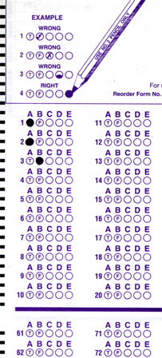
Setup:
Prepare your scantron:
Use
a pencil,
not a pen!
Fill in your name and fill the bubbles under
your name.
LAST NAME FIRST, First name second
Put your 4-digit code instead of “IDENTIFICATION NUMBER”.
--- (The last 4 digits of your OleMiss ID.)
Question # 1: answer B
Question # 2: answer C
Question # 3: answer B
Reading assignment
Galaxies: ours and others, Chapters 19-20, pp. 580-626
(A superficial reading will suffice)
Please take a moment to mute your cell phone!

Slide 2
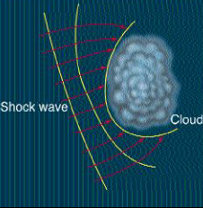
What starts the collapse?
• Once collapse started, gravity of gas increases: accelerating collapse
- but something must start it
• Interstellar clouds are moving around
- dense regions do arise randomly
(just as in normal clouds on Earth – there you get rain)
• For the Sun, proof exists: collapse of cloud was started by
a nearby supernova explosion
The Sun
formed here
SuperNova

Slide 3
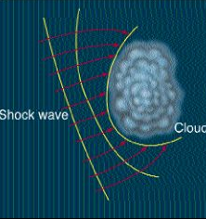
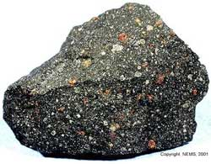
What induced the birth of the Sun?
A close-by supernova! - How do we know? - Xe¹²⁹ in meteorites
• Xe¹²⁹ is found trapped inside meteorites
• Xenon is a noble gas: could not get into meteorites
• Must be a radioactive decay product
• Process: I¹²⁹ ➔ Xe¹²⁹ + e⁻ + ν, half-life = 17 million years
• How did the I¹²⁹ get stuck in meteorites?
– Must have been there when the meteorite froze.
- Within 10-20 million years before the solar system formed,
a SN must have exploded in the vicinity!
The powerful initial push
from a SN is enough
to trigger the collapse
of the solar nebula.
SN

Slide 4
Questions coming …

Slide 5
Question 4
sec
30
29
28
27
26
25
24
23
22
21
20
18
17
16
15
14
13
12
11
10
9
8
7
6
5
4
3
2
1
0
19
What triggered the collapse of the gas cloud that gave birth to the Sun?
A A collision with another star.
B A nearby supernova explosion.
C It was a spontaneous collapse.
D A sudden strengthening of the magnetic field of the Galaxy.
Next question coming …

Slide 6
Question 5
sec
30
29
28
27
26
25
24
23
22
21
20
18
17
16
15
14
13
12
11
10
9
8
7
6
5
4
3
2
1
0
19
What proof do we have about the explosion of a supernova just before the birth of the Sun?
A Radiation damage to the surface of the Moon.
B The existence of gold on Earth.
C The isotope composition of meteorites.
D The existence of oxygen on Earth.

