Slide 1
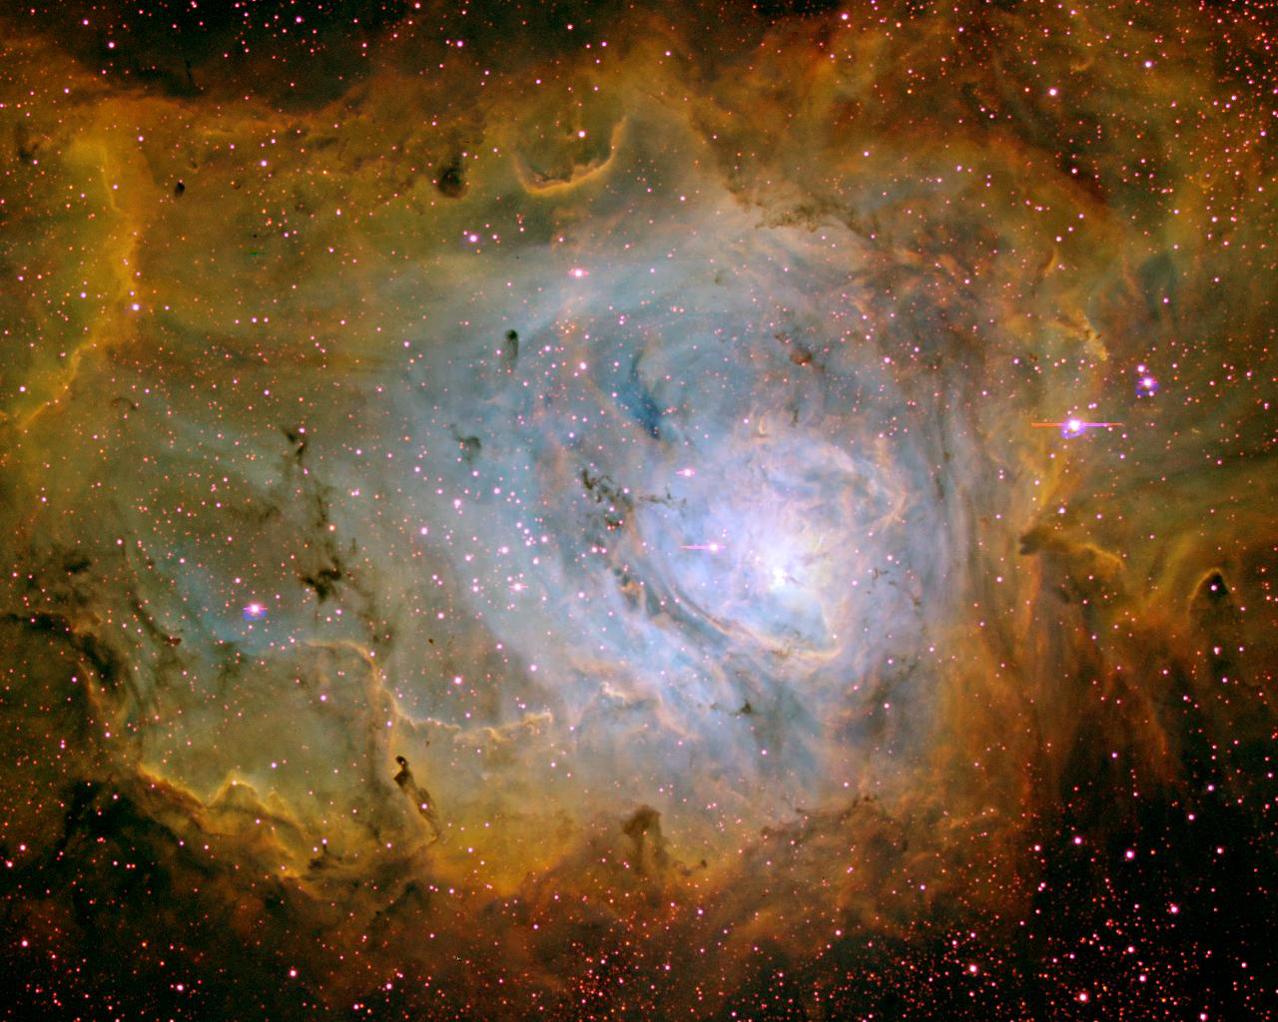
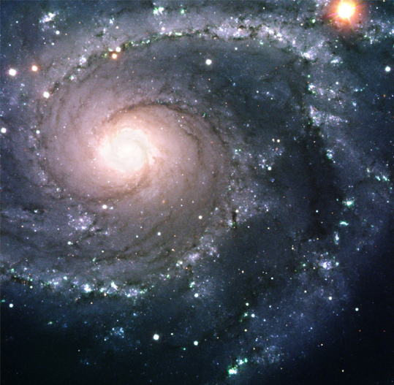
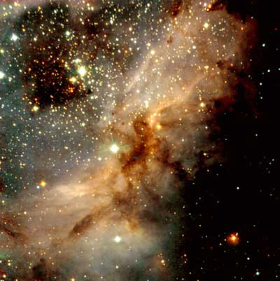
Stars are born in molecular clouds
~ 100 light years in size
Density: 10,000 atoms/cm³
A galaxy (like ours)
[A diffuse nebula is a small part of a molecular cloud that is ionized by embedded hot stars.]

Slide 2
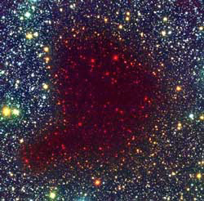
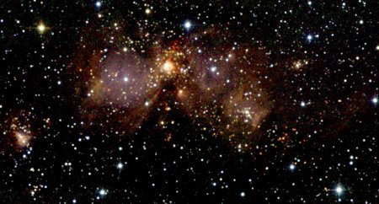
Collapse
Dense regions of a molecular cloud collapse
under their own weight ~ 100 million years
Density: 10⁸ atoms/cm³.
1 - 2 light years
100 light years
A molecular cloud
A Bok globula
(A closeby supernova can help to start the collapse!)

Slide 3
Questions coming …

Slide 4
Question 6
sec
30
29
28
27
26
25
24
23
22
21
20
18
17
16
15
14
13
12
11
10
9
8
7
6
5
4
3
2
1
0
19
What are stars formed from?
A From interstellar gas clouds.
B They are thrown out of the black hole in the center of the Galaxy.
C They were present already when the Universe started.
D They were produced by volcanic activity on planets like Earth.
Next question coming …

Slide 5
Question 7
sec
30
29
28
27
26
25
24
23
22
21
20
18
17
16
15
14
13
12
11
10
9
8
7
6
5
4
3
2
1
0
19
How dense is a molecular cloud, compared to air?
A Much denser, as dense as water.
B About a hundred times denser.
C The same.
D Somewhat less dense.
E Much less dense, even much less dense that what we call ‘vacuum’ in a lab.

Slide 6
Fragmentation
Fragmentation: small regions (size of a star) collapse
faster than the whole cloud: ~ 100, 000 years
Clusters of stars AND double-triple stars are born at a time
Star
1 - 2 light years
Star
Star
A Bok globula

Slide 7
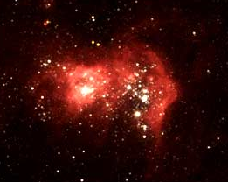
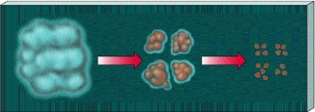
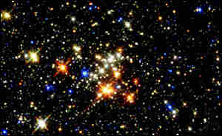
Fragmentation and heat-up
Cloud contracts:
- gets hot
- H ignites
- becomes a star
Smaller pieces collapse faster:
- cloud fragments
- star clusters are born
- binary stars are born
A star forming

Slide 8
Questions coming …

Slide 9
Question 8
sec
30
29
28
27
26
25
24
23
22
21
20
18
17
16
15
14
13
12
11
10
9
8
7
6
5
4
3
2
1
0
19
Will the Orion Nebula collapse into one large star?
A Yes, eventually.
B No, because it is made of gas that has no gravity of its own.
C No, but smaller parts of it will collapse into stars.
D No, because stars are not formed by collapsing gas clouds.
Next question coming …

Slide 10
Question 9
sec
30
29
28
27
26
25
24
23
22
21
20
18
17
16
15
14
13
12
11
10
9
8
7
6
5
4
3
2
1
0
19
Why are there many double stars?
A Because stars are thrown off the center of the Galaxy in bunches.
B Because supernova explosions result in stars split into parts.
C Because a collapsing gas cloud fragments into small pieces.
D Because stars collide so often that they stay stuck together.

Slide 11
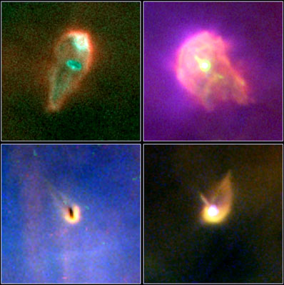
Nebula turns into star
Collapse heats up star - hydrogen ignites
Newly formed star is still unstable
Called a ‘T Tauri’ variable star
Has strong stellar wind, cleans out gas in ~ 100 million yrs
Proto-planetary disks
(~ 100 AU size)
Stars are born in a “cocoon”
of
gas and dust
which
gets collected
into planets
gets blown off
by the star
AND/OR

Slide 12
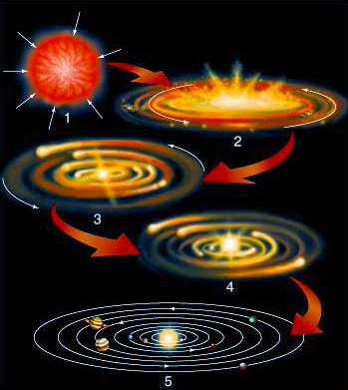
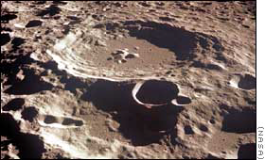
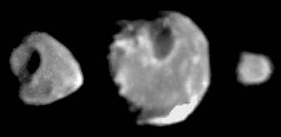
Planets form
Remaining interstellar gas and dust
turns disk shape (friction)
and sticks together into planets
Planets clean up dust/rocks
and feel heavy bombardment
for ~ 1 billion years
get cratered

Slide 13
Questions coming …

Slide 14
Question 10
sec
45
40
35
30
25
19
18
17
16
15
14
13
12
11
10
9
8
7
6
4
3
2
1
0
20
45
5
How are planets formed?
A They are thrown out from the depths of the Sun.
B From the leftover gas and dust after star formation.
C They are formed in the interstellar space and stars capture them when they come close.
D They form from the breakup of the black hole in the center of the Galaxy.
E They form in supernova explosions.
Next question coming …

Slide 15
Question 11
sec
45
40
35
30
25
19
18
17
16
15
14
13
12
11
10
9
8
7
6
4
3
2
1
0
20
45
5
How long after star formation do planets arise?
A Planets are formed at the same time as stars.
B Planets are formed a few thousand years after their stars.
C Planets need about 100 million years to stick together in a protoplanetary disc.
D They form billions of years after their stars.
E There is no relationship, planets may form first, or they may forms long after their stars do.

