Slide 1


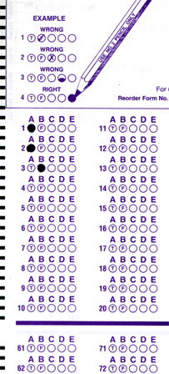
Setup:
Prepare your scantron:
Use
a pencil,
not a pen!
Fill in your name and fill the bubbles under
your name.
LAST NAME FIRST, First name second
Put your 4-digit code instead of “IDENTIFICATION NUMBER”.
--- (The last 4 digits of your OleMiss ID.)
Question # 1: answer B
Question # 2: answer B
Question # 3: answer E
Reading assignment
Star Birth, Chapter 16, pp. 513-533
Please take a moment to mute your cell phone!

Slide 2
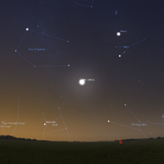
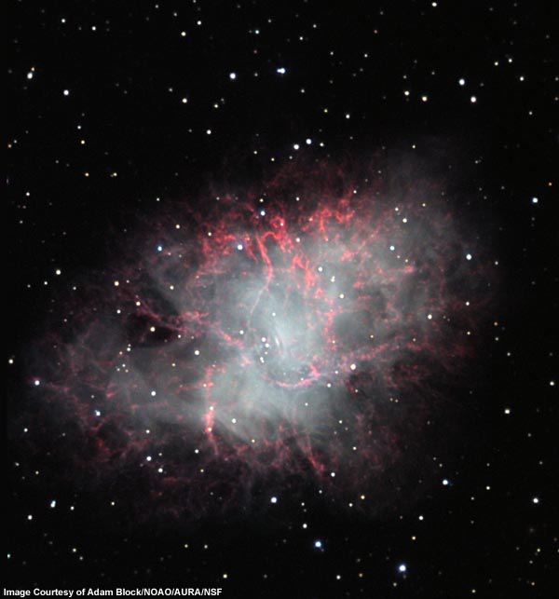

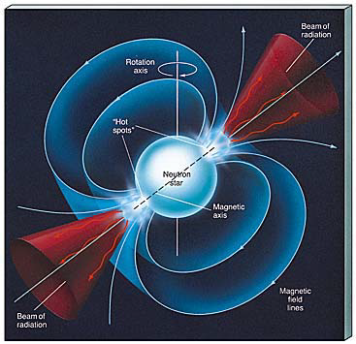
simulated image July 4, 1054
This star blew up 1054 A.D. (Type-II SN)
Now: the “Crab” nebula (M1)
slow motion 100 x
A 5-mile sized very strange object: PULSAR
• extremely dense
• rotates fast
A supernova remnant

Slide 3
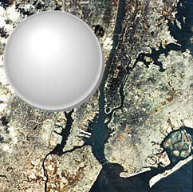
What is a neutron star?
Recoil of a supernova explosion presses together
matter in the very middle
Extremely dense, collapse stopped when
all substance is in one huge atomic nucleus,
made of neutrons only
p⁺ + e⁻ ➔ n
• As small as Manhattan
• As heavy as a small star
• 10¹⁴ g/cm³
• Spins fast (many times a sec)
Pulsar if N/S pole is
directed towards us

Slide 4
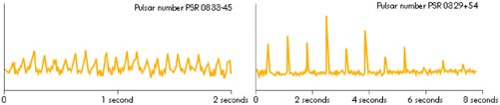
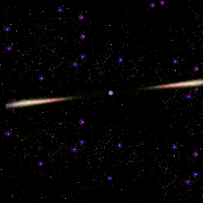
What is a pulsar?
Jocelyn Bell, 1967 - observed radio signals like these
A pulsar is
A spinning neutron star
Spitting out material towards
the magnetic N, S poles
Earth
This charged material makes nebula glow

Slide 5
Question 4
sec
30
29
28
27
26
25
24
23
22
21
20
18
17
16
15
14
13
12
11
10
9
8
7
6
5
4
3
2
1
0
19
Which one is true of a neutron star?
A It is as dense as an atomic nucleus.
B No light can ever leave it.
C It is cold.
D It is huge, as large as a supergiant.
E It is always observed as a pulsar.
Next question coming …

Slide 6
Question 5
sec
30
29
28
27
26
25
24
23
22
21
20
18
17
16
15
14
13
12
11
10
9
8
7
6
5
4
3
2
1
0
19
What is a pulsar?
A A star that periodically changes its size.
B A neutron star formed in a supernova explosion.
C A planet emitting radio signals.
D A special type of binary stars.

