Slide 1
Remnants
Stars: losing fight against gravity.
Balance: gravity against pressure gradient – while fuel lasts
When fuel gone,
● atoms touch – white dwarf
(mass < 1.44 solar)
● atoms crushed, nuclei touch – neutron star
(1.44 solar < mass < 10 solar)
● nothing can balance gravity – black hole
(10 solar < mass)
Earth-size
(Example: Sirius B)
Extremely
dense
stable
remnants
Ten miles size
A few miles size
● or nothing, if it all flies apart.

Slide 2
Questions coming …

Slide 3
Question 6
sec
30
29
28
27
26
25
24
23
22
21
20
18
17
16
15
14
13
12
11
10
9
8
7
6
5
4
3
2
1
0
19
What determines what sort of an object
remains after a dead star?
A The temperature of the star.
B The chemical composition of the star.
C The mass of the star.
D The brightness of the star.
Next question coming …

Slide 4
Question 7
sec
30
29
28
27
26
25
24
23
22
21
20
18
17
16
15
14
13
12
11
10
9
8
7
6
5
4
3
2
1
0
19
In a white dwarf,
A Atoms are far apart from each other.
B Atoms are not broken up, but touch.
C Atoms are crushed into each other, atomic nuclei touch.
D There is nothing to withstand gravity, the star
has completely collapsed.

Slide 5
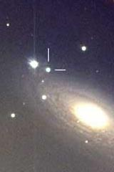
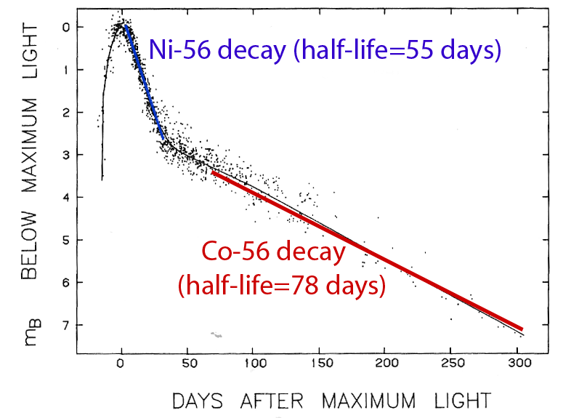
Supernova light curve
A very bright star appears in a distant galaxy,
shines for a few months, then slowly fades away
Energy source of fading supernova is the decay
Proof that heavy elements originate in supernovae!

Slide 6
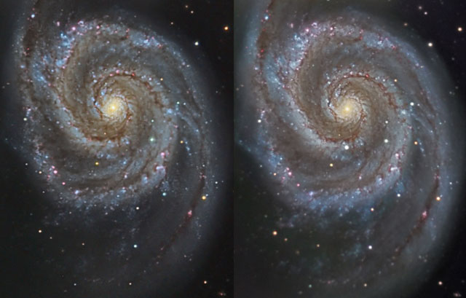
Supernova in M51
8 hours of total exposures, 12 in Takahashi f/9 telescope

Slide 7
Questions coming …

Slide 8
Question 8
sec
30
29
28
27
26
25
24
23
22
21
20
18
17
16
15
14
13
12
11
10
9
8
7
6
5
4
3
2
1
0
19
What is a supernova?
A A Sun-sized star blowing up.
B A very heavy star blowing up.
C A very large and very old star.
D A newly born star.
E A new planet.

Slide 9
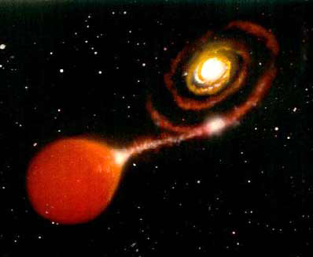
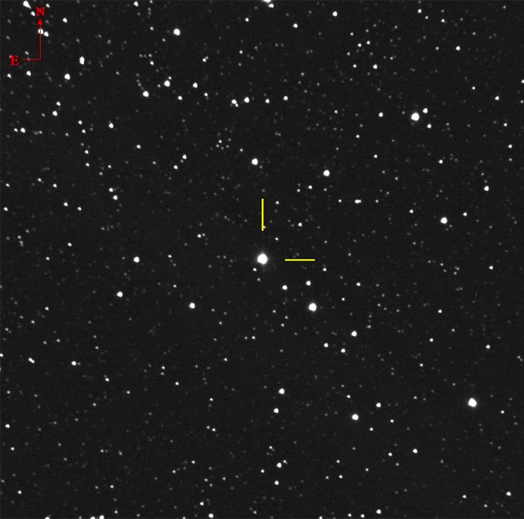
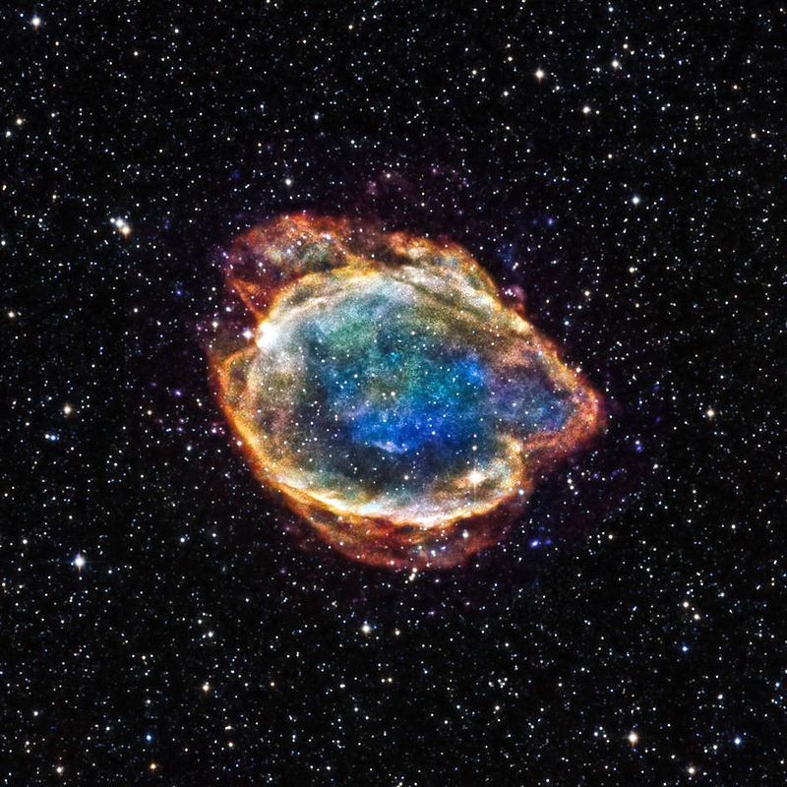
Type-Ia SN
Novae and Type-Ia supernovae
White dwarfs: Normally “decent” objects, slowly cooling off
Density ~ 1,000,000 g/cm³ - atoms touch
When part of a close binary, can produce “fireworks”:
White dwarf steals hydrogen -
H piles up on its hot surface
suddenly ignites: a nova
M=-8^{mg}, a few per year in the Galaxy
White dwarf steals hydrogen -
mass grows over 1.44 solar, collapses: a Type-Ia supernova
M=-19^{mg}, a few per millinea in the Galaxy
Normal star
White dwarf inside
Nova Cassiopeiae 2021
on 3/19/2021
at 7.5mg still brightening
IR+X-ray photo of an old
Type-Ia SN remnant G299.2-2.9

Slide 10
Questions coming …

Slide 11
Question 9
sec
30
29
28
27
26
25
24
23
22
21
20
18
17
16
15
14
13
12
11
10
9
8
7
6
5
4
3
2
1
0
19
Can a white dwarf explode as a supernova?
A It cannot.
B It normally blows up as a supernova after
all its fuel has been exhausted.
C Normally no, but if it collides with another star
in a globular cluster, it may.
D Normally no, but if it receives hydrogen (fuel) from
its companion in a double star system, it may.
Next question coming …

Slide 12
Question 10
sec
45
40
35
30
25
19
18
17
16
15
14
13
12
11
10
9
8
7
6
4
3
2
1
0
20
5
What is a type Ia supernova?
A A planet falling into the Sun.
B A planet falling into a star.
C A very heavy star blowing up when it exhausts all its fuel.
D A double star, the white dwarf component blowing up because
its companion spits matter on it
E A solar-mass star blowing up when it exhausts all its fuel.

Slide 13
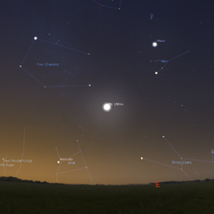
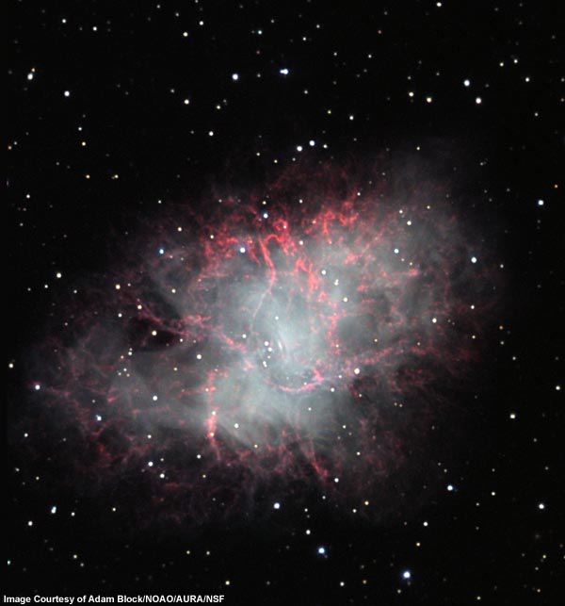

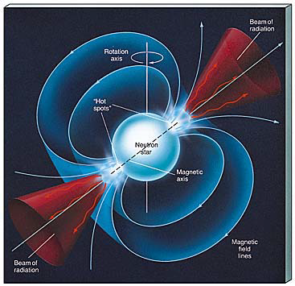
simulated image July 4, 1054
This star blew up 1054 A.D. (Type-II SN)
Now: the “Crab” nebula (M1)
slow motion 100 x
A 5-mile sized very strange object: PULSAR
• extremely dense
• rotates fast
A supernova remnant

Slide 14
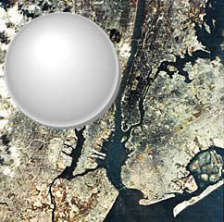
What is a neutron star?
Recoil of a supernova explosion presses together
matter in the very middle
Extremely dense, collapse stopped when
all substance is in one huge atomic nucleus,
made of neutrons only
p⁺ + e⁻ ➔ n
• As small as Manhattan
• As heavy as a small star
• 10¹⁴ g/cm³
• Spins fast (many times a sec)
Pulsar if N/S pole is
directed towards us

Slide 15
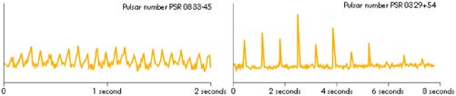
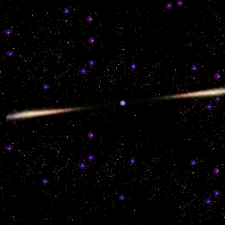
What is a pulsar?
Jocelyn Bell, 1967 - observed radio signals like these
A pulsar is
A spinning neutron star
Spitting out material towards
the magnetic N, S poles
Earth
This charged material makes nebula glow

