Slide 1
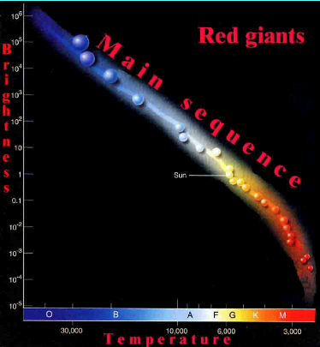
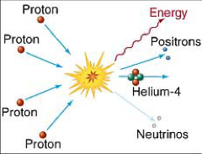
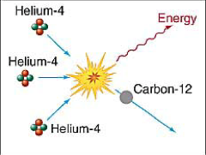
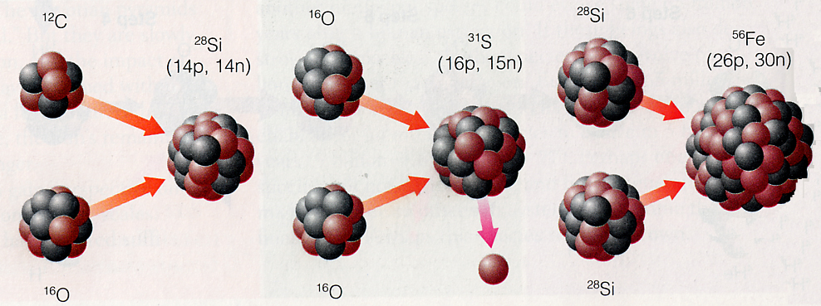
What if all hydrogen is gone?
All stars start on the main sequence
All stars become giants (when hydrogen is used up in the center):
This produces heat and keeps the red giant shining.

Slide 2
Questions coming …

Slide 3
Question 10
sec
30
29
28
27
26
25
24
23
22
21
20
18
17
16
15
14
13
12
11
10
9
8
7
6
5
4
3
2
1
0
19
Which one comes first, the main sequence stage,
or the red giant stage?
A The main sequence stage.
B The red giant stage.
C It varies, depending on the chemical composition of the
gas the star is born from.
D It varies, depending on the mass of the star.
E It is not in order: heavy stars are born as red giants,
light stars are born as main sequence stars.
Next question coming …

Slide 4
Question 11
sec
30
29
28
27
26
25
24
23
22
21
20
18
17
16
15
14
13
12
11
10
9
8
7
6
5
4
3
2
1
0
19
What provides the heat in a main sequence star?
A It burns hydrogen into water.
B It produces helium from hydrogen in its center.
C It produces helium from hydrogen in a shell around center.
D It is hot and cooling slowly as it gives off its heat.
E It produces heavier elements from helium.

Slide 5
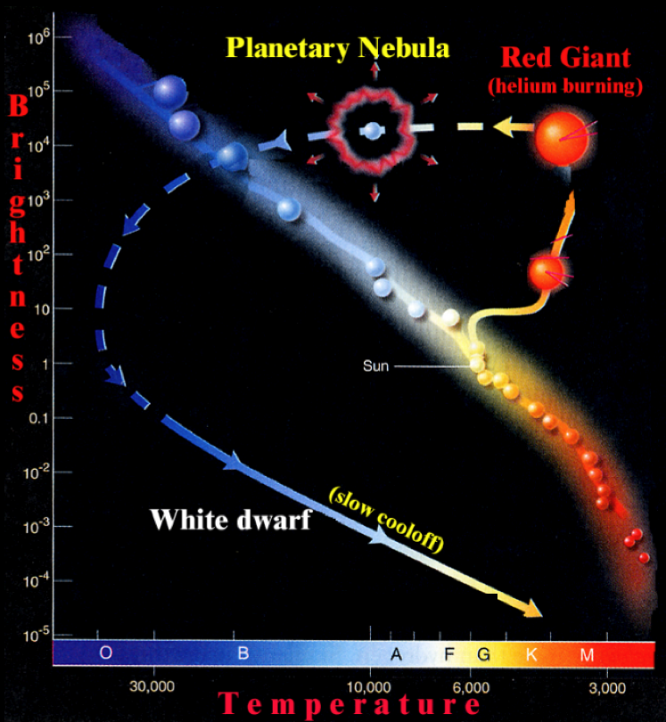
Stellar evolution (Sun-like)
Stellar
Evolution
Evolution
Of
Sun-like stars
(Mass < 1.44 M)
AGB
AGB
(asymptotic giant branch)
• Huge envelope
• Strong stellar wind
• Mass loss
(half of the star’s mass)

Slide 6
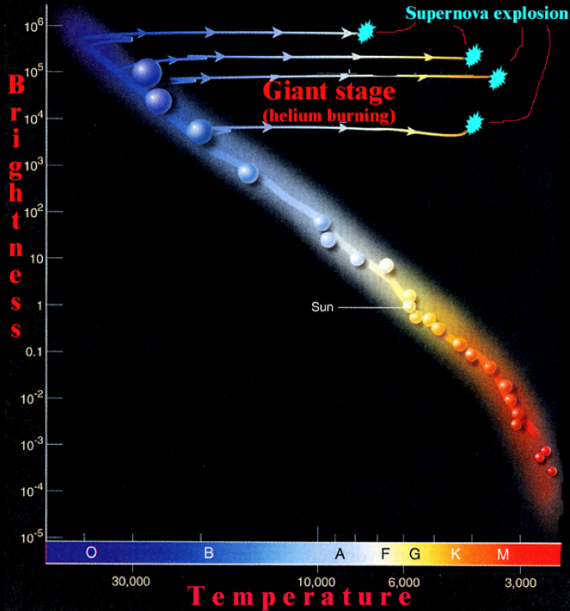
Stellar evolution (massive)
Stellar
Evolution
Evolution
of
massive stars
(Mass > 1.44 M)

