Slide 1


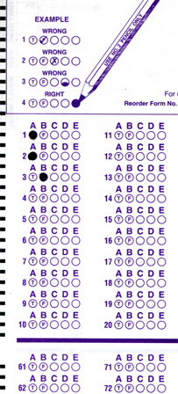
Setup:
Prepare your scantron:
Use
a pencil,
not a pen!
Fill in your name and fill the bubbles under
your name.
LAST NAME FIRST, First name second
Put your 4-digit code instead of “IDENTIFICATION NUMBER”.
--- (The last 4 digits of your OleMiss ID.)
Question # 1: answer B
Question # 2: answer A
Question # 3: answer A
Reading assignment
Star Stuff, Chapter 17, pp. 534-556
Please take a moment to mute your cell phone!

Slide 2
What is burning?
What fuels the stars?
Stars give off a lot of heat: need to keep up for a long time - need very effective fuel
Only nuclear (fusion) provides enough energy.
Burning is not enough.
… is a chemical reaction: fusion with oxygen
Coal:
Hydrogen (gas):
More precisely:
Octane (car fuel):
Oxygen
coming form the air
Notice: number of atoms is conserved.
(No change of nuclei in chemistry!)

Slide 3
Question 4
sec
30
29
28
27
26
25
24
23
22
21
20
18
17
16
15
14
13
12
11
10
9
8
7
6
5
4
3
2
1
0
19
What chemical do you need (other than the coal)
for burning coal and what is the result?
A Need: oxygen; Result: carbon dioxide.
B Need: carbon; Result: oxygen.
C Need: hydrogen; Result: water.
D Need: nitrogen; Result: nitrogen acid.
E Need: oxygen; Result: only ash.

Slide 4
Question 5
sec
30
29
28
27
26
25
24
23
22
21
20
18
17
16
15
14
13
12
11
10
9
8
7
6
5
4
3
2
1
0
19
What is burning?
A The production of heat.
B Conversion of electrical energy into heat and light.
C A chemical fusion with oxygen.
D A nuclear reaction that turns hydrogen, carbon, or other chemical elements into more complicated ones and releases heat.
E The production of energy.

Slide 5
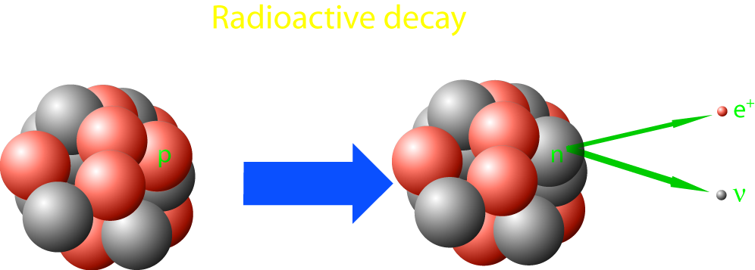
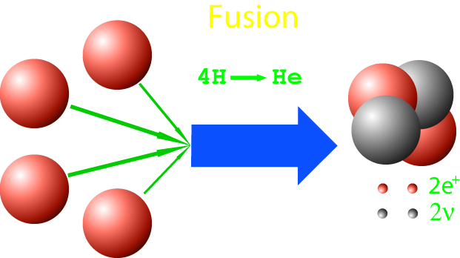
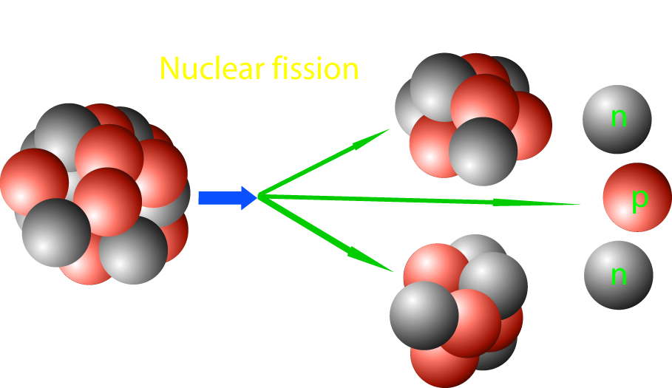
Nuclear processes
Nuclear processes
Decay (occurs in nature)
Fission (Reactors & A-bomb)
Fusion (H-bomb)
Don’t confuse with chemical processes!
They don’t change one atom into another.

Slide 6
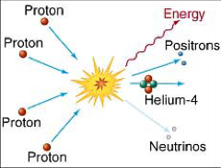
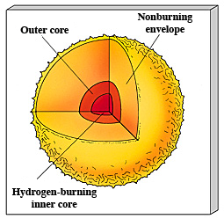
Hydrogen to helium fusion
In the Sun:
This reaction needs
heat > 1 million K
(only in the very center of a star!)
4 H → He + heat
(Call it H ‘burning’ - it is really not!)
Mass of
1 proton 1.00867 units
4 protons 4.03468 units
1 He 4.00260 units
Missing 0.03208 units = 0.8%
Becomes energy of heat:
E = m c²

Slide 7
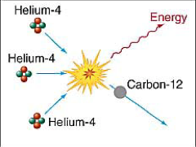
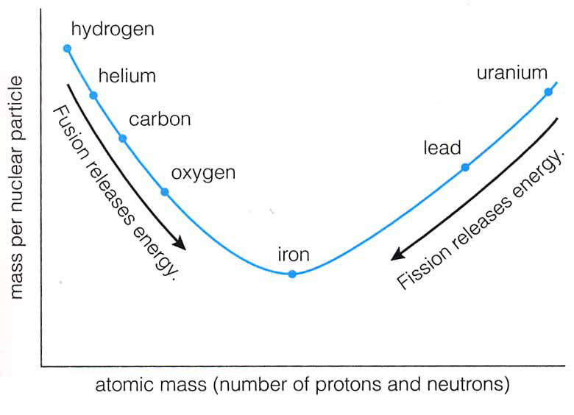
”Metals” build up
• More processes - helium fusion and beyond
He + He + He → C + heat
He + C → O + heat
...
• These processes need
hotter and hotter temperatures
Not in the Sun yet!
• Energy is produced by fusion
of heavier elements up to iron
A-bomb does this
Stars do this

Slide 8
Questions coming …

Slide 9
Question 6
sec
30
29
28
27
26
25
24
23
22
21
20
18
17
16
15
14
13
12
11
10
9
8
7
6
5
4
3
2
1
0
19
What keeps the Sun hot?
A It burns hydrogen into water.
B It produces helium from hydrogen.
C It produces heavier elements from helium.
D It is hot and cooling slowly as it gives off its heat.
Next question coming …

Slide 10
Question 7
sec
30
29
28
27
26
25
24
23
22
21
20
18
17
16
15
14
13
12
11
10
9
8
7
6
5
4
3
2
1
0
19
Where in the Sun is there heat production?
A Everywhere.
B Only in the center.
C Nowhere. The Sun in only giving off its existing heat.
D Only on the surface.
Next question coming …

Slide 11
Question 8
sec
30
29
28
27
26
25
24
23
22
21
20
18
17
16
15
14
13
12
11
10
9
8
7
6
5
4
3
2
1
0
19
Which of the following uses the same physical process as the Sun to generate heat?
A A gas stove.
B A wood stove.
C A hydrogen bomb.
D An atomic bomb.
E A nuclear reactor.

