Slide 1
Photons
Einstein’s • light comes in chunks (photons)
discovery: • each photon has E=1240/λ energy
in electron-volts (eV) in nm’s
Examples:
Red λ = 720 nm, E = 1.7 eV
Blue λ = 420 nm, E = 3 eV
UV λ = 100 nm, E = 12 eV
X-ray λ = 1 nm, E = 1200 eV
Enough to destroy most atoms
Destroys everything if strong
Do remember this:
shorter wavelength – more energetic photons

Slide 2
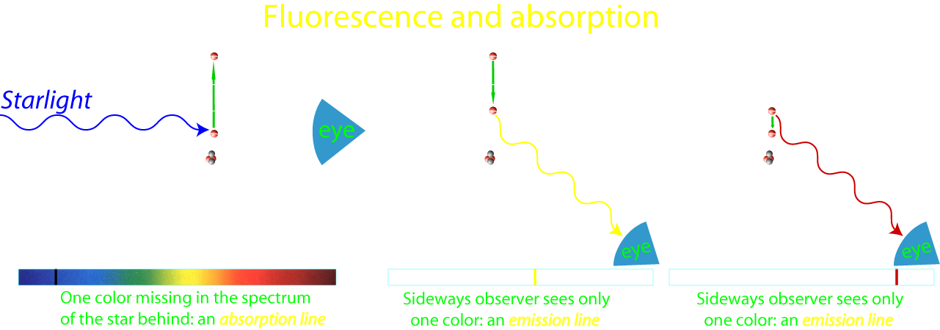
The formations of spectral lines
Example: a star’s spectrum
Example: nebula’s spectrum

Slide 3
Question 7
sec
30
29
28
27
26
25
24
23
22
21
20
18
17
16
15
14
13
12
11
10
9
8
7
6
5
4
3
2
1
0
19
Which of the following is correct about
red and blue light?
A Red light always contains more photons than blue light.
B Red light always contains fewer photons than blue light.
C A blue photon is more energetic than a red photon.
D A blue photon is less energetic than a red photon.
Next question coming …

Slide 4
Question 8
sec
30
29
28
27
26
25
24
23
22
21
20
18
17
16
15
14
13
12
11
10
9
8
7
6
5
4
3
2
1
0
19
In a planetary nebula, what type of spectrum would
the central star and the nebula have?
A Star: continuous spectrum; Nebula: emission spectrum.
B Star: absorption spectrum; Nebula: emission spectrum.
C Star: emission spectrum; Nebula: absorption spectrum.
D Star: absorption spectrum; Nebula: continuous spectrum.
E Star: continuous spectrum; Nebula: absorption spectrum.

Slide 5
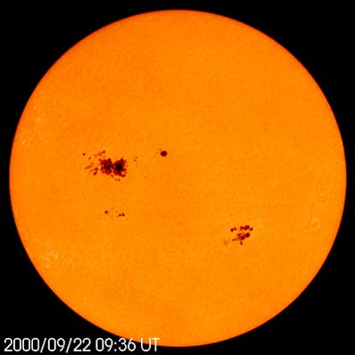

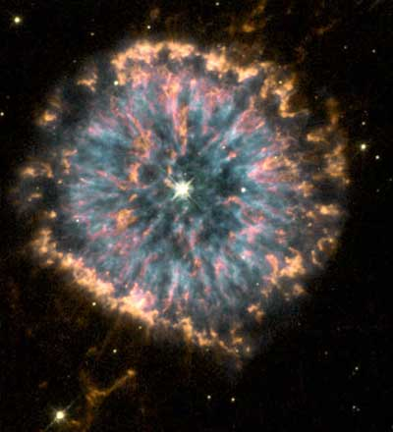

Light production
In astronomy
Light is produced by:
The Sun
• Stars are hot, glowing: thermal radiation
continuous spectrum
(or absorption spectrum when colder gas is in front)
• Hot stars’ UV cause interstellar gas glow: fluorescence
emission spectrum
NGC 6369
[Also: white shirts glow in “black light”]

Slide 6
Questions coming …

Slide 7
Question 9
sec
30
29
28
27
26
25
24
23
22
21
20
18
17
16
15
14
13
12
11
10
9
8
7
6
5
4
3
2
1
0
19
What type of spectrum is generated in fluorescence?
A Continuous.
B Absorption.
C Emission.
D None.
E A mix of emission and continuous spectra.
Next question coming …

Slide 8
Question 10
sec
30
29
28
27
26
25
24
23
22
21
20
18
17
16
15
14
13
12
11
10
9
8
7
6
5
4
3
2
1
0
19
What is thermal radiation?
When substances (gas in astronomy) …
A glow because they reflect the light of a star.
B glow because they are hot.
C glow because they are illuminated by UV light.
D glow because they reflect sunlight.
E glow because electrically charged particles hit magnetic fields.

