Slide 1


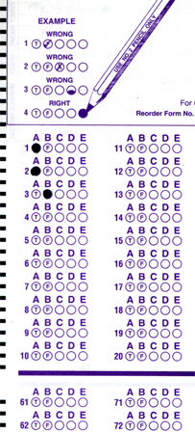
Setup:
Prepare your scantron:
Use
a pencil,
not a pen!
Fill in your name and fill the bubbles under
your name.
LAST NAME FIRST, First name second
Put your 4-digit code instead of “IDENTIFICATION NUMBER”.
--- (The last 4 digits of your OleMiss ID.)
Reading assignment
Chapter 5, Light and matter, pp. 137 – 164
Question # 1: answer A
Question # 2: answer D
Question # 3: answer B
• Pass/fail test on Friday, Oct. 10.
• The solutions to Test 1 are available, click ‘tests’ on the website.
Please take a moment to mute your cell phone!

Slide 2
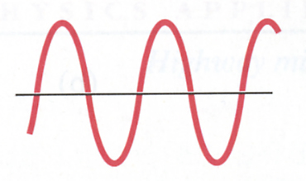
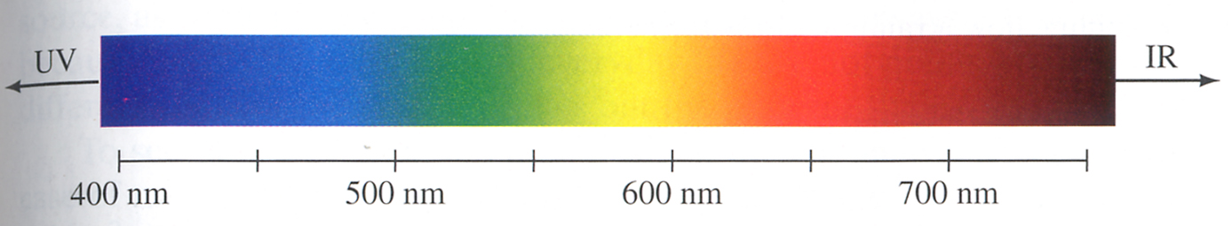
The electromagnetic spectrum
Light has a wavelength:
λ
Wavelength of light means color:
IR
UV
700 nm
600 nm
500 nm
400 nm
• Blue has short wavelength
• Red has long wavelength
These are colors of light
invisible to the eye.
What is
beyond blue?
Bluer than blue is UV (ultraviolet) - even shorter wavelength
Redder than red is IR (infrared) - even longer wavelength

Slide 3
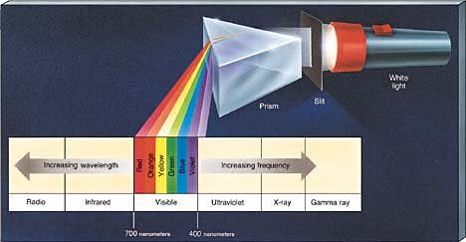
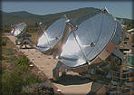
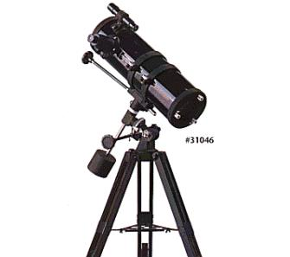
The full spectrum
And what is beyond those wavelengths?
(A prism breaks up white light into colors.)
White light
Slit
Prism
Radio | Infrared | Visible | Ultraviolet X-ray| γ -ray
Radio antenna
Eye / Telescope
Need spacecraft
(Far UV, X-ray, γ-ray)
Need spacecraft
They all move with the same speed c = 300,000 km/s

Slide 4
Questions coming …

Slide 5
Question 4
sec
30
29
28
27
26
25
24
23
22
21
20
18
17
16
15
14
13
12
11
10
9
8
7
6
5
4
3
2
1
0
19
What is the difference between red and blue light?
A Intensity.
B Speed.
C Wavelength.
D Blue is composite, red is not.
E Red is existence of light, blue is lack of light.
Next question coming …

Slide 6
Question 5
sec
30
29
28
27
26
25
24
23
22
21
20
18
17
16
15
14
13
12
11
10
9
8
7
6
5
4
3
2
1
0
19
Astronomical origin X-rays can be observed only …
A using very large telescopes
B on high mountains
C from space
D with cameras attached to telescopes on high mountains
E on Antarctica

Slide 7
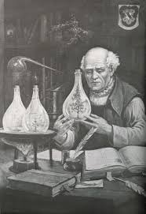
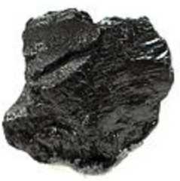

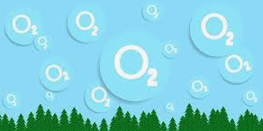
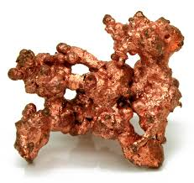
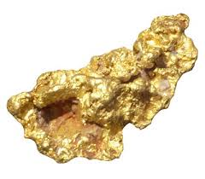
What is in an atom?
WRONG:
Wrong answer:
protons, electrons, neutrons
Why important?
makes you confuse nuclear with chemical
Why different?
energy: ~1 eV (chemical) vs. ~1 MeV (nuclear)
(1 electronvolt) (1 million eV)
Consequence:
- nuclei change only in very extreme situations
(reactors, atomic bombs, centers of stars
+ tiny amounts in radioactive decays)
e⁻
n⁰
e⁻
p⁺
e⁻
p⁺
e⁻
n⁰
e⁻
Proven wrong:
Rutherford
1909
Paracelsus
(alchemist, ~ 1500)
Carbon
Won’t happen
Oxygen
Copper
Gold
Didn’t work

Slide 8

What is in an atom?
Correct
but not to scale:
nucleus shown too large
Correct answer:
One nucleus + electrons
Correct sizes:
nucleus = 1 unit size
atom = 50,000 units size
(size of atom = electrons’ orbits)
The nucleus is an extremely tiny thing
in the center of an atom, like a point!
(even though most of the mass
of the atom is in the nucleus)
e⁻
electron (-)
nucleus (++++++)
Nuclei are preserved:
C
(case of carbon in drawing)
The electric charge of
the nucleus tells
which
chemical element
it is.
Carbon dioxide
Carbon + oxygen
CO₂ C + O₂

Slide 9
Questions coming …

Slide 10
Question 6
sec
30
29
28
27
26
25
24
23
22
21
20
18
17
16
15
14
13
12
11
10
9
8
7
6
5
4
3
2
1
0
19
The constituents of atoms are:
A Protons, electrons and neutrons.
B Chemical compounds.
C Molecules of various sorts.
D Electrons and protons.
E One nucleus and electrons.
Next question coming …

Slide 11
Question 7
sec
30
29
28
27
26
25
24
23
22
21
20
18
17
16
15
14
13
12
11
10
9
8
7
6
5
4
3
2
1
0
19
Can a chemical process turn hydrogen into helium?
A Yes, but only at very hot temperature.
B Yes, and that is the process that keeps the Sun hot.
C No, because too much energy is needed to change one nucleus into another.
D No, because a chemical process can turn hydrogen only into oxygen.

Slide 12
Phases
The phases of matter
• Solid
• Liquid (only under pressure – rarely in astronomy)
• Gas
Hot matter:
T > 1,000 - 2,000 K molecules fall apart into atoms (gas)
T > 2,000 - 3,000 K atoms are ionized (plasma)
More accurately:
hydrogen
H⁺ at 10,000 K
He⁺ at 20,000K ; He⁺⁺ at 40,000K
C⁺ , N⁺ , O⁺ , ... at ~2,000K
…
C ⁺⁺⁺⁺⁺⁺ , N ⁺⁺⁺⁺⁺⁺⁺ , O ⁺⁺⁺⁺⁺⁺⁺, … at >50,000K
→
helium
→
once ionized
called metals
→
fully ionized

Slide 13
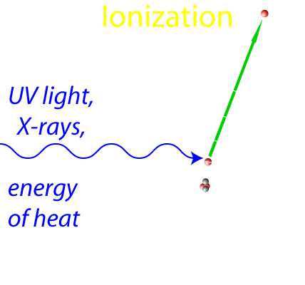
What is plasma?
• Matter with a lot of ionized atoms.
⇒ Feels magnetic field
Examples: Flame
Lightening bolt
Substance of the stars
The Solar wind
Hot interstellar matter
_______________________________________________________
What is interstellar matter made of?
• when gas: H₂, H, H+, and other atoms, ions, and molecules
• when solid grains (“dust”): ice, carbon (‘soot’), silicates (“rock”)

Slide 14
Questions coming …

Slide 15
Question 8
sec
30
29
28
27
26
25
24
23
22
21
20
18
17
16
15
14
13
12
11
10
9
8
7
6
5
4
3
2
1
0
19
What is plasma?
A Substance under tremendous pressure.
B Liquid or gas containing chemical compounds.
C Gas containing (at least a portion of) ionized atoms.
D Fully ionized gas.
E A gas of purely neutral hydrogen atoms.
Next question coming …

Slide 16
Question 9
sec
30
29
28
27
26
25
24
23
22
21
20
18
17
16
15
14
13
12
11
10
9
8
7
6
5
4
3
2
1
0
19
What is ionization?
A Molecules fall apart into atoms due to heat.
Glowing gas is formed.
B Nuclear processes in stars produce dangerous radiation.
C Atomic nuclei fall apart into neutrons and protons.
A neutron star results.
D Atoms lose (some of) their electrons due to heat or UV
radiation. The substance becomes plasma.

Slide 17
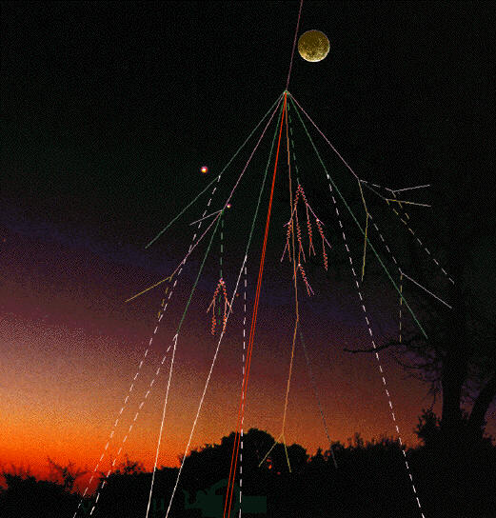
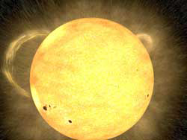
Cosmic rays
From Deep Space (??)
The Solar Wind
protons, electrons
Earth’s
atmosphere and magnetic field
absorb them
(dangerous for astronauts)
very energetic protons & nuclei
Break up into showers
of many less energetic particles
in the atmosphere.
(always present: causes mutations)

Slide 18
Question 10
sec
45
40
35
30
25
19
18
17
16
15
14
13
12
11
10
9
8
7
6
4
3
2
1
0
20
(45)
5
Which of the following causes a noticeable amount of radiation, present on Earth?
The Solar Wind.
“Deep Space” cosmic rays.
Radiation from nuclear reactors.
Radiation from naturally occurring decays.
A I and III.
B II and IV.
C I, II and III.
D None of the above.
E All of the above.

