Slide 1



Setup:
Prepare your scantron:
Use
a pencil,
not a pen!
Fill in your name and fill the bubbles under
your name.
LAST NAME FIRST, First name second
Put your 4-digit code instead of “IDENTIFICATION NUMBER”.
--- (The last 4 digits of your OleMiss ID.)
Question # 1: answer
Question # 2: answer
Question # 3: answer
Reading assignment
Cosmology, Chapters 22-23, pp. 648-697
(A superficial reading will suffice)
Please take a moment to mute your cell phone!

Slide 2
The story of the Universe (cosmology) and the Big Bang
The logic:
1: Observation –Hubble’s law : far-away galaxies are redshifted
proportionally to their distance
(If redshift is correctly interpreted as the Doppler effect, the Universe is expanding and
it all started in the Big Bang 14 billion years ago.)
2: Theory – General Relativity: Einstein ~1912, law of
gravity-space-time
(Requires either an expanding Universe and a Big Bang or a contracting Universe and
a Big Crunch or both.)
3: Circumstantial evidence: no stars are older than 10-12 billion yrs
4: The early Universe was small, hot, and evenly spread-out gas
(Expanding, cooling, and forming structure ever since
structure formation is due to gravitational collapse – gravity is always attractive.)

Slide 3
5: Observable predictions: Today we are sure this is all correct.
a: Redshift of far-away galaxies – details of the Hubble curve
b: Cosmic background radiation – including details of strength,
spectrum, even distribution, wave pattern over the sky
c: Primordial nucleosynthesis made/left
~25% He, ~75% H, not much else
d: Old galaxies were different (smaller, more star formation,
larger number of AGN’s/quasars) – evolutionary effects
e: Etc.

Slide 4
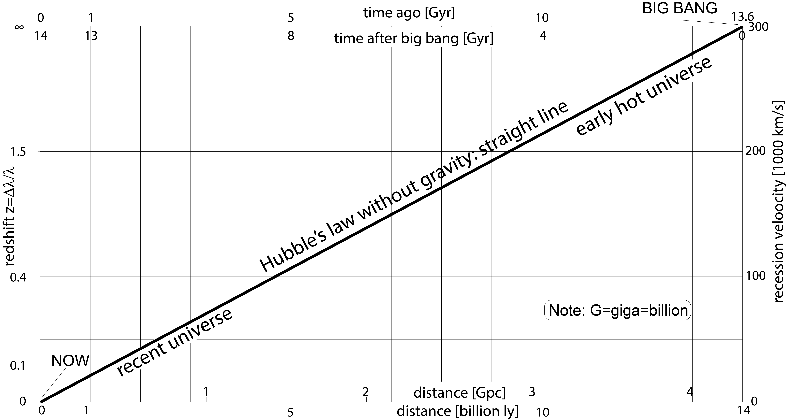
Long ago = far away redshift ~ recession velocity
( the big bang is in the sky, ( relativistic correction
14 billion light years away) Δλ/λ = z ≈ v/c = z ✕ ^{1+z/2}/_{1+z(1+z/2)} )
The farthest observed galaxy is at z=12

Slide 5
The evolution of the Universe
Name | Time after big bang | z | Density | Tempera- ture | What is happening?
Big Bang | 0 | ∞ | ∞ | ∞ | Booom!!
Inflation | 10⁻³⁶-10⁻³² sec |  |  | 10²⁸ to 10²² K | Universe expands 10²⁶ times
Primordial nucleosynthesis | ~ 3 min | ~3x10¹³ |  | ~ 10⁹ K | H→He fusion 76%-H, 24%-He
Matter domination starts | 47 kyr | 3300 | 8.9x10⁻²⁰ g/cm³ | 9000 K | Gravity of matter overtakes gravity of photons
Decoupling | 370 ky | 1100 | 3.3x10⁻²¹ g/cm³ | 3000 K | Universe becomes transparent Beginning of ‘dark age’
First stars and galaxies | ~ 200 Myr | ~ 15 | 1.0x10⁻²⁶ g/cm³ | ~ 40 K | End of ‘dark age’
Reionization | ~ 200 Myr | ~ 15 | 1.0x10⁻²⁶ g/cm³ | ~ 40 K | Interstellar hydrogen becomes ionized from quasar’s UV
Dark energy domination starts | 9.6 Gyr | 0.39 | 1.3x10⁻²⁹ g/cm³ | 3.79 K | Gravity of dark energy overtakes gravity of matter
Now | 13.8 Gyr | 0 | 9.2x10⁻³⁰ g/cm³ | 2.73 K

Slide 6
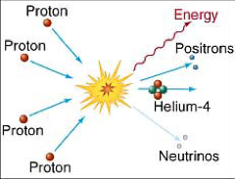
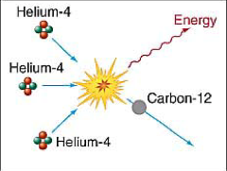
Primordial nucleosynthesis
Before t<3min, T>10⁹K, z>3✕10¹³ all nuclei break up in the heat.
The Universe is an evenly distributed gas of p⁺ and e⁻.
The Universe is cooling: at t≈3min, T=10⁹K, z≈3✕10¹³, H→He fusion starts.
Not enough He
for He→CNO to run
10⁷K
←YES NO→
Too cold
for He→CNO to run
The Universe is cooling: at t≈20min, T≈10⁶K, z≈10¹², H→He fusion ends.
Result: 76% H, 24% He, not much else
All other nuclei were made much later, inside stars.
One great success of ‘Big Bang theory’:
- old stars are 76% H, 24% He and not much else.
- interstellar matter is almost everywhere 76% H, 24% He.

Slide 7
Recombination, decoupling and the cosmic microwave background (CMB)
At t~370 kyr , T~3000 K, z~1100 four things happen:
Recombination: universe is cold enough for p⁺e⁻→H⁰ atoms
Decoupling: the Universe becomes transparent
(iii) CMB radiated off
(iv) Dark age starts: still no stars, matter is very uniform H⁰ gas

Slide 8
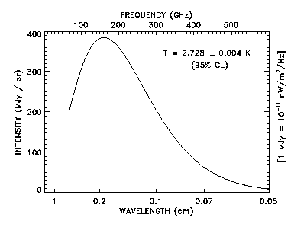
Cosmic background radiation (CMB)
Right after Big bang the Universe was hot:
- interstellar matter was dense and it glowed
Light started then but cooled down - now 2.728 K (radio waves)
Background radiation
is a relic
of the
originally hot universe:
a proof of
“Big Bang” theory
Very even
(0.0001% variation)
Intensity

Slide 9
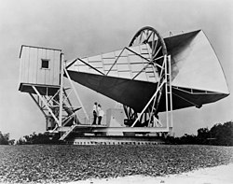
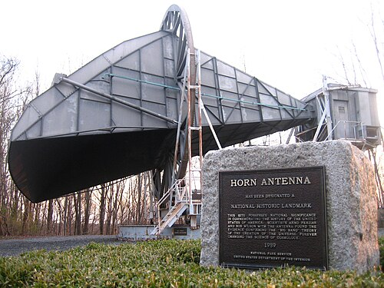
A.A. Penzias, R.W. Wilson, 1965
The Holmdel Horn Antenna, New Jersey
Bell laboratories
Working at 7.35 cm wavelength
Strength of radiation equals to the thermal glow of a 2.7K body

Slide 10
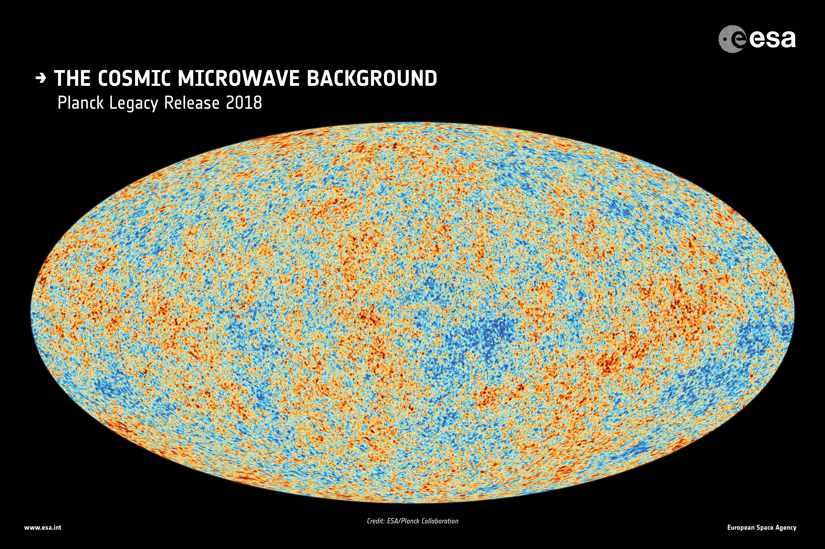
Variation of the temperature of the CMB across the sky by ~ 0.00001 K
The ‘cold’ spots are the kernels of later galaxies

Slide 11
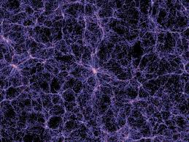
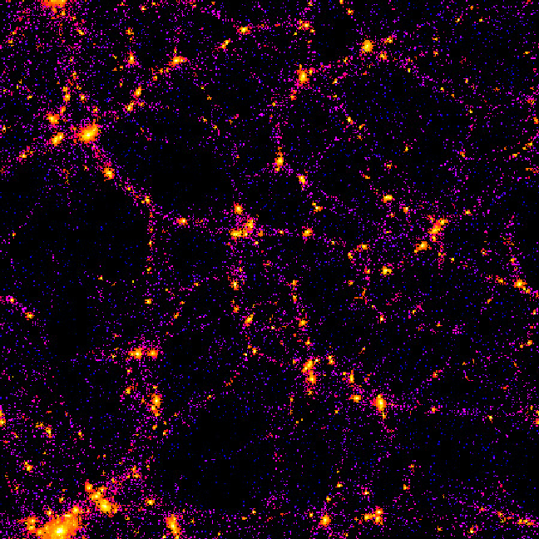
First stars and galaxies:
At t≈200 Myr, z≈15, T≈40K, enough time has passed for gravity
to start forming structure
Gas forms sheets, filaments, blobs and makes galaxies where dense
(Each bright dot is a galaxy or a galaxy cluster)

Slide 12
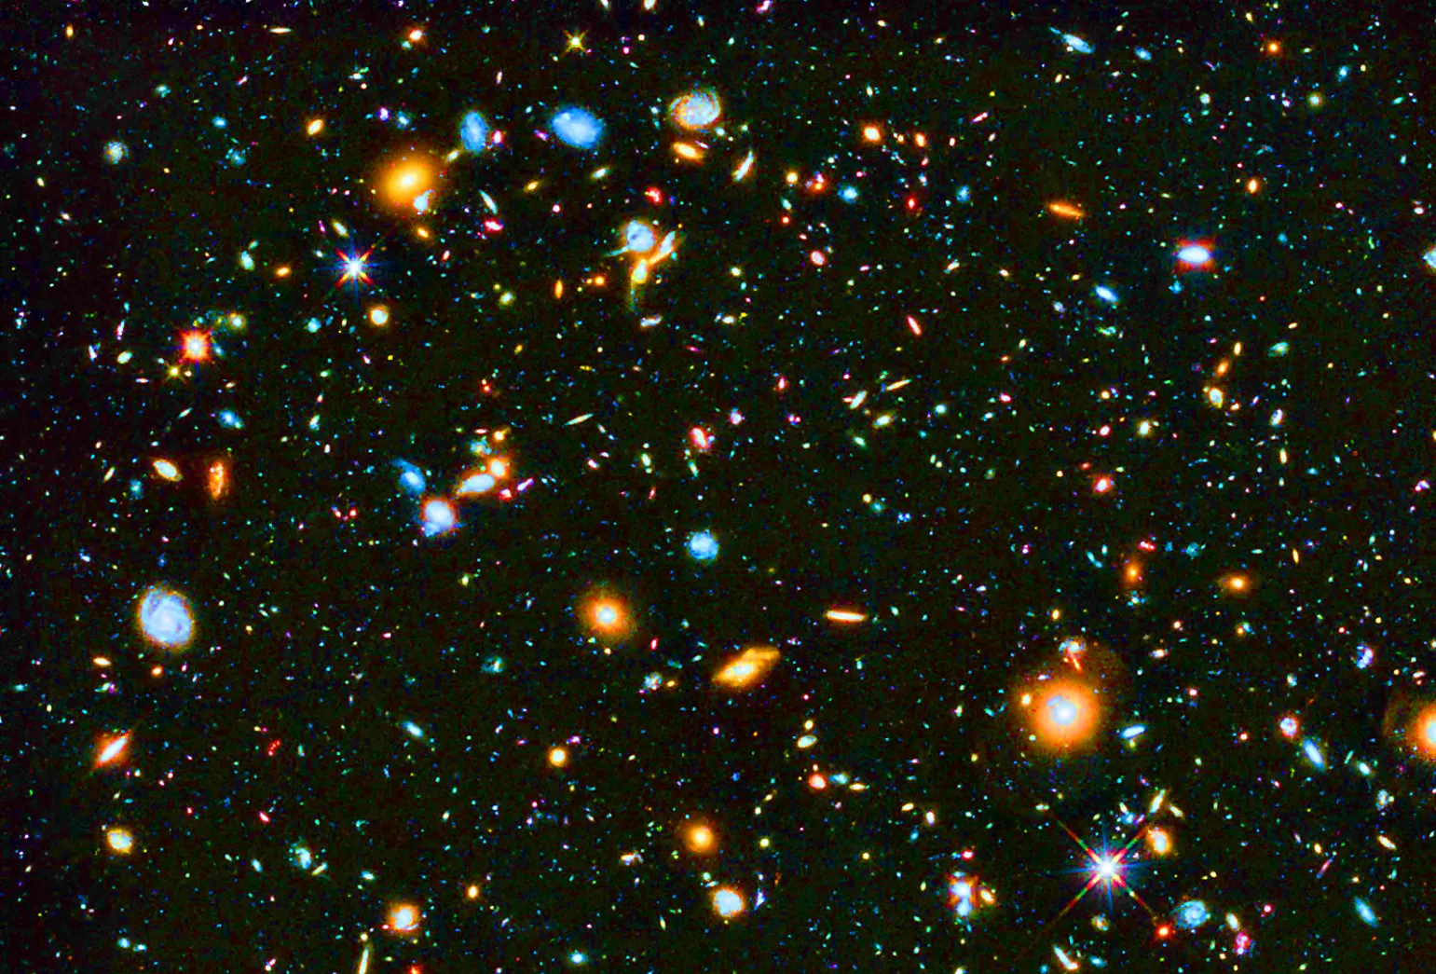
First galaxies are very small and grow by collisions
Reionization:
First quasars’ (and stars’) UV ionizes intergalactic H⁰ into H⁺ and e⁻.
From then on, star formation is only possible inside galaxies.

