Slide 1

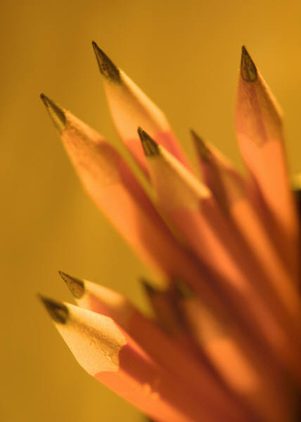
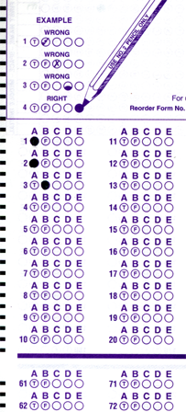
Setup:
Prepare your scantron:
Use
a pencil,
not a pen!
Fill in your name and fill the bubbles under
your name.
LAST NAME FIRST, First name second
Put your 4-digit code instead of “IDENTIFICATION NUMBER”.
--- (The last 4 digits of your OleMiss ID.)
Regular Test 2
Oct. 16, Friday
Material covered:
All since the first test only
Question # 1: answer A
Question # 2: answer E
Question # 3: answer C
Pass/fail test makeup
on Oct. 23, Friday
1:00 pm only.
Reading assignment
Chapter 5, Light and matter, pp. 137 – 164
Please take a moment to mute your cell phone!

Slide 2
Photons
Einstein’s • light comes in chunks (photons)
discovery: • each photon has E=1240/λ energy
in electron-volts (eV) in nm’s
Examples:
Red λ = 720 nm, E = 1.7 eV
Blue λ = 420 nm, E = 3 eV
UV λ = 100 nm, E = 12 eV
X-ray λ = 1 nm, E = 1200 eV
Enough to destroy most atoms
Destroys everything if strong
Do remember this:
shorter wavelength – more energetic photons

Slide 3
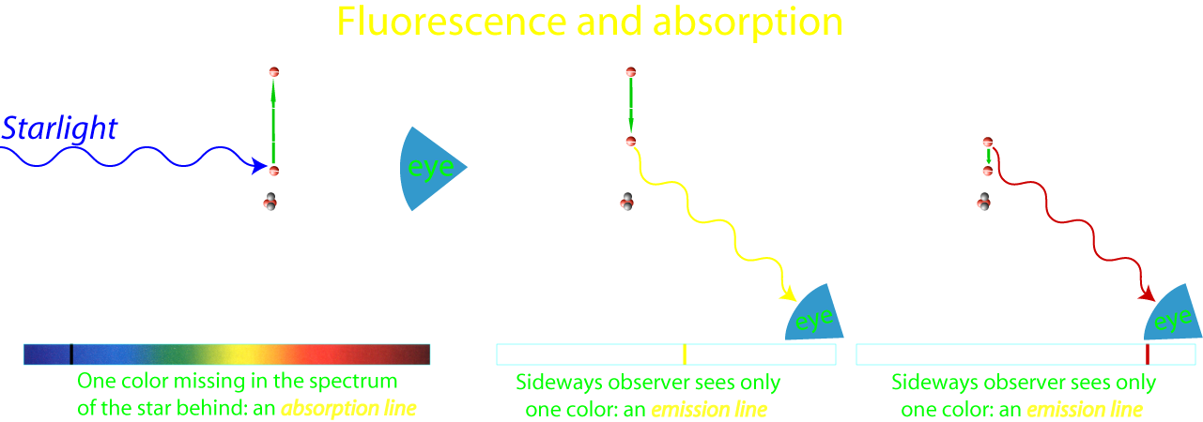
The formations of spectral lines
Example: a star’s spectrum
Example: nebula’s spectrum

Slide 4
Question 4
sec
30
29
28
27
26
25
24
23
22
21
20
18
17
16
15
14
13
12
11
10
9
8
7
6
5
4
3
2
1
0
19
Which of the following is correct about
red and blue light?
A Red light always contains more photons than blue light.
B Red light always contains fewer photons than blue light.
C A blue photon is more energetic than a red photon.
D A blue photon is less energetic than a red photon.
Next question coming …

Slide 5
Question 5
sec
30
29
28
27
26
25
24
23
22
21
20
18
17
16
15
14
13
12
11
10
9
8
7
6
5
4
3
2
1
0
19
In a planetary nebula, what type of spectrum would
the central star and the nebula have?
A Star: continuous spectrum; Nebula: emission spectrum.
B Star: absorption spectrum; Nebula: emission spectrum.
C Star: emission spectrum; Nebula: absorption spectrum.
D Star: absorption spectrum; Nebula: continuous spectrum.
E Star: continuous spectrum; Nebula: absorption spectrum.

Slide 6
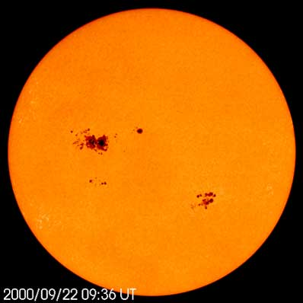
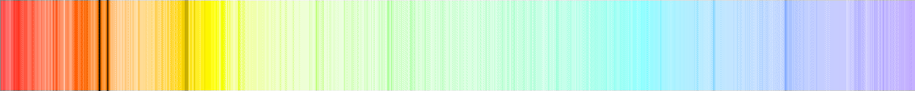
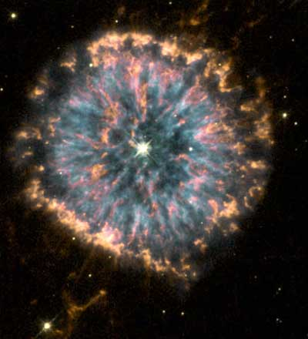

Light production
In astronomy
Light is produced by:
The Sun
• Stars are hot, glowing: thermal radiation
continuous spectrum
(or absorption spectrum when colder gas is in front)
• Hot stars’ UV cause interstellar gas glow: fluorescence
emission spectrum
NGC 6369
[Also: white shirts glow in “black light”]

Slide 7
Questions coming …

Slide 8
Question 6
sec
30
29
28
27
26
25
24
23
22
21
20
18
17
16
15
14
13
12
11
10
9
8
7
6
5
4
3
2
1
0
19
What type of spectrum is generated in fluorescence?
A Continuous.
B Absorption.
C Emission.
D None.
E A mix of emission and continuous spectra.
Next question coming …

Slide 9
Question 7
sec
30
29
28
27
26
25
24
23
22
21
20
18
17
16
15
14
13
12
11
10
9
8
7
6
5
4
3
2
1
0
19
What is thermal radiation?
When substances (gas in astronomy) …
A glow because they reflect the light of a star.
B glow because they are hot.
C glow because they are illuminated by UV light.
D glow because they reflect sunlight.
E glow because electrically charged particles hit magnetic fields.

Slide 10
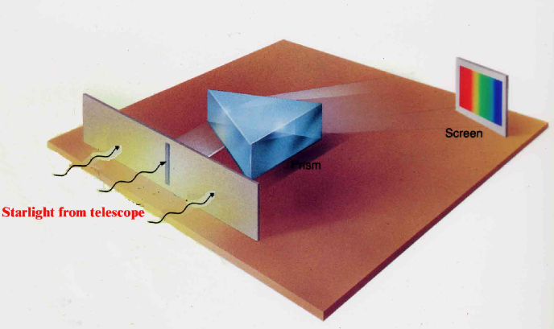
The spectroscope
The device that resolves the colors of light:
the spectroscope
(Joseph von Fraunhofer, 1814)
• Light from telescope enters
slit (to block off stray light)
• Prism (or grating) separates
the colors
• Produces spectrum
on a screen/on a film
(Put this device in a box and
attach it to the telescope)
Spectrum: each color is a “line”
Surprise:
The spectrum of the Sun
has black lines:
Some colors are missing!
(Fraunhofer-lines)

Slide 11

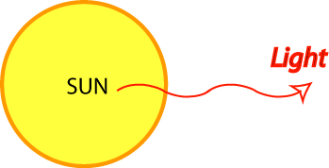
The spectrum of the Sun
Hα
(Color and b/w version of the same thing.)
Hβ
Hγ
Absorption lines (“Frauenhofer-lines”),
many in hydrogen wavelengths
Here: colder gas takes out a few colors
Solar atmosphere

Slide 12
Questions coming …

Slide 13
Question 8
sec
30
29
28
27
26
25
24
23
22
21
20
18
17
16
15
14
13
12
11
10
9
8
7
6
5
4
3
2
1
0
19
The spectrum of the Sun consists of
A a few bright lines only.
B dark lines over a bright continuum.
C dark bands of light with bright centers, over a bright continuum.
D a continuous bright spectrum like a rainbow.
E a few bright bands with dark centers.
Next question coming …

Slide 14
Question 9
sec
30
29
28
27
26
25
24
23
22
21
20
18
17
16
15
14
13
12
11
10
9
8
7
6
5
4
3
2
1
0
19
What are Fraunhofer lines?
A linear clouds in the disc of Jupiter.
B emission lines in the spectrum of a diffuse nebula.
C absorption lines in the spectrum of the Sun.
D dark lines connecting red spots on Mars.
E fake spectral lines in a spectroscope due to diffraction of light.

Slide 15


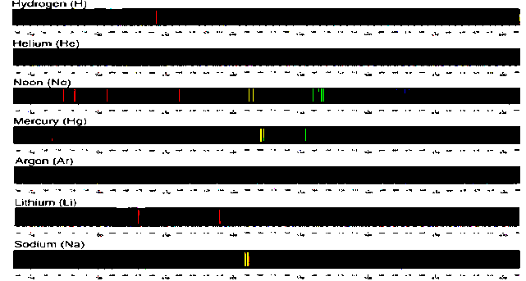
Recall the types of spectra
Continuous spectrum
(thermal glow)
Absorption spectrum
(cold gas illuminated from behind)
Emission spectrum
(by rarified gas: fluorescence)
Each chemical element
has its own spectral lines:
A good way to tell
the chemical composition
of a star!

Slide 16
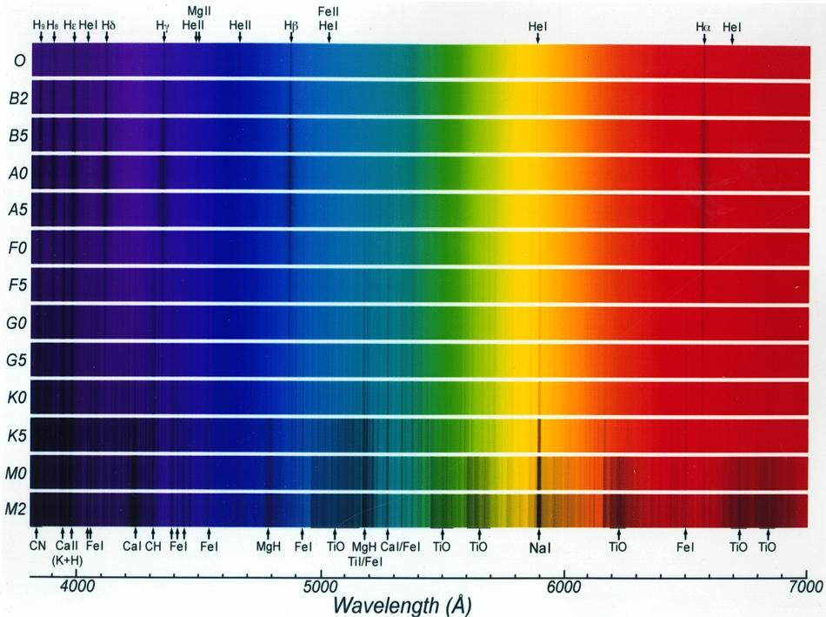
The spectra of stars – the effect of photospheric temperature
Example: hydrogen lines are strongest in A0 stars (at 10000K) – explain why?
20,000K
9,000K
6,000K
3,000K

Slide 17
Questions coming …

Slide 18
Question 10
sec
30
29
28
27
26
25
24
23
22
21
20
18
17
16
15
14
13
12
11
10
9
8
7
6
5
4
3
2
1
0
19
How do we tell precisely the spectral type of stars?
Based on …
A a calculation of the star’s brightness.
B the overall color of the star.
C which spectral lines are strongest.
D the width (or profile) of spectral lines.
E the Doppler-shift in individual spectral lines.
Next question coming …

Slide 19
Question 11
sec
30
29
28
27
26
25
24
23
22
21
20
18
17
16
15
14
13
12
11
10
9
8
7
6
5
4
3
2
1
0
19
Metal lines are strongest in a star’s spectrum
when the star is … ?
A Hottest.
B Coldest.
C Largest.
D Smallest.
E Closest.

