Slide 1
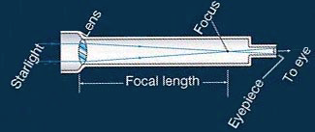
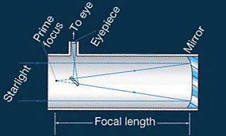
Astronomical telescopes
How do they work?
Use eyepiece to
watch image
Refractor:
Lens collects light
Use eyepiece to
watch image
Reflector:
Mirror collects light
Diameter:
2”-5” toy
6”-30” amateur
3’-10’ professional
10’-33’ super
Large lens/mirror collects much light -
the diameter of the telescope
is the important indicator.

Slide 2
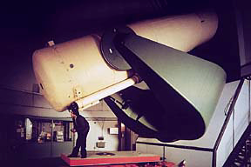
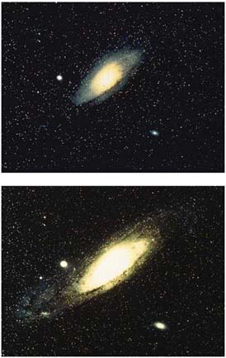
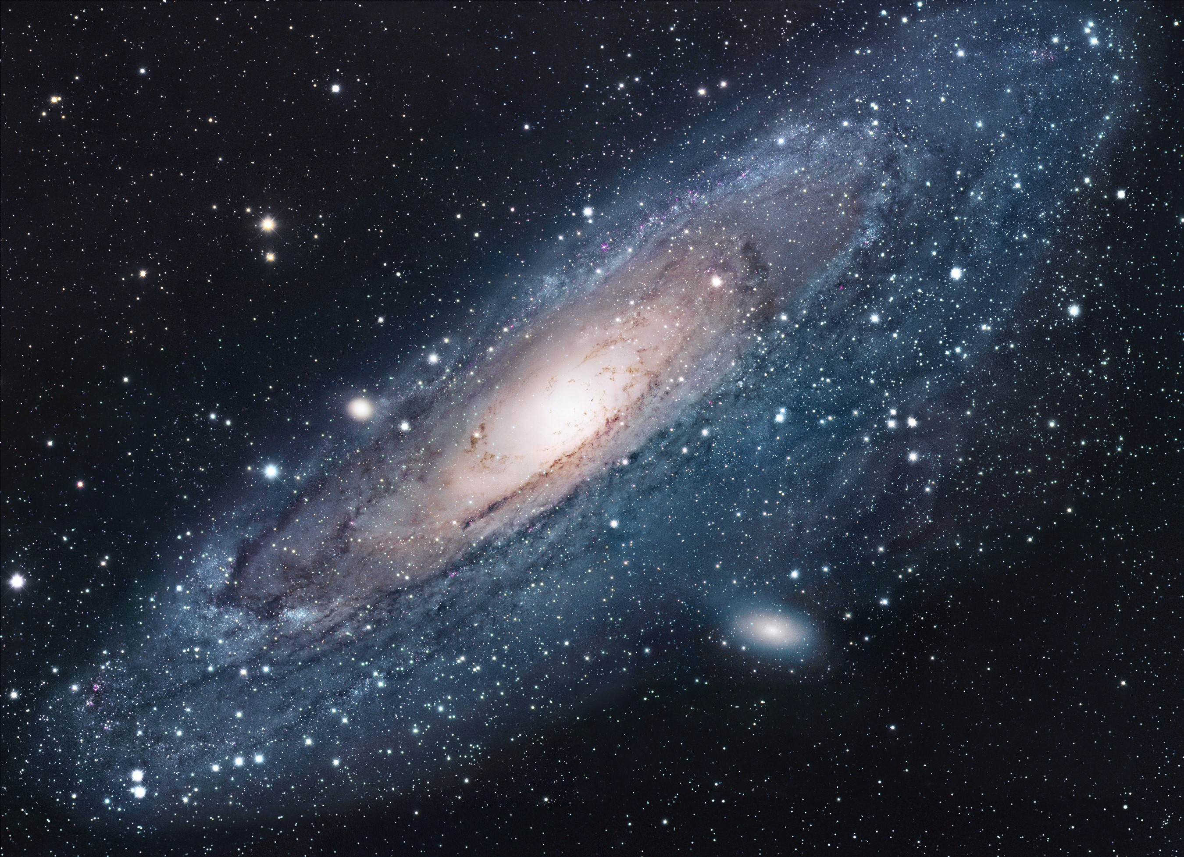
Why do we need telescopes?
To collect much light
- need large diameter
To make small objects look large
- need magnification
Limits to light collection:
Diameter ~ 10 m (30 feet) would be too heavy to hold
(Three larger ones with segmented mirrors are being built.)
little light
Limits to magnification:
“Seeing” - stars jump around (related to twinkling)
- caused by air turbulence
much light

Slide 3
Questions coming …

Slide 4
Question
sec
30
29
28
27
26
25
24
23
22
21
20
18
17
16
15
14
13
12
11
10
9
8
7
6
5
4
3
2
1
0
19
Which of the following is the most important measure of a telescope?
A The magnification.
B The diameter of its mirror (or lens).
C The focal length of its mirror (or lens).
D The length of the telescope.
E The distance of the farthest object it can see.
Next question coming …

Slide 5
Question
sec
30
29
28
27
26
25
24
23
22
21
20
18
17
16
15
14
13
12
11
10
9
8
7
6
5
4
3
2
1
0
19
The largest telescope we have at Ole Miss
is 15 inches. What category is that?
A Large professional.
B Average professional.
C A decent amateur size.
D A small amateur size.
E Uselessly small for astronomy.

Slide 6

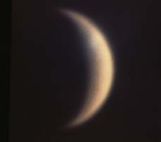
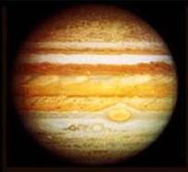
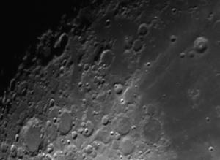
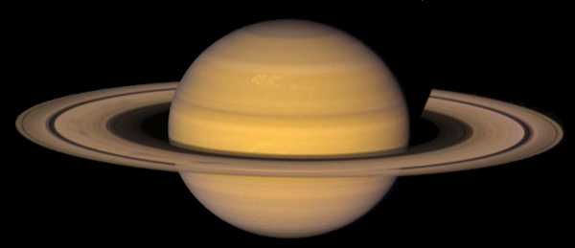
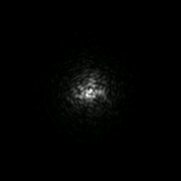
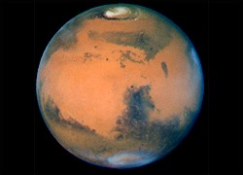
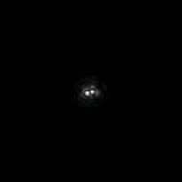
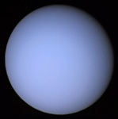
Seeing
: air moves →
stars jump around and twinkle
• 2 to 4 arc seconds in Mississippi
• 1 arc second in good location
• 0.4 arc second on Mauna Kea, Hawaii
Compare sizes:
30 as
Size of “seeing”
Venus
Jup
Sat
Mars
Uranus
Seeing limits magnification to a few hundred at best
Look at a
double star
in good and
in bad
weather:
Bad
seeing
Good
seeing

Slide 7
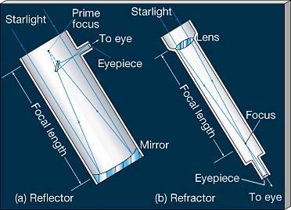
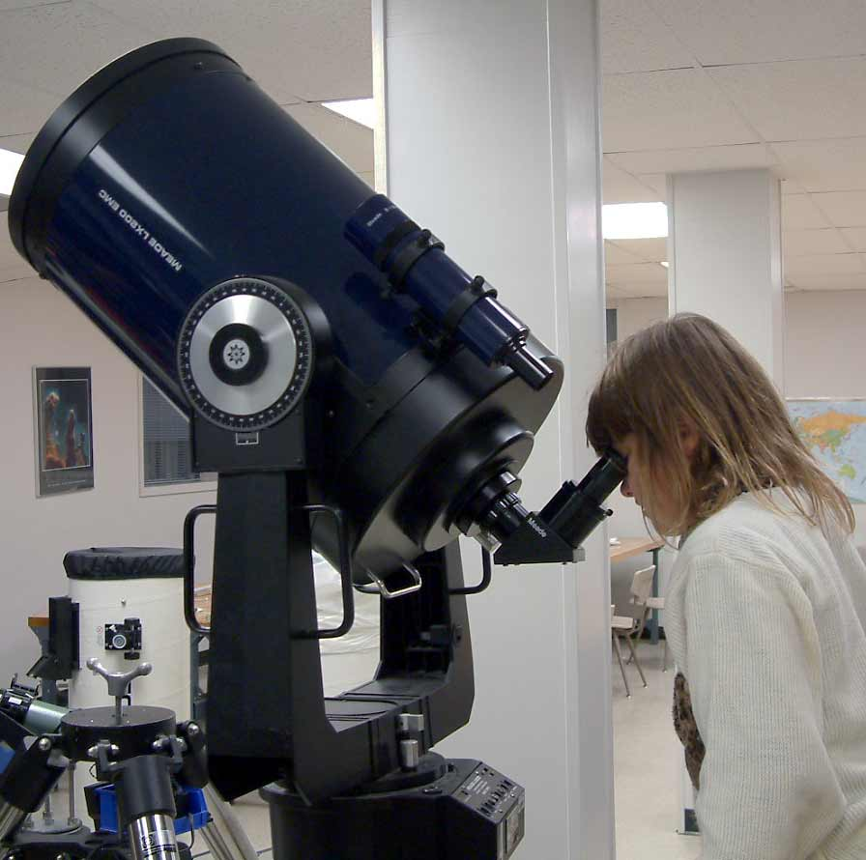
Magnification computed
M = f_{objective}/f_{eyepiece}
Example:
Meade, diameter = 12 inches, f_{obj} = 3048 mm
Resolution: 0.4 as (optical)
1-2 as atmospheric
With f=26 mm eyepiece, M = 117 x
With f=10 mm eyepiece, M = 305 x
With f = 4 mm eyepiece, M = 762 x
Which ones make sense?

Slide 8
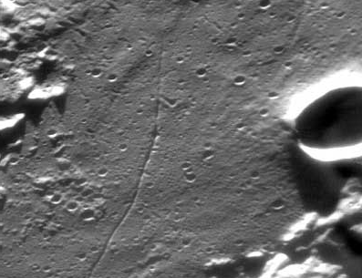
Smallest detail Moon
The smallest detail we can see on the Moon
Crater Cameron
a 1 mile wide rille
(looks 1 as wide)

Slide 9
Questions coming …

Slide 10
Question
sec
30
29
28
27
26
25
24
23
22
21
20
18
17
16
15
14
13
12
11
10
9
8
7
6
5
4
3
2
1
0
19
What is seeing?
A The amount of air starlight passes through to reach our eyes.
B The diameter of the blur caused by the atmosphere.
C The amount of light passing through the atmosphere.
D The brightness of a star as it appears to us in the sky.
Next question coming …

Slide 11
Question
sec
30
29
28
27
26
25
24
23
22
21
20
18
17
16
15
14
13
12
11
10
9
8
7
6
5
4
3
2
1
0
19
Which of the following limits the magnification of all but the smallest telescopes?
A Optical effects.
B Quality of the lens/mirror.
C Seeing.
D The shaking of the telescope mount.
E Inaccurate tracking.
Next question coming …

Slide 12
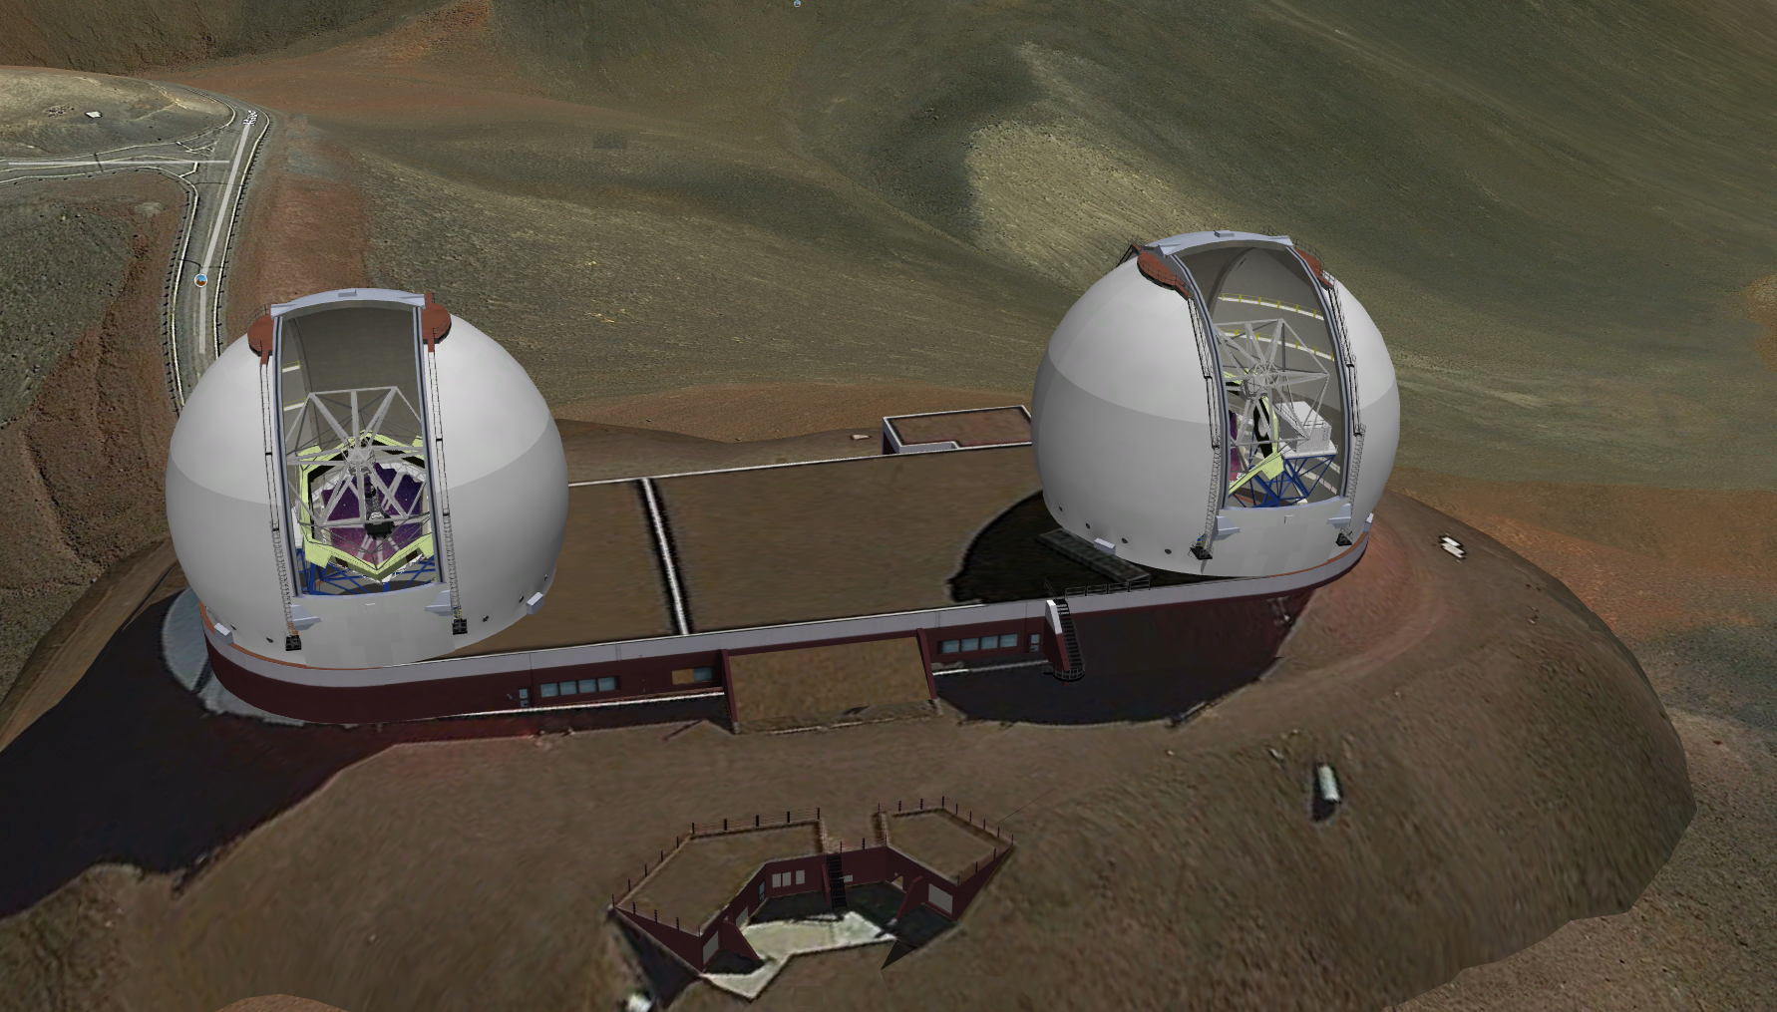
The 10-m Keck telescopes on Mauna Kea, Hawaii
$192 million; first light: 1993

Slide 13
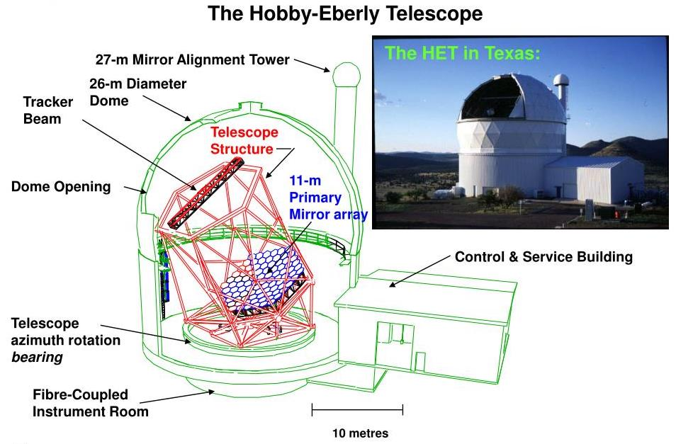
A large telescope with limited motion (58º up) in the Texas desert:
Equivalent diameter: 10 m. Worth: $1 million in 1939 dollars

Slide 14
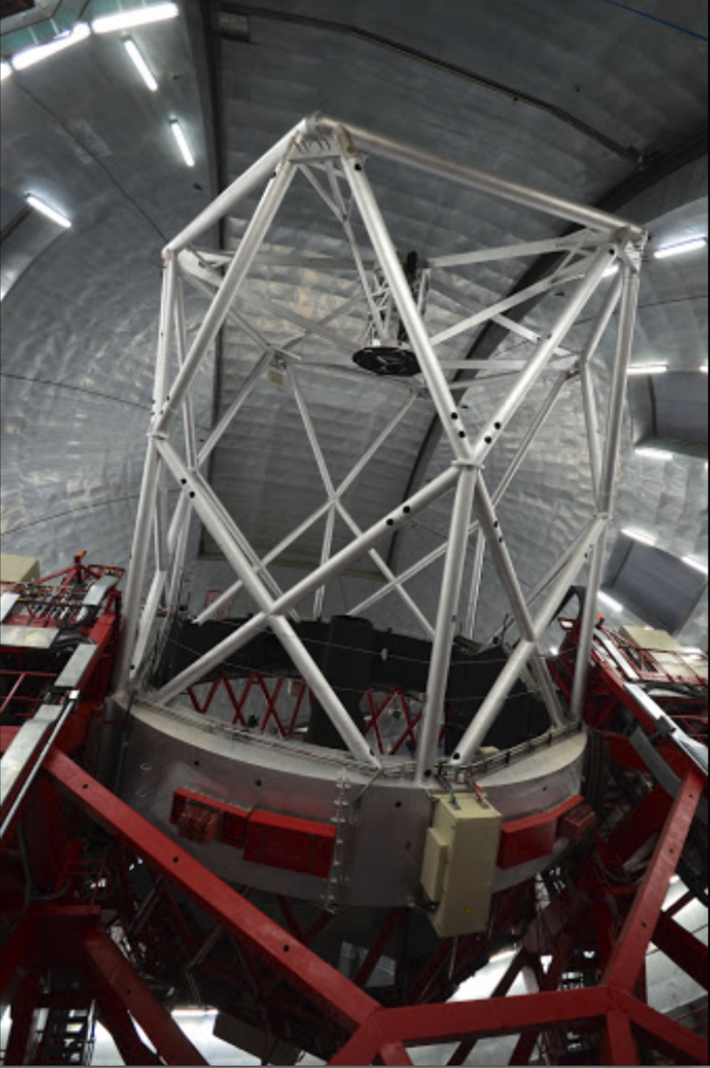
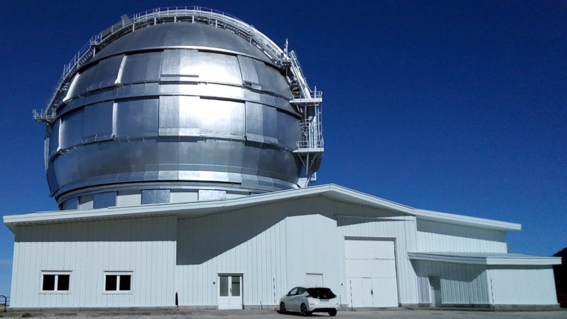
The largest telescope
in the world:
Gran Telescopo Canarias
La Palma Island (Spain)
Diameter: 10.4 m
Worth: $180 million
First light: 2007

Slide 15
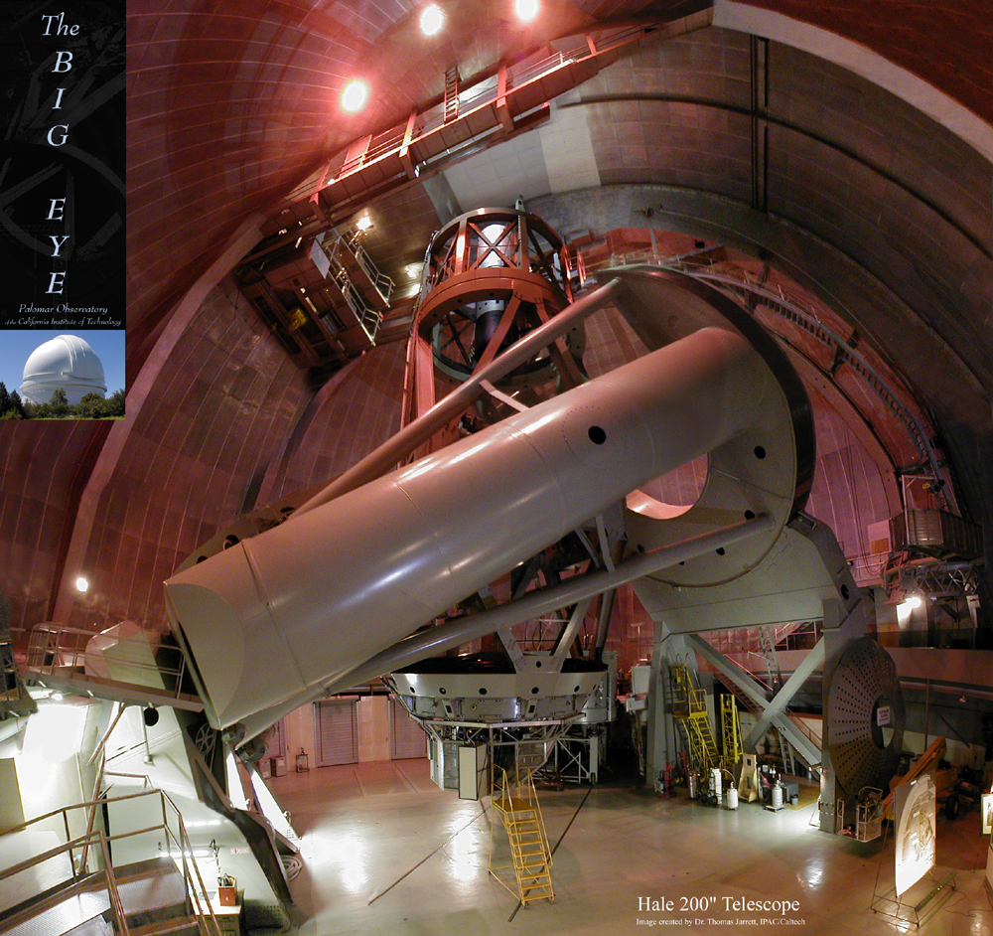
Mt. Palomar
Flagship for a half a century:
(1948-92)
Mt. Palomar Observatory
Observer in cage
California
SW of LA
Diameter:
5 m
Length of tube:
16 m
Main mirror

Slide 16
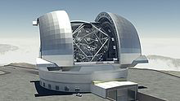
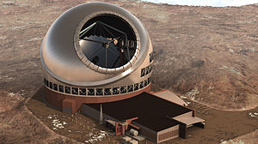
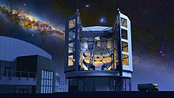
Under construction …
Extremely Large Telescope
Cerro Armazones, Chile
2025 ?
€1.3 billion
Effective diameter: 39.2 m
Thirty Meter Telescope
Mauna Kea, Hawaii
2027 ?
$1.4 billion
Effective diameter: 30 m
Giant Magellan Telescope
Las Campanas, Chile
2025 ?
$ 1 billion
Effective diameter: 24.5 m

Slide 17
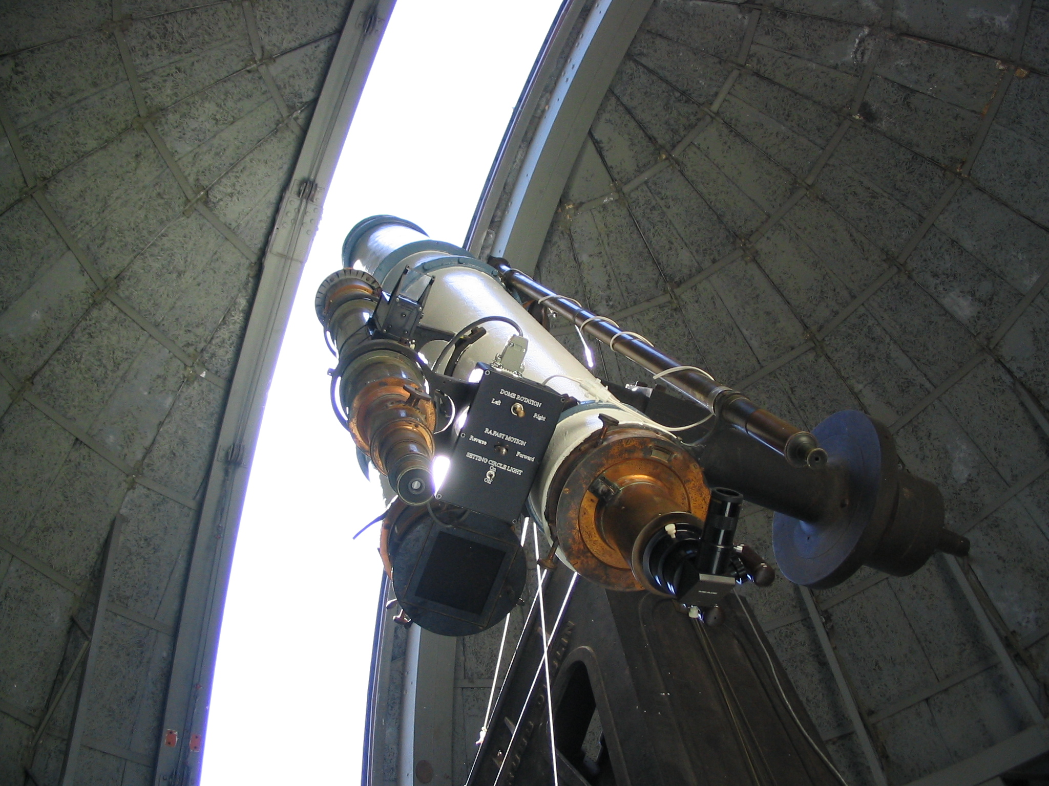
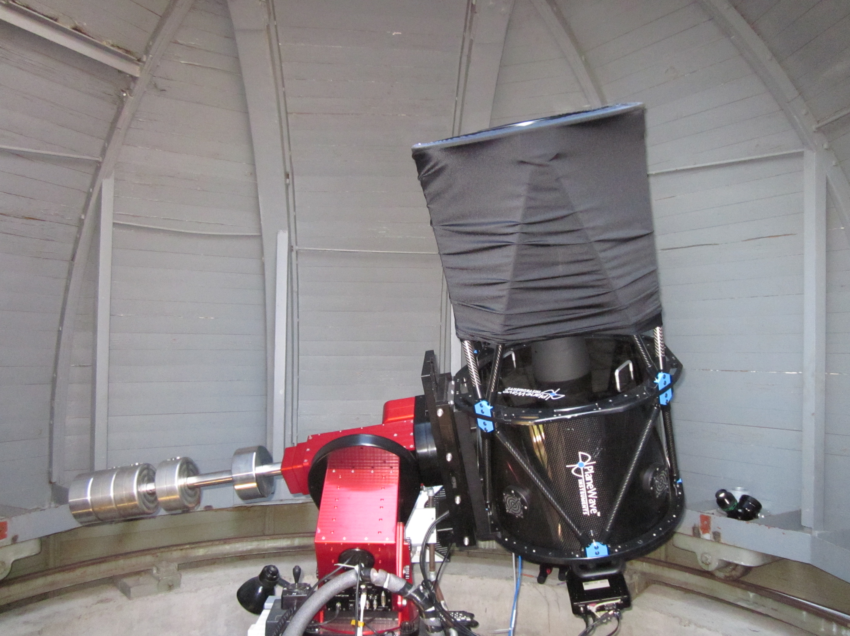
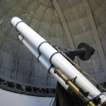
The 17” CDK telescope
(little but modern)
in the little dome
Fully photographic use:
CCD camera installed
The Grubb Refractor
in the
large dome
(1892)
Diameter
15”

Slide 18
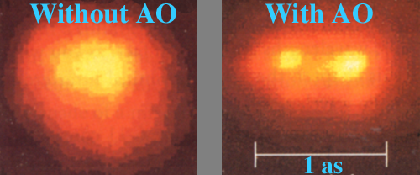
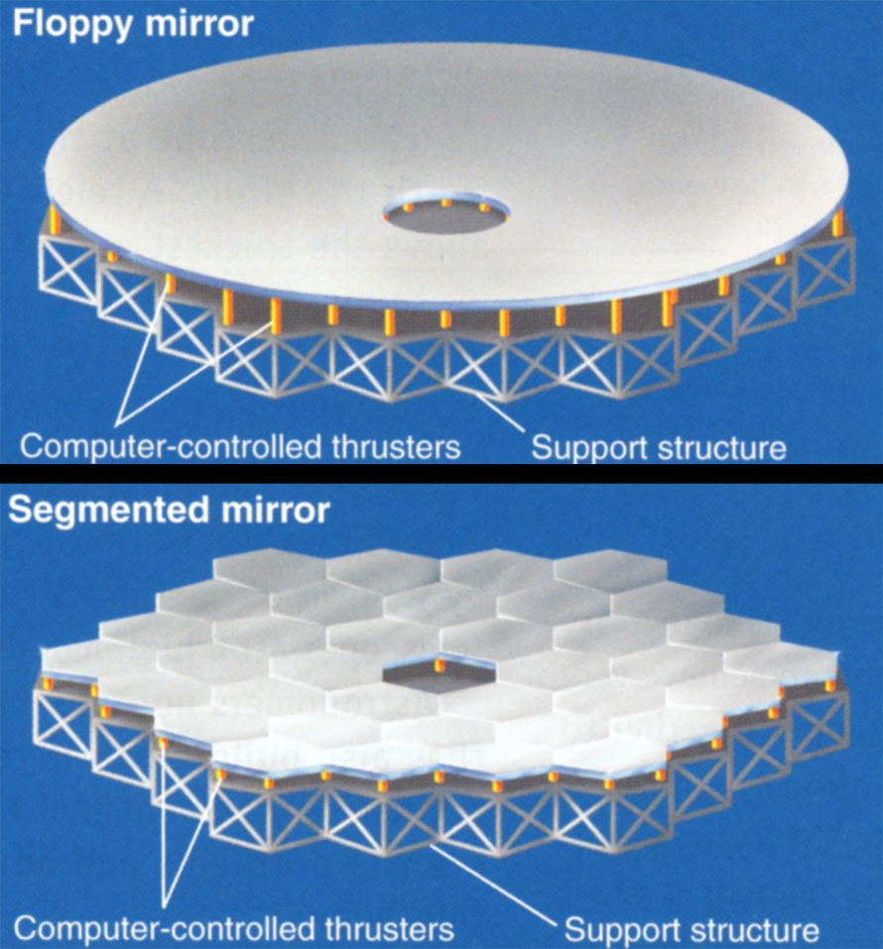
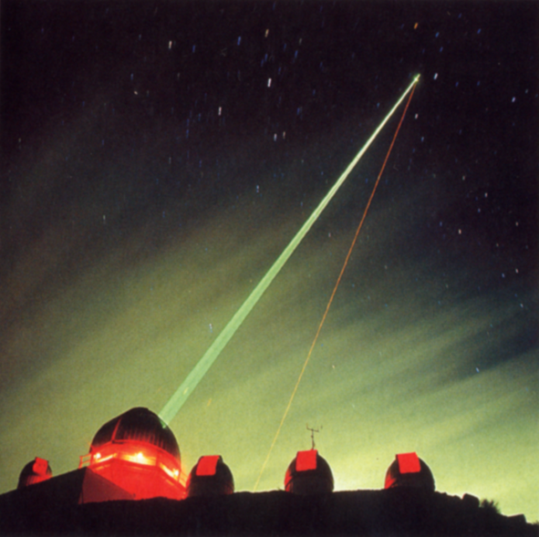
Adaptive optics
How do you fight seeing?
(1) Put your observatory on a mountaintop: seeing at best: ~ 0.4 as
(2) Use adaptive optics: seeing at best: ~ 0.05 as
• Deform your mirror to compensate for seeing
• Observe a “guide” star and have a computer tell how to deform mirror
• Do this ~ 100 times each second
No guide star?
Make one!

Slide 19
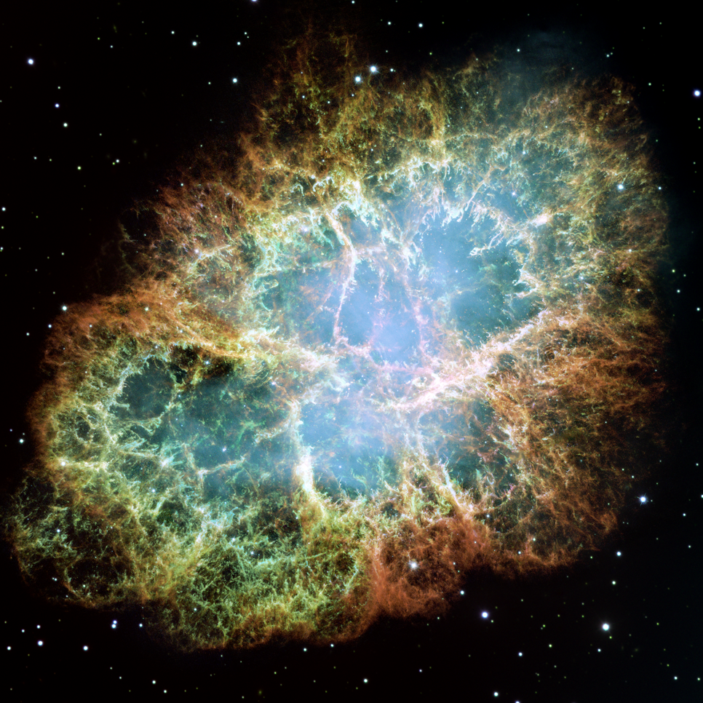
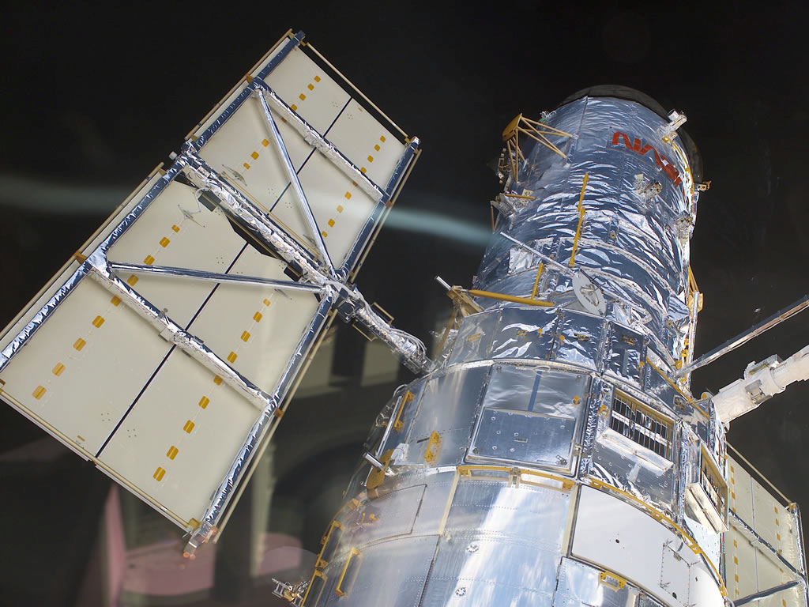
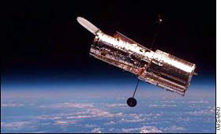
The Hubble
How do you fight seeing?
(3) Put your telescope on a spaceship:
seeing: 0 as
Hubble Space Telescope is a “small” telescope
Diameter: 2 m; resolution: 0.06 as
More discoveries than all other
telescopes combined.

Slide 20
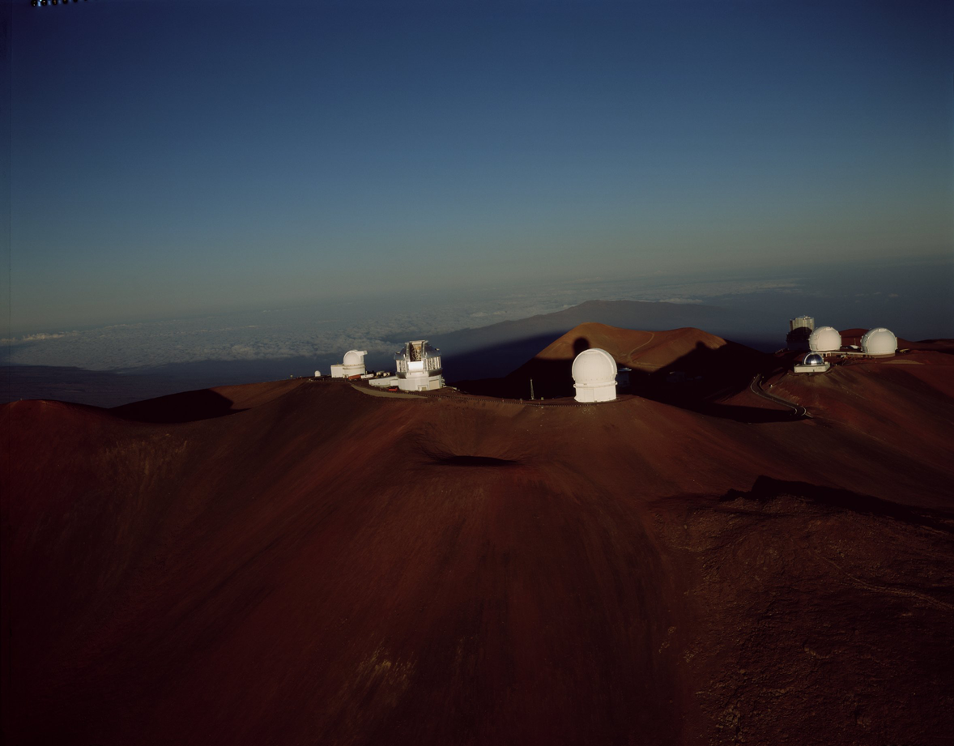
Mauna Kea
M
A
U
N
A
K
E
A

Slide 21
Questions coming …

Slide 22
Question
sec
45
40
35
30
25
19
18
17
16
15
14
13
12
11
10
9
8
7
6
4
3
2
1
0
20
5
Why does the Hubble Telescope make very
detailed images?
A Because it has the largest diameter of all telescopes.
B Because it is of exceptionally good quality.
C Because it is in space where the atmosphere does
not blur the image.
D Because it can use infrared radiation that other
telescopes cannot.
E Because it is in space, closer to the stars than other telescopes.
Next question coming …

Slide 23
Question
sec
45
40
35
30
25
19
18
17
16
15
14
13
12
11
10
9
8
7
6
4
3
2
1
0
20
5
What is adaptive optics?
A When the telescope follows the stars as they
move in the sky.
B When some of the telescope’s lens or mirror is covered according to changes in the atmosphere.
C When the shape of the optics is changed according to the changes in the atmosphere.
D When appropriate color filters are used as the atmosphere absorbs more or less red or blue light.
E When the magnification of the telescope is chosen according to how turbulent the atmosphere is on the day of the observation.

Slide 24
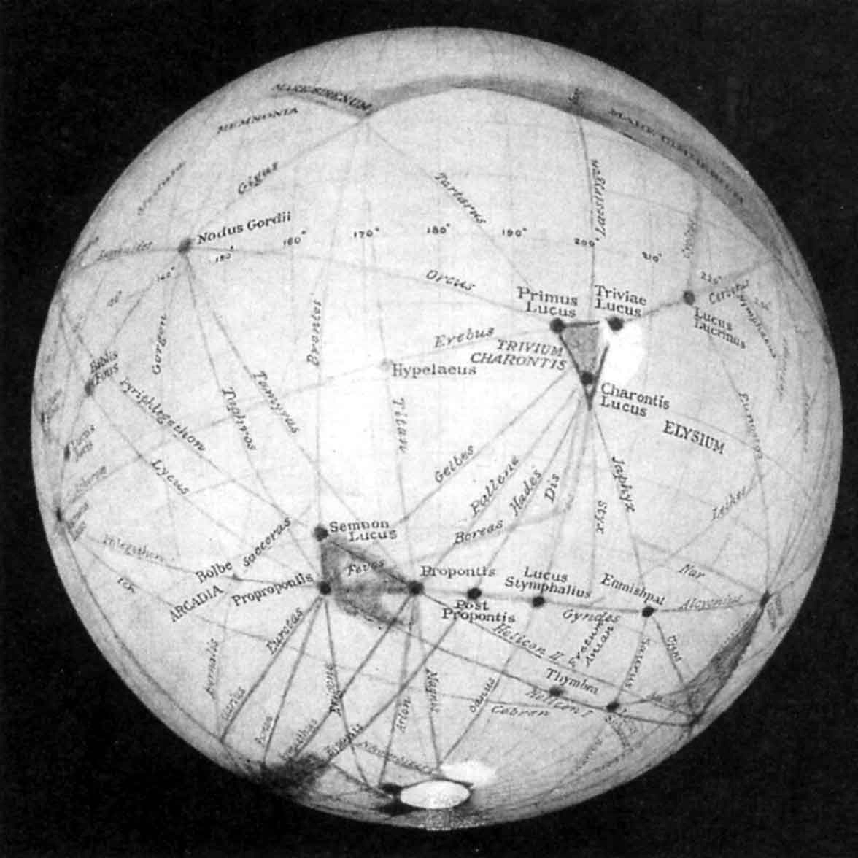
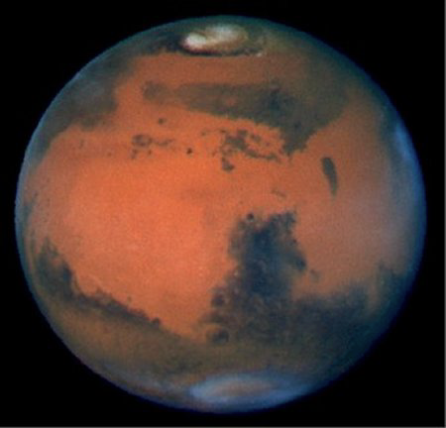
Visual vs. CCD
The professional way of doing astronomy: picture taking and imaging
(1) Visual observation: always unreliable
Recall the canals on Mars - G. Schiaparelli &P. Lowell

Slide 25
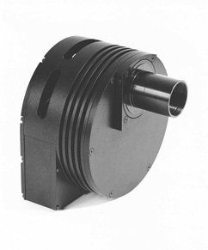
CCD
The professional way of doing astronomy: picture taking and imaging
(2) Photography: • reliable • can collect light for a long time
(3) The modern way: CCD imaging
• in CCD chip light moves electrons into pixel
• computer counts electrons in each pixel
and turns numbers into image on screen
Similar to a digital camera but:
• chip is cooled to reduce noise
• computer controlled - image can be much
improved with computerized processing techniques
• many images can be added to improve quality
The CCD revolution after 1995: one can take pictures
even of galaxies with amateur equipment from light-polluted sites.

Slide 26
Questions coming …

Slide 27
Question
sec
45
40
35
30
25
19
18
17
16
15
14
13
12
11
10
9
8
7
6
4
3
2
1
0
20
5
Why do astronomers no longer look into
their telescopes?
A Because the observer’s body would obstruct the
light in research-grade telescopes.
B Because visual observations are unreliable.
C Because there is dangerous radiation in a research observatory.
D Because large telescopes collect so much light that their eyes
would be damaged.
E Because there is nothing left to discover in optical light;
infrared and X-ray radiation must be observed to make new
discoveries.
Next question coming …

Slide 28
Question
sec
45
40
35
30
25
19
18
17
16
15
14
13
12
11
10
9
8
7
6
4
3
2
1
0
20
5
What is a CCD?
A A new type of telescope that replaces reflectors.
B A new type of optical device that replaces the lens or mirror
of a telescope.
C A new type of a telescope mount.
D A new type of a detector that replaces photography.
E A new type of an instrument that separates colors in starlight.
Next question coming …

Slide 29
Question
sec
45
40
35
30
25
19
18
17
16
15
14
13
12
11
10
9
8
7
6
4
3
2
1
0
20
5
Which of the following is an advantage of
imaging over visual observations in astronomy?
A One can get better resolution.
B The human eye cannot see X-rays, but cameras can.
C One can collect light for a long time.
D Cameras can be handled automatically in observatories in
remote high mountains.
E Seeing does not affect camera images.

