Slide 1


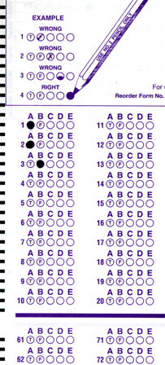
Setup:
Prepare your scantron:
Use
a pencil,
not a pen!
Fill in your name and fill the bubbles under
your name.
LAST NAME FIRST, First name second
Put your 4-digit code instead of “IDENTIFICATION NUMBER”.
--- (The last 4 digits of your OleMiss ID.)
• Labs: DS visit this week
(weather permitting)
• No class on Friday
Question # 1: answer A
Question # 2: answer B
Question # 3: answer D
Recall reading assignment
Chapter 14, The Sun, pp. 466 – 487
Please take a moment to mute your cell phone!

Slide 2
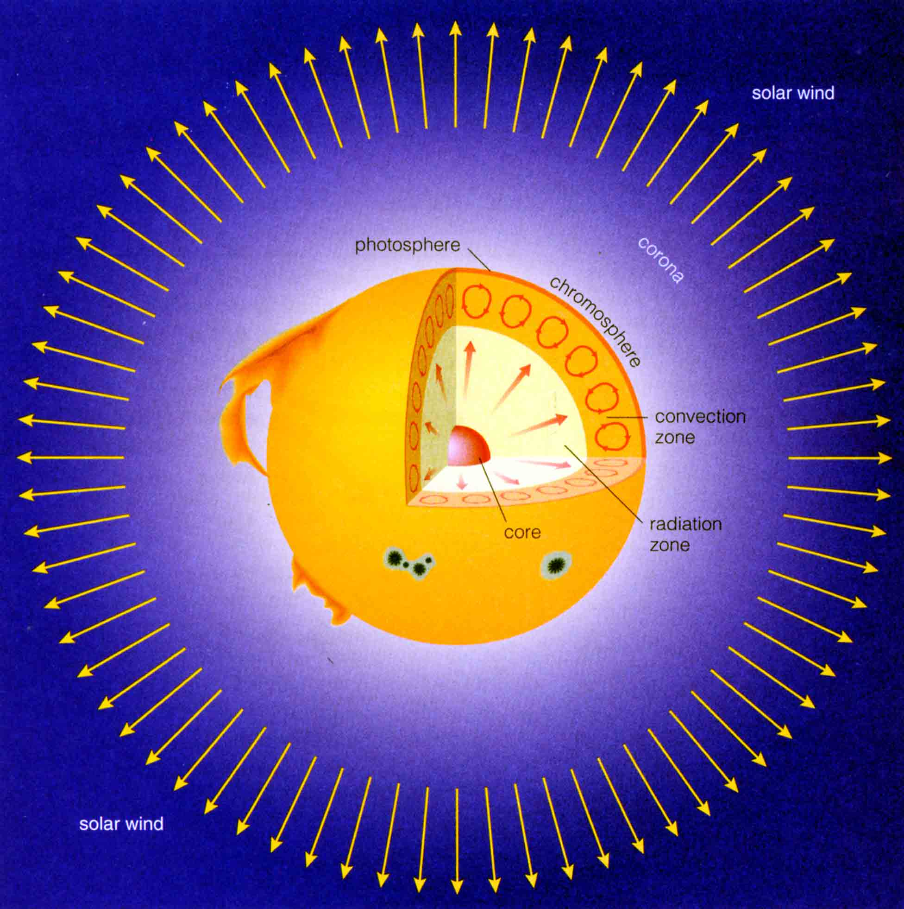
What’s inside?
In core: 4 H -> He
(>> 1 million K)
Radiation zone:
heat transfer
by radiation
Convection zone:
heat transfer
by convection
(“boiling”)
Photosphere:
visible light
coming from
(6000 K)

Slide 3
Questions coming…

Slide 4
Question 4
sec
30
29
28
27
26
25
24
23
22
21
20
18
17
16
15
14
13
12
11
10
9
8
7
6
5
4
3
2
1
0
19
Where in the Sun is heat being produced?
A Everywhere inside the Sun.
B Only in the core (close to the center).
C Only in a narrow region close to the surface.
D In most of the Sun except in the convective outside region.
E Nowhere, because no more energy is being produced in the Sun now. It has been heated up once and it is only giving off its heat as it is cooling off.
Next question coming …

Slide 5
Question 5
sec
30
29
28
27
26
25
24
23
22
21
20
18
17
16
15
14
13
12
11
10
9
8
7
6
5
4
3
2
1
0
19
How hot is the center of the Sun?
A -273 K
B 6,000K
C 200,000K
D 15 million K
E 6 billion K

Slide 6
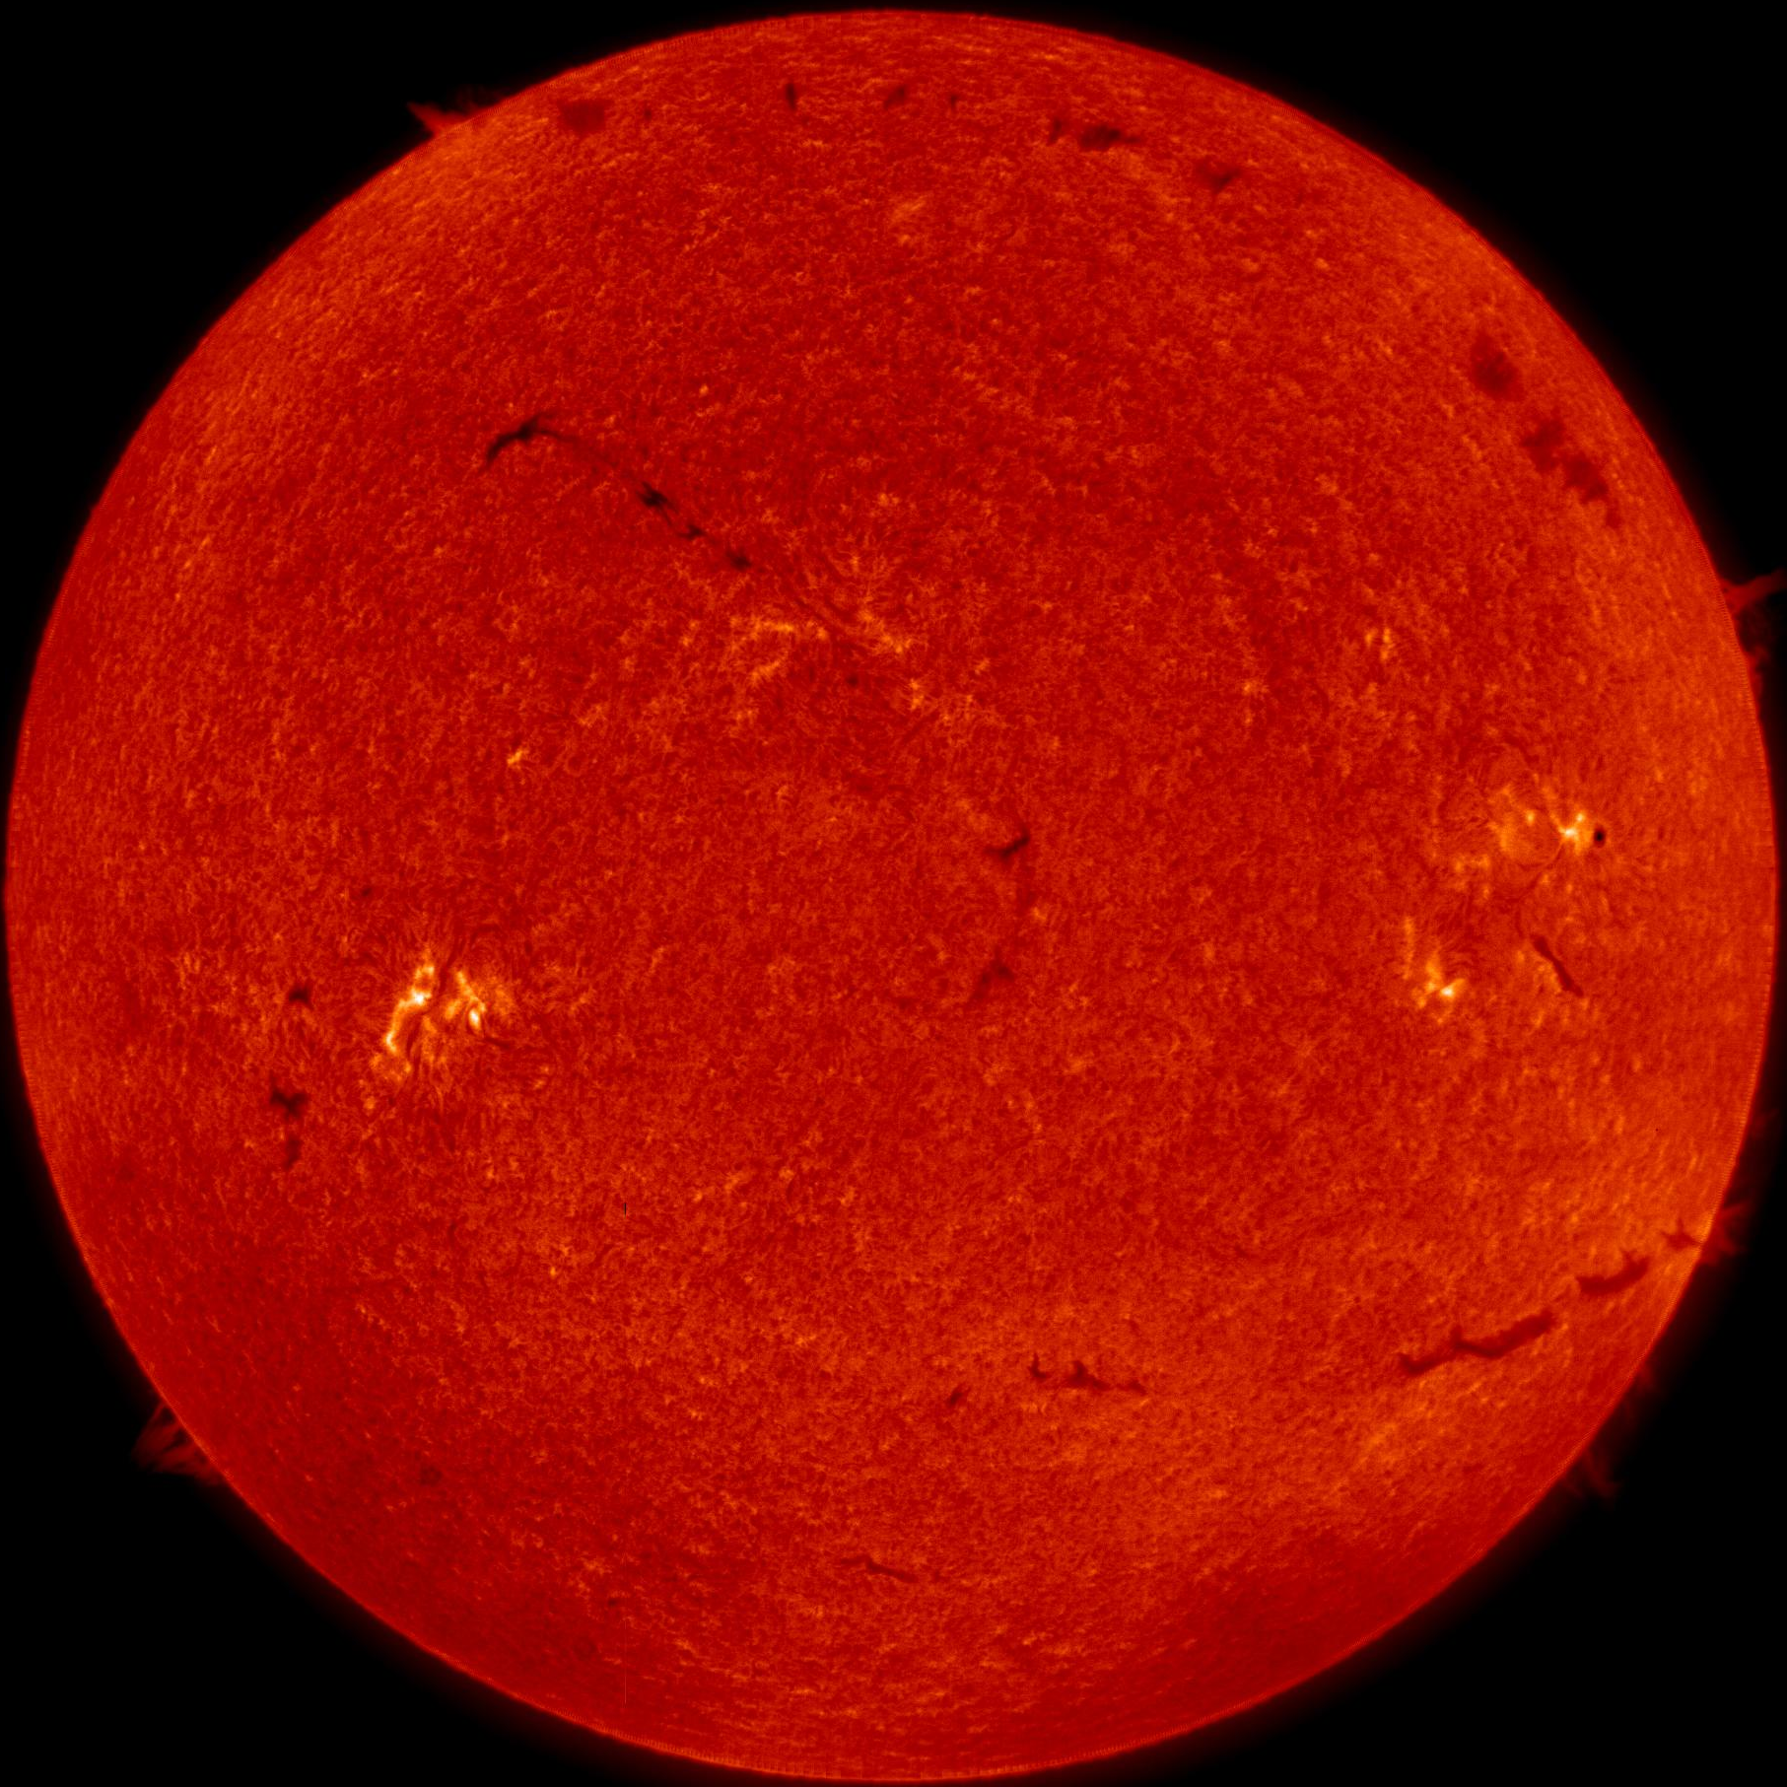
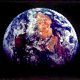
granulation
Convection zone sticking out:
Compare the size!
The Sun is
“boiling”:
Granules
live ~ 10 min
rising (hot)
and
sinking (“cold”)
matter
A red filtered image

Slide 7
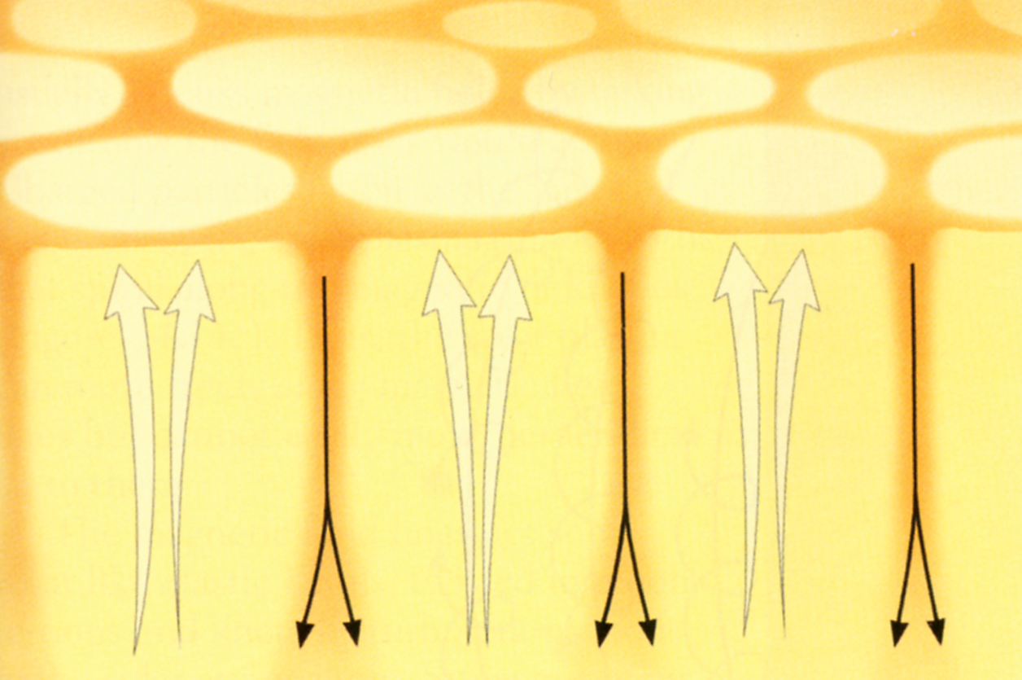
Granules explained
Photosphere: “grainy”
Hot gas up
Cold gas down

Slide 8
Question coming ...

Slide 9
Question 6
sec
45
40
35
30
25
19
18
17
16
15
14
13
12
11
10
9
8
7
6
4
3
2
1
0
20
(45)
5
Which of the following explains what granules are?
A The strong heat from below causes cracks on the
surface of the Sun.
B Rising hot bubbles reach the surface and glow until they cool down and sink.
C The magnetic field of the Sun makes gas glow when charged particles cross it.
D Clouds float over the photosphere.
E Asteroids keep falling into the Sun and burn up in the intense heat.

Slide 10
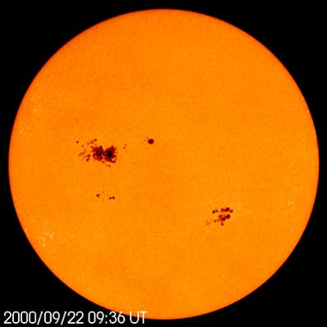
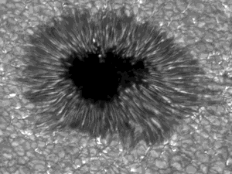
Sunspots
Undisturbed
photosphere
(6000 K)
“Cold spots”
in the
photosphere
where
convection
is stopped
by the
strong
magnetic field
Penumbra
(5000 K)
Umbra
(4000 K)

Slide 11
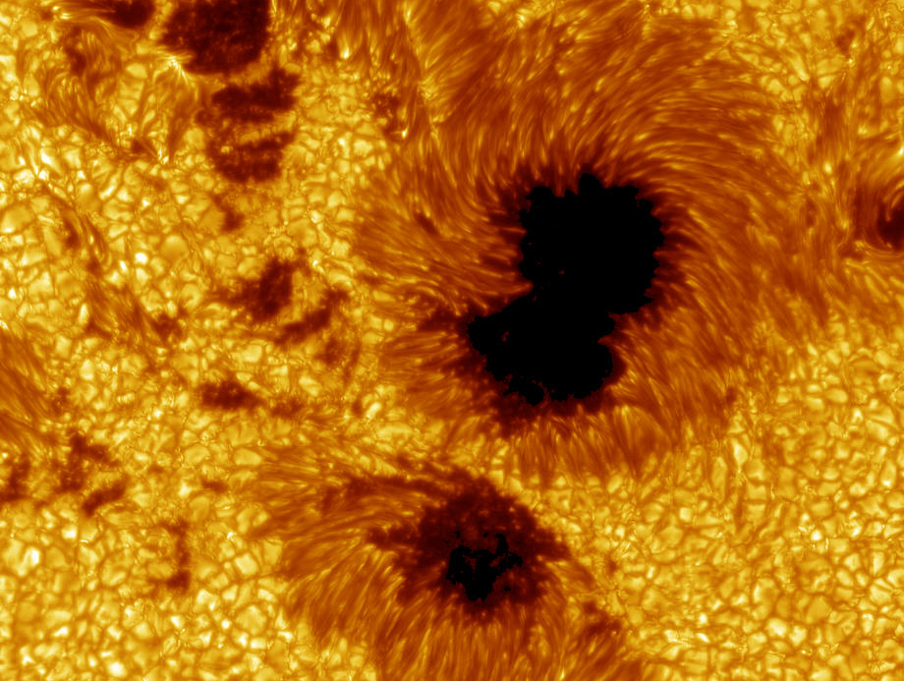
Sunspot details

Slide 12
Questions coming …

Slide 13
Question 7
sec
30
29
28
27
26
25
24
23
22
21
20
18
17
16
15
14
13
12
11
10
9
8
7
6
5
4
3
2
1
0
19
What are sunspots?
A Regions on the Sun, hotter than the photosphere.
B Regions on the Sun, composed of dark substances.
C Regions on the Sun, colder than the photosphere.
D Holes in the surface of the Sun where we see deep into the Sun.
E Clouds floating over the photosphere.
Next question coming …

Slide 14
Question 8
sec
45
40
35
30
25
19
18
17
16
15
14
13
12
11
10
9
8
7
6
4
3
2
1
0
20
(45)
5
What causes the sunspots?
A The magnetic fields of the Sun deflects sunlight from
the spots, so they appear dark.
B The magnetic field of the Sun channels dark
substances into sunspots.
C The magnetic field of the Sun stops hot bubbles of gas from
rising, causing the region to cool off.
D The gravity of the Sun heats up the gas, which burns quickly
and the remaining ashes are dark.
E The shadow of the Moon is cast on the Sun, covering
dark regions.

Slide 15
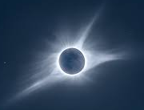
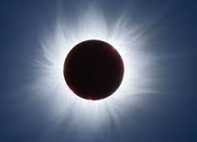
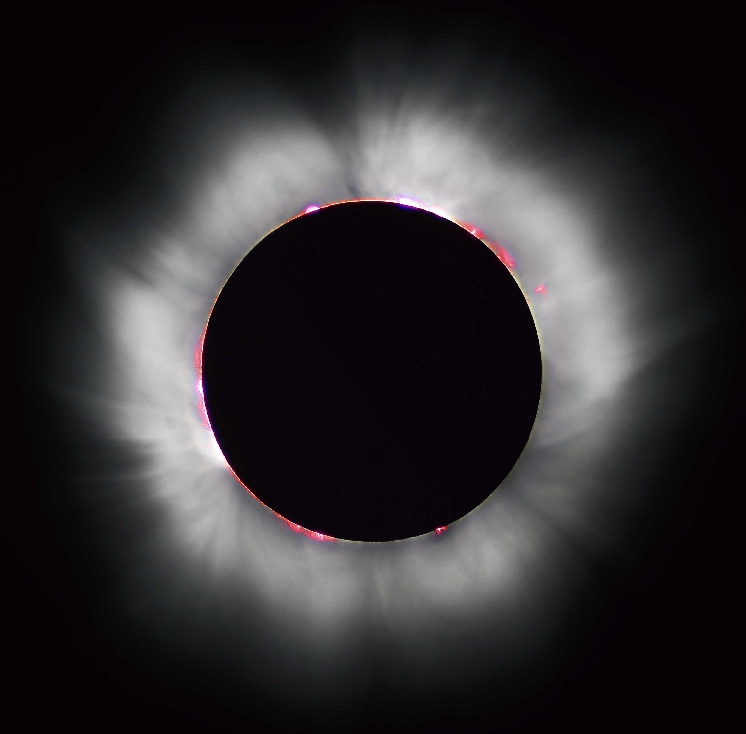
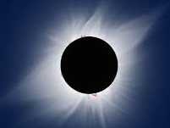
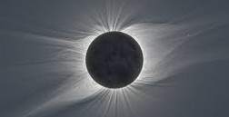
The Solar Corona
Extremely hot & extremely tenuous(=thin=rarified):
density: (10-100) particles/cm³ = ~ (1-10) x 10⁻²³ g/cm³
transparent
temperature: >1 million K
composition: p⁺ and e⁻ (ionized hydrogen)
Observable only: - during a total solar eclipse (extremely rare)
- from spacecraft (blocking out the solar disk)

Slide 16
Questions coming …

Slide 17
Question 9
sec
30
29
28
27
26
25
24
23
22
21
20
18
17
16
15
14
13
12
11
10
9
8
7
6
5
4
3
2
1
0
19
What is the solar corona?
A A dense and hot gas cloud surrounding the Sun.
B Very thin gas surrounding the Sun, immobile.
C Very thin gas being blown off the Sun.
D A dust cloud around the Sun, reflecting sunlight.
E A solid ring appears around the Sun, due to light scattered in out air.
Next question coming …

Slide 18
Question 10
sec
30
29
28
27
26
25
24
23
22
21
20
18
17
16
15
14
13
12
11
10
9
8
7
6
5
4
3
2
1
0
19
Why is it that the solar corona glows very faintly,
even though it is extremely hot?
A Because it is not in fact hot.
B Because it is very thin and contains few atoms.
C Because it is very far from the Sun.
D Because it is very far away from us.

Slide 19
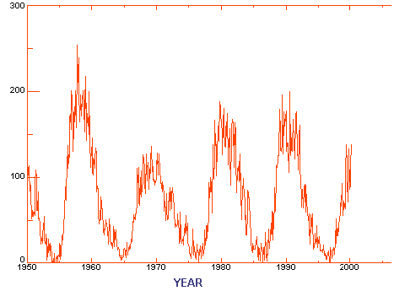
The 11 year solar cycle
(# of spots) +
10 x
(# of groups)

Slide 20
Solar maximum
Solar
maximum
• Many large sunspots
• Flares
• Prominences
• Eruptions
➔
Weather affected strongly

Slide 21
Questions coming …

Slide 22
Question 11
sec
45
40
35
30
25
19
18
17
16
15
14
13
12
11
10
9
8
7
6
4
3
2
1
0
20
5
What is the “solar cycle”?
A Every eleven years the Sun is more active and has a
lot of sunspot, followed by years of relative quiet.
B Once in year sunspots cause disruptions in the
magnetic field of Earth.
C Nuclear reactions heat up the Sun hotter than normal for a few
months every year, and this causes summer.
D Holes in the surface of the Sun where we see deep into the Sun.
E The energy production in the Sun oscillates with a
period of a few hundred years.
Next question coming …

Slide 23
Question 12
sec
45
40
35
30
25
19
18
17
16
15
14
13
12
11
10
9
8
7
6
4
3
2
1
0
20
5
How long is the “sunspot cycle”?
A 1 day.
B 1 year.
C 11 years.
D 4 billion years.
E 11 billion years.

