Slide 1
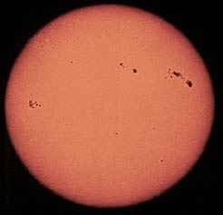
The Sun
Sunspots
An
average
STAR
‘Surface’ features:
• sharp edge
• sunspots
• limb darkening
Hydrogen (mainly) gas ball
Hot ‘surface’ (6000 K)

Slide 2
Questions coming …

Slide 3
Question 9
sec
30
29
28
27
26
25
24
23
22
21
20
18
17
16
15
14
13
12
11
10
9
8
7
6
5
4
3
2
1
0
19
The photosphere is
A the name of all the hot parts of the Sun
B the name of the visible edge of the solar disk
C the name of the central region of the Sun
D the name of a type of camera used to photograph the Sun.
E the name of a type of lens used to photograph the Sun.
This question is confusing. It has been invalidated.
The photosphere is the outer region (a ~ 100-km layer) of the Sun
from where light can still escape into space (and reach us).

Slide 4
Question 10
sec
30
29
28
27
26
25
24
23
22
21
20
18
17
16
15
14
13
12
11
10
9
8
7
6
5
4
3
2
1
0
19
How hot is the photosphere?
A 600 K
B 6,000 K
C 60,000 K
D 600,000 K
E 6,000,000 K

Slide 5
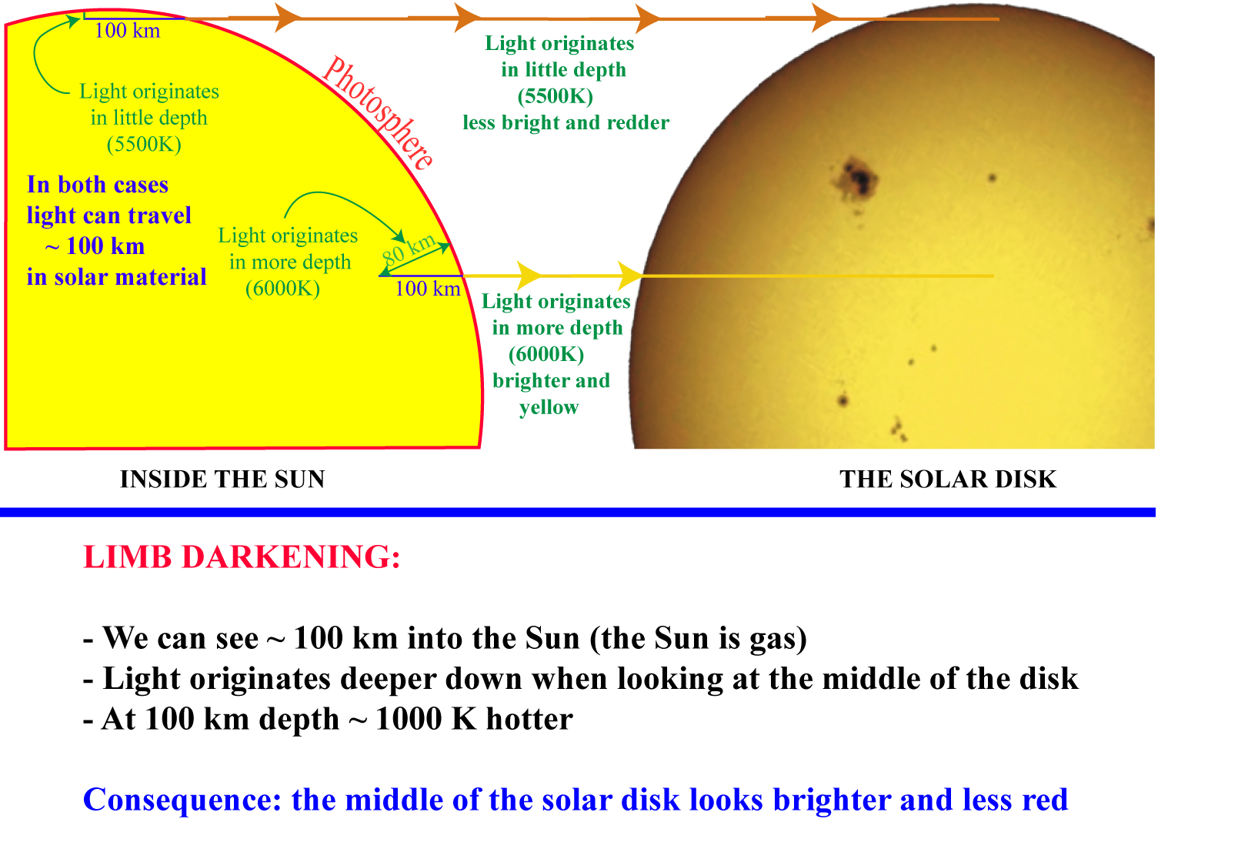

Slide 6
Questions coming …

Slide 7
Question 11
sec
30
29
28
27
26
25
24
23
22
21
20
18
17
16
15
14
13
12
11
10
9
8
7
6
5
4
3
2
1
0
19
Why does the edge of the solar disk look
darker than the middle?
A Because the photosphere is colder at the edge
of the Sun than in the middle.
B Because of the blurring effect of Earth’s atmosphere.
C Because we see deeper down in the middle of the solar disk,
where it is hotter.
D Because light is absorbed on the long way to the edge of the Sun.
E Because the middle of the Sun is closer to us than the edge.

