Slide 1
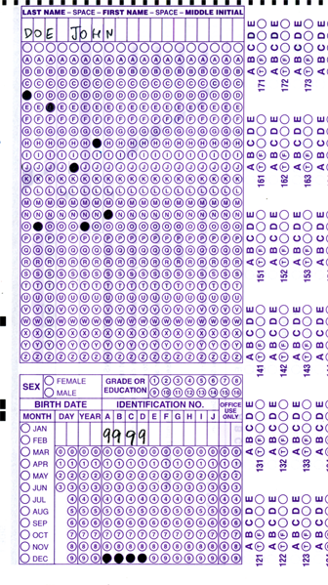

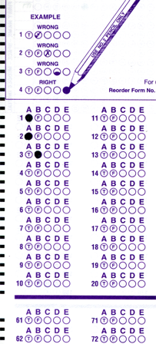
Setup:
Prepare your scantron:
Use
a pencil,
not a pen!
Fill in your name and fill the bubbles under
your name.
LAST NAME FIRST, First name second
Put your 4-digit code instead of “IDENTIFICATION NUMBER”.
--- (The last 4 digits of your OleMiss ID.)
Question # 1: answer A
Question # 2: answer A
Question # 3: answer E
Reading assignment
Angular size; arcseconds (pp. 27-28)
Parallax, parsecs, absolute magnitude, distance modulus (pp. 489-493)
Please take a moment to mute your cell phone!

Slide 2
Review questions coming …

Slide 3
Question 4
This question counts double!
sec
30
29
28
27
26
25
24
23
22
21
20
18
17
16
15
14
13
12
11
10
9
8
7
6
5
4
3
2
1
0
19
How soon after / how long before the Sun were the planets made?
A 10 billion years before
B 6000 years before
C 100 million years after
D 4.5 billion years after
E 6000 years after
Next question coming …

Slide 4
Question 5
This question counts double!
sec
30
29
28
27
26
25
24
23
22
21
20
18
17
16
15
14
13
12
11
10
9
8
7
6
5
4
3
2
1
0
19
Human history constitutes … percents of the age of the Universe.
A 98%
B 25%
C 1%
D 0.1%
E 0.0001%
Next question coming …

Slide 5
Question 6
This question counts double!
sec
30
29
28
27
26
25
24
23
22
21
20
18
17
16
15
14
13
12
11
10
9
8
7
6
5
4
3
2
1
0
19
Can two constellations collide?
A No, because each constellation is at a different distance from us.
B No, because they are no real objects.
C No, because they are each located at a different direction.
D Yes, but this only happens once in a hundred million years.
E Yes, this happens many times a year.

Slide 6
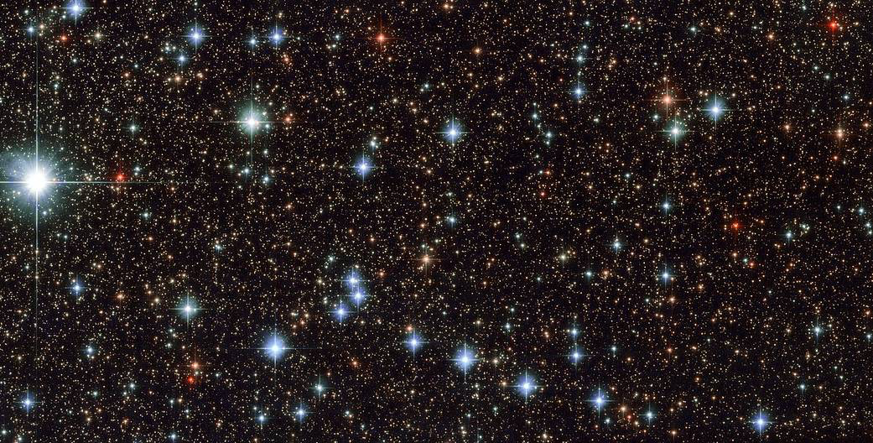
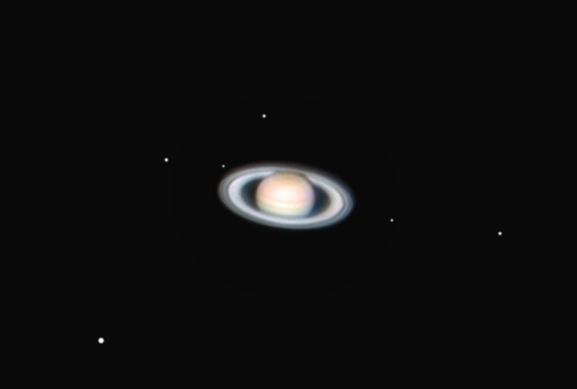
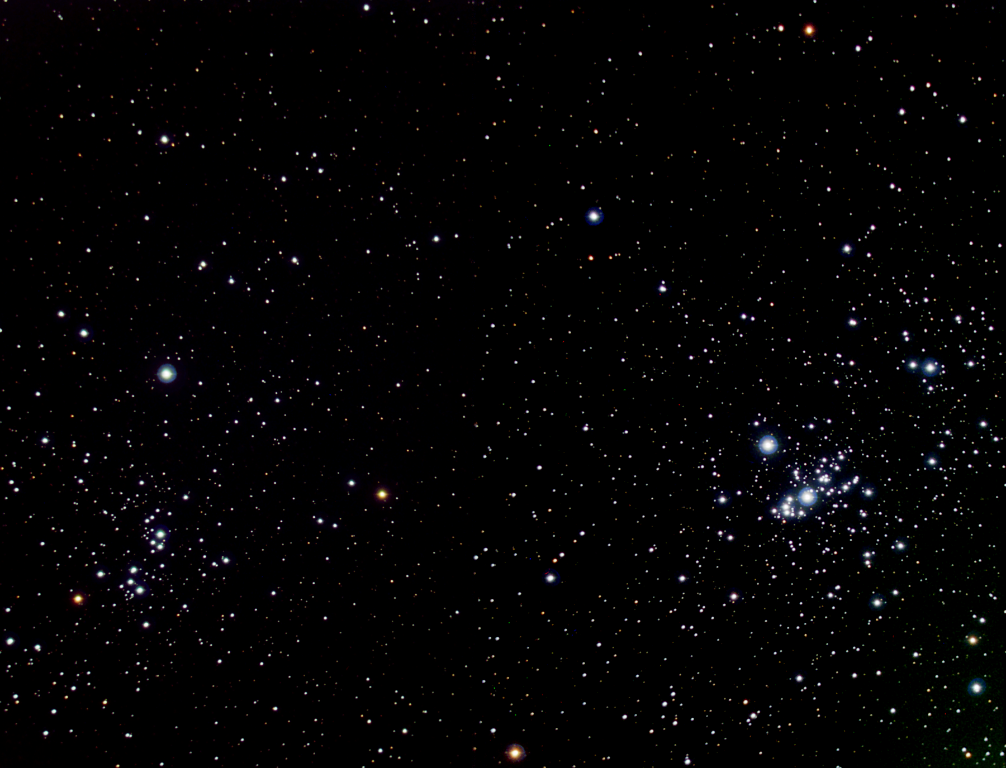
The Milky Way in Sagittarius
(long exposure)
9.8 mg
16.2 mg
12.2 mg
An open cluster in Perseus
Dione
10.5^{mg}
Iapetus
11.2^{mg}
13.2^{mg}
Magnitude
limit in
professional
astronomy:
22^{mg}-24^{mg}
Titan
8.4^{mg}
9.0^{mg}
5.6 mg
Saturn and its moons
7.1^{mg}

Slide 7
Questions coming …

Slide 8
Question 7
sec
30
29
28
27
26
25
24
23
22
21
20
18
17
16
15
14
13
12
11
10
9
8
7
6
5
4
3
2
1
0
19
What is the brightness of the dimmest star
that is barely showing up in long exposure
professional images?
A 7.0^{mg}
B 17.0^{mg}
C 23.0^{mg}
D 43^{mg}
E 150^{mg}
Next question coming …

Slide 9
Question 8
sec
30
29
28
27
26
25
24
23
22
21
20
18
17
16
15
14
13
12
11
10
9
8
7
6
5
4
3
2
1
0
19
Do you need a telescope to see Pluto whose
brightness is a 15^{mg}?
A No, it can be seen by the naked eye.
B Yes, but even binoculars will suffice.
C Yes, a small amateur telescope is needed.
D A fairly large amateur telescope or a small
professional telescope is needed.
E Pluto is only observable in the largest professional
telescopes in the world.

Slide 10
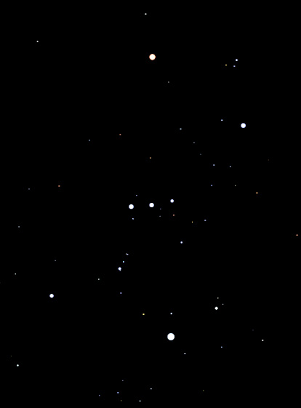
Exercises on magnitudes 1
This is how Orion looks to a naked-eye
observer in complete darkness.
α
α Orionis: 0.5 mg
α Orionis is one of the brightest stars in the sky.
How bright do you think it is?
How bright do you think κ Orionis is?
κ Orionis : 2.0 mg
θ
θ Orionis : 4.3 mg
How bright do you think θ Orionis is?
κ

Slide 11
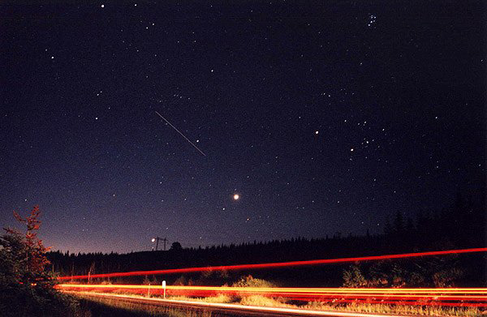
Exercises on magnitudes 2
Capella is 0 mg.
How bright do you think the following are?
Pleiades
2 mg
1 mg
International
Space Station
Aldebaran
1 mg
- 4 mg
Venus
- 2 mg
Jupiter

Slide 12
Questions coming …

Slide 13
Question 9
sec
30
29
28
27
26
25
24
23
22
21
20
18
17
16
15
14
13
12
11
10
9
8
7
6
5
4
3
2
1
0
19
The magnitude of a star tells us …
A How far the star us from us.
B How bright the star appears in the sky.
C How bright the star is in reality.
D How large the star appears in the sky.
E How large the star is in reality.
Next question coming …

Slide 14
Question 10
sec
30
29
28
27
26
25
24
23
22
21
20
18
17
16
15
14
13
12
11
10
9
8
7
6
5
4
3
2
1
0
19
Which one is brighter, a 1^{mg} star or a 5^{mg} star,
and how much?
A The magnitude of a star does not refer to
brightness at all, it refers to size.
B The 1^{mg} star is much brighter.
C The 1^{mg} star is a little brighter.
D The 1^{mg} star is much fainter.
E The 1^{mg} star is a little fainter.

