Slide 1


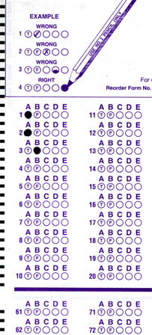
Setup:
Prepare your scantron:
Use
a pencil,
not a pen!
Fill in your name and fill the bubbles under
your name.
LAST NAME FIRST, First name second
Put your 4-digit code instead of “IDENTIFICATION NUMBER”.
--- (The last 4 digits of your OleMiss ID.)
• Labs: DS visit next week
(weather permitting)
• No class on Friday
Question # 1: answer A
Question # 2: answer B
Question # 3: answer B
Reading assignment
Chapter 14, The Sun, pp. 466 – 487
Please take a moment to mute your cell phone!

Slide 2
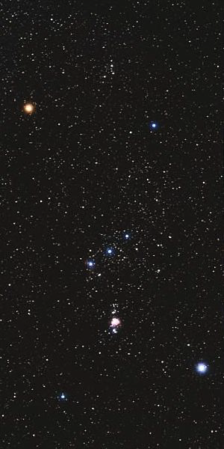
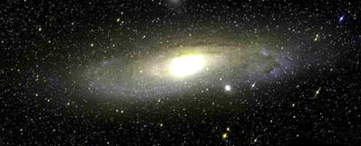
(Hipparchos
~ 170 BC)
Understand brightness of stars: the magnitude scale
An m = 10^{mg,} star,
need
an amateur telescope
to see it
The Andromeda Galaxy
m = 3^{mg} in total
An m = 17^{mg,} star,
need
a professional telescope
to see it
Magnitudes mean brightness:
• The larger the number, the fainter the object
• One magnitude difference means a lot dimmer (2.5 times)
A fifth magnitude star: m = 5^{mg,},
just visible to the naked eye
A third magnitude star: m = 3^{mg}
A second magnitude star: m = 2^{mg}
__
I
A first magnitude star: m = 1^{mg}
m = -2.5 × lg
I
Vega

Slide 3
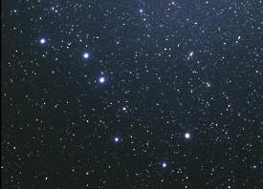
Example: stars in the Big Dipper
4.0 mg
1.9 mg
2.2 mg
3.3 mg
5.6 mg

Slide 4
Questions coming …

Slide 5
Question 4
sec
30
29
28
27
26
25
24
23
22
21
20
18
17
16
15
14
13
12
11
10
9
8
7
6
5
4
3
2
1
0
19
Which one is brighter, a 2^{mg} star or a 5^{mg} star?
A The 2^{mg} star is brighter.
B The 5^{mg} star is brighter.
C They are equally bright.
D Cannot tell from these numbers.
Next question coming …

Slide 6
Question 5
sec
30
29
28
27
26
25
24
23
22
21
20
18
17
16
15
14
13
12
11
10
9
8
7
6
5
4
3
2
1
0
19
How much brighter is a 1^{mg} star than a 6^{mg} star?
A Only a little (by 5%).
B Twice as bright.
C Five times as bright.
D A hundred times as bright.
E A billion times as bright.

Slide 7
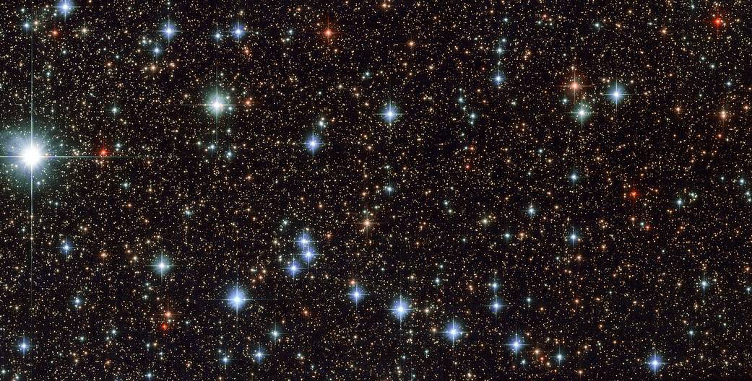
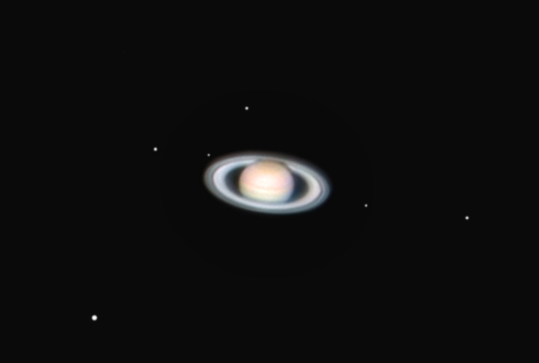
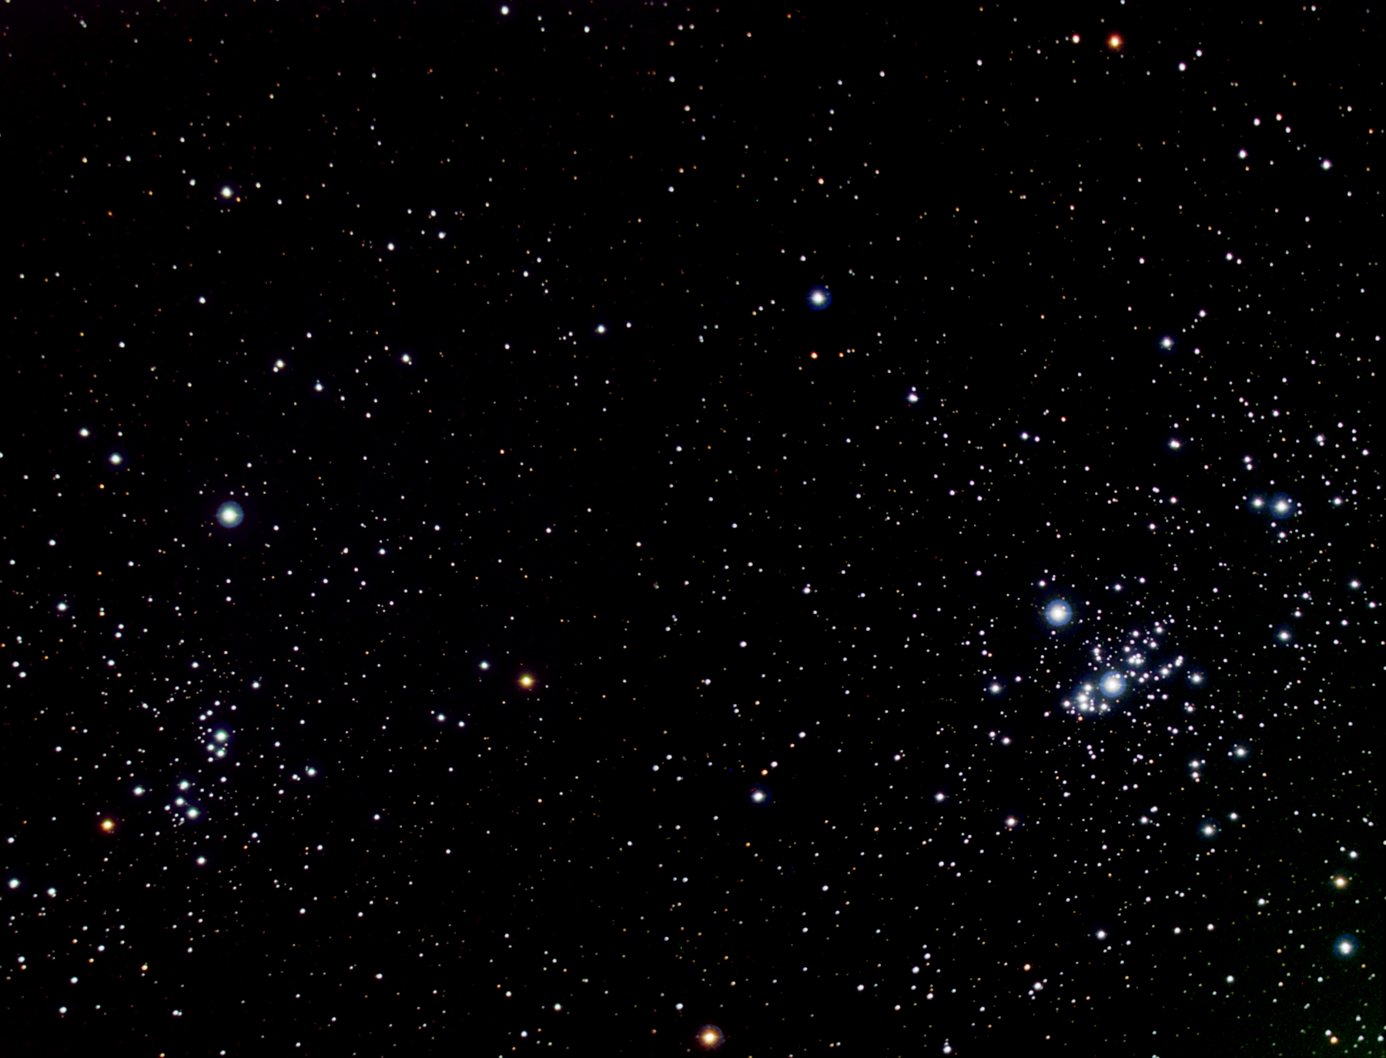
The Milky Way in Sagittarius
(long exposure)
9.8 mg
16.2 mg
12.2 mg
An open cluster in Perseus
Dione
10.5^{mg}
Iapetus
11.2^{mg}
13.2^{mg}
Magnitude
limit in
professional
astronomy:
22^{mg}-24^{mg}
Titan
8.4^{mg}
9.0^{mg}
5.6 mg
Saturn and its moons
7.1^{mg}

Slide 8
Questions coming …

Slide 9
Question 6
sec
30
29
28
27
26
25
24
23
22
21
20
18
17
16
15
14
13
12
11
10
9
8
7
6
5
4
3
2
1
0
19
What is the brightness of the dimmest star
that is barely showing up in long exposure
professional images?
A 7.0^{mg}
B 17.0^{mg}
C 23.0^{mg}
D 43^{mg}
E 150^{mg}
Next question coming …

Slide 10
Question 7
sec
30
29
28
27
26
25
24
23
22
21
20
18
17
16
15
14
13
12
11
10
9
8
7
6
5
4
3
2
1
0
19
Do you need a telescope to see Pluto whose
brightness is a 15^{mg}?
A No, it can be seen by the naked eye.
B Yes, but even binoculars will suffice.
C Yes, a small amateur telescope is needed.
D A fairly large amateur telescope or a small
professional telescope is needed.
E Pluto is only observable in the largest professional
telescopes in the world.

Slide 11
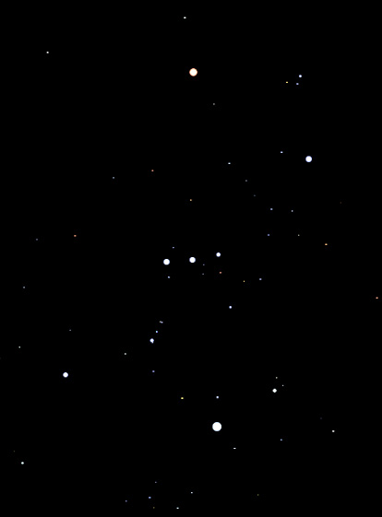
Exercises on magnitudes 1
This is how Orion looks to a naked-eye
observer in complete darkness.
α
α Orionis: 0.5 mg
α Orionis is one of the brightest stars in the sky.
How bright do you think it is?
How bright do you think κ Orionis is?
κ Orionis : 2.0 mg
θ
θ Orionis : 4.3 mg
How bright do you think θ Orionis is?
κ

Slide 12
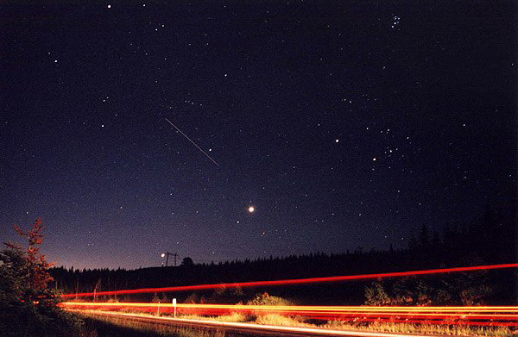
Exercises on magnitudes 2
Capella is 0 mg.
How bright do you think the following are?
Pleiades
2 mg
1 mg
International
Space Station
Aldebaran
1 mg
- 4 mg
Venus
- 2 mg
Jupiter

Slide 13
Questions coming …

Slide 14
Question 8
sec
30
29
28
27
26
25
24
23
22
21
20
18
17
16
15
14
13
12
11
10
9
8
7
6
5
4
3
2
1
0
19
The magnitude of a star tells us …
A How far the star us from us.
B How bright the star appears in the sky.
C How bright the star is in reality.
D How large the star appears in the sky.
E How large the star is in reality.

